Slide 1
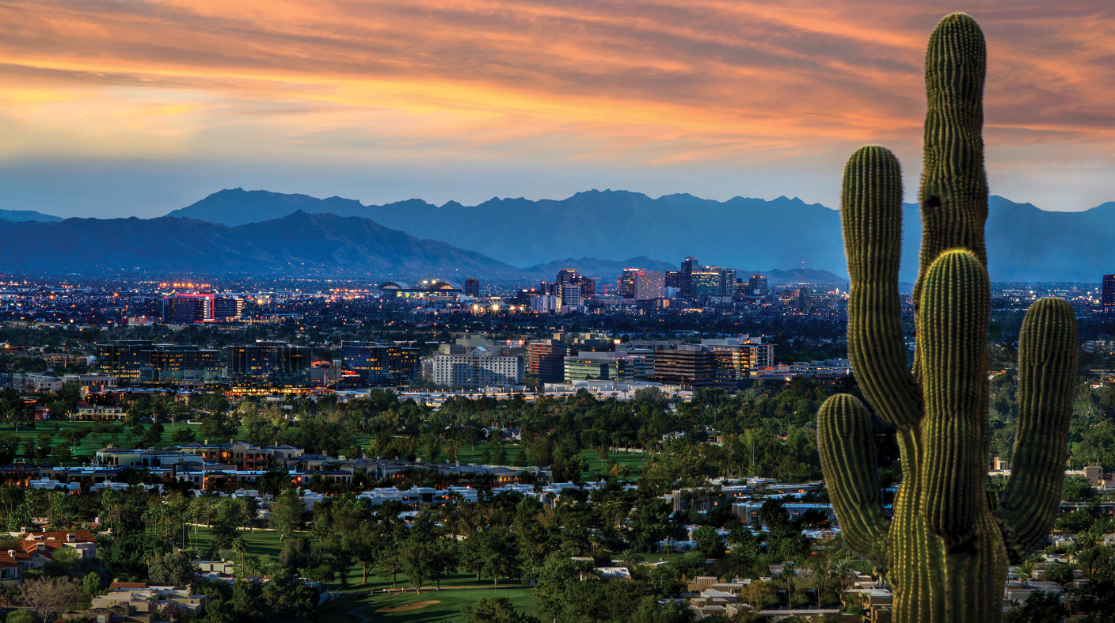
Crime in the Greater Phoenix Area

Slide 2
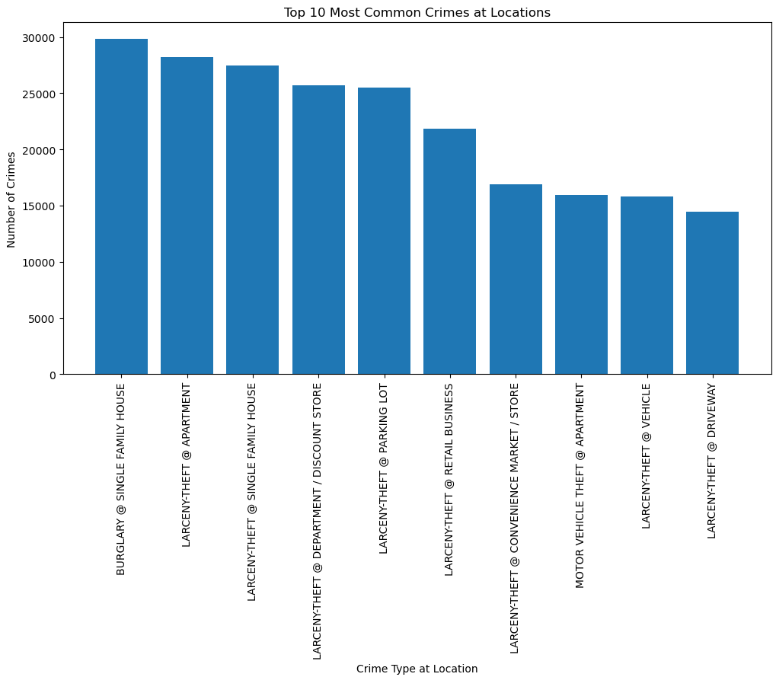
Where are the top 10 locations crimes are happening in Phoenix?

Slide 3
Crime incidents are concentrated in a mix of residential, public and commercial locations. We see that overall, the most crimes that are taking place are happening at single-family homes. Followed closely by apartments.

Slide 4
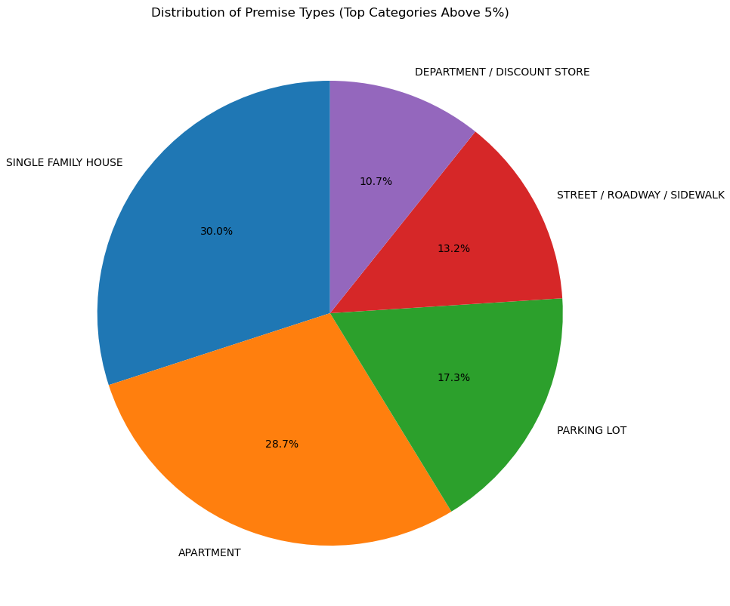
For premise types, there are total number of 98 types that had crime happened. Within these, the top locations with more than 5% crime rates are: Single family house, apartment, parking lot, street/roadway/sidewalk, department/discount store. Overall, these are the residential areas (58.7% crime rates) and open space zones.

Slide 5
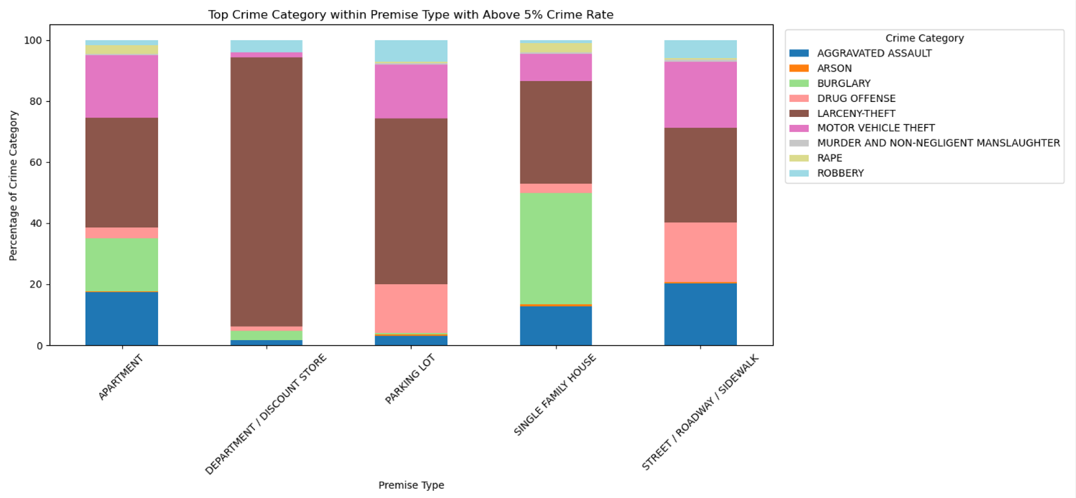
Is there any commonality within each top premise type?

Slide 6
Within the top premise types, the top 5 crime categories are listed. While the #2-#5 crime varies by premise type and location based, the top crime category for each premise type is always larceny-theft. This is a universal crime category happening across all premise types, matching to the bulk crime category analysis

Slide 7
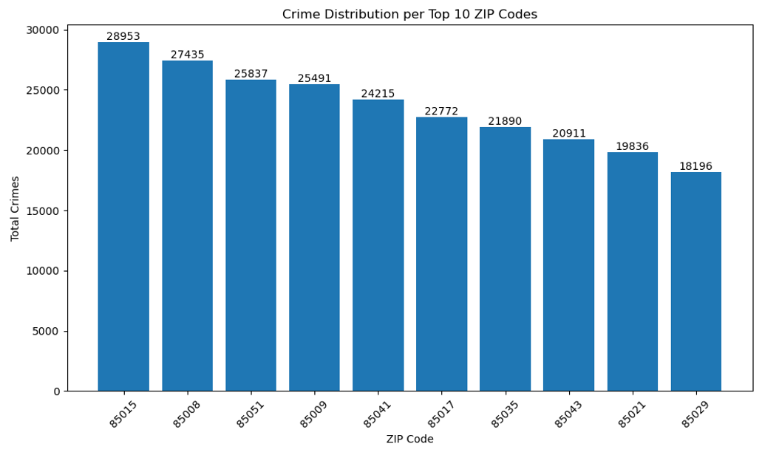
What are the Top 10 zip codes in the greater Phoenix area with the most crime?

Slide 8
This chart looks at the top 10 zip codes in Phoenix with the most crimes, and it shows that theft is the most common crime by far. One zip code, 85015, stands out as having a lot more crime overall than the others, especially theft. While other crimes like assault and burglary also happen, they're less frequent, and murder and rape are thankfully very rare in all these areas. Some other zip codes, like 85041, tend to have lower crime numbers. Zip code 85015 seems to be the riskiest of these ten areas, but it's important to remember this chart only shows some types of crime, and doesn't consider how many people live in each zip code

Slide 9
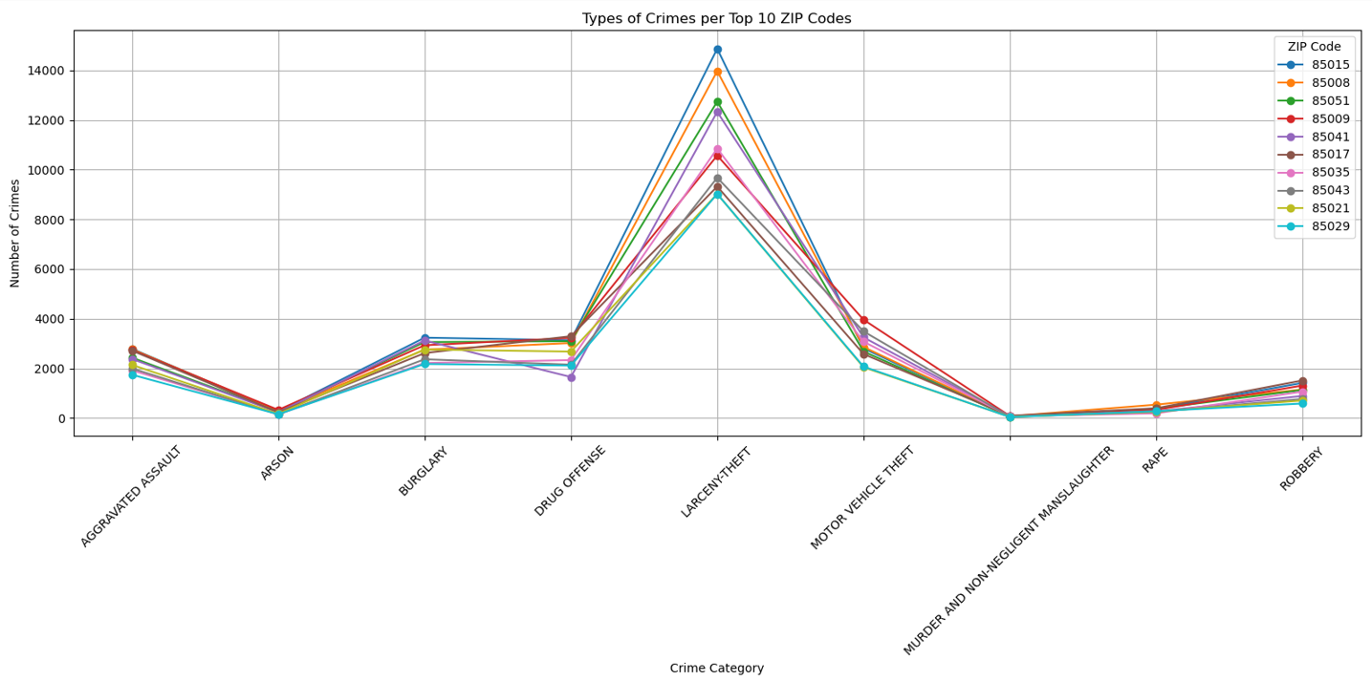
What are the most occurring crimes per zip code?

Slide 10
This chart shows the total number of crimes in the ten zip codes with the most crime. The biggest takeaway is that zip code 85015 stands out as having a significantly higher number of crimes compared to all other zip codes in the top 10. There's a substantial drop in crime between 85015 and the next highest, 85008, emphasizing the outlier status of 85015. After this initial drop, the decrease in crime numbers across the remaining zip codes is more gradual. This suggests 85015 has a crime concentration, likely due to socioeconomic factors and policing strategies. However, the chart only looks at the top ten worst areas and doesn't consider population size.

Slide 11
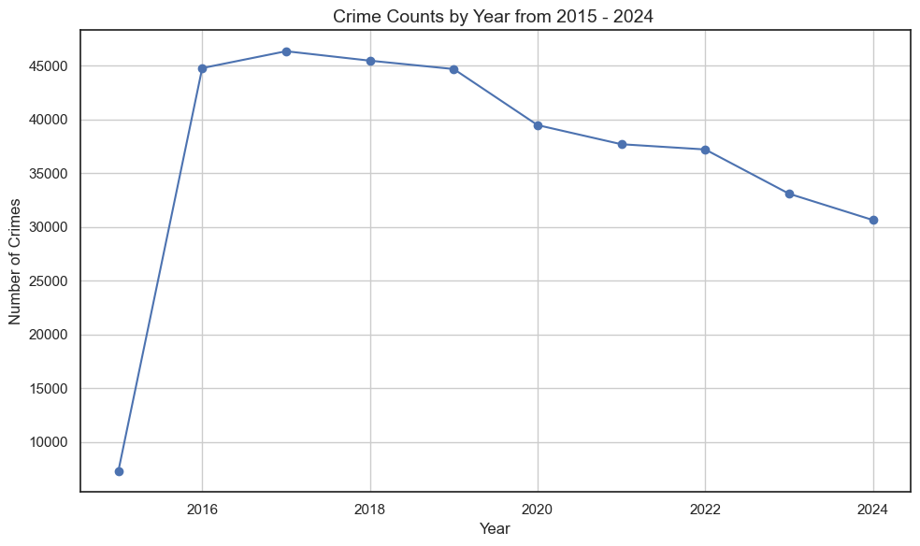
What do the crime rates look like over the last 9 years ?

Slide 12
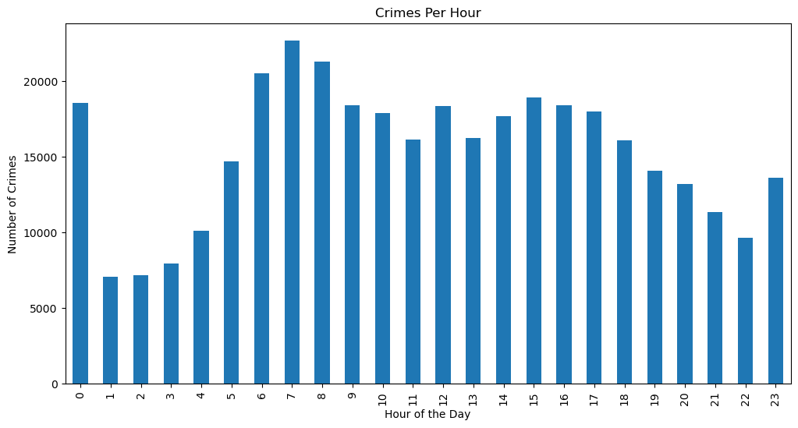
What hours of the day see the most crimes?

Slide 13
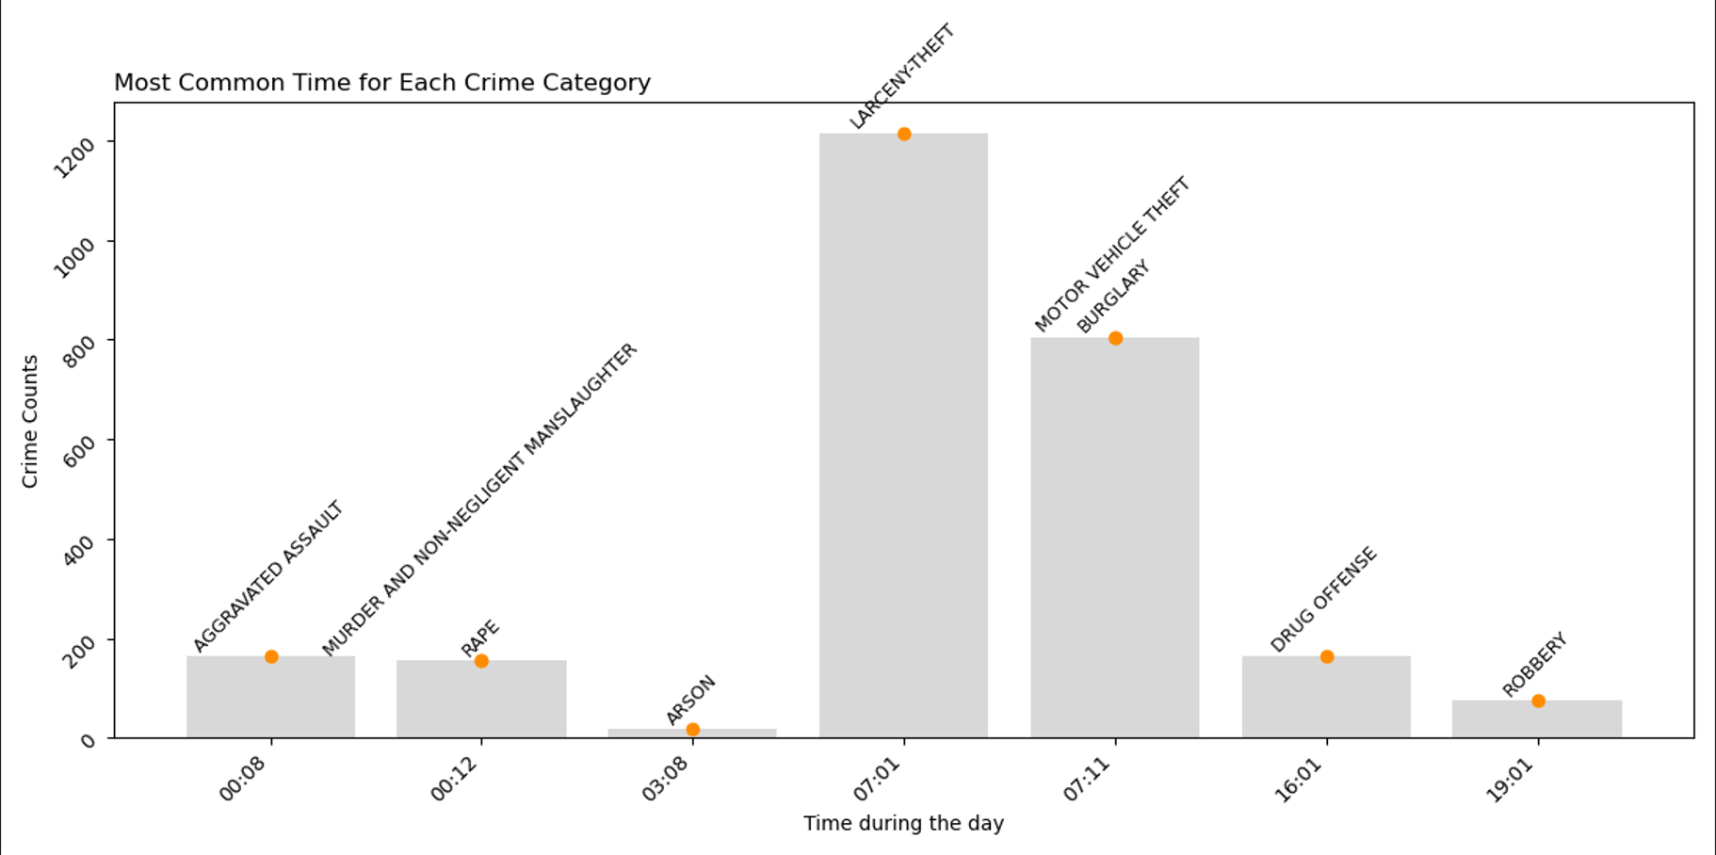
What are the most common times certain crimes occur?

