Slide 1
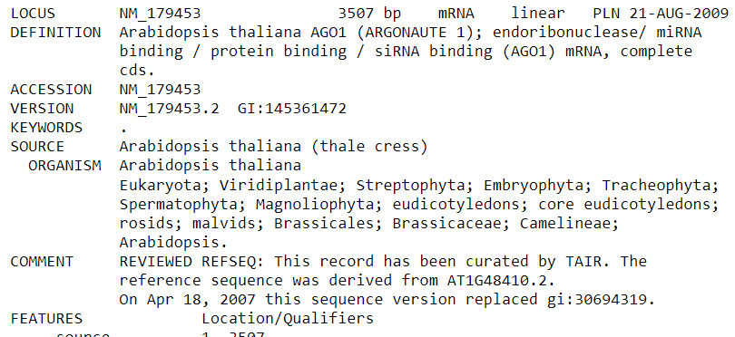
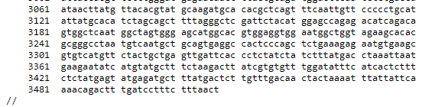
Start pattern?
GenBank record
(…)
End pattern?

Slide 2
A
B
Accession 1,
Organism 1,
Length 1,
Sequence 1,
GC content 1
Accession 2,
Organism 2,
Length 2,
Sequence 2,
GC content 2
Accession 1 Organism 1 Length 1 Sequence 1 GC content 1
Accession 2 Organism 2 Length 2 Sequence 2 GC content 2
,
,…
,
,…
C
D
‘Organism’: Organism 1
‘Length’: Length 1
‘Sequence:’ Sequence 1
‘GC content’: GC con. 1
Organism 1,
Length 1,
Sequence 1,
GC content 1
‘Accession 1’ :
‘Accession 1’ :
,…
,…

