Slide 1
Microsoft Movie Analysis
By Jake Brooks & Bobby Williams

Slide 2
Key Questions
What are the most profitable movie genres?
What are the top studios based on profit within those genres?
What spend levels appear to indicate the best possibility of showing a profit, and how much should Microsoft expect to spend on a typical project?

Slide 3
Data
The datasets analyzed came from:
IMDB
Box Office Mojo
The Numbers
The analysis centered around the following data for 2010-2019:
Genre
Worldwide Profit
Studio
Production Budget

Slide 4
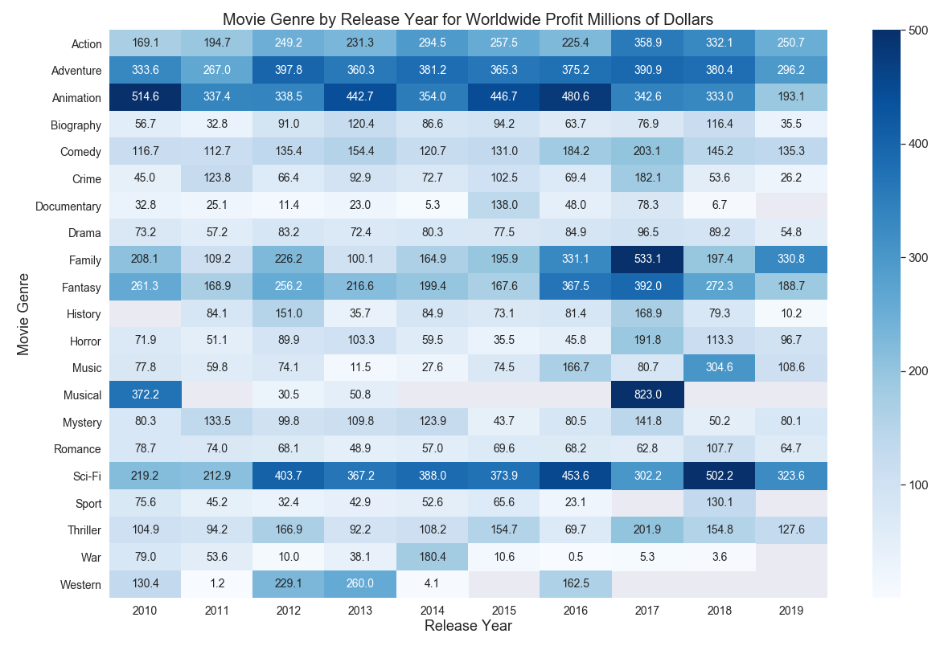
Most Profitable Genres

Slide 5
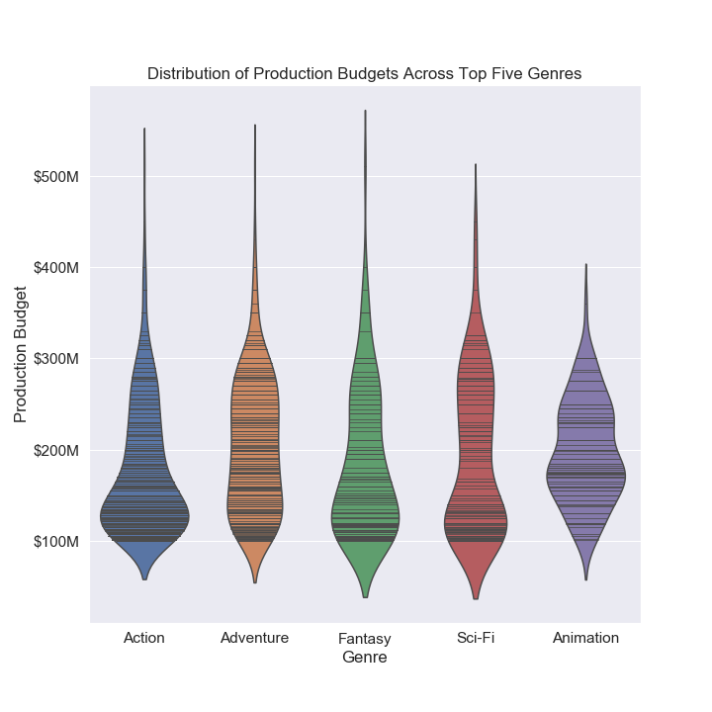
Popular Genres by Production Budget

Slide 6
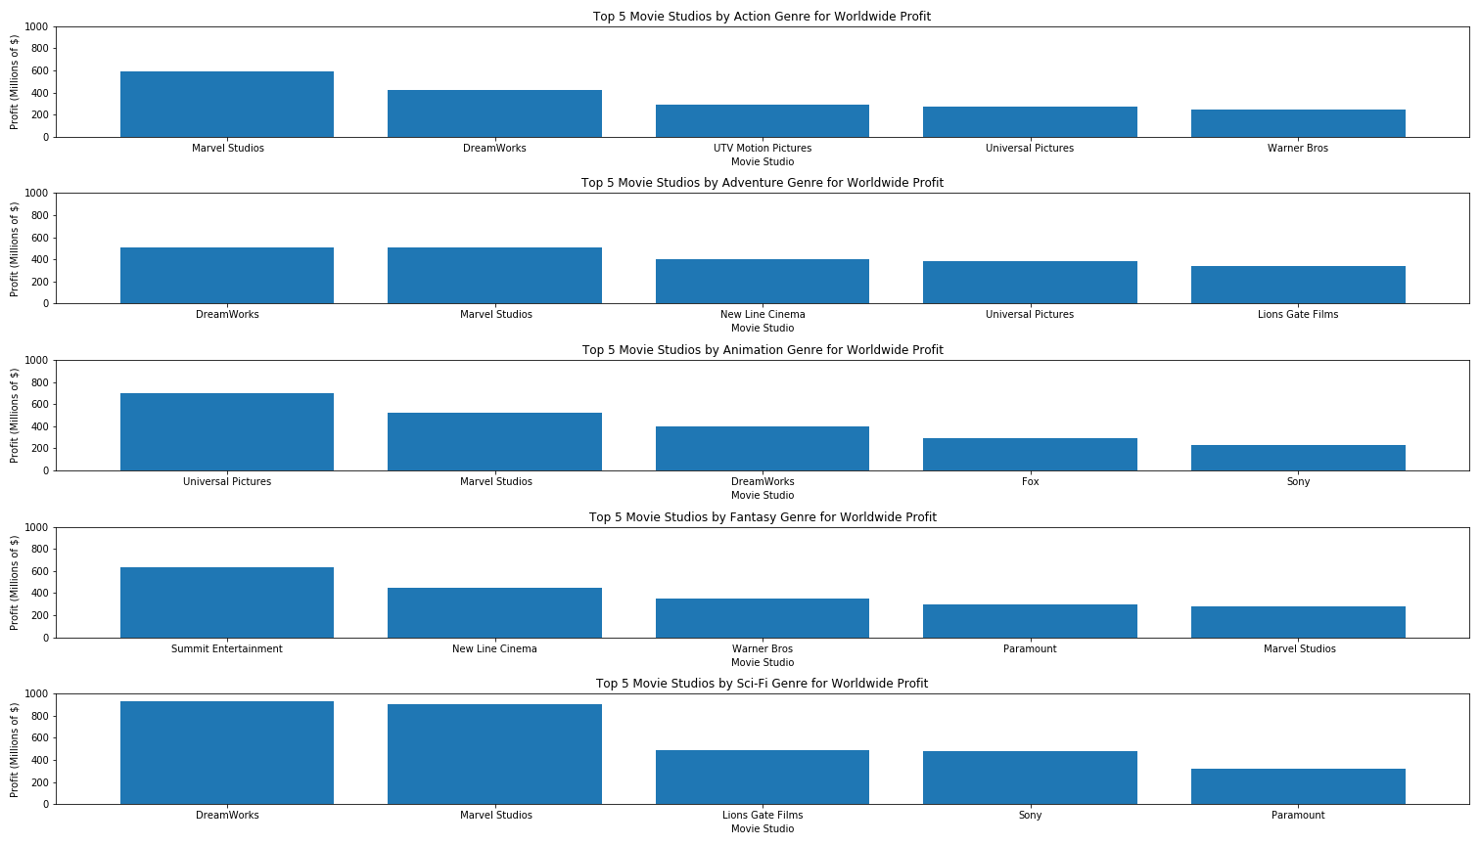
Top Studios by Top Genre

Slide 7
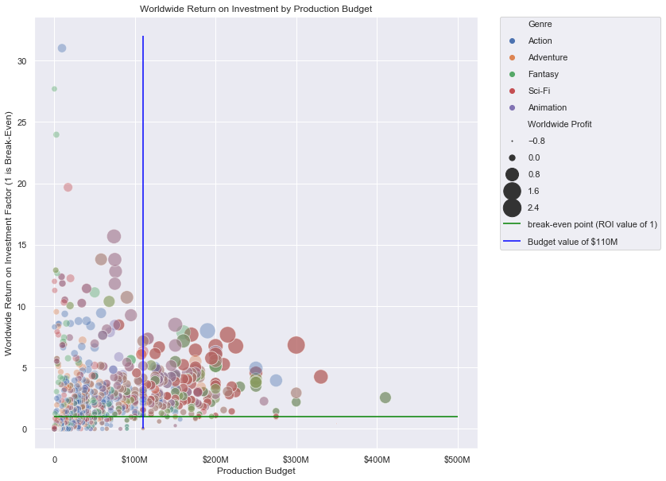
ROI vs Production Budget

Slide 8
Recommendations
Providing content in the Action, Adventure, Animation, Fantasy, or Sci-Fi genres will be most profitable.
Partnering with a top studio: Marvel Studios, DreamWorks, Universal, will maximize returns.
Though there is possibility of higher return on investment at lower spend levels, there is also much higher rate of net loss.
Recommend spend level of around 110M or higher as there is low likelihood of losing investment, and larger net profits despite the lower ROI values.

Slide 9
Further Research
Determine which studios have the highest ROI vs Production Budget
Understand the effects that the Directors, Writers, and Cast have on ROI
Obtain data from additional resources to ensure accuracy and to provide more insightful analysis

Slide 10
Questions

