Slide 1
Microsoft Movie Analysis
By Jake Brooks & Bobby Williams

Slide 2
Key Questions
What are the most profitable movie genres?
What are the top studios based on profit within those genres?
Production budget…

Slide 3
Data
The datasets analyzed came from:
IMDB
Box Office Mojo
The Numbers
The analysis centered around the following data for 2010-2019:
Genre
Worldwide Profit
Studio
Production Budget

Slide 4
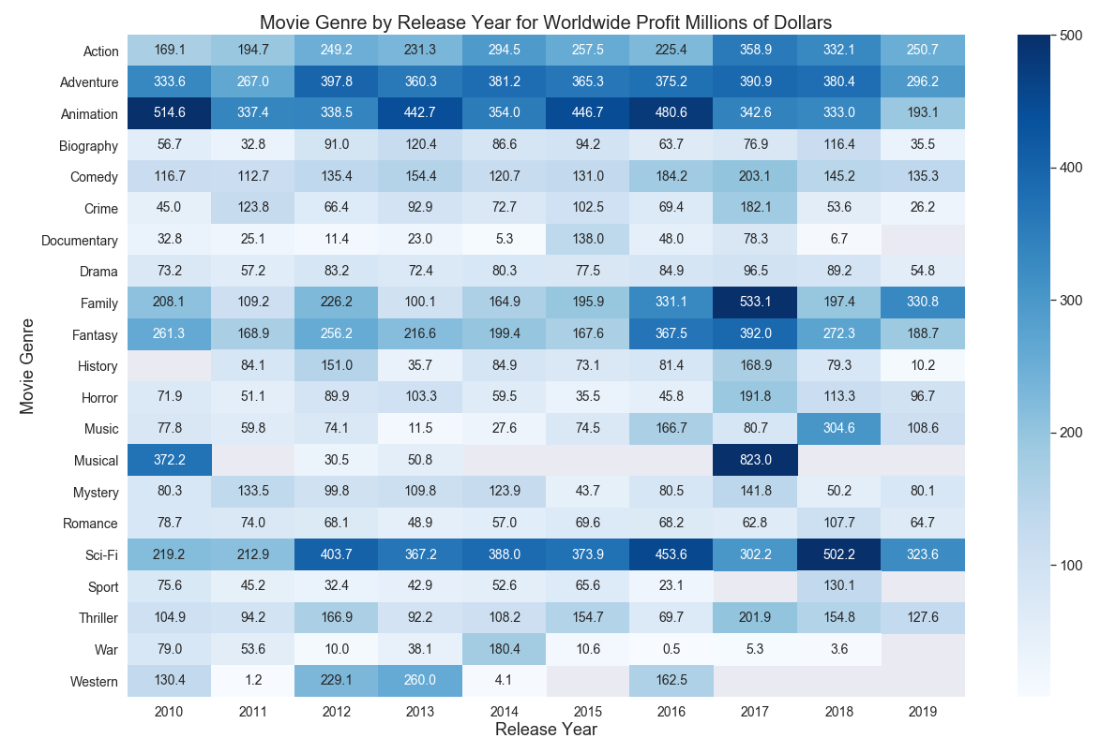
Most Profitable Genres

Slide 5
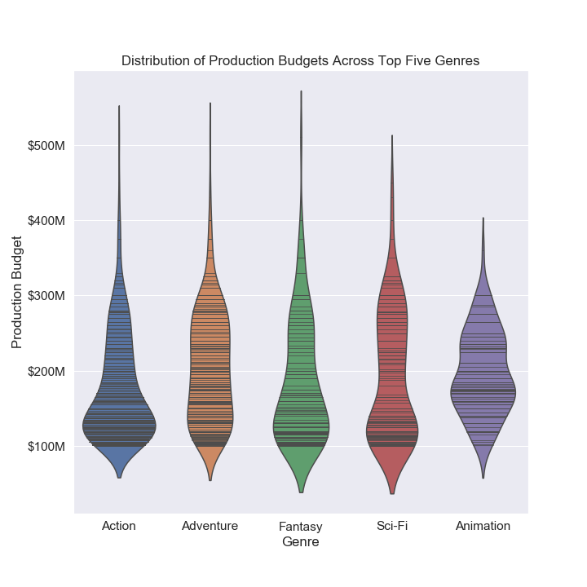
Popular Genres by Production Budget

Slide 6
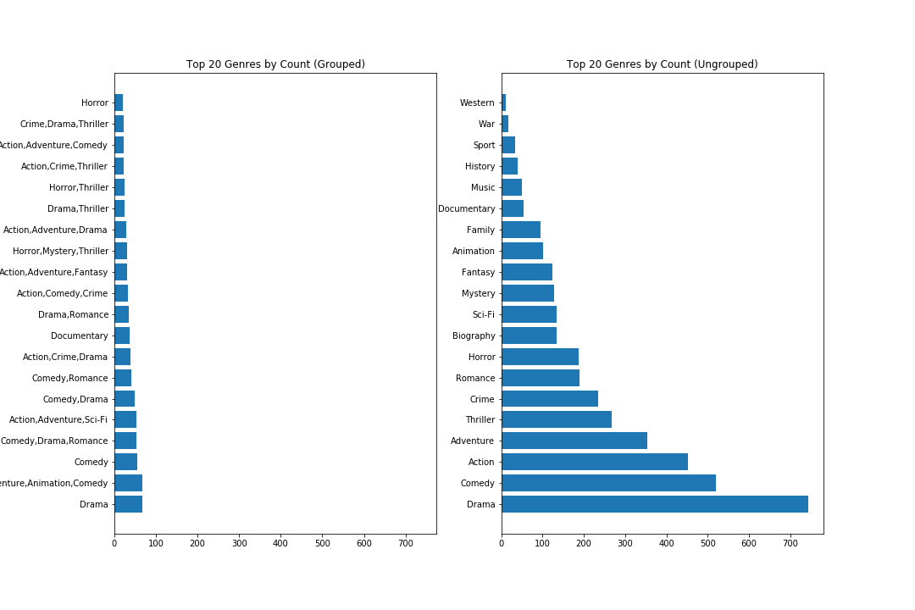
How are we exploring genre?

Slide 7
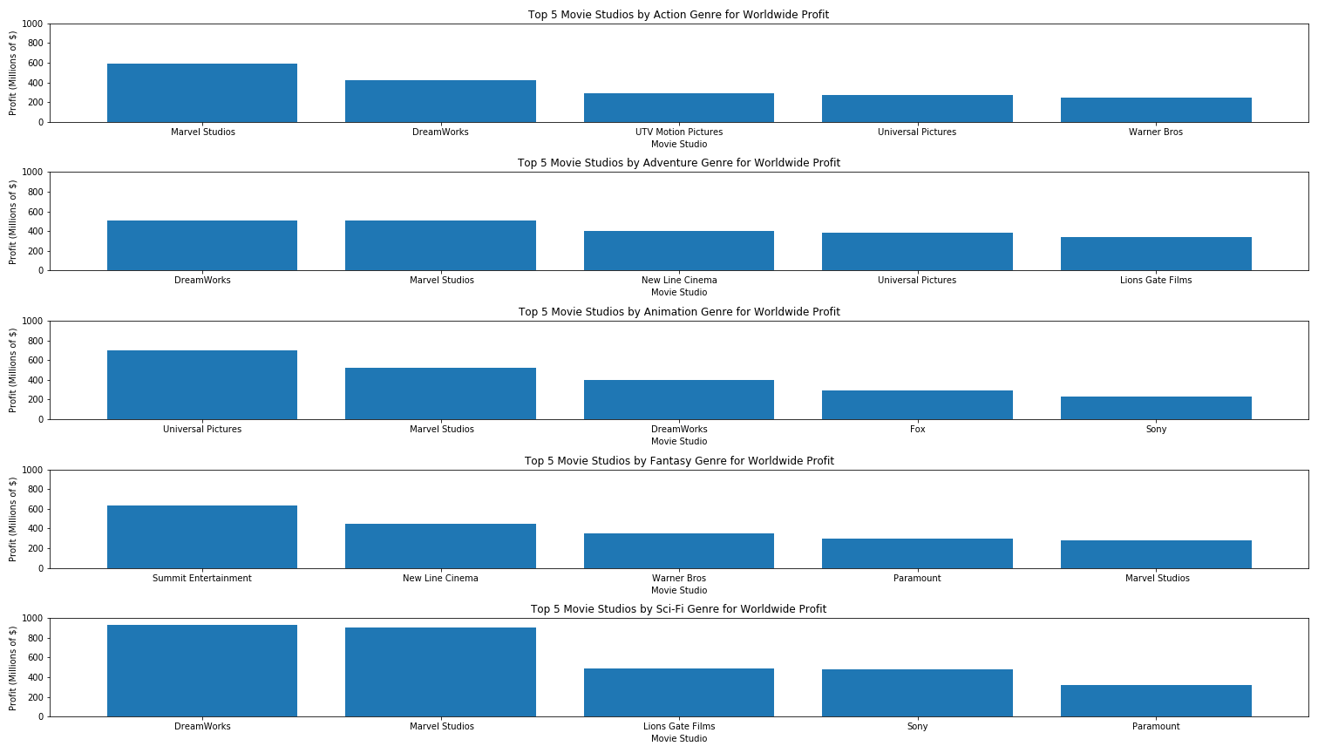
Top Studios by Top Genre

Slide 8
Recommendations

Slide 9
Further Research - Limitations

Slide 10
Questions

