Slide 1
Crossover Networks
Loudspeaker System Design

Slide 2
Purposes of Crossovers
Feed highs to tweeter and lows to woofer
Protect small tweeters from low frequency overload
  High distortion
  Damage
Adjusts efficiencies and corrects for impedance variations

Slide 3
Kinds of Networks
Number of drivers
Sharpness of cutoff action
The way speakers are wired into the circuit

Slide 4
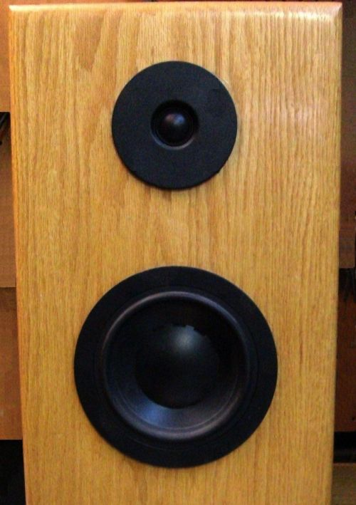
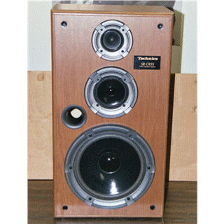
Number of Drivers
2-way speaker system
3-way speaker system

Slide 5
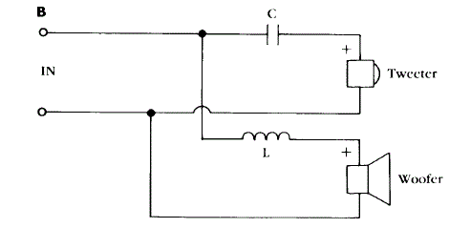
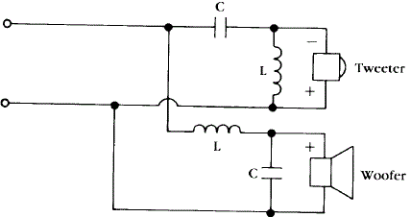
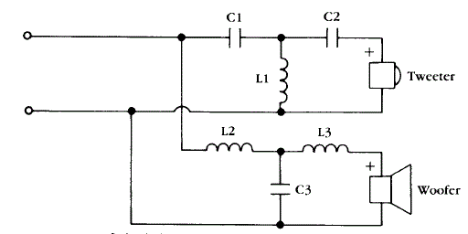
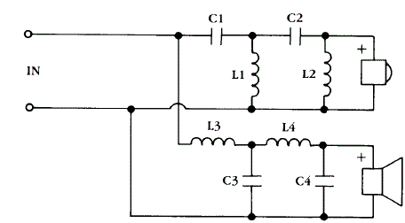
Sharpness of Cutoff Action
First-order speaker system
Second-order speaker system
Third-order speaker system
Fourth-order speaker system

Slide 6
Advantages of First-order Networks
Simple to design and make
Gentle cutoff slope – larger shared bandwidth
  -20 dB/decade
  -6 dB / octave
Good phase characteristics
  Each leg is equal and opposite in phase
Less inductance to woofer (reduces damping)
Also used in expensive systems

Slide 7
Disadvantages of First-order Networks
Less protection for small tweeters
Phase shifts from shared bandwidth can cause lobing in response

Slide 8
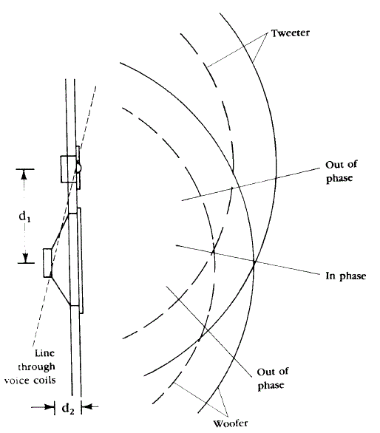
Lobing in Loudspeakers
Lobing between in-phase and out-of-phase waves

Slide 9
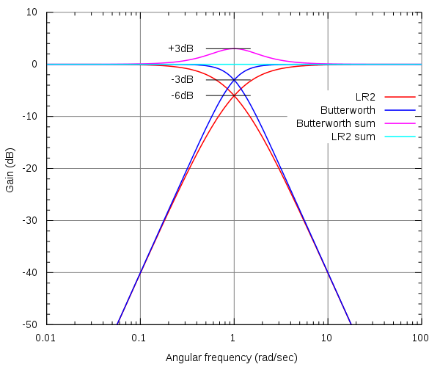
Higher-order Networks
Advantages
Disadvantages
Sharper cutoff rates
  -12 dB / octave (2nd order)
  -18 dB / octave (3rd order)
  Etc.
Extra protection to small tweeters
Filter types
  Butterworth filters
  Linkwitz-Riley filters
  Bessel filters
More complex
180 degree phase shift
  Null at crossover frequency

Slide 10
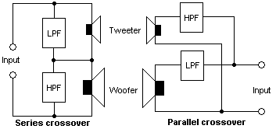
Speaker Wiring

Slide 11
Wiring Systems
Parallel
Series
Easy to design
Most widely used
Single slope and damping factor
Difficult to design
Better transient clarity
Changing reactance changes damping factor (higher L) or slope (higher C)
Must design to type of amplifier
Requires same impedance for woofer and tweeter

Slide 12
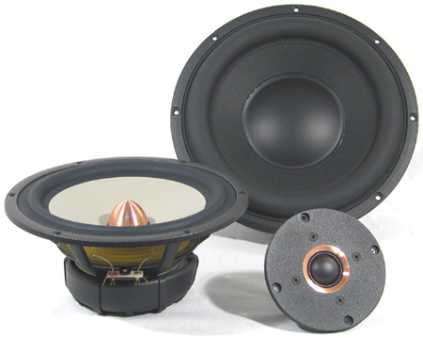
Selecting Loudspeaker Drivers
Woofer
Midrange
Tweeter

Slide 13
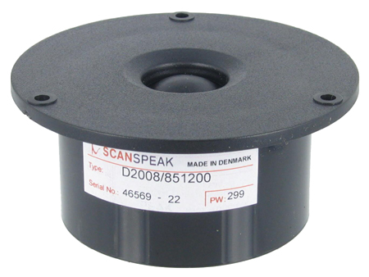
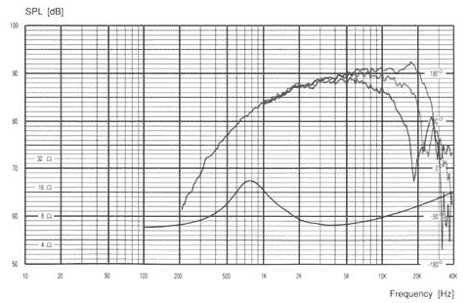
Scan-Speak D2008/8512
Tweeter
Frequency range
  2k-30 kHz
Impedance
  8 Ohms
Sensitivity
  90 dB re 1W/1m
F_{S} = 1000 Hz

Slide 14
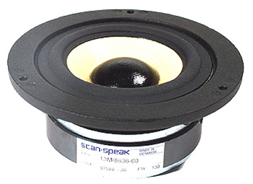
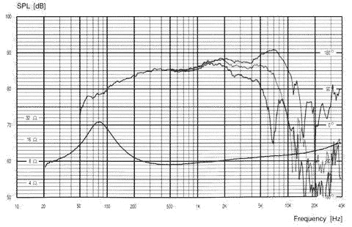
Scan-Speak 13M/8636
Midrange
Frequency range
  200-4 kHz
Impedance
  8 Ohms
Sensitivity
  88 dB re 1W/1m

Slide 15
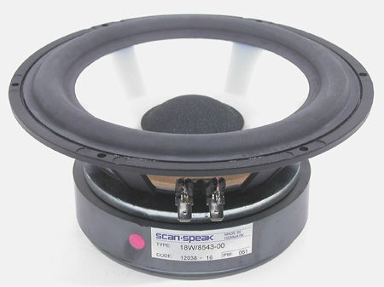
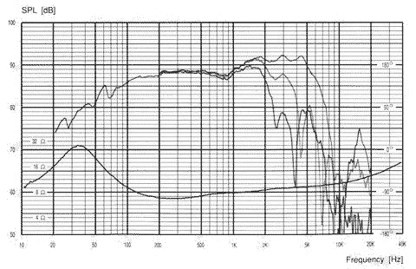
Scan-Speak 18W/8543
Woofer
Frequency range
  35-3.2 kHz
Impedance
  8 Ohms
Sensitivity
  89 dB re 1W/1m

Slide 16
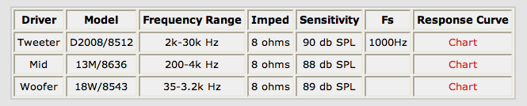
Driver Specifications

Slide 17
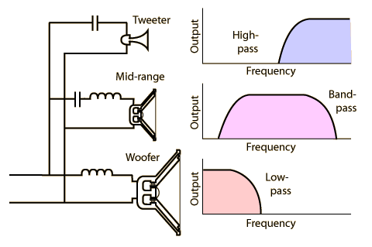
Loudspeaker Crossover

Slide 18
Selecting Crossover Frequencies
Use frequency response curves (-3dB level)
Tweeter (4 kHz)
  Avoid resonant frequency
  f_{C}/f_{S} ≥ 1.5 octaves
Midrange
  f_{h}/f_{l} ≥ 8 (3 octaves)
Woofer (500 Hz)
Tweeter
Midrange
Woofer

Slide 19
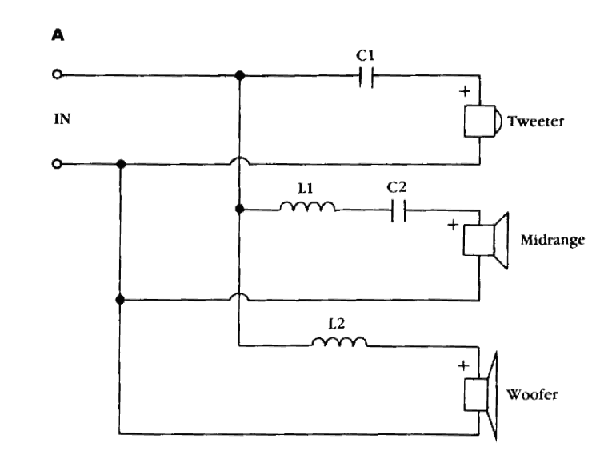
High-Pass Filter Design
Use with tweeter
Set crossover frequency
  f_{c} = 4,000 Hz
X_{C} = Z_{T} (8Ω) at f_{c}
C1 = 1/(2π f_{c} X_{C})
  = 1/[(2π)(4,000)(8)]
  = 5 μF

Slide 20
Low-Pass Filter Design
Use on woofer
Set crossover frequency
  f_{c} = 500 Hz
X_{L} = Z_{T} (8Ω) at f_{c}
L2 = X_{L} / (2π f_{c})
  = 8 / [(2π)(500)]
  = 2.5 mH

Slide 21
Band-Pass Filter Design
Use on midrange
f_{h}/f_{l} ≥ 8 (3 octaves)
Solve for L1 and C2
  L1 = 0.28 mH
  C2 = 44.81 μF

Slide 22
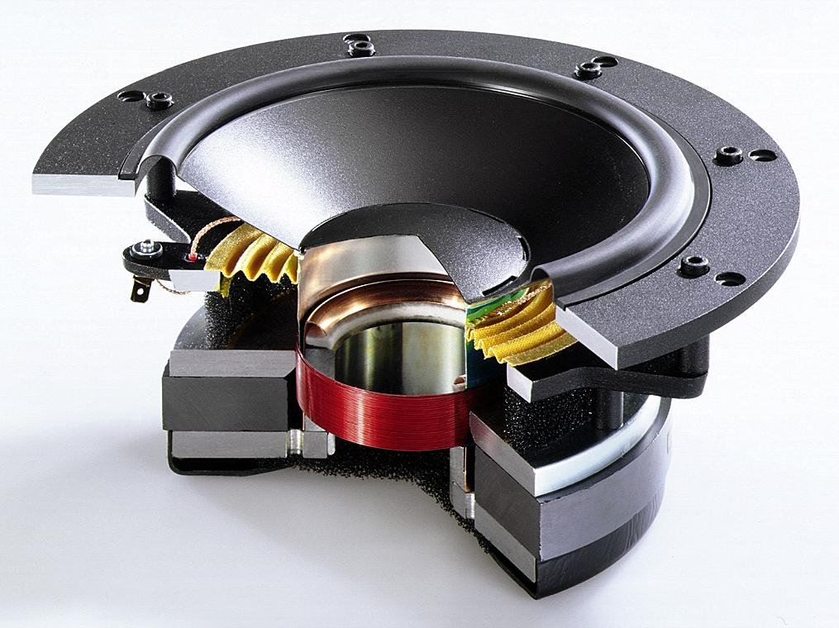
Loudspeaker Drivers

Slide 23
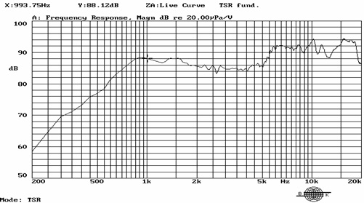
Loudspeaker Response

Slide 24
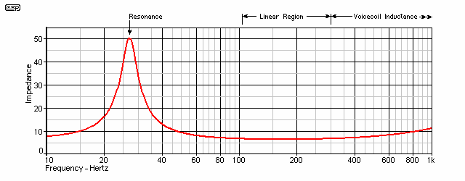
Loudspeaker Impedance

Slide 25
3-Way Speaker System
Tweeter
  High frequencies
  2,000 to 20,000 Hz
Mid-range
  Middle frequencies
  300 – 5,000 Hz
Woofer
  Low frequencies
  40 – 1,000 Hz

Slide 26
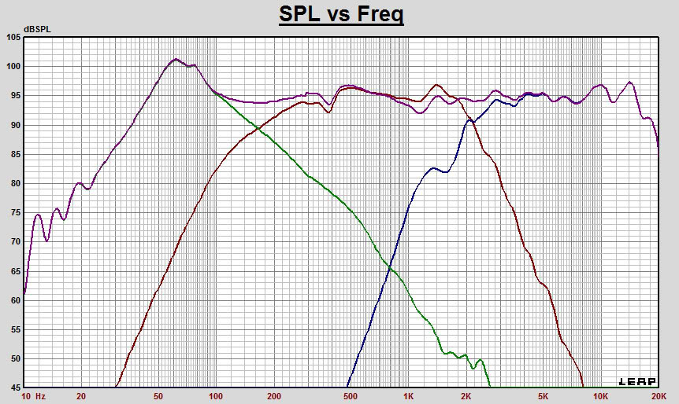
Crossover Response

