Slide 1
ArchLab 2017
TA: Prabal Basu

Slide 2
Y86 processor simulator
SEQ model
SEQ+ model
PIPE model

Slide 3
Subdirectories
Misc
YAS: the Y86 assembler
YIS: the Y86 instruction set simulator
HCL2C: HCL to C translator
Seq
SEQ and SEQ+ simulators
Pipe
PIPE simulator
Y86-code
Y86 assembly code for many example problems
Ptest
Systematic regression tests scripts

Slide 4
Misc folder
Make object code
unix > make asum.yo
Simulate the execution
unix > ./yis asum.yo

Slide 5
Seq/pipe folder
Processor simulators
SSIM for SEQ
SSIM+ for SEQ+
PSIM for PIPE
Each simulator runs in TTY or GUI mode
TTY: default, prints everything on screen, good for automated testing.
GUI: visualizing processor activity, good for debugging.

Slide 6
Examples
1. unix> ../seq/ssim -h
Prints all command line options for ssim.
2. unix> ../seq/ssim -t < asum.yo
Run SEQ sim in TTY mode, reading asum.yo.
3. unix> ../pipe/psim -t -g asum.yo
Run PIPE simulator in GUI mode, reading asum.yo

Slide 7

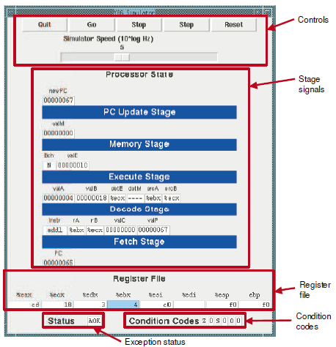
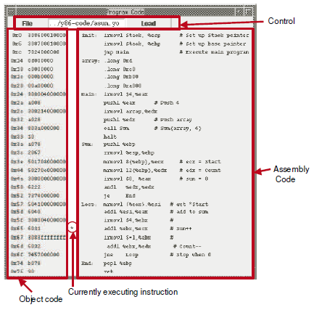
SEQ simulators

Slide 8
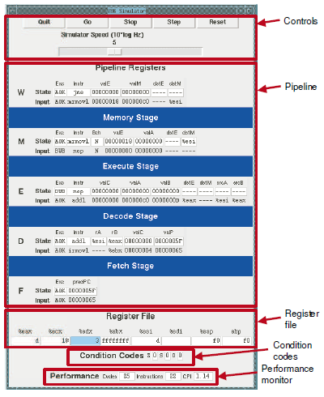

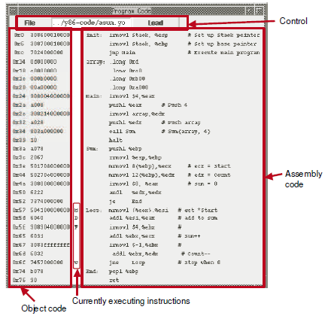
PIPE simulator

Slide 9
Some advice
Use example code to familiarize with the simulators
Data forwarding is tricky
No address > 0x0FFF is allowed

