Slide 1
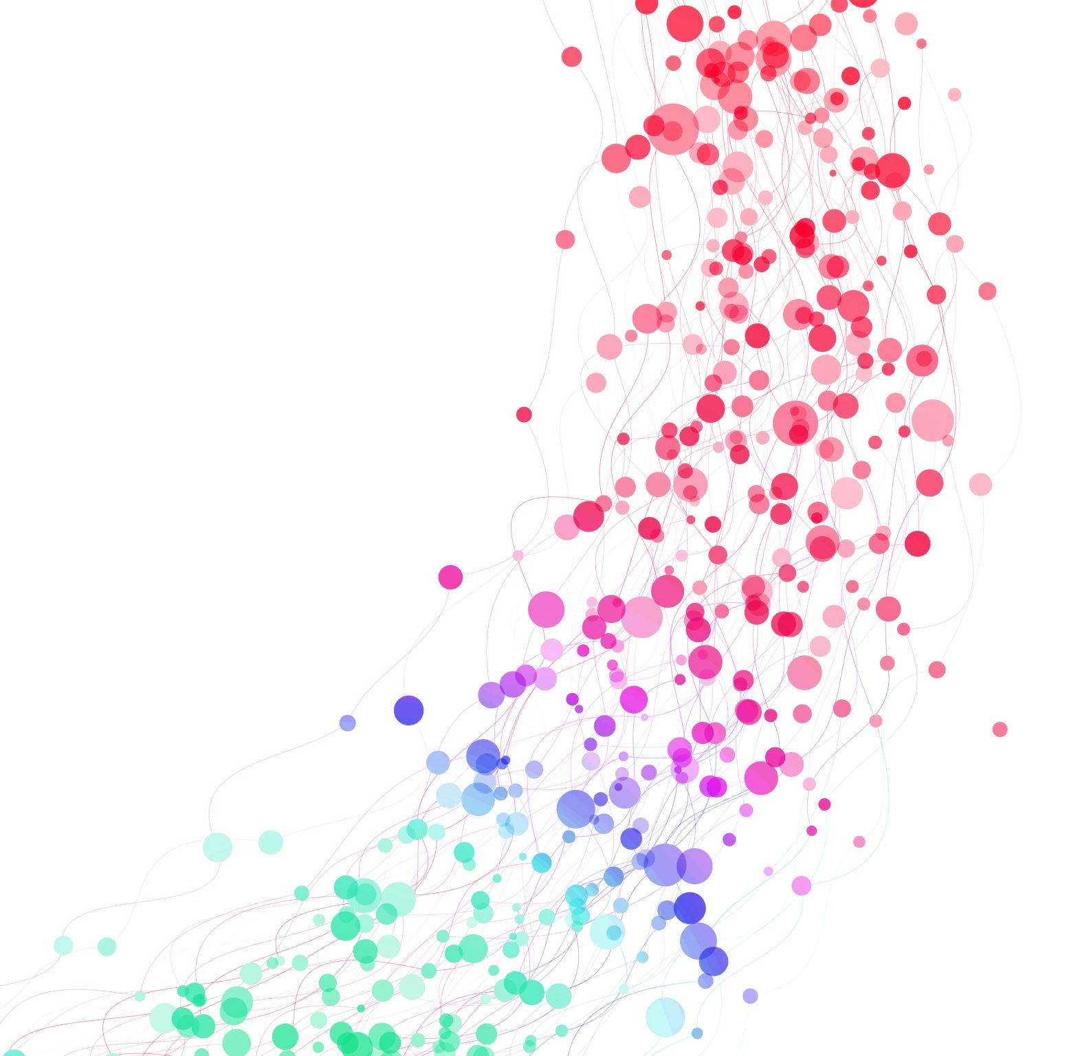
GPT-4-Powered Insights for Diabetes Risk Prediction
Jesus Minjares
UT AUSTIN: AI in HEALTHCARE

Slide 2
Healthcare Issue: Diabetes Risk
Problem: Diabetes affects millions globally.
Challenge: Early risk detection is complex.
GPT-4 Role: Predicts risk and simplifies notes.
Goal: Enhance early intervention.

Slide 3

Medical Dataset Used
Source: Synthea (synthea.mitre.org).
Size: 7 MB, 100 patients.
Key Files:
conditions.csv: Diagnoses.
observations.csv: Glucose data.

Slide 4
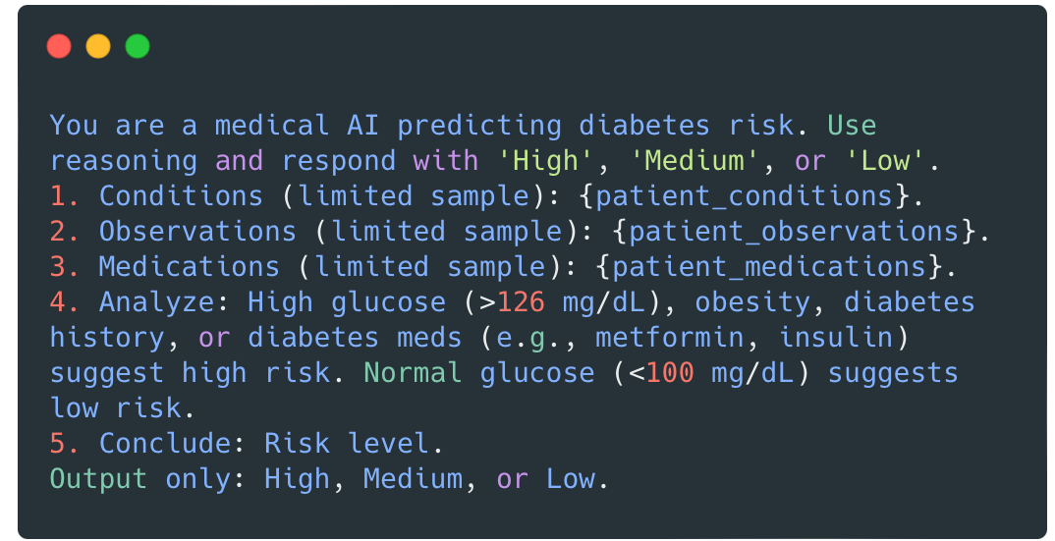
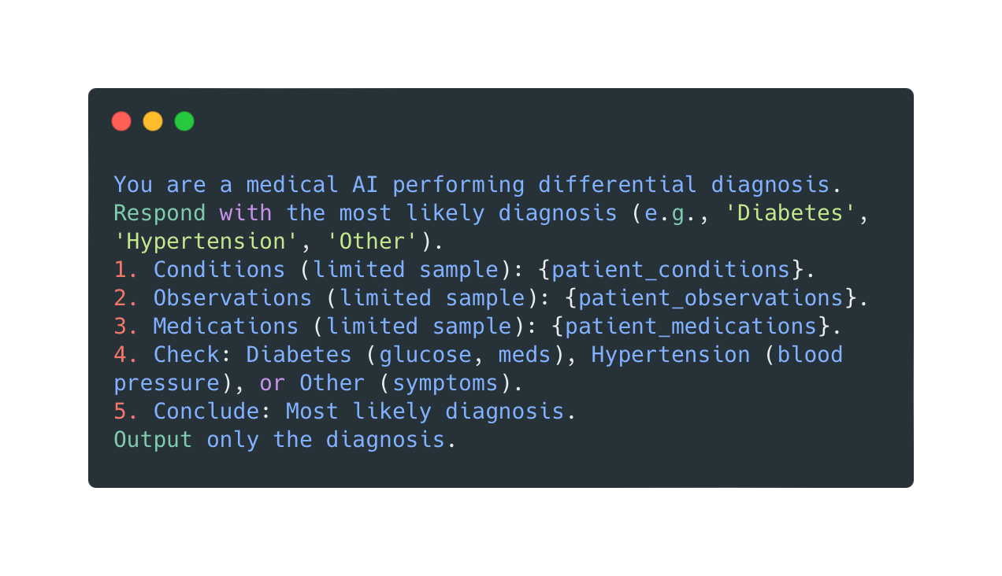
Engineered Prompts for GPT-4
CoT Prompt: Predicts risk (High/Medium/Low).
Analyze glucose, obesity, meds.
ToT Prompt: Diagnoses (e.g., "Diabetes").
Check conditions and meds.

Slide 5
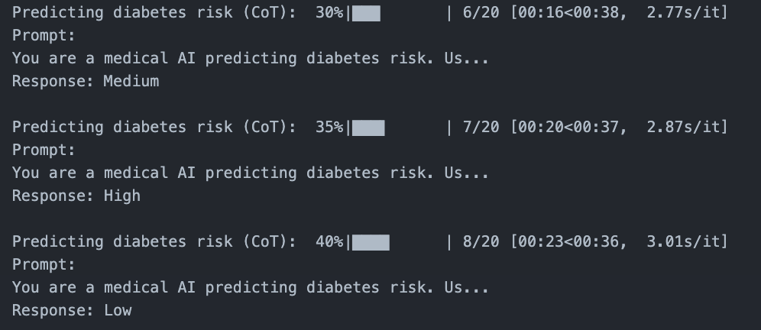
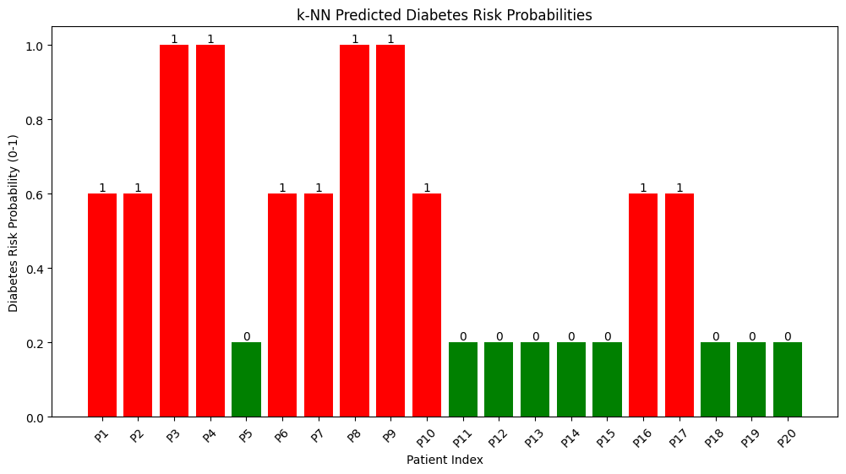
Methods Employed
Preprocessing: Loaded Synthea data.
GPT-4:
CoT: Risk prediction.
ToT: Differential diagnosis.
ML: k-NN for prediction/classification.

Slide 6
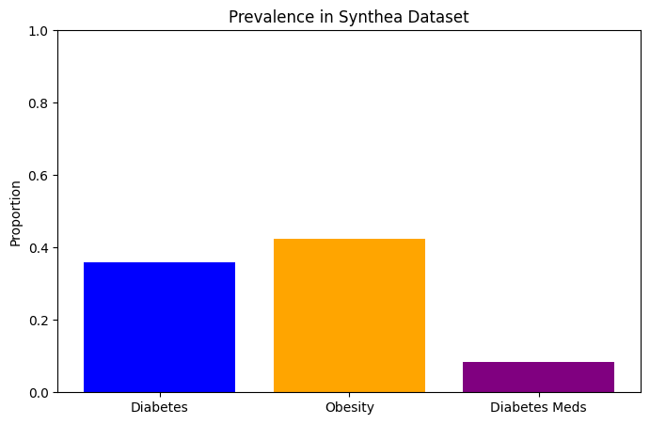
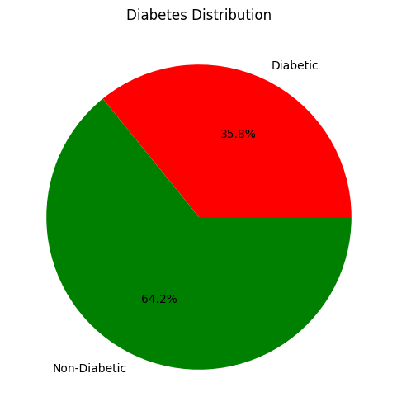
Evaluation of Results
Prevalence:
Diabetes: 35.85%.
Obesity: 42.45%.
GPT-4 Accuracy:
CoT & ToT at 0.90.

Slide 7
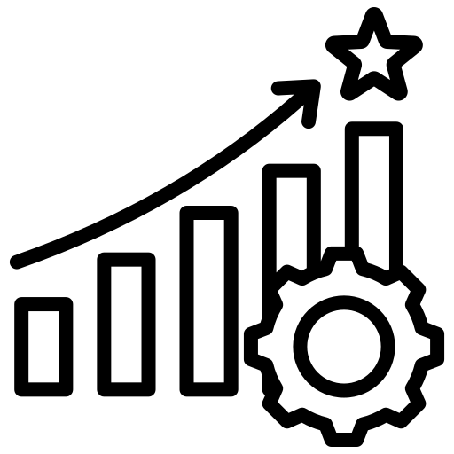
Ideas for Improvement
Dataset: Larger Synthea sample.
GPT-4: Refine prompts with examples.
ML: Add features, tune k-NN.
Visualization: Glucose trend plot.

