Slide 1

SQL Queries for Analyzing Diabetes Using the MIMIC Database
Jesus Minjares
UT AUSTIN: AI in HEALTHCARE

Slide 2
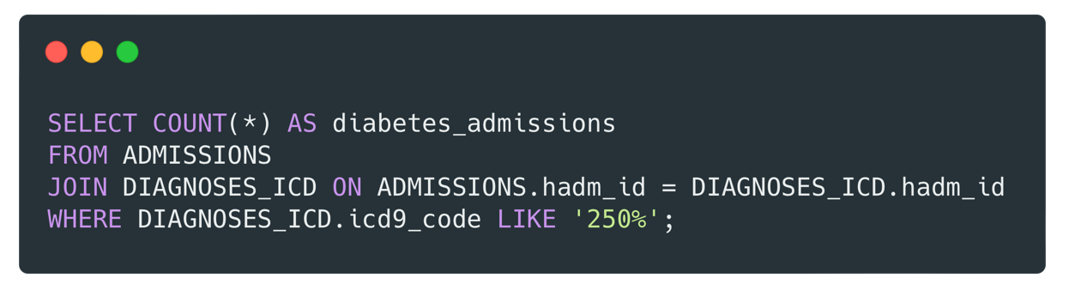

Query 1: Diabetes-Related Hospital Admissions
Query
Meaning
Counts the number of hospital admissions related to diabetes.
Explanation
This query filters hospital admissions where the diagnosis code starts with 250, the ICD-9 code for diabetes.
The output provides the total count of diabetes-related admissions.
Result

Slide 3
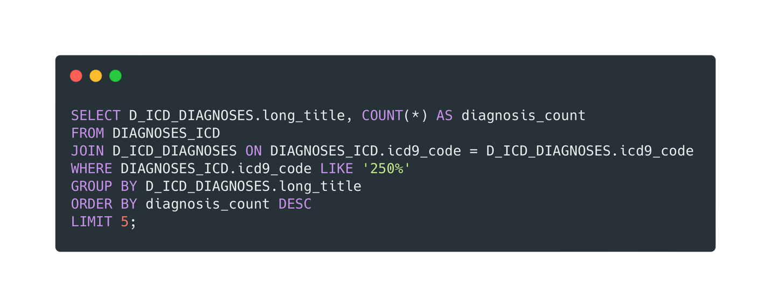
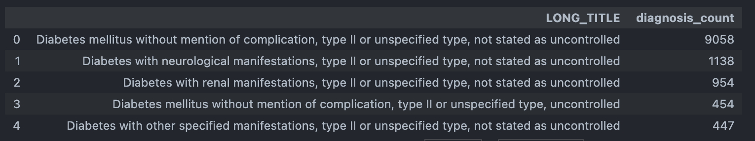
Query 2: Most Common Diabetes Diagnoses
Query
Meaning
Identifies the most frequently diagnosed diabetes conditions.
Explanation
The query joins diagnosis codes with their descriptions.
It counts occurrences of each diagnosis and returns the top 5 most common ones.
Result

Slide 4
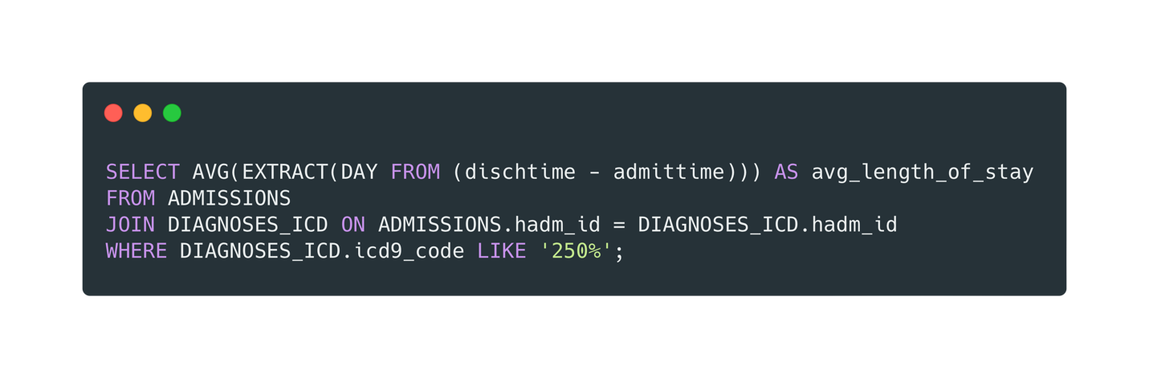

Query 3: Average Length of Stay for Diabetes Patients
Query
Meaning
Calculates the average length of hospital stays for diabetes patients.
Explanation
The time difference between discharge and admission is extracted in days.
The average length of stay for diabetes patients is computed.
Result

Slide 5
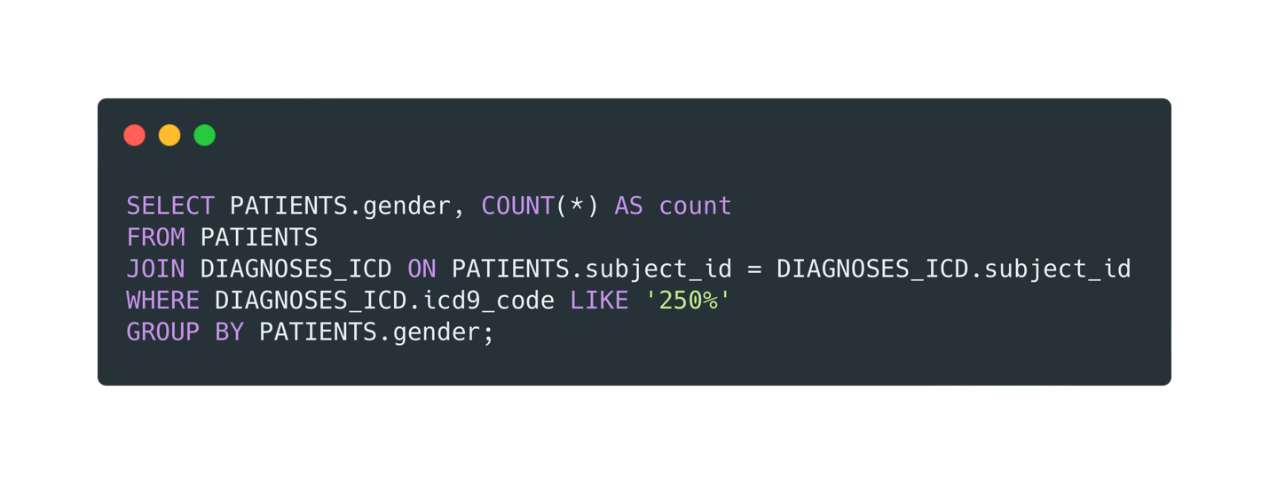
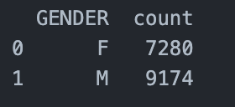
Query 4: Gender Distribution of Diabetes Patients
Query
Meaning
Shows the gender distribution of diabetes patients
Explanation
This query groups diabetes patients by gender and counts the occurrences.
It helps understand if diabetes is more common in a specific gender.
Result

Slide 6
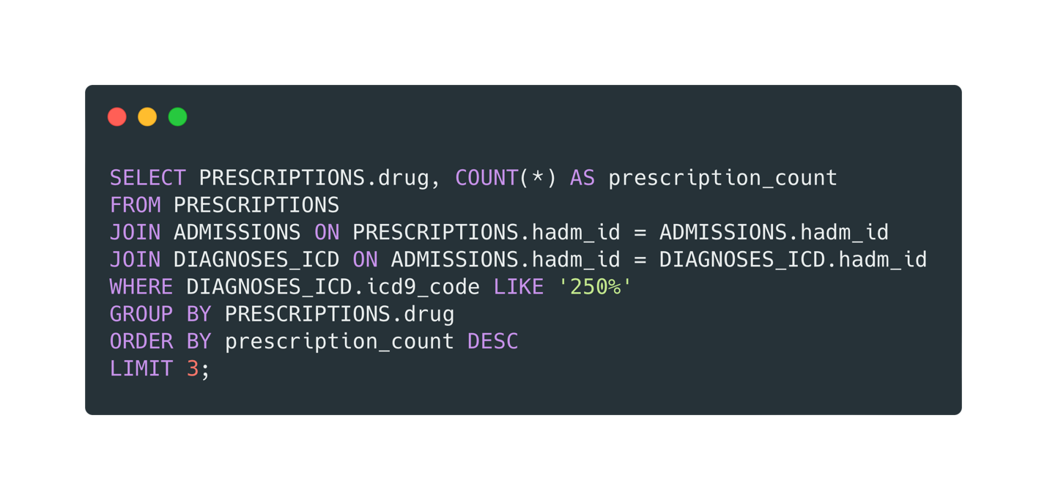
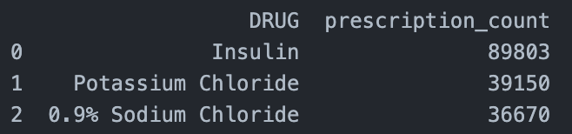
Query 5: Top 3 Prescribed Medications for Diabetes
Query
Meaning
Identifies the most prescribed medications for diabetes patients.
Explanation
The query counts how often each drug is prescribed for diabetes patients.
The top 3 most commonly prescribed medications are listed.
Result

Slide 7
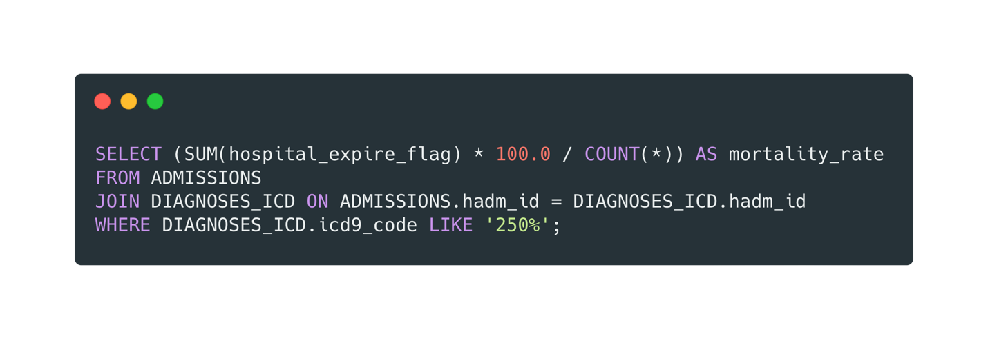

Query 6: Hospital Mortality Rate for Diabetes Patients
Query
Meaning
Calculates the percentage of diabetes patients who died in the hospital.
Explanation
The query checks how many diabetes patients had hospital_expire_flag = 1.
The percentage of diabetes patients who passed away during hospitalization is calculated.
Result

Slide 8
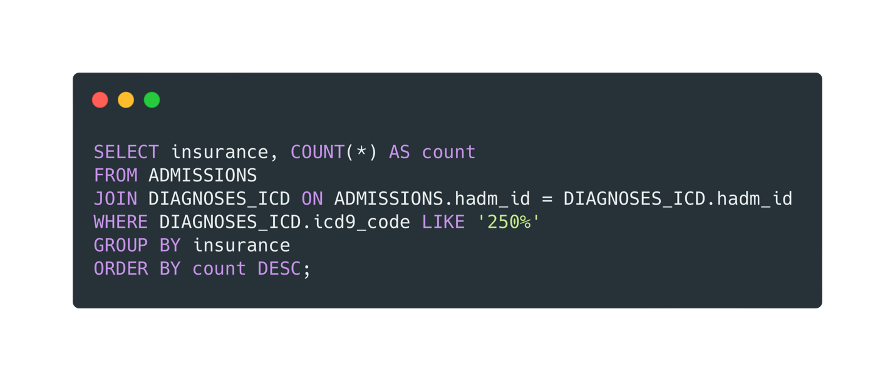
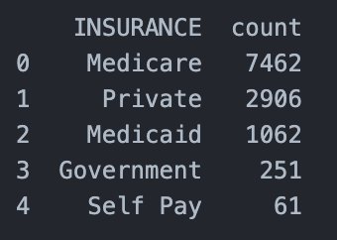
Query 7: Most Common Insurance Types for Diabetes Patients
Query
Meaning
Lists the most common insurance types among diabetes patients.
Explanation
The query groups diabetes patients by insurance type and counts occurrences.
It helps in understanding the coverage patterns for diabetes patients.
Result

Slide 9
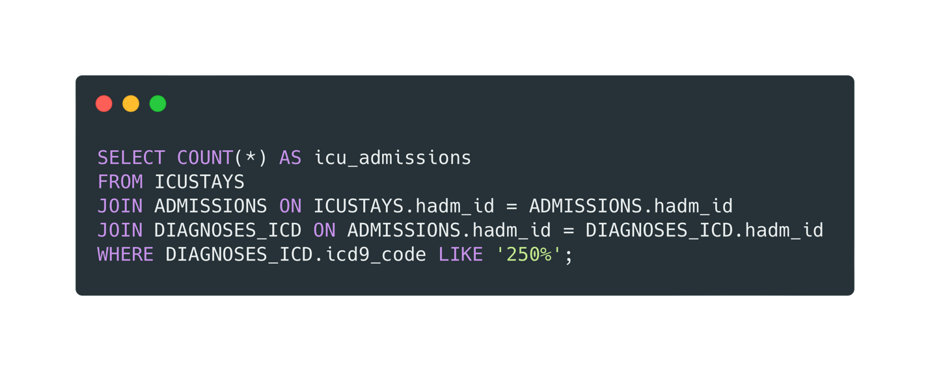

Query 8: ICU Admissions for Diabetes Patients
Query
Meaning
Counts how many diabetes patients were admitted to the ICU.
Explanation
The query checks how many diabetes-related hospitalizations led to ICU stays.
This helps assess the severity of diabetes cases requiring intensive care.
Result

Slide 10
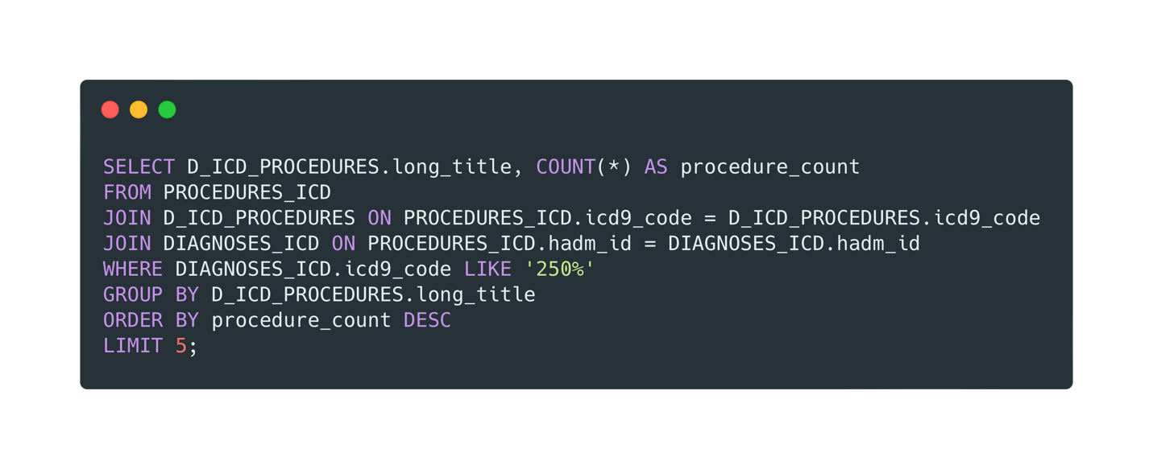
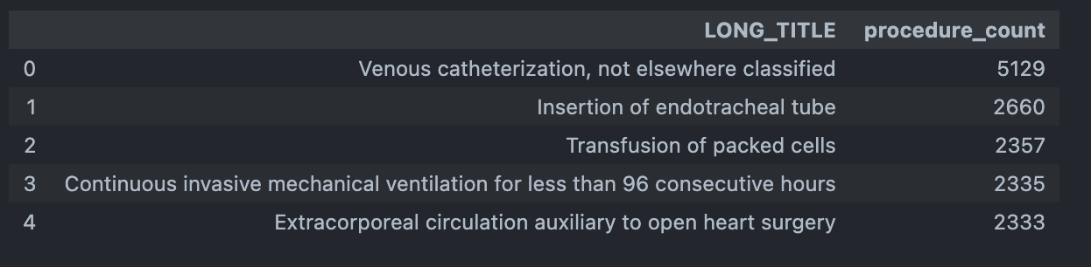
Query 9: Most Common Procedures for Diabetes Patients
Query
Meaning
Identifies the most common medical procedures performed on diabetes patients.
Explanation
This query retrieves the most frequently conducted medical procedures for diabetes patients.
The output ranks the top 5 procedures performed on hospitalized diabetes patients.
Result

Slide 11
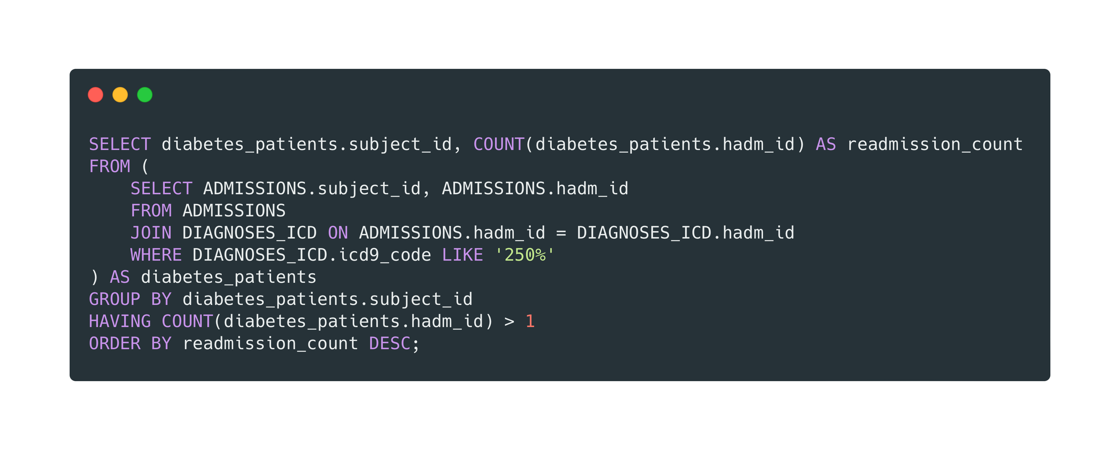
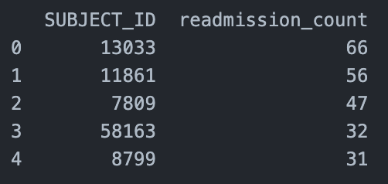
Query 10: Patients with Multiple Diabetes-Related Hospitalizations
Query
Meaning
Identifies patients with multiple diabetes-related hospital admissions.
Explanation
The query finds diabetes patients who have been hospitalized multiple times.
It counts how many times each patient was admitted and returns those with more than one admission.
Result

Slide 12
Conclusion
11,742 diabetes-related admissions, with an average hospital stay of 9.25 days.
High-risk cases: 12,378 ICU admissions and 9.93% mortality rate.
Insulin is the most prescribed medication, indicating its central role in diabetes treatment.
Most common procedures involve catheterization, intubation, and blood transfusions.
Gender split: More males (9,174) than females (7,280) admitted.
Frequent readmissions, with some patients hospitalized up to 66 times

