Slide 1
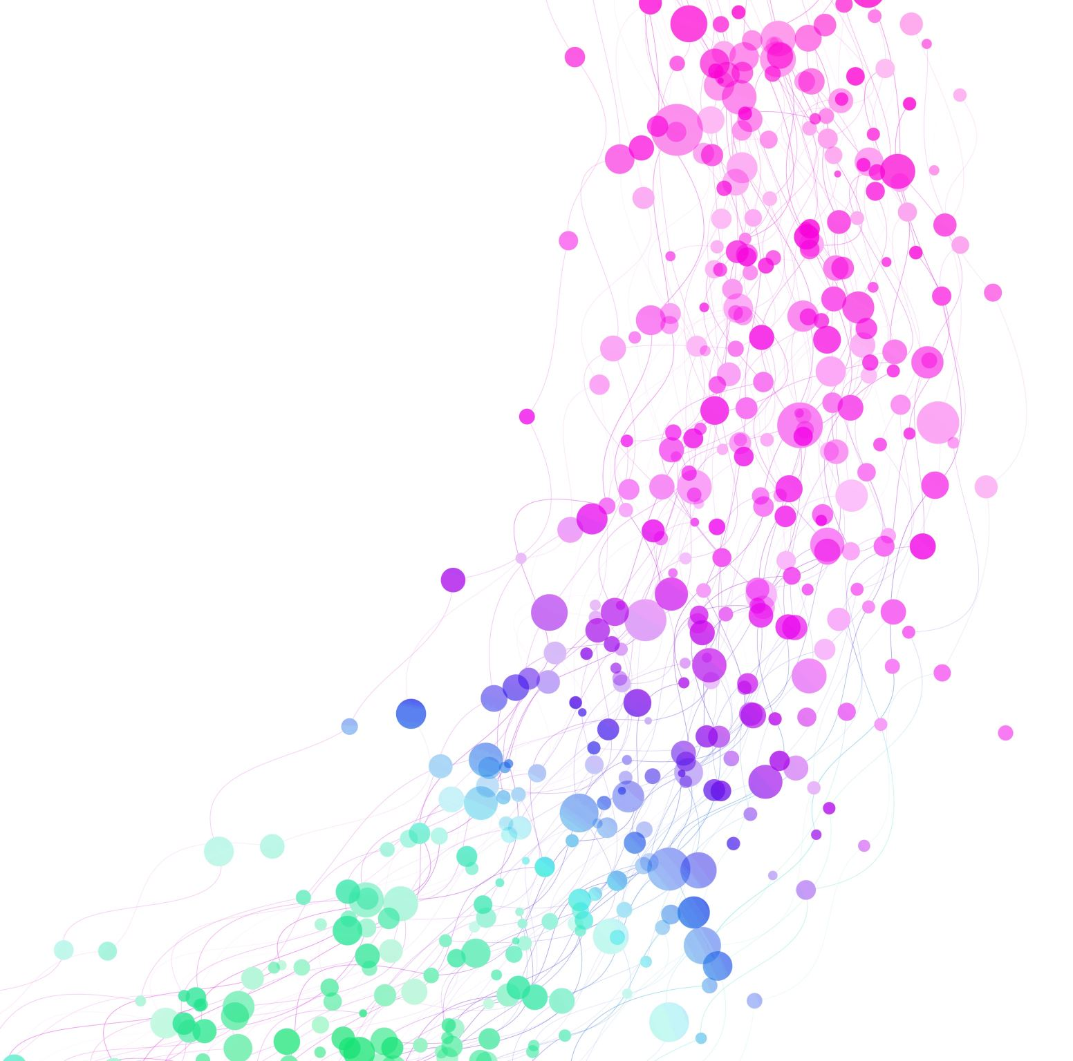

Early Sepsis Detection with Machine Learning
Jesus Minjares
UT Austin
AI in Healthcare
Notes:
Hello, I’m Jesus Minjares and I’m excited to share my project on Early Sepsis Detection with Machine Learning. I developed a machine learning model to detect sepsis early, and I’ll cover my goals, methods, results

Slide 2
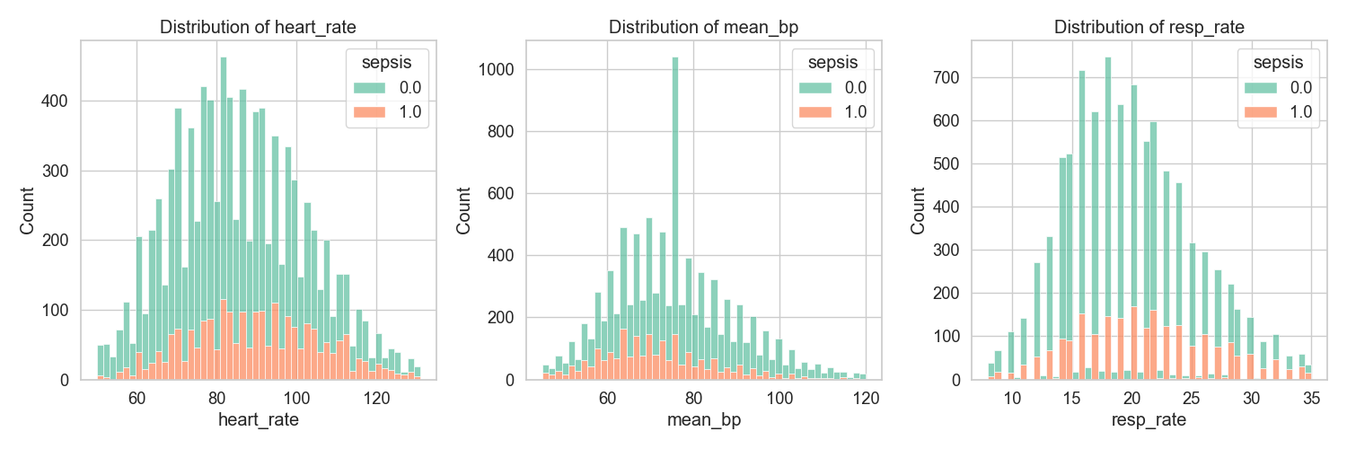
Introduction
Sepsis
Data
Graph Result
Sepsis patients have higher heart rates (100-120 bpm vs. 80-100 bpm) and lower mean blood pressure (some <80 mmHg vs. 80-100 mmHg
MIMIC-III (vitals + notes)
Mortality >30%, early detection critical.
Notes:
Sepsis is a life-threatening condition with a mortality rate over 30%, and early detection is critical to saving lives. I used the MIMIC-III dataset, which includes vital signs and clinical notes, to predict sepsis. These graphs show heart rate and mean blood pressure distributions. Sepsis patients (orange) have higher heart rates, peaking at 100-120 bpm, compared to non-sepsis (green) at 80-100 bpm. For mean blood pressure, sepsis patients show a wider spread, with some values dropping below 80 mmHg, while non-sepsis patients cluster around 80-100 mmHg, highlighting these as key predictors.

Slide 3
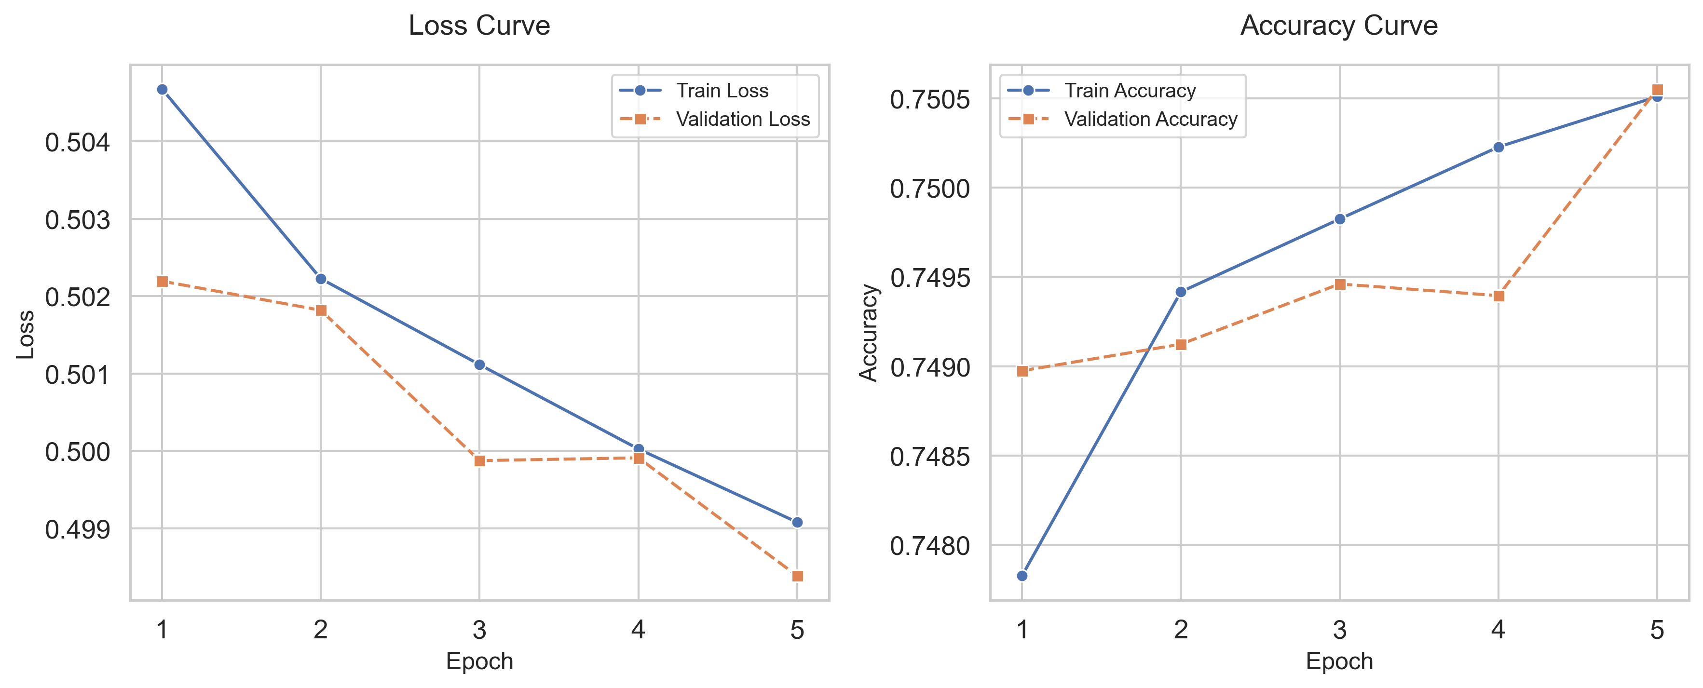
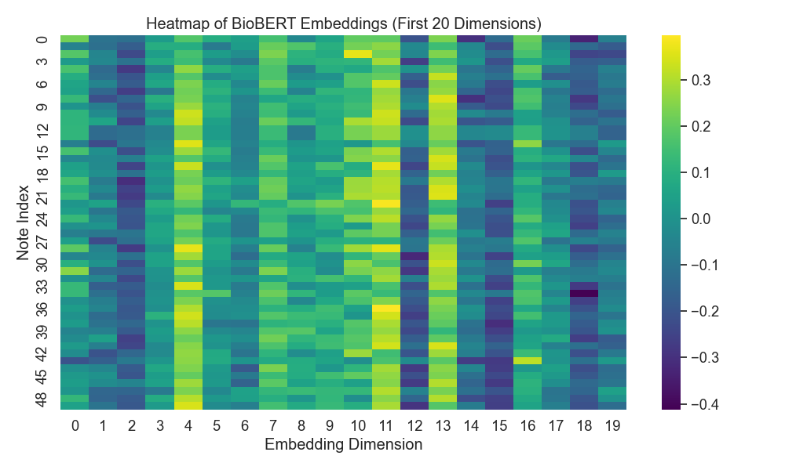
Method
Data
Models
Graph Result (Heatmap)
Graph Result (Loss Curve)
Vitals (12 time steps), notes via BioBERT
Logistic Regression, LSTM (5 epochs).
Embeddings for 50 notes, values from -0.4 to 0.3.
Training loss at 0.500, validation at 0.502, minimal overfitting.
Notes:
Next, I used MIMIC-III data: vital signs like heart rate, mean blood pressure, and respiratory rate over 12 time steps, and clinical notes processed with BioBERT. This heatmap shows BioBERT embeddings for 50 notes across 20 dimensions, with colors from yellow (0.3) to purple (-0.4) capturing semantic patterns like "infection." I trained two models: Logistic Regression and an LSTM, over 5 epochs. The loss curve shows my training loss (blue) dropping to 0.500 and validation loss (orange) to 0.502 by epoch 5, indicating effective learning with minimal overfitting. I also included demographics for fairness analysis.

Slide 4
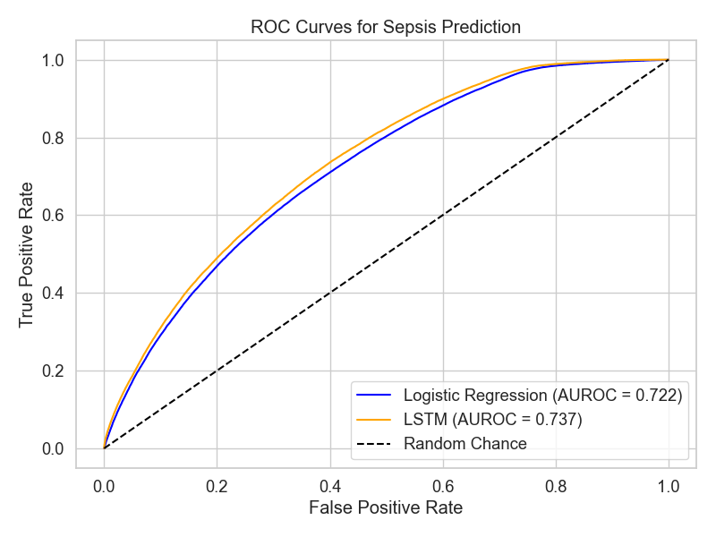
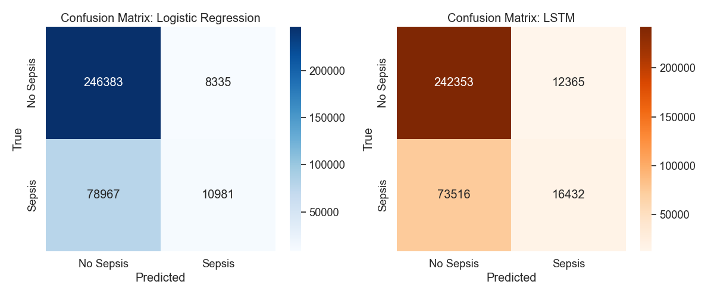
Results
Performance
Graph Result (Confusion Matrices)
LSTM AUROC = 0.737, Logistic Regression = 0.722,
Graph Result (ROC)
LSTM outperforms Logistic Regression.
LSTM: 24,233 correct non-sepsis, 16,432 missed sepsis; Logistic Regression: 10,981 missed sepsis, 8,335 false positives.
Notes:
LSTM achieved an AUROC of 0.737, outperforming Logistic Regression at 0.722. The ROC curve shows the LSTM (orange) above the blue Logistic Regression line. The LSTM confusion matrix reports 24,233 correct non-sepsis predictions but 16,432 missed sepsis cases, while Logistic Regression’s matrix shows fewer false negatives (10,981) but more false positives (8,335).

Slide 5

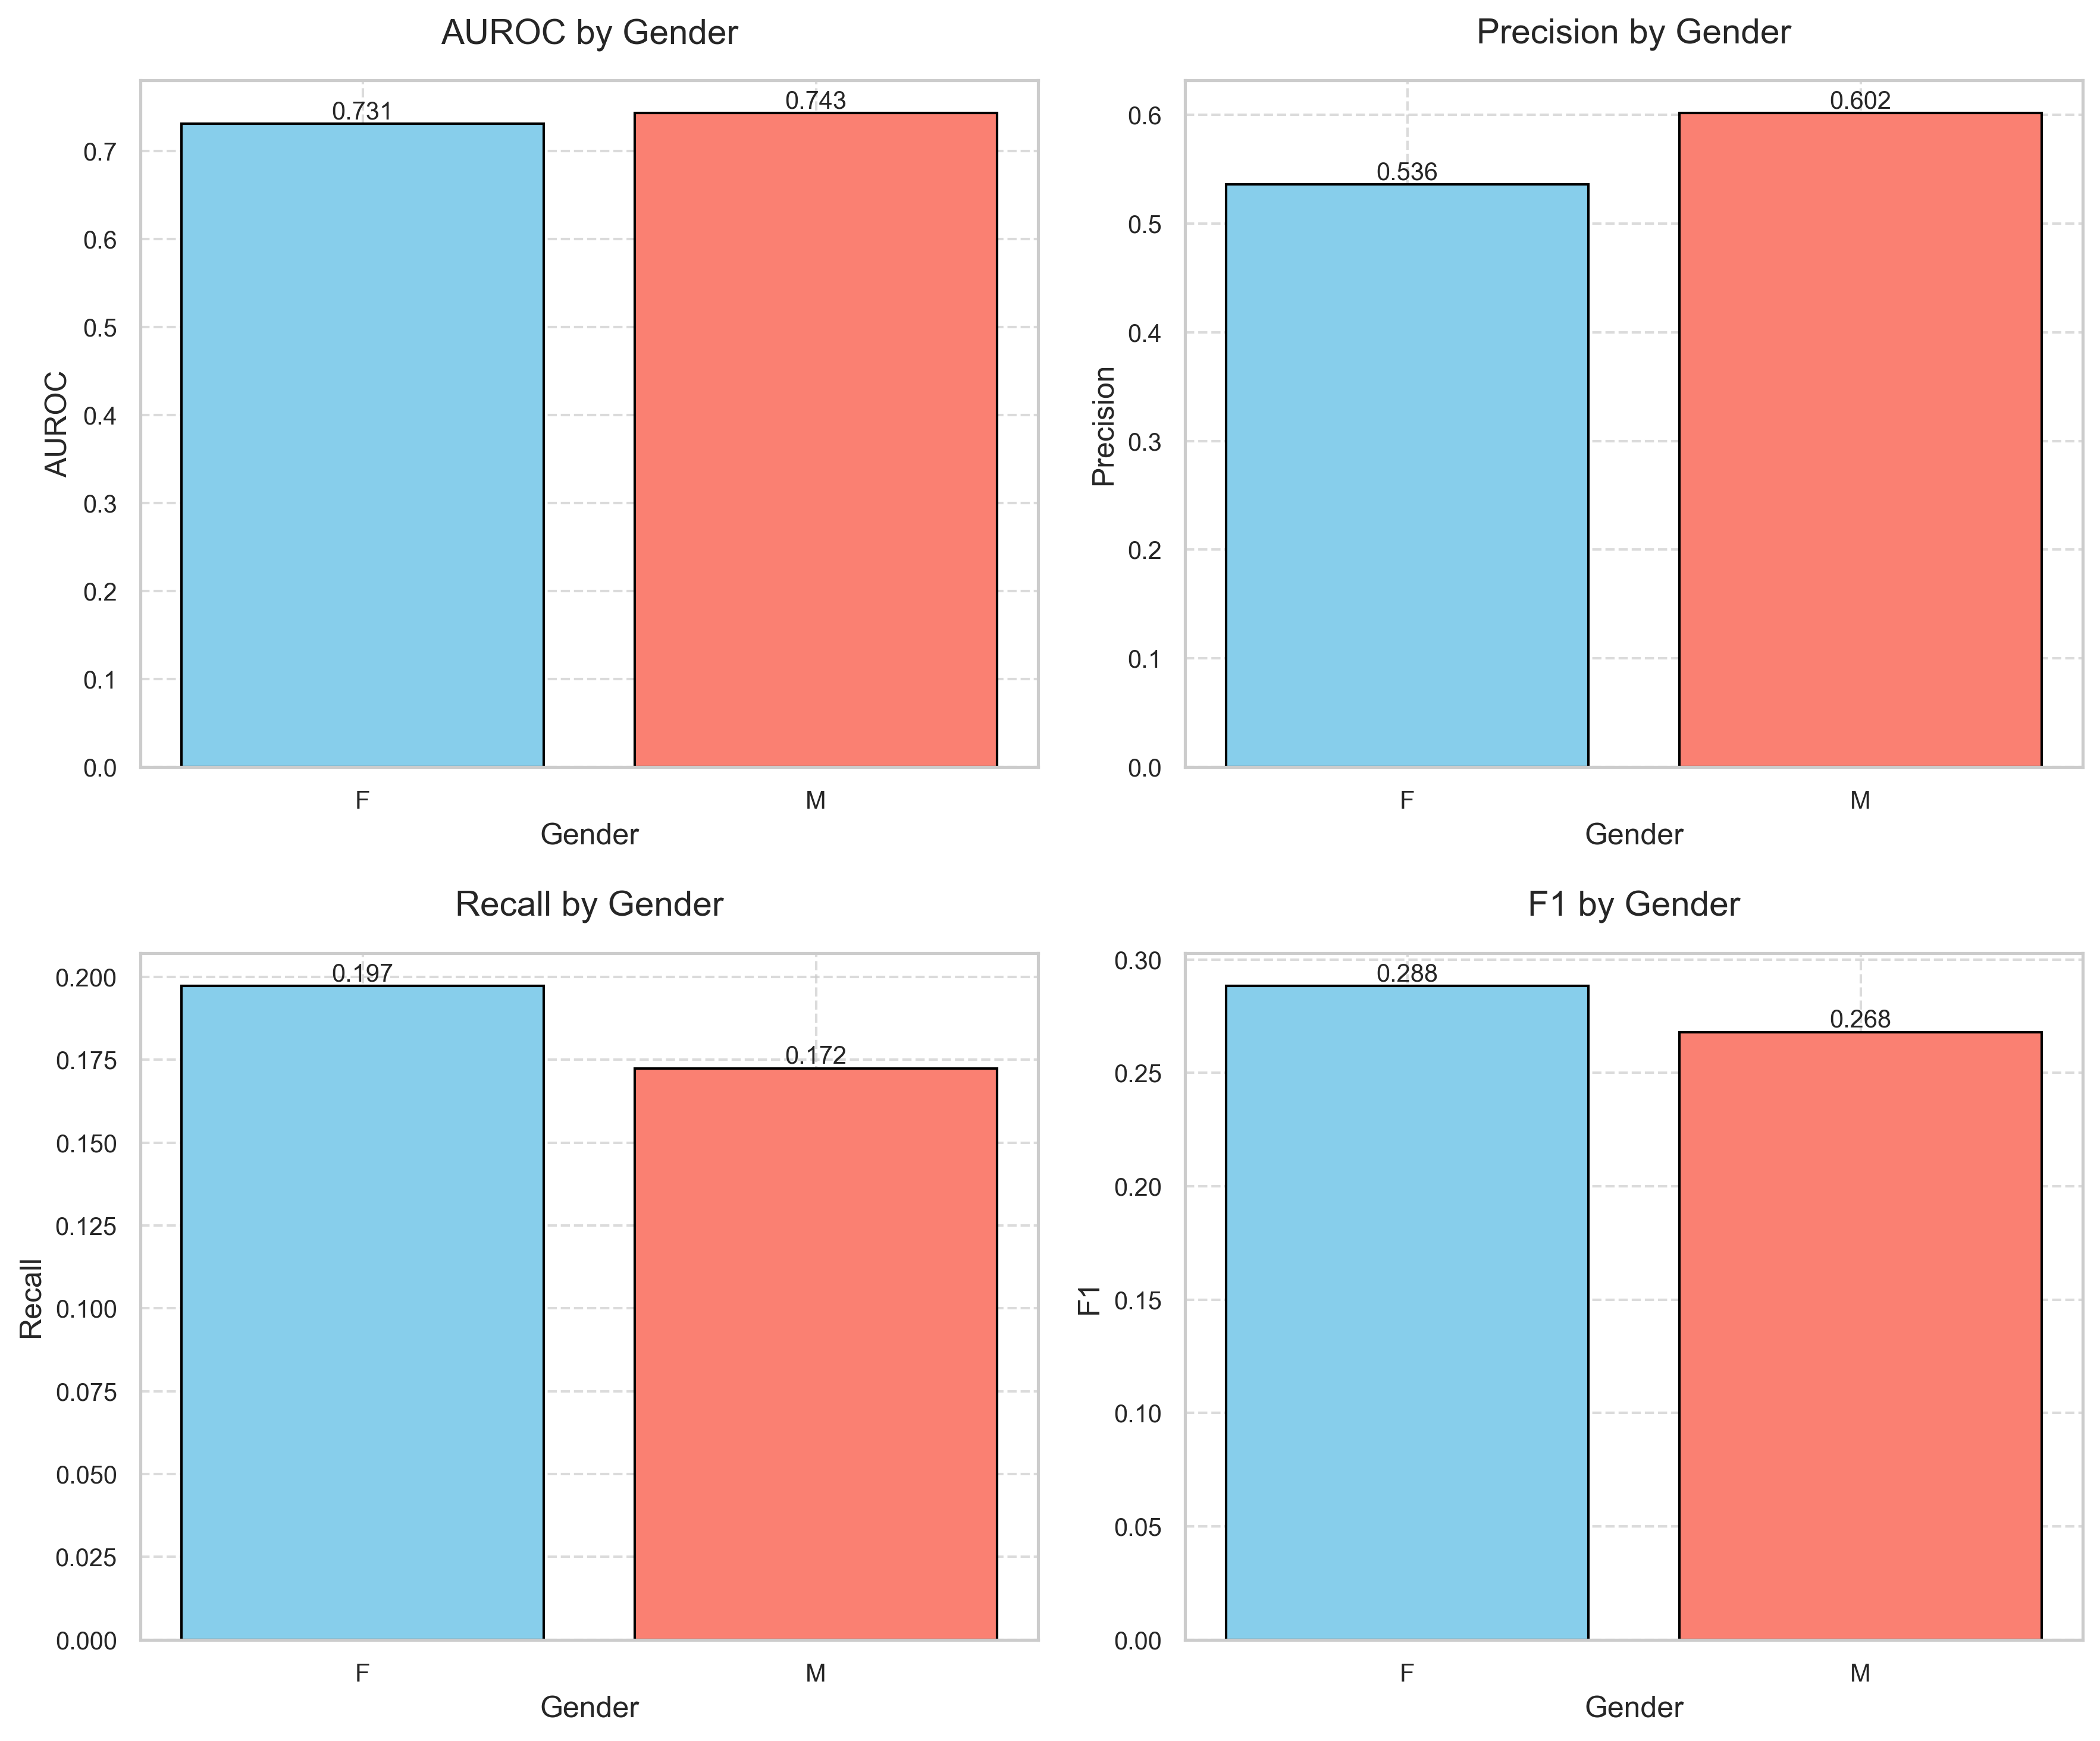
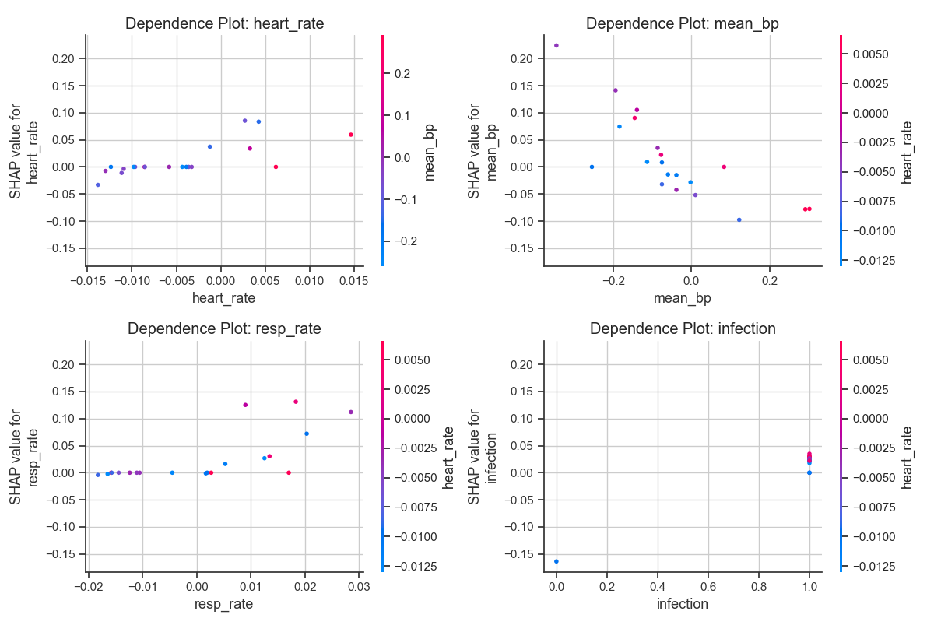
Results Cont.
Graph Result (Precision-Recall)
Logistic Regression higher precision at low recall, LSTM better at higher recall.
Graph Result (Fairness)
AUROC balanced (F: 0.731, M: 0.743), recall higher for females (0.197 vs. 0.172).
Graph Result (SHAP)
Higher heart rates increase sepsis prediction (SHAP values up to 0.2).
Notes:
The precision-recall curve indicates Logistic Regression (blue) has higher precision at low recall, while LSTM (orange) balances better at higher recall. Fairness analysis shows AUROC balanced—0.731 for females, 0.743 for males—but recall is higher for females (0.197 vs. 0.172). The SHAP plot for heart rate shows higher values (e.g., 0.015) increase sepsis prediction (SHAP values up to 0.2). My model supports early sepsis detection but needs better sensitivity.

Slide 6
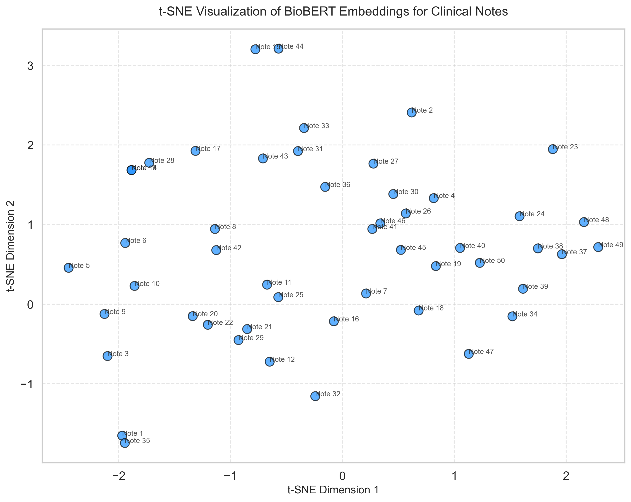

Future Directions
Improve text processing with larger samples or GPT-4, as t-SNE shows clustering (Notes 2, 23) but room for better pattern capture.
Enhance text feature extraction, as SHAP plots show infection (SHAP values up to 0.8) and fever (SHAP values up to 0.1) are key predictors.
Address fairness (recall: F 0.197, M 0.172) by analyzing age and ethnicity, plus use SMOTE for class imbalance.
Real-time ICU monitoring to save lives.
Notes:
I’ll improve text processing with larger samples or GPT-4, enhance feature extraction for infection and fever signals, and expand fairness analysis to age and ethnicity. Using SMOTE to address class imbalance, my goal is real-time ICU deployment to boost sepsis detection and support faster clinical action.

Slide 7

Conclusion
Summary
Future
AUROC 0.737, key predictors identified
Real-time, equitable detection
Notes:
In conclusion, my project achieves an AUROC of 0.737, identifying key predictors like heart rate and infection. Real-time, equitable detection is my next step. Thank you!

