Slide 1
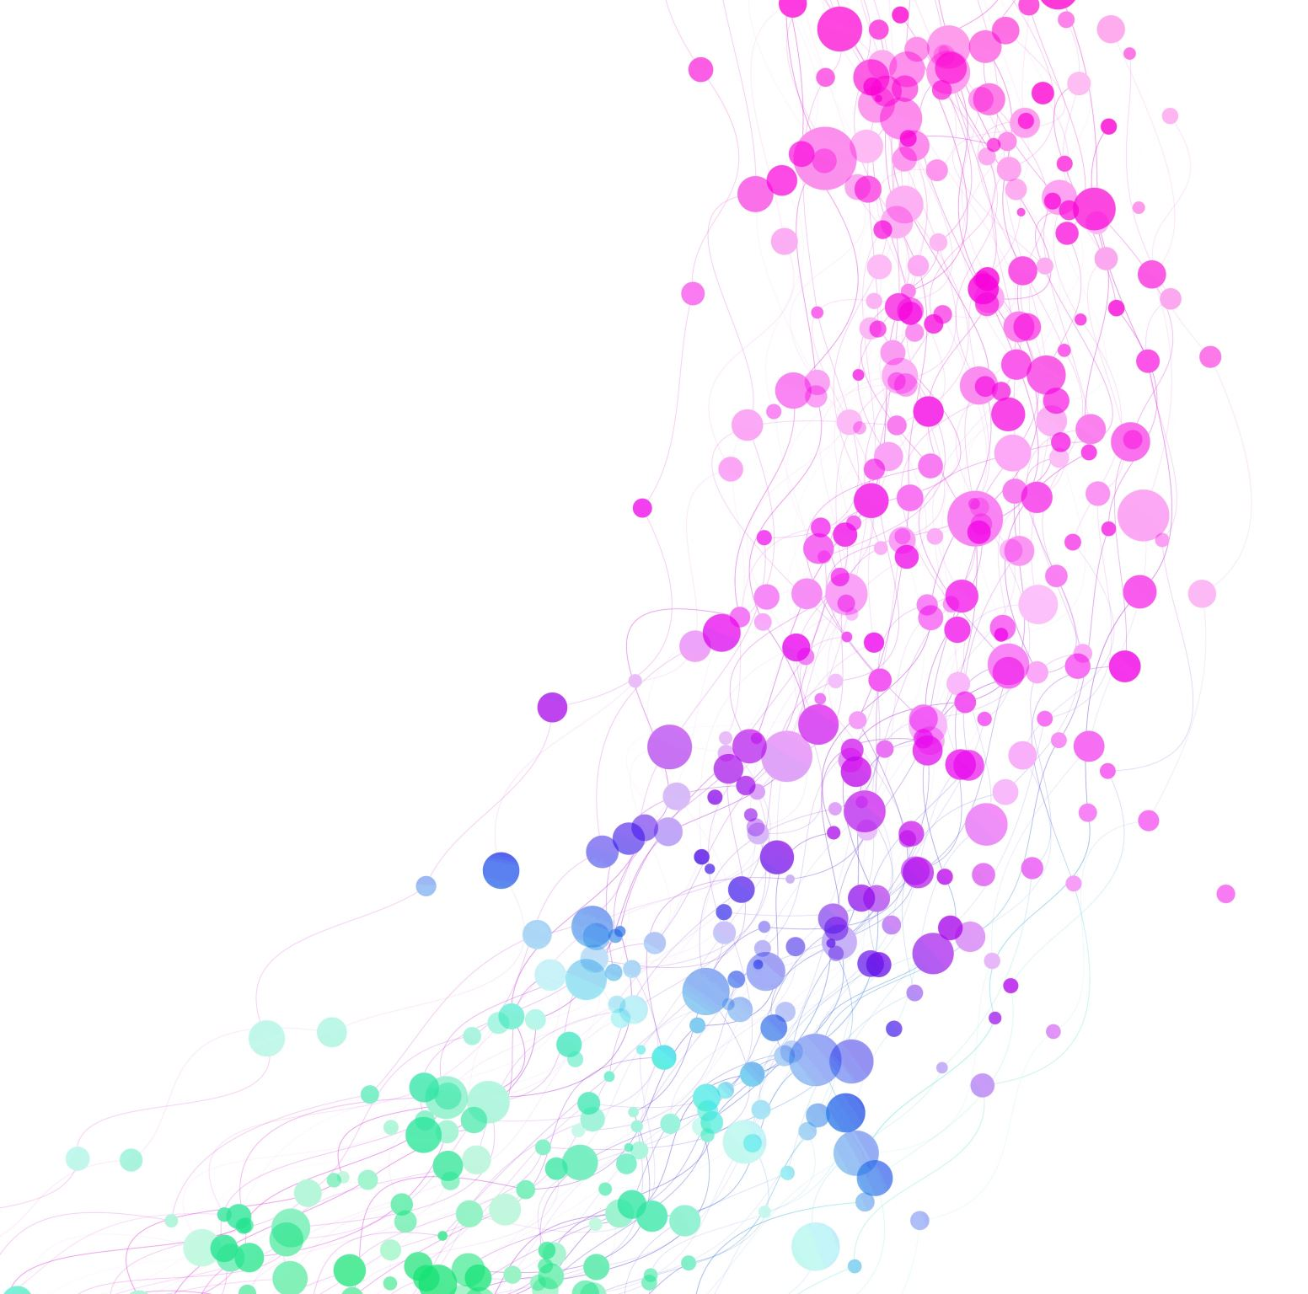
Tutorial for Heart Failure Mortality Prediction Using MIMIC-IV
Jesus Minjares
UT AUSTIN: AI in HEALTHCARE

Slide 2
Introduction
Assignment Goals:
Apply ML/DL to EHR data for risk management.
Extract features, fit models, derive insights.
Objective: Predict in-hospital mortality in heart failure patients.
Dataset: MIMIC-IV (v3.1), 42,990 admissions (34,392 train, 8,598 test).
Models: XGBoost, Advanced FNN, Ensemble (XGBoost + FNN).
Task: Binary classification (mortality vs. non-mortality).
Mortality Rate: 5.40% (class imbalance).

Slide 3
Data Preprocessing and Feature Extraction
Data Loading:
Loaded MIMIC-IV: admissions, patients, diagnoses_icd, icustays.
Filtered for heart failure (ICD-10: I50.x).
Feature Extraction:
Demographics: Age (capped at 90), gender (M=0, F=1).
Clinical: ICU stay (binary), admission type (categorical).
Comorbidities: Top ICD-10 codes (one-hot encoded).
Target: mortality (1 if deathtime not null, 0 otherwise).
Preprocessing: 80/20 train-test split, scaled features.

Slide 4
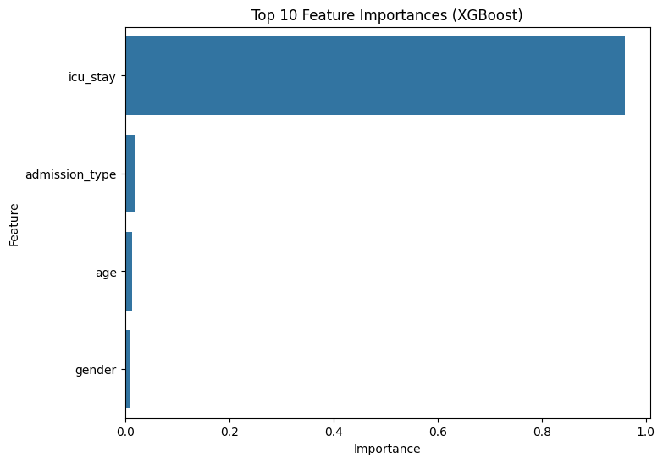
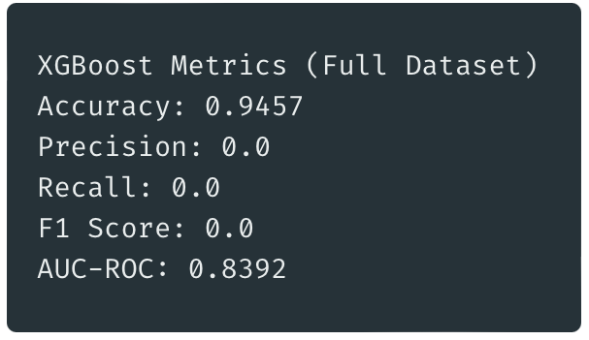
ML Model - XGBoost
Model: XGBoost (gradient boosting classifier).
Setup: eval_metric='logloss', trained on 34,392 samples.
Feature Fitting: Used scaled features (age, gender, ICU stay, etc.).
Evaluation: Predicted on 8,598 test samples, computed metrics.
Feature Importance: Top features (e.g., ICU stay, age).

Slide 5
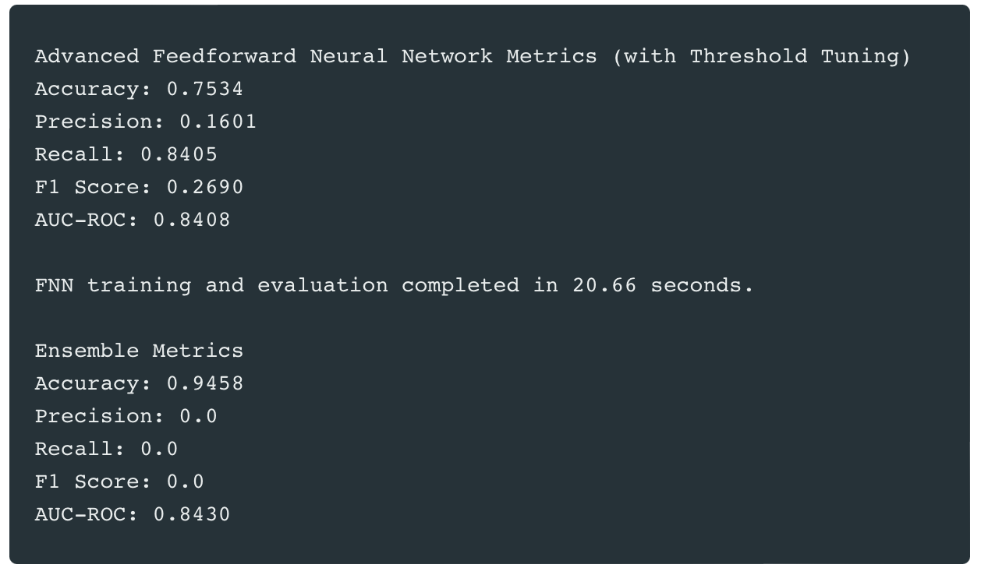
DL Model - Advanced Feedforward Neural Network (FNN)
Model: Advanced FNN with residual connections.
Architecture: input_dim→256→128→64→32→1, focal loss.
Feature Fitting: Used scaled features, learned complex patterns.
Training: 80/20 train-validation split (27,513 train, 6,879 val).
Data augmentation (noise), early stopping (epoch 26).
Evaluation: Threshold tuning (best = 0.30, min recall 0.7).

Slide 6
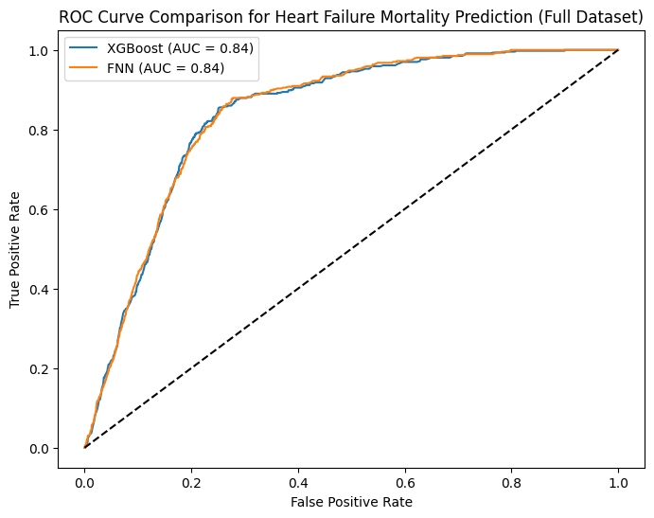
Evaluation of Results
ROC Curve:
XGBoost AUC = 0.844, FNN AUC = 0.844.
Nearly identical curves, excellent discriminative power.
Key Metrics:
XGBoost: Accuracy: 0.9457, Precision: 0.0, Recall: 0.0, F1: 0.0.
FNN: Accuracy: 0.7534, Precision: 0.1601, Recall: 0.8405, F1: 0.2690.
Ensemble: Accuracy: 0.9458, Precision: 0.0, Recall: 0.0, F1: 0.0.
Analysis:
FNN’s high recall (0.8405) identifies most high-risk patients.
Low precision (0.1601) due to class imbalance (5.40% mortality).
Plot/Output: ROC curve plot (XGBoost AUC = 0.844, FNN AUC = 0.844).

Slide 7

Discussion and Insights
Strengths:
AUC of 0.844 for both models, suitable for risk stratification.
FNN’s high recall (0.8405) identifies most high-risk patients.
XGBoost’s feature importance (e.g., ICU stay, age) aids decisions.
Insights:
ICU stay and age are key predictors of mortality.
FNN supports timely interventions for at-risk patients.
Challenges:
Class imbalance (5.40%) leads to low precision for FNN.
Ensemble threshold (0.5) needs tuning for better recall.

Slide 8

Conclusion
Summary:
Developed ML/DL models for mortality prediction using MIMIC-IV.
Achieved AUC of 0.844, FNN recall of 0.8405.
Ensemble AUC of 0.8437 shows potential.
Future Work:
Optimize ensemble threshold for better recall and F1.
Explore advanced DL (e.g., transformers) with better hardware.
Clinical Impact:
FNN identifies high-risk patients for timely interventions.
XGBoost provides evidence-based insights for decisions.

