Slide 1

Modern Approaches to Prediction Modeling: Integrating AI and Machine Learning
Jessica Minnier, Ph.D.Associate Professor, Biostatistics
OHSU-PSU School of Public Health
Knight Cancer Institute, Biostatistics & Data Science Shared Resource
OHSU AI Research Summit, 11/19/2025

Slide 2
The Evolution: From Association to Prediction
Traditional Association
Prediction Modeling
Research Question:"Is gene X associated with disease Y?"
Research Question:"What is this specific patient's risk of disease Y?"
Primary Goal:Causal inference and etiologic understanding
Primary Goal:Accurate risk stratification and clinical decision support
Key Metrics:P-values, Odds Ratios, Confidence Intervals
Key Metrics:Accuracy, AUC, Calibration, PPV/NPV, NRI
Today's data landscape is extraordinarily complex: EHR systems, multi-omics platforms, natural language processing, and advanced imaging all generate massive datasets. Our thesis: The most powerful models integrate AI innovation with biostatistical rigor, rather than relying on either approach alone.

Slide 3
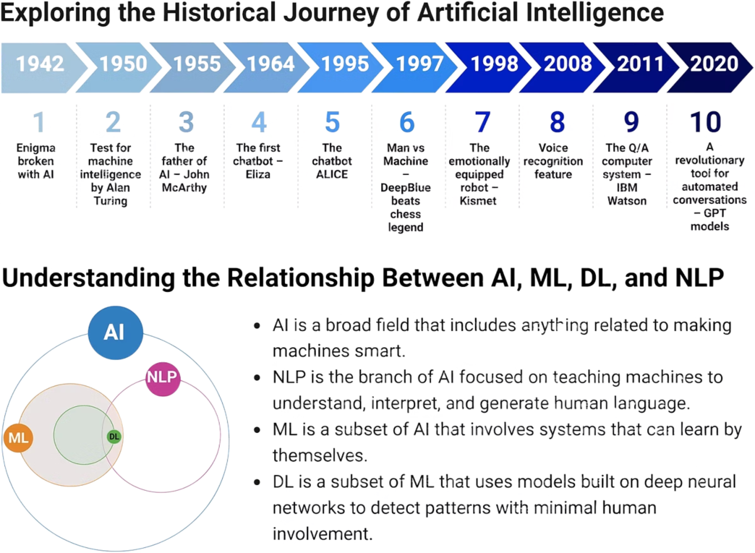
The Evolving Synergy: Biostatistics Meets AI
Biostatistics Foundation
1
Provided a rigorous foundation for medical research, focusing on causal inference, hypothesis testing, and understanding disease mechanisms.
AI's Rise & Capabilities
2
Emergence grew with data volume and computational power, excelling in pattern recognition, predictive modeling, and complex data integration.
Synergistic Impact
3
Integrating biostatistics' rigor with AI's predictive power yields impactful advancements, leading to more comprehensive, reliable, and clinically actionable health insights.
Alowais et al. Revolutionizing healthcare: the role of artificial intelligence in clinical practice. BMC Medical Education, 2023

Slide 4

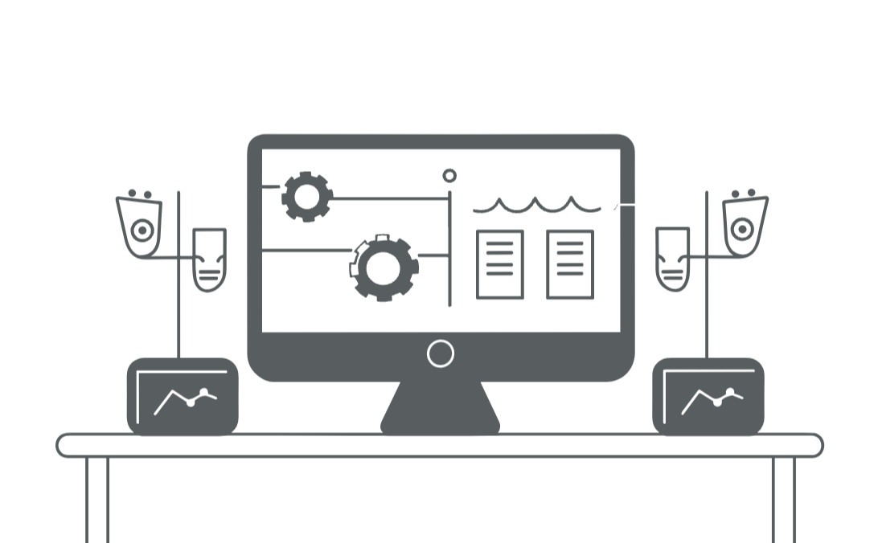

Challenge #1: Defining Reliable Outcomes
Before building prediction models, we must establish trustworthy outcome labels.
Phenotypes derived from insurance billing codes often lack the precision needed for robust outcome definition, introducing measurement error and bias into prediction models.
While a traditional gold standard, manual chart review is a labor-intensive process, creating a significant bottleneck that hinders research scalability and efficiency.
Machine learning and advanced statistical methods offer promising avenues to systematically define and validate reliable outcome labels, overcoming current limitations.
How can these innovative methods help us accurately define what we're trying to predict?

Slide 5
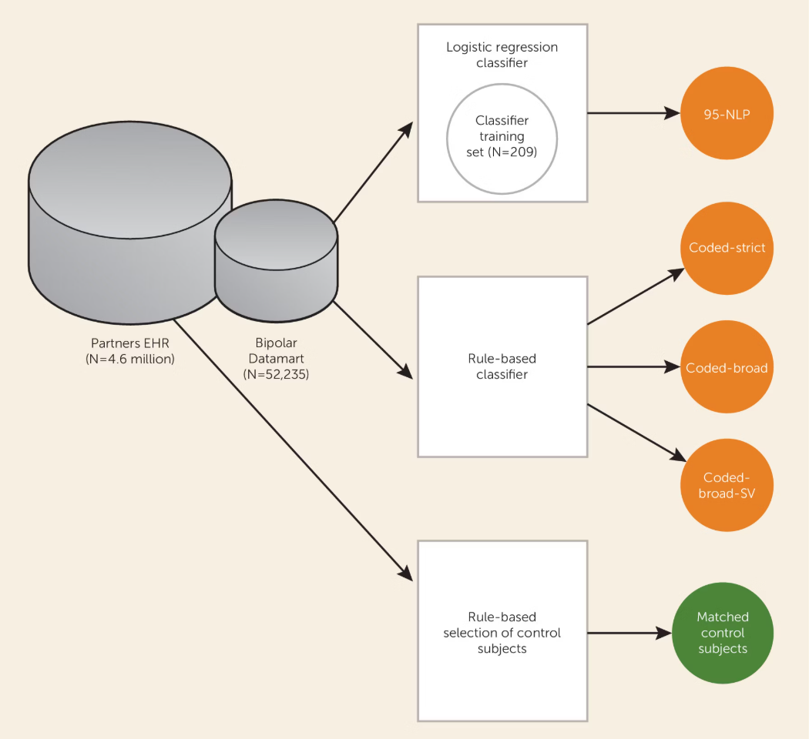
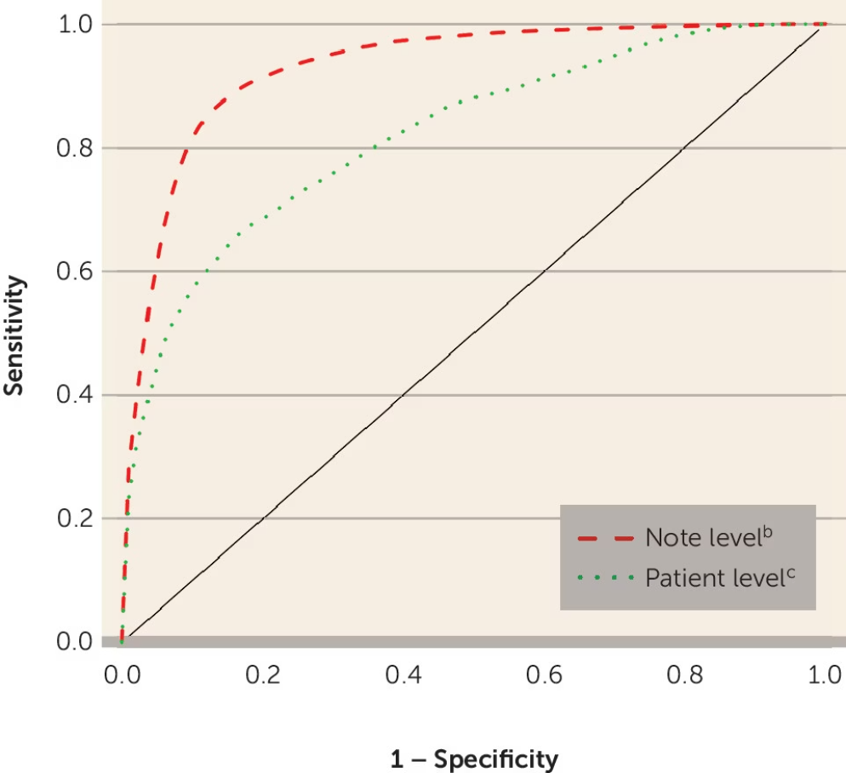
Case Study 1: Phenotyping Bipolar Disorder with Natural Language Processing
Research Goal
Methodological Approach
Validation Strategy
Identify Bipolar Disorder cases accurately within electronic health records
Applied Adaptive LASSO (regularized regression) combining coded diagnostic data with NLP-extracted features from clinical notes
Compared algorithm predictions against gold standard SCID (Structured Clinical Interview) assessments
Clinical Impact
Achieved PPV of 0.85, enabling creation of a reliable research cohort for subsequent genetic studies (4500 cases, 5000 controls)
Castro, Minnier et al. Validation of electronic health record phenotyping of bipolar disorder cases and controls. American Journal of Psychiatry, 2015

Slide 6


Case Study 2: Rheumatoid Arthritis with Limited Labels
The Innovation
Challenge: Automated feature selection with minimal labeled data
Solution: Unsupervised clustering on surrogate markers (ICD code counts) to generate "silver standard" labels, followed by Adaptive LASSO selection
Result: Achieved equivalent accuracy using only 50% of the labeled training data
Gronsbell, Minnier et al. Automated feature selection of predictors in electronic medical records data. Biometrics, 2018
Key Takeaway: Machine learning and statistical methods are essential not just for prediction, but for defining the very outcomes we seek to predict.

Slide 7

Challenge #2: Integrating Complex, Multi-Modal Data
Once reliable outcomes are established, the next frontier involves modeling complex, high-dimensional predictors from diverse data sources. How do we effectively integrate genomic data, clinical variables, imaging features, and unstructured text?

Slide 8



Case Study 3: Non-Linear Genomic Risk Modeling
The Problem
The Solution
The Advantage
Disease risk from thousands of SNPs exhibits non-linear relationships and gene-set structures that simple linear models cannot capture
Adaptive Naive Bayes Kernel Machine (ANBKM)
Captures biological pathway structures while maintaining statistical interpretability and feature selection
Kernel Machine: Models complex, non-linear risk within gene-sets
Naive Bayes + LASSO: Aggregates risk scores and selects informative gene-sets
Minnier et al. Risk classification with an adaptive naive Bayes kernel machine model. Journal of the American Statistical Association, 2015

Slide 9
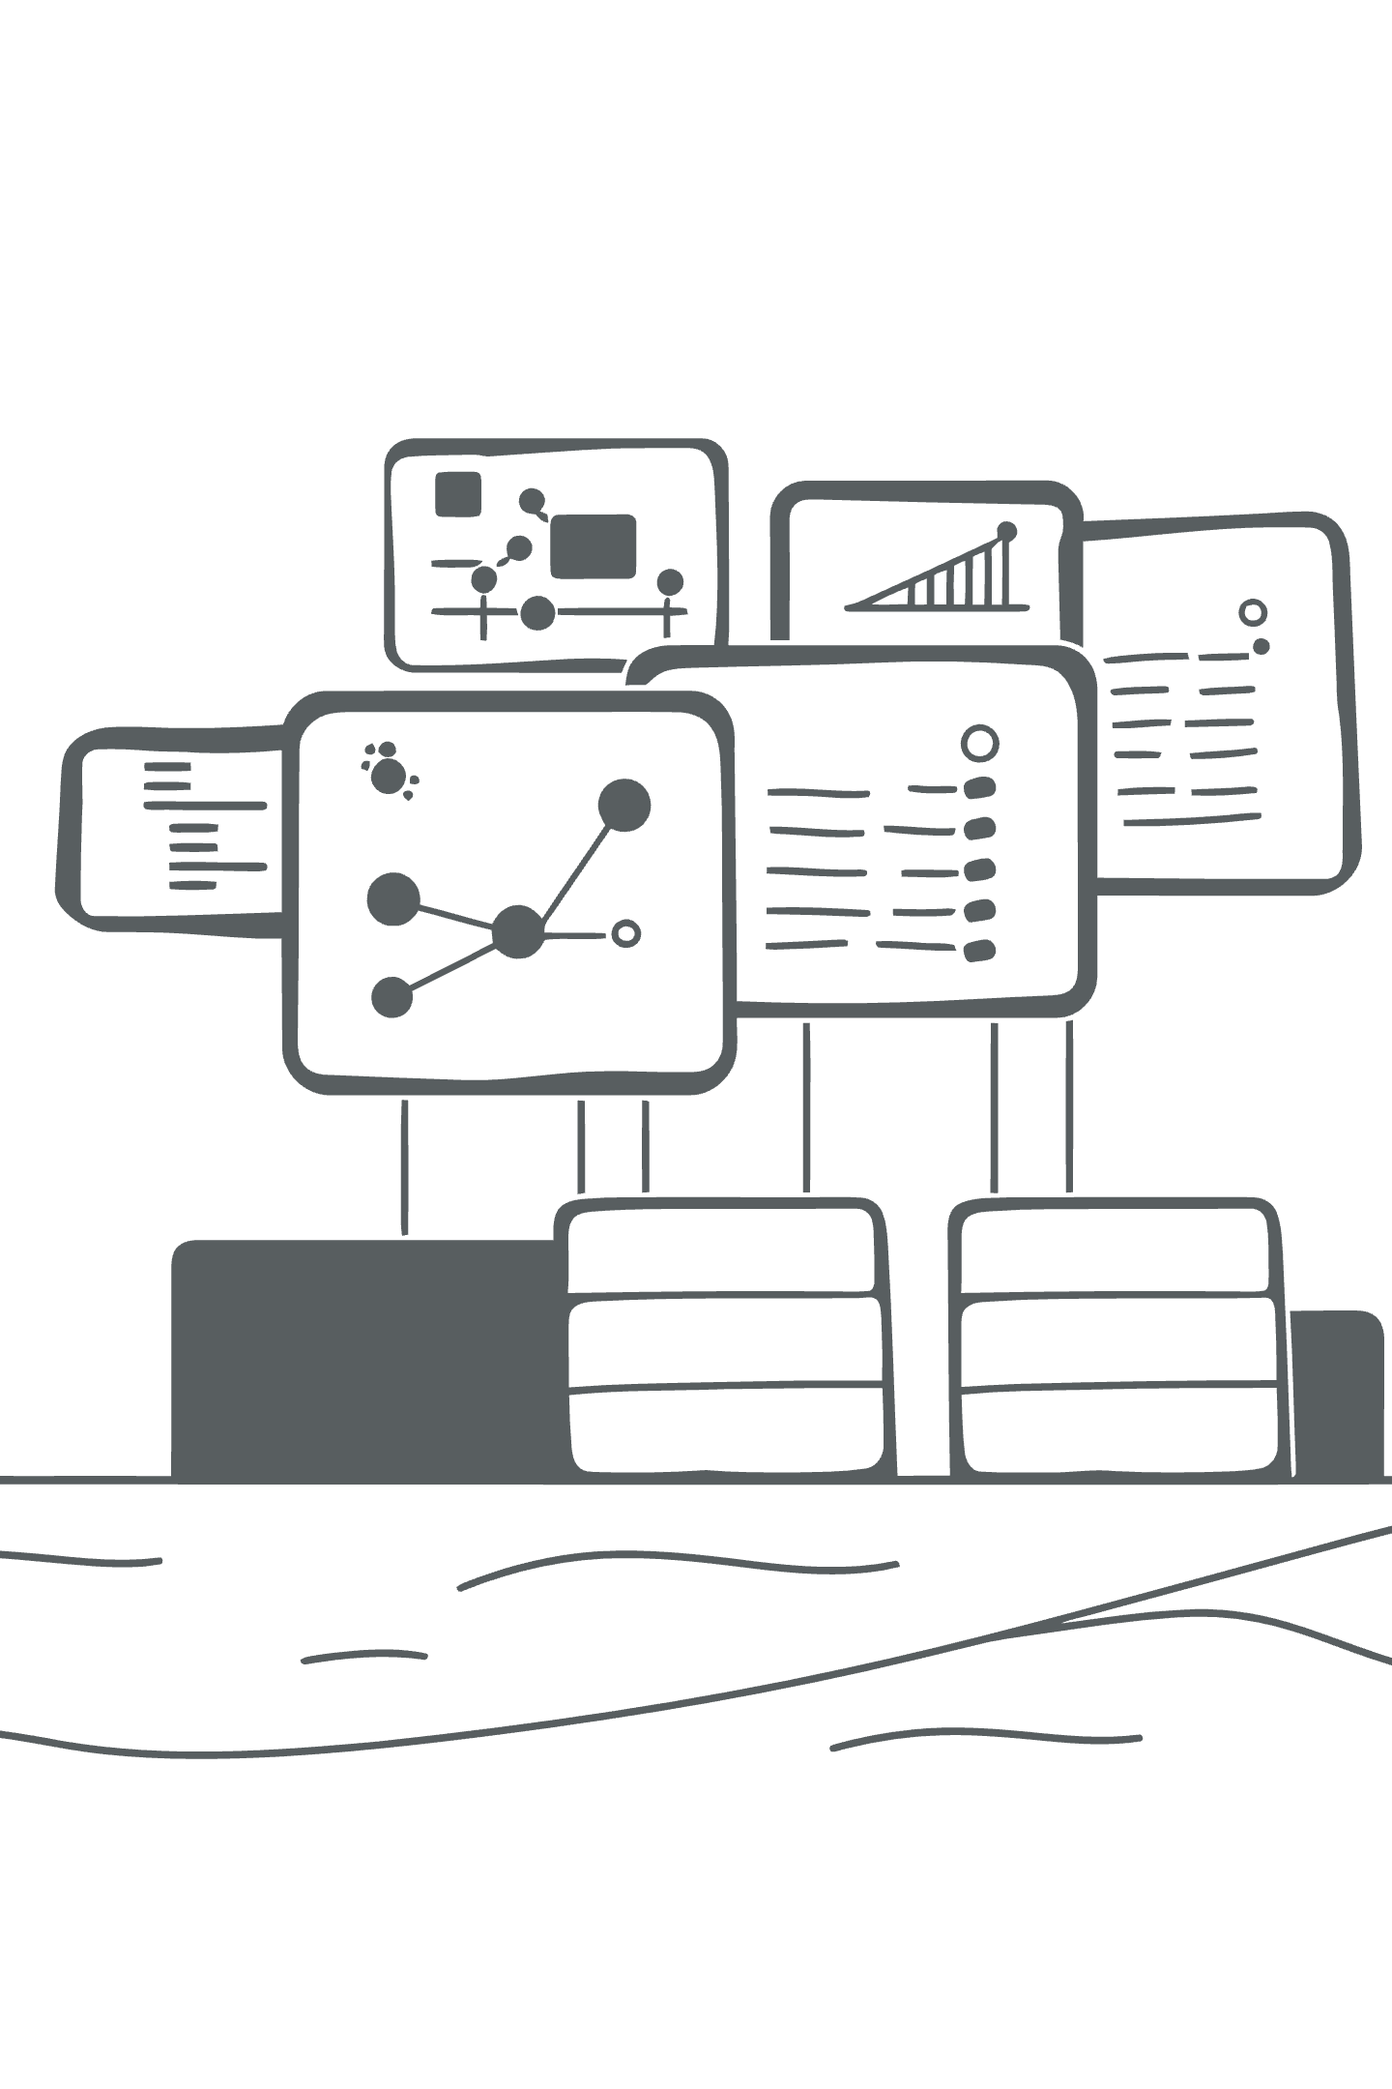
Case Study 4: Ensemble Learning for Health Equity
Research Context
Super Learner Approach
Goal: Infer Latino nativity status for health equity research using diverse EHR data sources
Combined multiple algorithms (Logistic Regression, Random Forest, Gradient Boosting) using optimal weighted averaging
Data Sources:
Performance: Ensemble model achieved AUC > 0.90, substantially outperforming any individual algorithm
Electronic health records
Census tract information
Surname-based indicators
Marino, Minnier et al. Disaggregating Latino nativity in equity research using electronic health records. Health Services Research, 2023

Slide 10

The Frontier: Integrating "Black Box" AI into Prediction Models
The New Reality
The Biostatistician's Role
FDA-authorized AI algorithms now provide powerful, stand-alone predictions for clinical use
Our challenge: How do we rigorously integrate these AI tools with other predictive data sources?
The Opportunity
Create hybrid models that leverage AI strengths while maintaining statistical interpretability

Slide 11




Project Spotlight: VA Breast Cancer Risk Integration
We are developing the most comprehensive breast cancer risk model by integrating all available predictive data sources.
Clinical Data
Genomics
AI Imaging
Age, family history, reproductive factors, breast density, etc.
Polygenic Risk Score (PRS) from genome-wide association studies
"Clairity" algorithm score: deep learning model analyzing mammogram patterns
Statistical Innovation: New_Risk_Model = f(Clinical_Data, PRS, AI_Score)
Don't just compare AI to genomics—integrate them for maximum predictive power.
Clinical Impact: Identify high-risk women (elevated PRS + high AI score) for enhanced screening protocols and prevention interventions.

Slide 12

The Next Frontier: Large Language Models for Feature Extraction
Clinical notes contain rich information absent from structured fields: nuanced social determinants of health, detailed family histories, symptom severity trajectories, and treatment response patterns. LLMs represent the next generation of NLP, capable of extracting this complex information at scale.
80%
Unstructured Data
Percentage of EHR data in free-text format

Slide 13
From Traditional NLP to LLM-Powered Extraction
Traditional NLP Approach
LLM-Powered Future
Our Previous Work:
Emerging Capabilities:
Bipolar Disorder: Keyword detection ("racing thoughts", "grandiosity")
Automated reading of entire clinical narratives
Complex concept extraction without manual rules
Rheumatoid Arthritis: Pre-defined term extraction
Contextual understanding of medical language
Manual feature engineering required
Advantage: Scales to millions of notes, captures nuanced clinical patterns
Limitations: Labor-intensive, limited to predefined concepts
Example Research Question: Can LLMs automate extraction of Bipolar subphenotypes (psychosis features, suicide attempts, age of onset) that we previously validated through manual review? If successful, this creates powerful new predictors for risk stratification models.

Slide 14

Key Conclusions: The Prediction Modeling Pipeline
1
1. Rigorous Phenotyping
Use ML and statistical methods to define reliable outcome labels when gold standards are limited
2
2. Flexible Modeling
Integrate diverse data types (clinical, genomic, imaging) using appropriate statistical and ML frameworks
3
3. AI Integration
Thoughtfully combine black-box AI predictions with interpretable statistical models for maximum clinical utility
4
4. Rigorous Validation
Assess calibration, clinical utility, and real-world performance—not just AUC

Slide 15
Critical Validation and Implementation Challenges
Beyond AUC: Comprehensive Validation
Power Analysis and Grant Strategy
Funding and Implementation
Funding Sources: Pursuing NIH and VA grants for validation and implementation
Calibration: Do predicted 30% risks match observed 30% event rates?
Calculate sample size requirements for incremental value metrics:
ΔAUC improvement from adding AI component
Key Requirements:
Clinical Utility: Does the model change clinical management decisions?
Access to images and/or non-coded text fields
Net Reclassification Improvement (NRI)
Ability to implement AI models in clinical workflows
PPV/NPV: What is real-world predictive performance in target populations?
Feature variability estimation: Large sample sizes needed for stable estimation in models with many predictors
Clinical trial studies examining utility of screening or early diagnosis
Often requires simulation studies to demonstrate feasibility

Slide 16



Thank You
Questions?
Jessica Minnier, Ph.D.Associate Professor, Biostatistics
OHSU-PSU School of Public Health
Knight Cancer Institute, Biostatistics & Data Science Shared Resource
minnier@ohsu.edu
Most images from lummi.ai

