Slide 1

“Blossom”-Online Flower Shop

Slide 2
Submitted To:
Dr. Md, Rejaul Karim
Professor
Md. Shiplu Hawlader
Lecturer
Submitted By:
Amifa Raj
Roll: SK-28
Jurdana Masuma Iqrah
Roll: SK-44

Slide 3
The name of our Web Engineering project is “Blossom”-Online Flower Shop.
We will give an overview of the software that we have been assigned to develop, mentioning the functionalities and requirements along with a proper use case diagram.

Slide 4
Purpose
make a Web and E-commerce site by which we will sell mainly different types of flowers .
give our customers the right to customize their products as they want.
provide many options regarding to choose the products.

Slide 5
Scopes
Benefits :
- customers can easily choose and order products from the site
- can customize according to their choices
- get delivery with least delivery charge

Slide 6
Goal
bring happiness to the door of our customers by giving them the opportunity to order their desired products from anywhere anytime
Build the project using PHP, HTML, CSS and to serve the customers.
manage a database to keep track of the information of the customers, order of the customers, product info, cart info etc.

Slide 7
Definitions
Web Engineering: the scientific discipline concerned with the study of systematic and quantifiable approaches
E-Commerce: buying and selling of goods and services, or the transmitting of funds or data, over an electronic network
occur either business-to-business, business-to-consumer, consumer-to-consumer or consumer-to-business.

Slide 8
The Overall Description
We have used web server XAMP for creating the user interface using PHP, HTML and CSS code.
For Database creating and handling we have used PhpMyAdmin.

Slide 9
Product Perspective
provide a wide variety of products
organize products based on different occasion like- birthday, wedding, mother’s day etc.
Customers have to register and have to be logged in while purchasing
Customers can personalize products according to their expectations
They can maintain their own cart for ordering products
Payment system is cash on delivery.

Slide 10

Product Functions
4 major functions with two actors:
Functions:
1. create accounts for customers 2. Add to Cart option for purchasing 3. ordering products
4. pay for the orders
Actors:
1. Customers
2. Admin

Slide 11
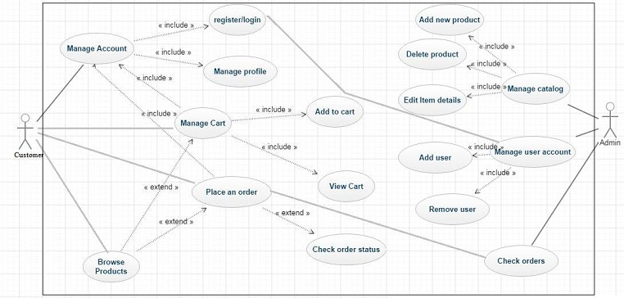
USE Case Diagram

Slide 12
Specific Requirements:
Functions:
Account management
manage the customer’s profile. customer can update his profile and personal information here.
Browse Product
browse through the web-site for available products.
available for both the registered and non-registered customers

Slide 13
Manage Cart
Customers can view the cart, add new products to the cart and remove previously selected products from the cart
Place Order
customers order their desired products. Once order is placed the order is delivered to the customer.

Slide 14
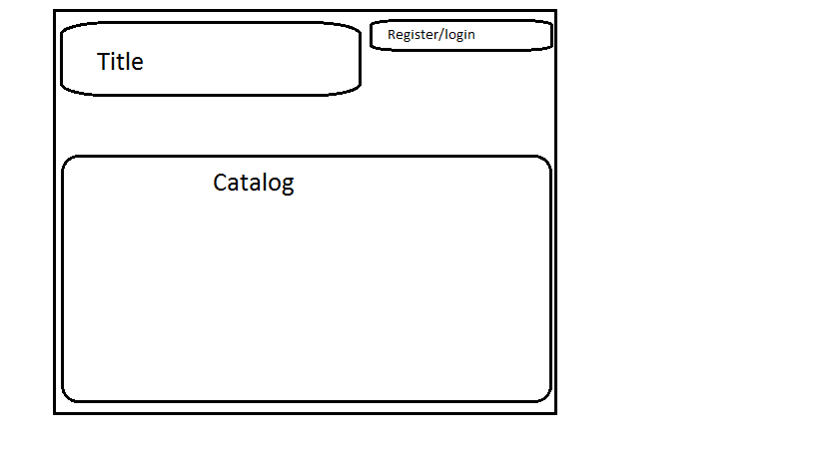
Home screen for unregistered customers

Slide 15
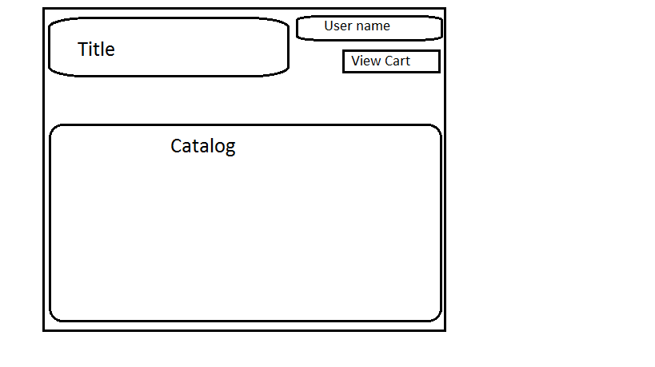
Home screen for registered customers

Slide 16
Product specifications
We will provide a wide variety of products
We will classify our products based on different occasions, events, special persons, types of flowers
Customers can customize their orders using existing decoration items (eg. ribbon, vase)

Slide 17



Select from various types of flowers-

Slide 18



Select for various occasions/events
Birthday
Propose
Get well soon

Slide 19



Decoration Items
Vase
Ribbon

Slide 20
Database Requirements
Customer - keep customer info like user id, email, password, contact number etc. in our database customer table.
Administrator - keep admin info like admin id, email, password, contact number etc. in our database admin table.
Product - Information about the products.
Shopping Cart - Stores customers selected items.
Order -Products that will be purchased stored here.
Payment – Cash on delivery.

Slide 21
Limitations
Our site does not allow global trading
Our site does not have any comment sections
We will include these options in our future extensions

Slide 22
Future Extensions
Add product reviews option.
Implement predictable search option.
Improve sites security system.

Slide 23

Conclusion
We will try to develop the site according to the mentioned functionalities
We will focus on providing a user friendly atmosphere.

Slide 24

Thank you

