Slide 1
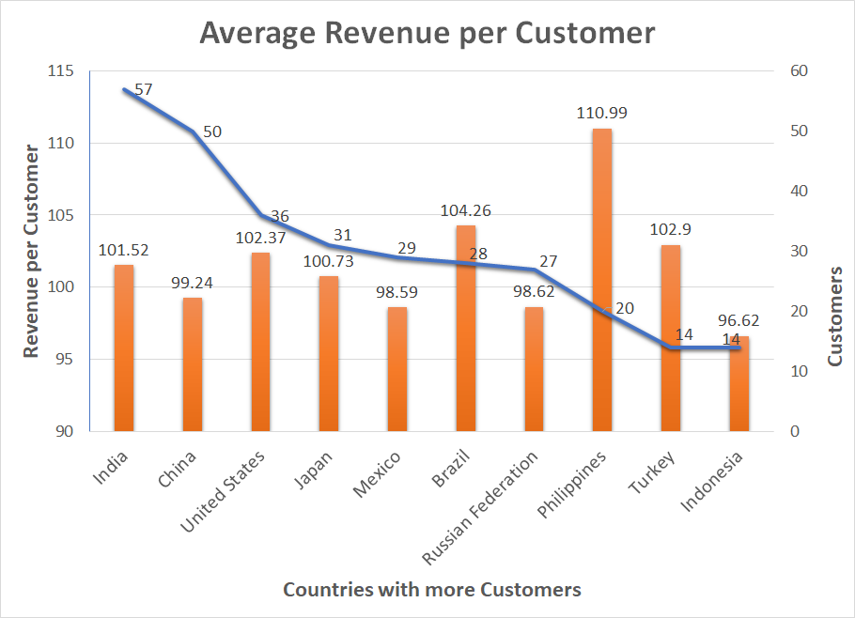
What is the average revenue per customer in the 10 countries with more active customers?
In this slide we can see the number of customers and the total payment received per customer. It is shown for the 10 countries with more customers.

Slide 2
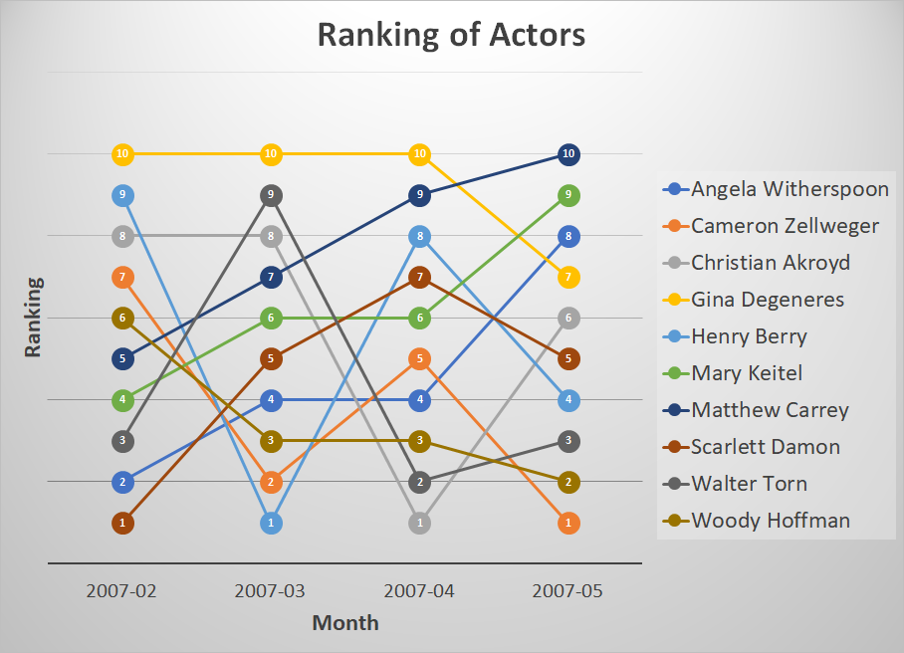
What are the 10 actors with more total payment amount?
And what is the evolution of these actors along the months?
For the 10 actors who generate more revenue, we can see their evolution from 1 to 10 in each month.
Mathew Carrey has increased the amount of payments, but Woody Hoffman has been losing positions.

Slide 3
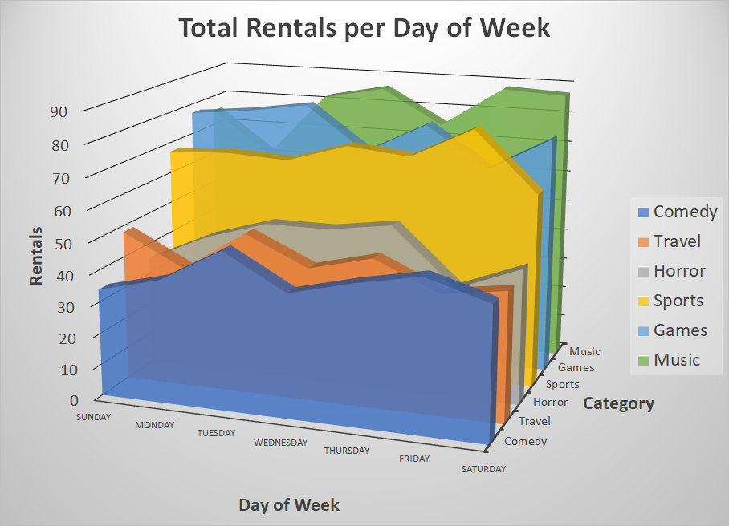
Number of rentals per day of week for the three categories with more and less rentals.
We can see in which day of the week, each one of this six categories, has more rentals. The result is filtered for films with rating NC-17 or R.
For example, Music has more rentals at the end of the week, and games has more rentals at the start of the week.

Slide 4
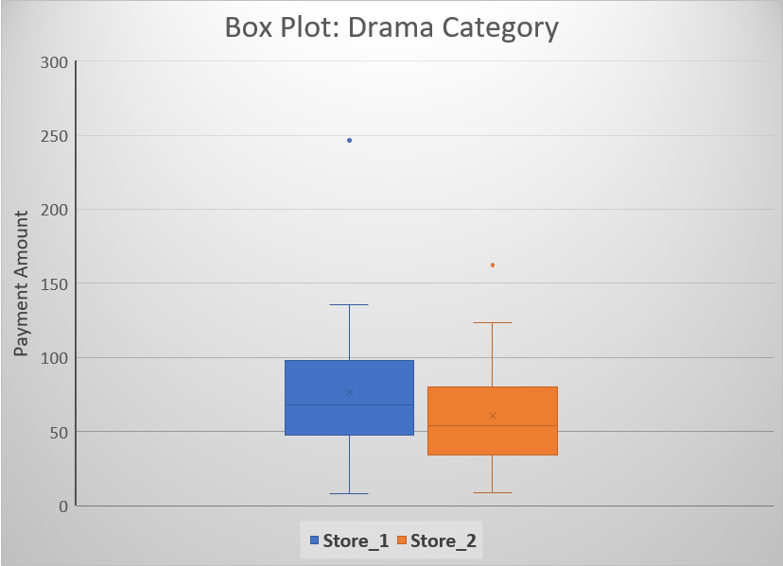
Box Plot comparison for Drama Category between the two stores.
Drama is the category with the biggest difference of payments amount in the two stores.
We can compare the quartile values for each store on this category. We can see also two outliers that can distort the total results.

