Slide 1
EWE Tech Week Montreal
Live Coding
SpringBoot & Netflix & Jhipster
Micro Services platform
Avril 2015

Slide 2
Agenda
Code
Code
Code
With short presentations

Slide 3
What do we need?
Java 8
Maven
Git
Node JS (https://nodejs.org/)
Install Yeoman “npm install –g yo”
Install Bower “npm install –g bower”
Install Jhipster “npm install –g generator-jhipster”

Slide 4
What are micro-services?
... an approach to developing a single application as a suite of small services, each running in its own process and communicating with lightweight mechanisms, often an HTTP resource API.
http://martinfowler.com/articles/microservices.html

Slide 5
What are the characteristics?
Each service must be a small part of the entire system
Each service must run in its own process
Lightweight protocol communications (Rest api)
Global configurations management
Global registry services management

Slide 6

What we will build today?
The “hotel management” micro services system
Aggregator
Search Agent

Slide 7







What is the stack?
Infrastructure
Spring Cloud
Config Server
Netflix Client
Spring Boot
Netflix Eureka
Registry & Configuration Servers
Spring Boot
Micro services
communication
Netflix Feign + Ribbon
Netflix Zuul + Ribbon
Spring Boot
Spring Boot
Aggregator

Slide 8

Let’s do coding?

Slide 9
Create the main folder?
Create the project’s folder
mkdir hotelManagement
cd hotelManagement

Slide 10
BUILD INFRASTRUCTURE
SERVICE REGISTRY & GLOBAL CONFIGURATION SERVICE

Slide 11
BUILD INFRASTRUCTURE
SERVICE REGISTRY (NETFLIX EUREKA)
Notes:
The main part of a microservices architecture
There are several other service registry platform (http://jasonwilder.com/blog/2014/02/04/service-discovery-in-the-cloud/)
Consul, Zookeper are two of them

Slide 12
Goals
Make in place a Service Registry & Discovery Service
Start Eureka as an embedded server

Slide 13
Let’s do it!!!
We will use http://start.spring.io/
Integrated with Intellij 14.1
Spring Tool Suite 3.6.4
Create the Registry Service
Name: Registry Service
Type: Maven
Packaging: Jar
Java Version: 1.8
Language: Java
Group: com.expedia.livecoding.mtl.service
Artifact: registry-service
Version: 0.0.1-SNAPSHOT
Description: Hotel Management - Registry Service
Package: com.expedia.livecoding.mtl.service.registry
Notes:
Open the browser on http://start.spring.io
Try curl http://start.spring.io

Slide 14
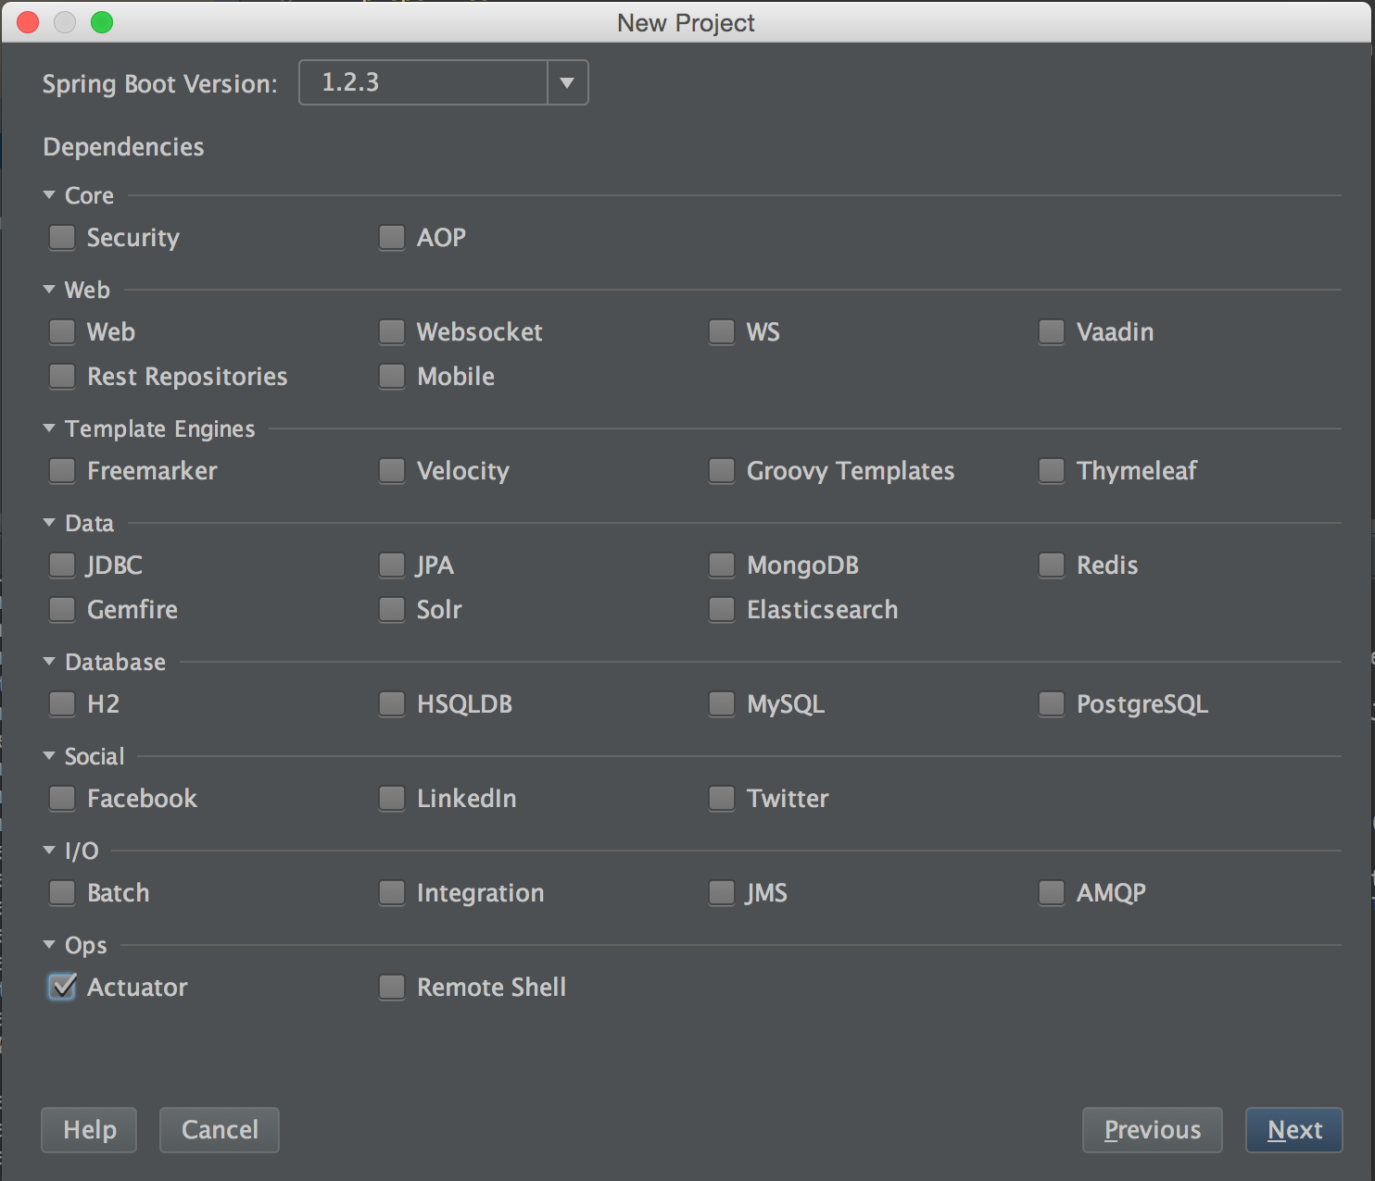
Let’s do it – cont.
Create the Registry Service – cont.
Spring Boot Version: 1.2.3
Select: Actuator

Slide 15
Configure the Eureka Server
Update the pom.xml
Add a new dependency management section
<dependencyManagement> <dependencies> <dependency> <groupId>org.springframework.cloud</groupId> <artifactId>spring-cloud-starter</artifactId> <version>1.0.0.RELEASE</version> <type>pom</type> <scope>import</scope> </dependency> </dependencies> </dependencyManagement>
Add new dependencies
<dependency> <groupId>org.springframework.cloud</groupId> <artifactId>spring-cloud-starter-eureka-server</artifactId> </dependency> <dependency> <groupId>org.springframework.cloud</groupId> <artifactId>spring-cloud-starter-hystrix</artifactId> </dependency>

Slide 16
Configure the Eureka Server – cont.
Rename the application.properties file to application.yml because yml is more fun ;) with the following content
server: port: 8761 eureka: client: registerWithEureka: false fetchRegistry: false
Update the RegistryServiceApplication.java
Add the @EnableEurekaServer annotation on the class
Notes:
@SpringCloudApplication is a meta-annotation used to read the config from the server
@SpringBootApplication @EnableDiscoveryClient used to connect with eureka and discovers services @EnableCircuitBreaker used by hystrix to manage failover

Slide 17
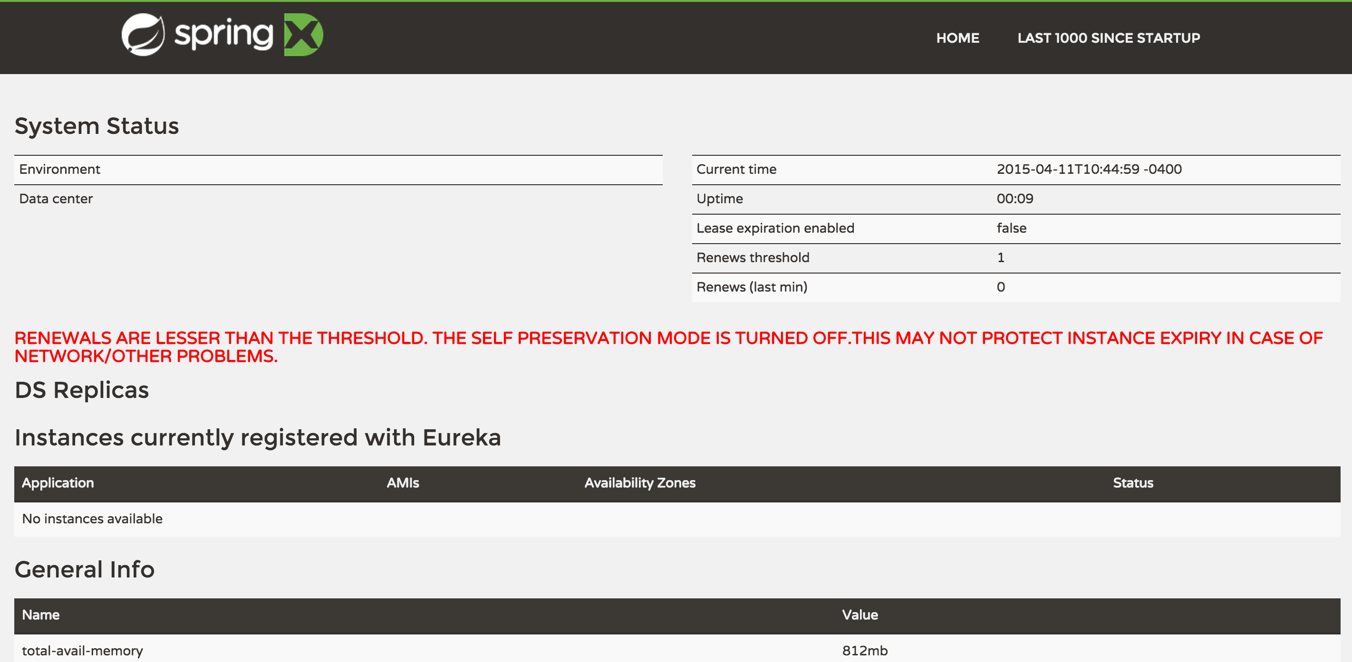
Check the Eureka Server
http://localhost:8761/
Notes:
https://github.com/Netflix/eureka/wiki/Eureka-REST-operations
Query for all instances GET http://localhost:8761/eureka/apps HTTP Code: 200 on success Output: JSON/XML
Query for all appID instances GET http://localhost:8761/apps/appID HTTP Code: 200 on success Output: JSON/XML
Query for a specific appID/instanceID GET http://localhost:8761/apps/appID/instanceID HTTP Code: 200 on success Output: JSON/XML
Query for a specific instanceID GET http://localhost:8761/instances/instanceID HTTP Code: 200 on success Output: JSON/XML

Slide 18
BUILD INFRASTRUCTURE
GLOBAL CONFIGURATION SERVICE
Notes:
http://cloud.spring.io/spring-cloud-config/
Spring Cloud Config provides server and client-side support for externalized configuration in a distributed system.
With the Config Server you have a central place to manage external properties for applications across all environments.

Slide 19
Goals
Centralize all configurations in a unique place
Git, SVN, local file are supported
Encrypt/Decrypt property values

Slide 20
Let’s do it!!!
Create the Configuration Service
Name: Configuration Service
Type: Maven
Packaging: Jar
Java Version: 1.8
Language: Java
Group: com.expedia.livecoding.mtl.service
Artifact: configuration-service
Version: 0.0.1-SNAPSHOT
Description: Hotel Management - Configuration Service
Package: com.expedia.livecoding.mtl.service.configuration

Slide 21
Let’s do it – cont.
Create the Configuration Service – cont.
Spring Boot Version: 1.2.3
Select: Actuator

Slide 22
Configure the Configuration Server
Update the pom.xml
Add a new dependency management section
<dependencyManagement> <dependencies> <dependency> <groupId>org.springframework.cloud</groupId> <artifactId>spring-cloud-starter</artifactId> <version>1.0.0.RELEASE</version> <type>pom</type> <scope>import</scope> </dependency> </dependencies> </dependencyManagement>
Add new dependency
<dependency> <groupId>org.springframework.cloud</groupId> <artifactId>spring-cloud-config-server</artifactId> </dependency>
<dependency> <groupId>org.springframework.cloud</groupId> <artifactId>spring-cloud-starter-eureka</artifactId> </dependency>
<dependency> <groupId>org.springframework.cloud</groupId> <artifactId>spring-cloud-starter-hystrix</artifactId> </dependency>

Slide 23
Configure the Configuration Server – cont.
Add a bootstrap.yml file
spring: application: name: configuration-service info: name: Configuration Service description: Configuration Service Server version: ${project.version}
Update the pom.xml
<build>
…
<resources> <resource> <filtering>true</filtering> <directory>src/main/resources</directory> </resource> </resources>
…
</build>
Notes:
Local git will be used to save all configurations

Slide 24
Configure the Configuration Server – cont.
Rename the application.properties file to application.yml because yml is more fun ;) with the following content
server: port: 8888 spring: cloud: config: server: git: uri: file://${HOME}/livecoding-config
eureka: instance: leaseRenewalIntervalInSeconds: 5
client: serviceUrl: defaultZone: http://localhost:8761/eureka/
Update the ConfigurationServiceApplication.java
Add @EnableConfigServer and @EnableEurekaClient annotations on the class
Notes:
Local git will be used to save all configurations
leaseRenewalIntervalInSeconds
By default the client registers itself each 30sec. Change to 5 secs to speed up the time to register the client against the server

Slide 25
How do we manage the configuration files using git?
Initialize the git repository to save all configurations
» mkdir ~/livecoding-config
» cd ~/livecoding-config
» git init
Create our first config
Here one of the available format
/{application}-{profile}.yml
» vi test.yml
message: This message is managed by Spring Cloud Config Server
» git add test.yml
» git commit –m “our first config file”
Check if it works
Open the url at http://localhost:8888/test/env
Notes:
Check eureka – http://localhost:8761
Check config server is running
http://localhost:8888/test/dev
http://localhost:8888/test/master
Create a new branch
git branch –b projectX
Update the text.yml properties
http://localhost:8888/test/master/projectX
Make this branch as the default
spring: cloud: config: server: git: uri: file://${HOME}/livecoding-config defaultLabel: projectX

Slide 26
How do we use Encrypt & Decrypt?
Use the configuration management tool to encrypt any values like password
If a value start with {cypher}, the value will be decrypted before sending to the client
How it works?
Encrypt a password
» curl localhost:8888/encrypt -d passwordToEncrypt
{"description":"No key was installed for encryption service","status":"NO_KEY"}
How to set the key?
Update the bootstrap.yml
encrypt: key: thisIsMyKeyToEncrypt
Notes:
Centralized configuration management requires strong cryptographic algorithms for encrypting keys. Install Java JCE US for Oracle JDK: for Java 7 and Java 8.
Please pay attention where the new jars are places. It should be $JAVA_HOME/jre/lib/security (not directly in lib/security for JDK).
http://www.oracle.com/technetwork/java/javase/downloads/jce8-download-2133166.html

Slide 27
Encrypt & Decrypt feature? – cont
Try to encrypt a value?
» curl http://localhost:8888/encrypt -d passwordToEncrypt
» 0e9aa5cab9a29dafb72e1840d37c5ce1ff5d63166f7b68e5547d62facb1a0caff159c63be 6b265294b0375be24547b3a
Try to decrypt a value?
» curl localhost:8888/decrypt -d 0e9aa5cab9a29dafb72e1840d37c5ce1ff5d63166f7b68e5547d62facb1a0caff159c63be6b265294b0375be24547b3a
» passwordToEncrypt
Notes:
Add the following line in the properties
password: '{cipher}2091ca6a9cd7fe4f94e7c8cccea556352e67f94a4a832d0eaaf738eb04dfe6eff0371e2f097b3faf4be558fffbfb40bc’
And you will see it is decrypted - http://localhost:8888/test/dev
The service needs to be protected by any credentials (Spring Security)

Slide 28

What have been done?
Infrastructure
Spring Cloud
Config Server
Spring Boot
Netflix Eureka
Registry & Configuration Servers

Slide 29
BUILD
CONTENT GENERATOR SERVICE

Slide 30
Goals
Generate dynamically all the contents for an hotel
Name
Address
Description
Make this generated hotels available through a rest API
Register this service to eureka

Slide 31
Let’s do it!!!
Create the Content Generator Service
Name: Content Generator Service
Type: Maven
Packaging: Jar
Java Version: 1.8
Language: Java
Group: com.expedia.livecoding.mtl.service
Artifact: content-generator-service
Version: 0.0.1-SNAPSHOT
Description: Hotel Management – Content Generator Service
Package: com.expedia.livecoding.mtl.service.contentgeneratorservice

Slide 32
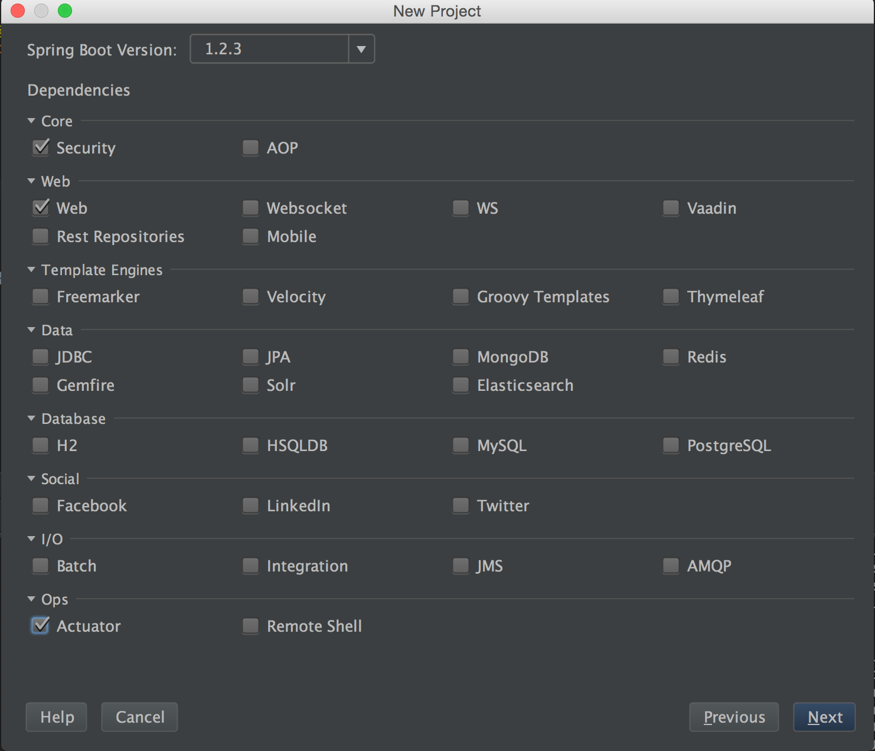
Let’s do it – cont.
Create the Content Generator Service – cont.
Spring Boot Version: 1.2.3
Select: Actuator, Security and Web

Slide 33
Configure the Content Generator Service
Update the pom.xml
Add a new dependency management
<dependencyManagement> <dependencies> <dependency> <groupId>org.springframework.cloud</groupId> <artifactId>spring-cloud-starter</artifactId> <version>1.0.0.RELEASE</version> <type>pom</type> <scope>import</scope> </dependency> </dependencies> </dependencyManagement>

Slide 34
Configure the Content Generator Service – cont.
Update the pom.xml – cont.
Add a dependency to include eureka spring cloud library
<dependency> <groupId>org.springframework.cloud</groupId> <artifactId>spring-cloud-starter-eureka</artifactId> </dependency>
<dependency> <groupId>org.springframework.cloud</groupId> <artifactId>spring-cloud-config-client</artifactId> </dependency> <dependency> <groupId>org.springframework.cloud</groupId> <artifactId>spring-cloud-starter-hystrix</artifactId> </dependency>
<build>
<resources> <resource> <directory>src/main/resources</directory> </resource> </resources>
…
</build>

Slide 35
Configure the Content Generator Service – cont.
Delete the application.properties file
Add a bootstrap.yml file
# Name of the service registered in Eureka Server spring: application: name: content-generator-service
cloud: discovery: enabled: true serviceId: configuration-service
eureka:
client: serviceUrl: defaultZone: http://127.0.0.1:8761/eureka/
# Info displayed by spring boot when calling /info
info: name: ${project.name} description: ${project.description}
version: ${project.version}
Notes:
The bootstrap.yml defines the name of the service that will be registered against the Eureka server
and the info of the service

Slide 36
Add a new content-generator-service.yml file to the config server?
Create a new content-generator-service.yml file
» vi ~/livecoding-config/content-generator-service.yml
With the following content
server: port: 9000
security:
user:
name: admin
password: admin
eureka:
instance:
leaseRenewalIntervalInSeconds: 5
hostname: localhost
Update the ContentGeneratorServiceApplication.java
Replace @SpringBootApplication by @SpringCloudApplication
Notes:
This service will run on the port 9000

Slide 37
Let’s do the search rest API?
Create a new Rest Service to return a list of hotel
Tips:
An hotel is defined by:
Name
Description
Address
City
PostalCode
State
Country
@RestController should be used on top of a class
@RequestMapping should be used on top of a method
Lorem lipsum library used to generate content
<dependency>
<groupId>net._01001111</groupId>
<artifactId>jlorem</artifactId>
<version>1.1</version>
</dependency>

Slide 38
Let’s do the search rest API? – cont.
Create a new Rest Service to return a list of hotel
Solution:
@RestController public class ContentGeneratorResource { @HystrixCommand(groupKey = "content-generator-service") @RequestMapping(value = "/", method = RequestMethod.GET, produces = MediaType.APPLICATION_JSON_VALUE) public ResponseEntity<List<Hotel>> getAll() { LoremIpsum jlorem = new LoremIpsum(); final List<Hotel> hotels = IntStream.range(1, 5).mapToObj(i -> { Hotel hotel = new Hotel(); hotel.setName(jlorem.randomWord()); hotel.setAddress(jlorem.sentence()); hotel.setDescription(jlorem.paragraphs(2)); hotel.setCity("Montreal"); hotel.setPostalCode("AAAAA"); hotel.setState("Quebec"); hotel.setCountry("Canada"); return hotel; }).collect(Collectors.toList()); return ResponseEntity.ok(hotels); } }

Slide 39
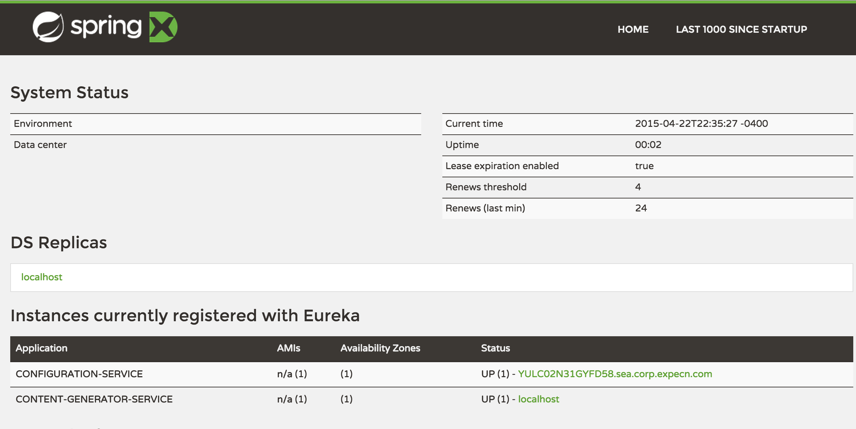
Check the eureka server
http://localhost:8761/ - The CONTENT-GENERATOR-SERVICE is registered
Notes:
Update the resources
<resources> <resource> <directory>src/main/resources</directory> <filtering>true</filtering> <includes> <include>**/*.yml</include> <include>**/*.xml</include> </includes> </resource>

Slide 40
What have been done?
Infrastructure
Spring Cloud
Config Server
Netflix Client
Spring Boot
Netflix Eureka
Spring Boot
Registry & Configuration Servers
Notes:
How can we register the admin to use the registry and the configuration servers

Slide 41
BUILD
AGGREGATOR SERVICE

Slide 42
Goals
Aggregates the list of hotels from each admin site
Retrieve the list of hotels at a fixed delay
Cache the list of hotels
Provides a search rest interface API

Slide 43
Let’s do it!!!
Create the Aggregator Service
Name: Aggregator Service
Type: Maven
Packaging: Jar
Java Version: 1.8
Language: Java
Group: com.expedia.livecoding.mtl.service
Artifact: aggregator-service
Version: 0.0.1-SNAPSHOT
Description: Hotel Management - Aggregator Service
Package: com.expedia.livecoding.mtl.service.aggregator

Slide 44
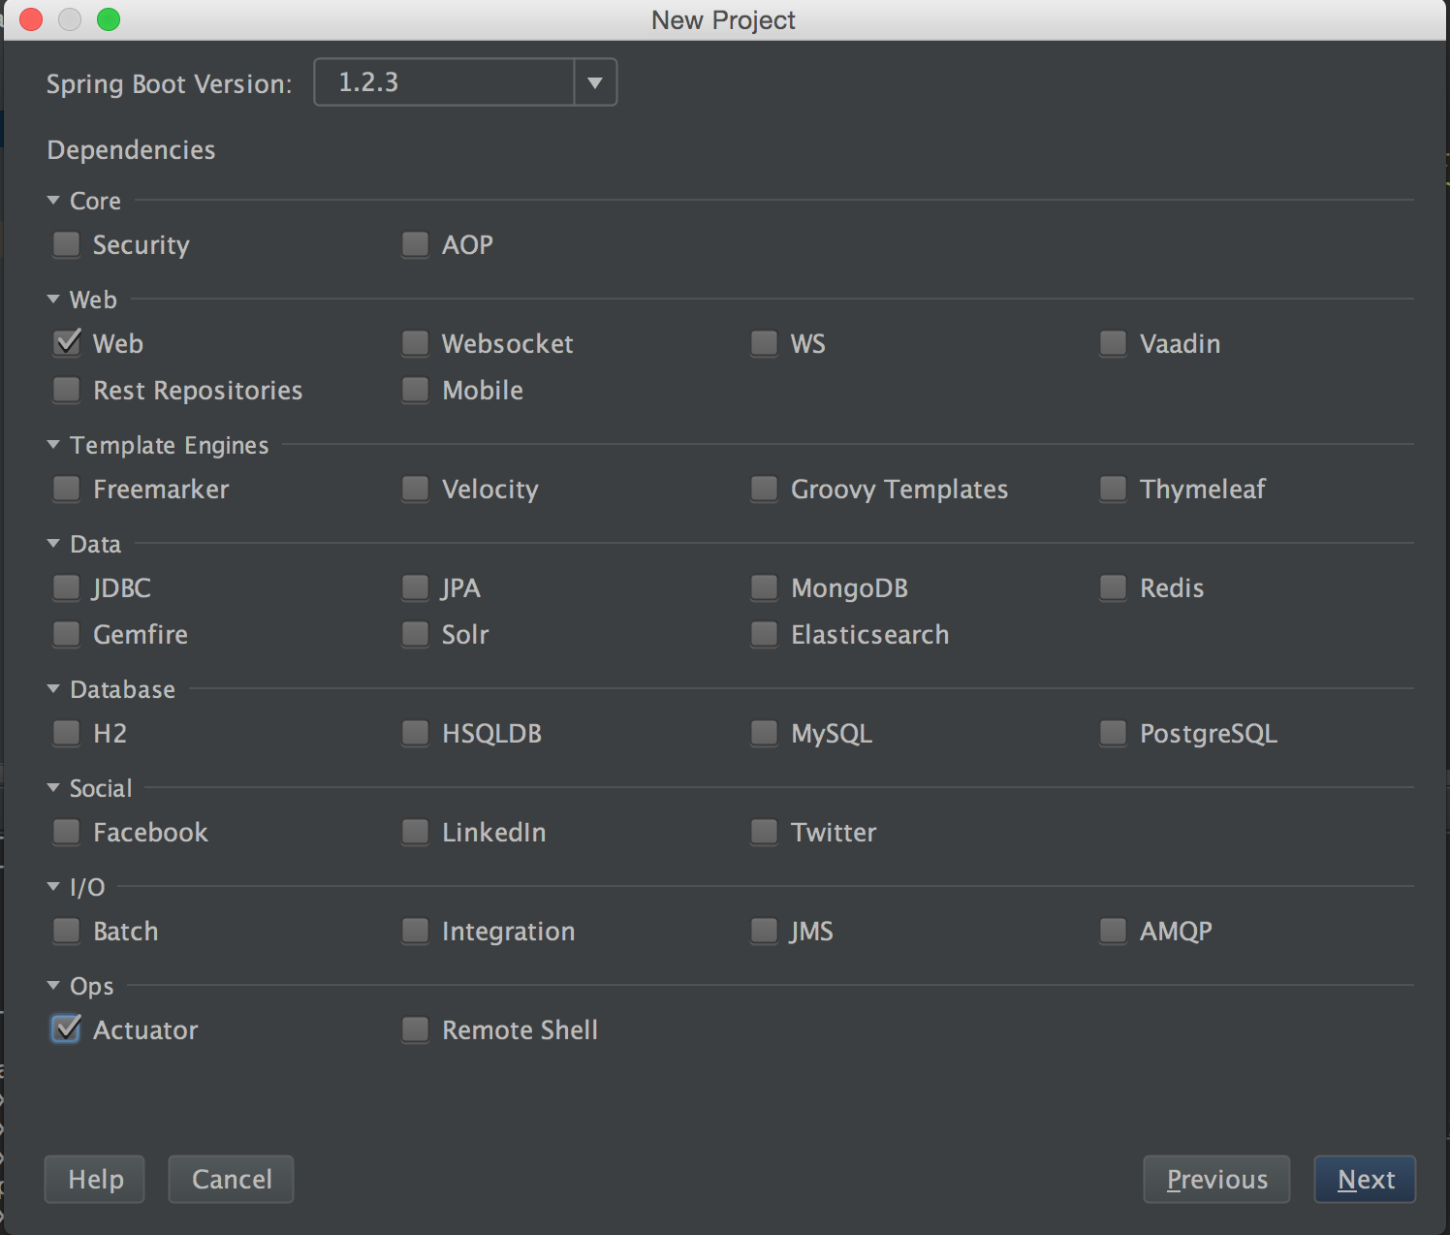
Let’s do it – cont.
Create the Aggregator Service – cont.
Spring Boot Version: 1.2.3
Select: Web and Actuator

Slide 45
Configure the Aggregator Service
Update the pom.xml
Add a new dependency management
<dependencyManagement> <dependencies> <dependency> <groupId>org.springframework.cloud</groupId> <artifactId>spring-cloud-starter</artifactId> <version>1.0.0.RELEASE</version> <type>pom</type> <scope>import</scope> </dependency> </dependencies> </dependencyManagement>

Slide 46
Configure the Aggregator Service – cont.
Update the pom.xml – cont.
Add a dependency to include eureka spring cloud library
<dependency> <groupId>org.springframework.cloud</groupId> <artifactId>spring-cloud-starter-eureka</artifactId> </dependency>
<dependency> <groupId>org.springframework.cloud</groupId> <artifactId>spring-cloud-config-client</artifactId> </dependency> <dependency> <groupId>org.springframework.cloud</groupId> <artifactId>spring-cloud-starter-hystrix</artifactId> </dependency>
<build>
<resources> <resource> <directory>src/main/resources</directory> </resource> </resources>
…
</build>

Slide 47
Configure the Aggregator Service – cont.
Delete the application.properties file
Add a bootstrap.yml file
# Name of the service registered in Eureka Server spring: application: name: aggregator-service
cloud: discovery: enabled: true serviceId: configuration-service
eureka:
client: serviceUrl: defaultZone: http://127.0.0.1:8761/eureka/
# Info displayed by spring boot when calling /info
info: name: ${project.name} description: ${project.description}
version: ${project.version}
Notes:
The bootstrap.yml defines the name of the service that will be registered against the Eureka server
and the info of the service

Slide 48
Add a new aggregator-service.yml file to the config server?
Create a new aggregator-service.yml file
» vi ~/livecoding-config/aggregator-service.yml
With the following content
server: port: 9000
eureka:
instance:
leaseRenewalIntervalInSeconds: 5
hostname: localhost
Update the AggregatorServiceApplication.java
Replace @SpringBootApplication by @SpringCloudApplication
Notes:
This service will run on the port 9000

Slide 49
How do we discovery services?
Find a way to list the available services registered in Eureka
Tips:
Use the DiscoveryClient to retrieve the list of available services
Use the CommandLineRunner interface in the main class
Solution
@SpringCloudApplication public class AggregatorServiceApplication { public static void main(String[] args) { SpringApplication.run(AggregatorServiceApplication.class, args); }
@Bean CommandLineRunner displayServices(DiscoveryClient discoveryClient) { return args -> discoveryClient.getServices().forEach(System.out::println); }
}

Slide 50
How do we manage scheduled tasks?
Create a new AggregatorHotelService class service to schedule each 10 seconds a call to retrieve the list of available “admin-service” services.
Tips:
@EnableScheduling annotation
@Scheduled annotation
Solution
@Service public class AggregateHotelService { @Autowired private DiscoveryClient discoveryClient; @Scheduled(fixedDelay = 10000) public void aggregate() { discoveryClient.getInstances("admin-service").stream() .forEach(s -> { System.out.println("*******************"); System.out.println(s.getHost()); System.out.println(s.getPort()); System.out.println(s.getUri()); System.out.println(s.getServiceId()); System.out.println("*******************"); } ); } }

Slide 51
How do we call method on services?
We will use Netflix Feign
Spring Cloud supports feign
<dependency> <groupId>org.springframework.cloud</groupId> <artifactId>spring-cloud-starter-feign</artifactId> </dependency>
<!– Use to encode and to decode the request/response -->
<dependency> <groupId>com.netflix.feign</groupId> <artifactId>feign-gson</artifactId> <version>7.1.0</version> </dependency>
Notes:
Feign is a declarative web interface definition
Annotate through interface
Encoder/decoder

Slide 52
How do we call method on services? – cont.
We will use Netflix Feign
Define an interface to interact with the admin-service to retrieve the list of hotels
Tips:
Here is an example to interact with Github
interface GitHub {
@RequestLine("GET /repos/{owner}/{repo}/contributors")
List<Contributor> contributors(@Param("owner") String owner,
@Param("repo") String repo);
}
Solution:
public interface AdminServiceClient { @RequestLine("GET /api/hotels") List<Hotel> getHotels(); }
Notes:
Feign is a declarative web interface definition
Annotate through interface
Encoder/decoder
Copy the com.expedia.livecoding.mtl.admin.domain.Hotel object from the admin client

Slide 53
How do we call method on services? – cont.
We will use Netflix Feign
How to let feign to use the new interface?
Tips:
Use Feign.builder()
Build the url used by the builder from the discoveryClient instance
Enhance the AggregateHotelService class
Solution:
@Scheduled(fixedDelay = 10000) public void aggregate() { discoveryClient.getInstances("admin-service").stream() .forEach(s -> {
AdminServiceClient adminServiceClient = retrieveAdminServiceClient(s); adminServiceClient.getHotels().forEach(System.out::println);
} ); } private AdminServiceClient retrieveAdminServiceClient(ServiceInstance serviceInstance) { return Feign.builder() .encoder(new GsonEncoder()) .decoder(new GsonDecoder()) .target(AdminServiceClient.class, s.getUri().toString()); }
Notes:
Feign is a declarative web interface definition
Annotate through interface
Encoder/decoder

Slide 54
How do we call method on services? – cont.
We will use Netflix Feign
How to let feign to use the new interface? – cont.
Issue:
An Unauthorized exception is thrown. Why?
feign.FeignException: status 401 reading AdminServiceClient#getHotels(); content:
{"timestamp":1429757460485,"status":401,"error":"Unauthorized","message":"Full authentication is required to access this resource","path":"/hotels"}
at feign.FeignException.errorStatus(FeignException.java:39)
at feign.codec.ErrorDecoder$Default.decode(ErrorDecoder.java:87)
at feign.SynchronousMethodHandler.executeAndDecode(SynchronousMethodHandler.java:144)
at feign.SynchronousMethodHandler.invoke(SynchronousMethodHandler.java:96)
at feign.ReflectiveFeign$FeignInvocationHandler.invoke(ReflectiveFeign.java:92)
at com.sun.proxy.$Proxy80.getHotels(Unknown Source)
at com.expedia.livecoding.mtl.service.aggregator.AggregateHotelService.lambda$aggregate$0(AggregateHotelService.java:30)
/api is protected - @see SecurityConfiguration in the admin service project
How to fix it?
Tips:
RequestInterceptor interface used to inject the basic authentication
BasicAuthRequestInterceptor is included out of the box
Notes:
Feign is a declarative web interface definition
Annotate through interface
Encoder/decoder

Slide 55
How do we fix the unauthorized exception?
Solution: - cont.
private AdminServiceClient retrieveAdminServiceClient(ServiceInstance serviceInstance) { return Feign.builder() .encoder(new GsonEncoder()) .decoder(new GsonDecoder())
.requestInterceptor(new BasicAuthRequestInterceptor("admin", "admin")) .target(AdminServiceClient.class, s.getUri().toString()); }

Slide 56
Let’s do the search rest API?
Cache the list of hotels and create a rest API to search hotels
Tips:
Admin client contains a tons of rest API
Use guava to create a cache of the hotels
Solution:
// In the AggregatorServiceApplication class
// Create a simple cache
@Bean public Cache<String, Hotel> cache() { return CacheBuilder.newBuilder().build(); }
// In the AggregateHotelService class
@Autowired private Cache<String, Hotel> hotelCache;
@Scheduled(fixedDelay = 30000) public void aggregate() { hotelCache.invalidateAll();
discoveryClient.getInstances("admin-service").stream() .forEach(s -> {
AdminServiceClient adminServiceClient = retrieveAdminServiceClient(s); adminServiceClient.getHotels()
.forEach(hotel -> hotelCache.put(hotel.getName(), hotel);
} ); }

Slide 57
Let’s do the search rest API? – cont.
Cache the list of hotels and create a rest API to search hotels by name – cont.
Solution:
@RestController public class AggregatorResource { @Autowired private Cache<String, Hotel> hotelCache; @RequestMapping(value = "/searchByName/{name}", method = RequestMethod.GET, produces = MediaType.APPLICATION_JSON_VALUE) public ResponseEntity<List<Hotel>> searchByName(@PathVariable String name) { final List<Hotel> hotels = hotelCache.asMap().values().stream() .filter(hotel -> hotel.getName().contains(name)) .collect(Collectors.toList()); return ResponseEntity.ok(hotels); } }

Slide 58
What has been done?
Infrastructure
Spring Cloud
Config Server
Netflix Client
Spring Boot
Netflix Eureka
Spring Boot
Registry & Configuration Servers
Netflix Feign + Ribbon
Spring Boot
Aggregator

Slide 59
BUILD
SEARCH HOTEL CLIENT SITE

Slide 60
Goals
Create a Web Site to search hotel
Search hotels using aggregator service

Slide 61
Let’s do it!!!
Create the Search Client
Name: Search Client
Type: Maven
Packaging: Jar
Java Version: 1.8
Language: Java
Group: com.expedia.livecoding.mtl.client
Artifact: search-client
Version: 0.0.1-SNAPSHOT
Description: Hotel Management – Search Client
Package: com.expedia.livecoding.mtl.client.search

Slide 62
Let’s do it – cont.
Create the Aggregator Service – cont.
Spring Boot Version: 1.2.3
Select: Web and Actuator

Slide 63
Configure the Search Client Website
Update the pom.xml
Modify the spring-boot-maven-plugin
<dependencyManagement> <dependencies> <dependency> <groupId>org.springframework.cloud</groupId> <artifactId>spring-cloud-starter</artifactId> <version>1.0.0.RELEASE</version> <type>pom</type> <scope>import</scope> </dependency> </dependencies> </dependencyManagement>

Slide 64
Configure the Search Client Website – cont.
Update the pom.xml – cont.
Add dependencies
<dependency> <groupId>org.springframework.cloud</groupId> <artifactId>spring-cloud-starter-eureka</artifactId> </dependency>
<dependency> <groupId>org.springframework.cloud</groupId> <artifactId>spring-cloud-config-client</artifactId> </dependency>
<dependency> <groupId>org.springframework.cloud</groupId> <artifactId>spring-cloud-starter-hystrix</artifactId> </dependency>
<dependency> <groupId>org.springframework.cloud</groupId> <artifactId>spring-cloud-starter-zuul</artifactId> </dependency>
<build>
<resources> <resource> <directory>src/main/resources</directory> </resource> </resources>
…
</build>

Slide 65
Configure the Search Client Website – cont.
Delete the application.properties file
Add a bootstrap.yml file
# Name of the service registered in Eureka Server spring: application: name: aggregator-service
cloud: discovery: enabled: true serviceId: configuration-service
eureka:
instance: leaseRenewalIntervalInSeconds: 5
client: serviceUrl: defaultZone: http://127.0.0.1:8761/eureka/
# Info displayed by spring boot when calling /info
info: name: ${project.name} description: ${project.description}
version: ${project.version}
Notes:
The bootstrap.yml defines the name of the service that will be registered against the Eureka server
and the info of the service

Slide 66
Add a new search-client-website.yml file to the config server?
Create a new search-client-website.yml file
» vi ~/livecoding-config/search-client-website.yml
With the following content
server:
port: 11000
aggregator-service:
ribbon:
ServerListRefreshInterval: 1000
MaxAutoRetries: 5
MaxAutoRetriesNextServer: 5
OkToRetryOnAllOperations: true
Update the AggregatorServiceApplication.java
Replace @SpringBootApplication by @SpringCloudApplication
Notes:
This service will run on the port 9000
Ribbon configuration
ServerListRefreshInterval: Interval to refresh the server list from the source
MaxAutoRetries: Max number of retries on the same server (excluding the first try) – DEFAULT IS 1
MaxAutoRetriesNextServer: Max number of next servers to retry (excluding the first server) – DEFAULT IS 1
OkToRetryOnAllOperations: Whether all operations can be retried for this client

Slide 67
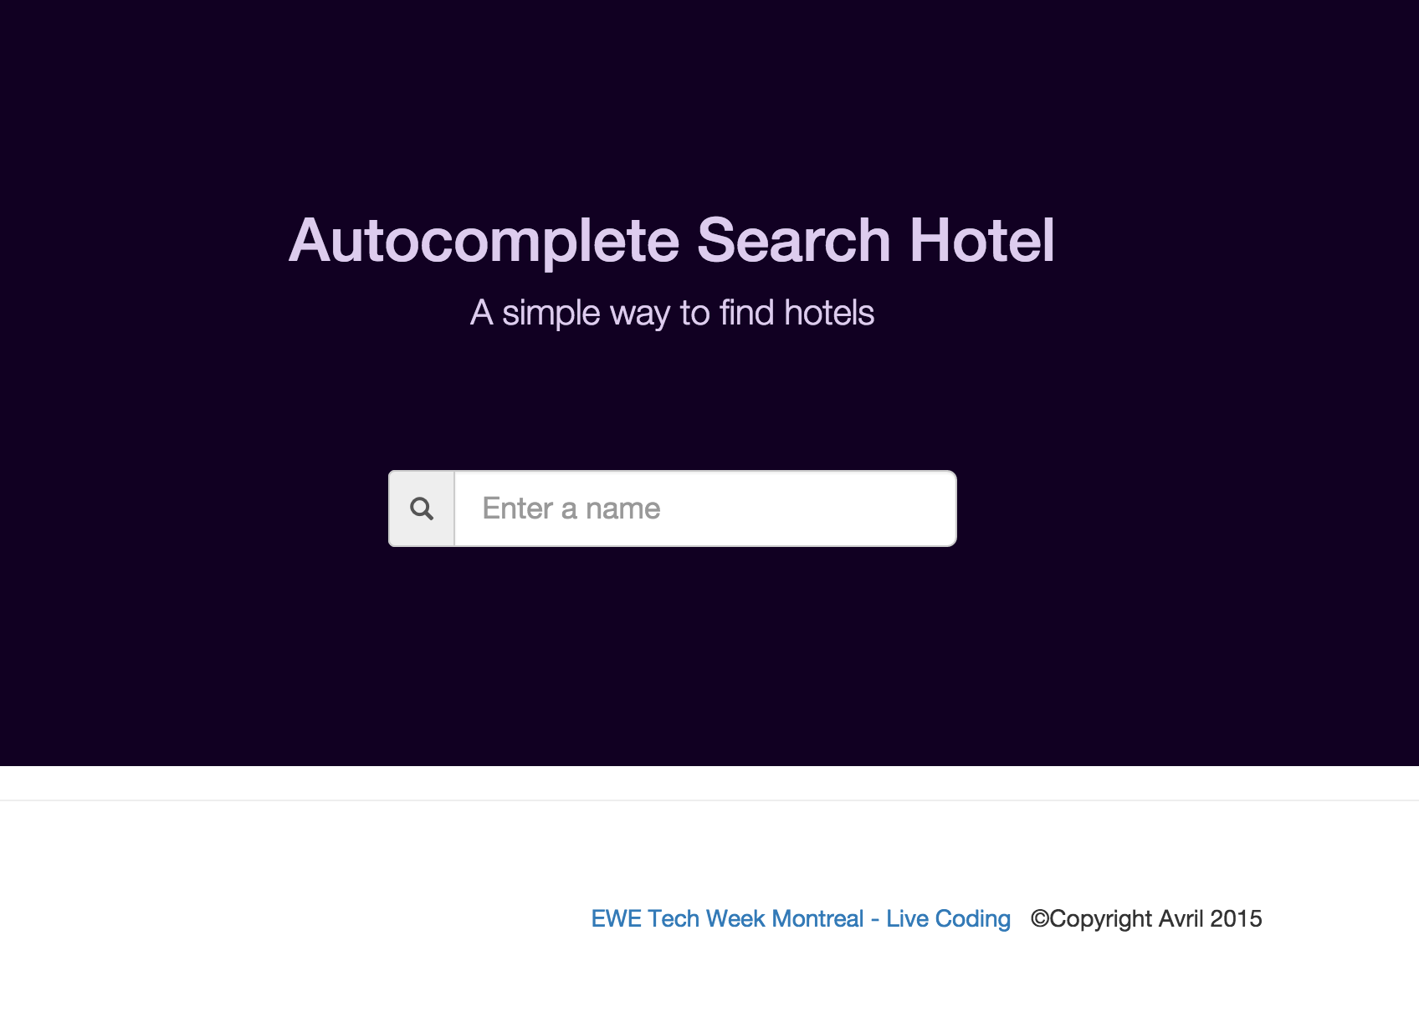
How do we manage static HTML and CSS files?
The HTML and the CSS must be located under the static folder
Download at https://github.com/jmirc/jhipsterlivecoding/blob/master/search-client-css-html.zip

Slide 68
How do we retrieve the list of hotels from the aggregator service
Two solutions are available
Create a copy of the resource class defined in the aggregator service
Use Netflix Zuul
Let’s do with Zuul. Why Zuul?
JVM based router and filter
Reverse proxy feature
Fully programmable rules and filters
Forward requests to the appropriate service - Hystrix -> Ribbon -> Eureka

Slide 69
How do we support Zuul?
Just put the annotation @EnableZuulProxy on the SearchClientWebsiteApplication class
A ZuulController is started to make available all services
2015-04-06 16:06:37.439 INFO 46768 --- [ main] o.s.c.n.zuul.web.ZuulHandlerMapping : Mapped URL path [/search-client-website/**] onto handler of type [class org.springframework.cloud.netflix.zuul.web.ZuulController]
2015-04-06 16:06:37.439 INFO 46768 --- [ main] o.s.c.n.zuul.web.ZuulHandlerMapping : Mapped URL path [/aggregator-service/**] onto handler of type [class org.springframework.cloud.netflix.zuul.web.ZuulController]
2015-04-06 16:06:37.439 INFO 46768 --- [ main] o.s.c.n.zuul.web.ZuulHandlerMapping : Mapped URL path [/admin-service/**] onto handler of type [class org.springframework.cloud.netflix.zuul.web.ZuulController]

Slide 70
What has been done?
Infrastructure
Spring Cloud
Config Server
Netflix Client
Spring Boot
Netflix Eureka
Spring Boot
Registry & Configuration Servers
Netflix Feign + Ribbon
Netflix Zuul + Ribbon
Spring Boot
Spring Boot
Aggregator

Slide 71
ADVANCED FEATURES
EUREKA REPLICA
RELOAD CONFIG / SPRING BEAN
LOAD BALANCING
FAILOVER
MONITORING

Slide 72
How to enable Eureka replica?
Peer to Peer connection
Update the application.yml file of the registry service project
--- spring: profiles: peer1 eureka: instance: hostname: localhost client: registerWithEureka: true fetchRegistry: true serviceUrl: defaultZone: http://localhost2:8762/eureka/ --- spring: profiles: peer2 server: port: 8762 eureka: instance: hostname: localhost2 nonSecurePort: ${server.port} client: serviceUrl: defaultZone: http://localhost:8761/eureka/

Slide 73
How to enable Eureka replica? – cont.
Peer to Peer connection
Start the first eureka server
» mvn spring-boot:run -Drun.jvmArguments="-Dspring.profiles.active=peer1"
Start the second eureka server
» mvn spring-boot:run -Drun.jvmArguments="-Dspring.profiles.active=peer2"
Update the bootstrap.yml of the search-client project
eureka: instance: leaseRenewalIntervalInSeconds: 5 client: serviceUrl: defaultZone: - http://127.0.0.1:8761/eureka/ - http://127.0.0.1:8762/eureka/
Try to call the searchByName rest API
http://localhost:11000/aggregator-service/searchByName?query=R
Notes:
Now try to close both eureka servers. The aggregator service continues to respond
The eureka client keeps a reference of the last list of services even when the eureka servers is down.

Slide 74
Reload Config / Spring Bean refresh
Spring Cloud Config can reload updated properties
curl http://localhost:11000/refresh –d {}
@RefreshScope annotation is used to refresh a spring bean
@RestController class MessageController { @Autowired private MessageService messageService; @RequestMapping(value = "/msg") public String getMessage() { return messageService.getMessage(); } } @RefreshScope @Service class MessageService { @Value("${message:no}") private String message; public String getMessage() { return message; } }

Slide 75
Reload Config / Spring Bean refresh – cont.
Call the new rest service
curl http://localhost:11000/msg
» No is displayed
Add a new message in the search-client.yml file
» vi ~/livecoding-config/search-client.yml
With the following content:
message: Spring Rocks! :)
Refresh the spring config
curl http://localhost:11000/refresh –d {}
» ["message"] is displayed – means this property has been reloaded
Call the new rest service
curl http://localhost:11000/msg
» Spring Rocks! :) is displayed

Slide 76
Load balancing - Ribbon
Support different rules
RoundRobiRule
AvailabilityFilteringRule
WeightedResponseTimeRule
Ribbon is supported by Feign, Zuul, Eureka, Spring RestTemplate
Demo
The Hotel domain will contain a new field named source that will be set with the value of the hostname
@Service public class AggregateHotelService {
@Value("${eureka.instance.hostname}") private String hostname;
…
.forEach(hotel -> { hotel.setSource(hostname); hotelCache.put(hotel.getName(), hotel); });
…
}
Notes:
RoundRobinRule
This rule simply choose servers by round robin. It is often used as the default rule or fallback of more advanced rules.
AvailabilityFilteringRule
This rule will skip servers that are deemed "circuit tripped" or with high concurrent connection count.
By default, an instance is circuit tripped if the RestClient fails to make a connection to it for the last three times. Once an instance is circuit tripped, it will remain in this state for 30 seconds before the circuit is deemed as closed again. However, if it continues to fail connections, it will become "circuit tripped" again and the wait time for it to become "circuit closed" will increase exponentially to the number of consecutive failures.
WeightedResponseTimeRule
For this rule, each server is given a weight according to its average response time. The longer the response time, the less weight it will get. The rule randomly picks a server where the possibility is determined by server's weight.
To enable WeightedResponseTimeRule, set it with the load balancer via API or set the following property

Slide 77
Load balancing – Ribbon – cont.
Demo – cont.
Check if the rest api return the new value
http://localhost:11000/aggregator-service/searchByName?query=R
Add a new instance of the aggregator service
Update the aggregator-service.yml (livecoding-config) with the following content.
---
spring:
profiles: server2 #name of the profile
server:
port: 9001
eureka:
instance:
hostname: localhost2 # need to set in the hosts file
Start a new instance
» cd aggregator-service
» java -jar target/aggregator-service-0.0.1-SNAPSHOT.jar --spring.profiles.active=server2
Check if the instance (localhost2) has been discovered by Eureka
http://localhost:8761
Notes:
Try to reload the URL and the hostname should switch from localhost to localhost2
Try to stop an instance and refresh the search client URL.

Slide 78
Failover - Hystrix
How to support failover when no services are available?
We need to retrieve a fake hotel when the aggregator service doesn’t return any hotels
Demo
Tips
Add @EnableHystrix on the AggregatorServiceApplication class
Use @HystrixCommand on the AggregatorResource class
Return an hotel with pre-defined values when no hotel is returned

Slide 79
Failover – Hystrix – cont.
Demo
Solution
Edit the Aggregator-service project
@HystrixCommand(groupKey = "aggregator-service", fallbackMethod = "defaultHotel") @RequestMapping(value = "/searchByName", method = RequestMethod.GET, produces = MediaType.APPLICATION_JSON_VALUE) public ResponseEntity<List<Hotel>> searchByName(@RequestParam("query") String name) { final List<Hotel> hotels = hotelCache.asMap().values().stream() .filter(hotel -> hotel.getName().contains(name)) .collect(Collectors.toList()); if (hotels.size() == 0) { throw new IllegalArgumentException(); } return ResponseEntity.ok(hotels); } public ResponseEntity<List<Hotel>> defaultHotel(String name) { List<Hotel> hotels = new ArrayList<>(); Hotel hotel = new Hotel(); hotel.setName("Default hotel's name"); hotels.add(hotel); return ResponseEntity.ok(hotels); }

Slide 80
Failover – Hystrix – cont.
Demo
Solution
The http://localhost:9000/searchByName?query=<GOOD> should return a list of hotels
The http://localhost:9000/searchByName?query=<BAD> should return the fake hotel

Slide 81
Monitoring – Hystrix dashboard + turbine
Be able to monitor each service?
Each method using @HystrixCommand annotation is monitored
How do we enable the dashboard?
Open the search-client-website project
Update the pom.xml with new dependencies
<dependency> <groupId>org.springframework.cloud</groupId> <artifactId>spring-cloud-starter-hystrix-dashboard</artifactId> </dependency>
Add @EnableHystrixDashboard annotation

Slide 82
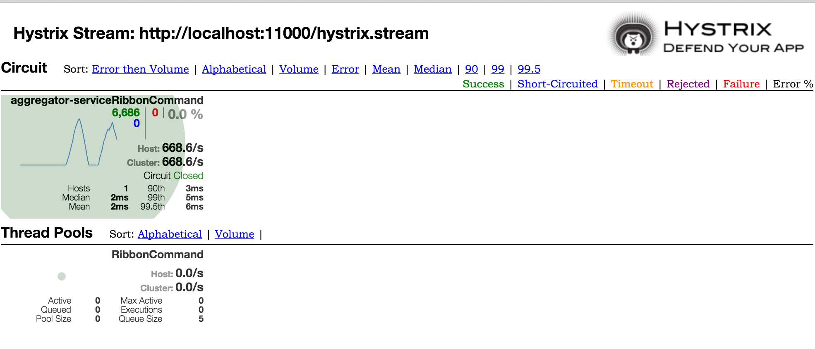
Monitoring – Hystrix dashboard + turbine – cont.
How to access Hystrix dashboard?
http://localhost:11000/hystrix/
Why we are able to see only the search-client-service?
Zuul enables out of the box hystrix on each service.

Slide 83
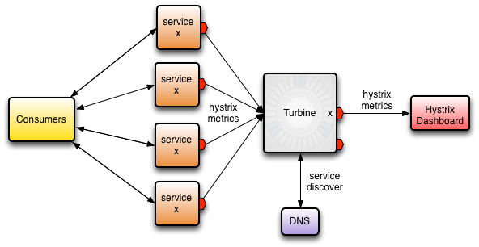
Monitoring – Hystrix dashboard + turbine – cont.
Why the “hotel-getAll” hystrix method is not displayed (Admin-service)?
Should we have an hystrix dashboard by service?
No. So, how can we aggregate all hystrix streams?
Turbine is the solution

Slide 84
Monitoring – Hystrix dashboard + turbine – cont.
How to configure Turbine?
Update the pom.xml with new dependencies
<dependency> <groupId>org.springframework.cloud</groupId> <artifactId>spring-cloud-starter-turbine</artifactId> </dependency>
Update the search-client.yml file on the git repo
turbine:
appConfig: CONTENT-GENERATOR-SERVICE,AGGREGATOR-SERVICE,SEARCH-CLIENT
clusterNameExpression: new String("default")
Add @EnableTurbine annotation
Run a load using ab
ab -n 10000 -c 5 http://localhost:11000/aggregator-service/searchByName\?query\=R
Notes:
Turbine allows to aggregate different services in one unique view

Slide 85
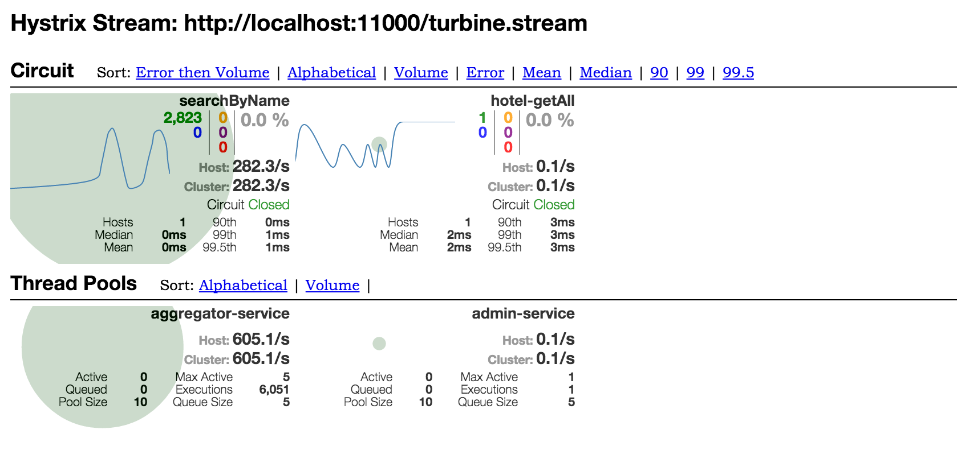
Monitoring – Hystrix dashboard + turbine – cont.
How to configure Turbine?
Aggregator-service and Admin-service have been added

Slide 86
Q&A

