Slide 1


Keys to Success
Module II Review

Slide 2

Communicating with Clients
Module II explores the counseling process including the essential skills used to facilitate communication & problem solving with clients
Unit 5: The Premise & Process of Counseling
Unit 6: Establishing Rapport
Unit 7: Active Listening
Unit 8: Interviewing Skills

Slide 3

Unit 5: The Premise & Process of Counseling

Slide 4

The Problem-Management/Opportunity-Development Model
The premise of counseling is to help clients manage problems & utilize resources more effectively.
To resolve debt issues, the client/counselor collaborate to manage repayment & find ways to optimize client resources.

Slide 5
Stages of Counseling
Rapport Building
Gathering Information
Gathering Information
Goal Setting
Goal Setting
Strategy Implementation
Strategy Implementation
Follow Up
Follow Up

Slide 6

  Five Stages of Counseling…
  1. Rapport Building. This first step actually encompasses the entire counseling process. Rapport is the essential vehicle for effective communication.
  2. Gathering Information. The counselor assesses the client’s current situation by asking questions & listening actively.
  3. Goal Setting. Now the counselor helps the client determine the desired scenario. What do you want to accomplish?
  4. Strategy Implementation. Implementing the plan of action is often the most challenging stage of counseling because it requires commitment on the part of the client.
  5. Follow Up. Is the plan working? Were goals accomplished? You will never know unless there is follow up communication.

Slide 7


Process & Outcome Goals
Process Goals
Universal goals of counseling
Ensures counseling as positive
Responsibility of counselor
Example: being non-judgmental
Outcome Goals
Specific to the client
Addresses client concerns
Responsibility of client
Example: decreasing level of debt

Slide 8

The Human/Business Model
Outcome goal – positive debt-to-income ratio
Process goal – making sure the counseling process is positive
Interactions take place on 2 levels – the business level where tasks are completed & goals are met
– the human level where our human needs are met. These include the need for attention, respect & acceptance.

Slide 9

5 Types of Communication
Social -- salutations & small talk
Persuasive -- attempting to influence others
Non-verbal -- body language & facial expressions
Expressive -- communicates values attitudes, feelings & other traits of our personality
Cognitive -- giving clients information, disclosing facts

Slide 10



Barriers to Communication
Anxiety & Pre-occupation
Needless interruption
Hidden agendas
Overreacting to emotional words
Passing judgments
Stereotyping

Slide 11
Improving Communication
Adopt an accepting attitude
Express yourself clearly
Listen for total meaning
Be physically attentive
Observe non-verbal cues
Share responsibility for communication
Be expressive, be yourself
Be assertive, not aggressive
Avoid “you should” messages
Show empathy

Slide 12

“I” Messages Contain:
suggestions that are expressed in a non-judgmental way
expected outcomes of an action taken
the speaker’s feelings or opinions
a positive solution or alternative

Slide 13
Unit 5 Summary
Counseling follows a 5 stage process that includes: building rapport, gathering information, setting goals, taking action & monitoring outcomes.
Process goals ensure that the client experiences the counseling process in a positive way whereas outcome goals address the specific issues the client brings to the table.
Understanding the 5 different types of communication helps counselors to monitor the messages they give & receive.
Being judgmental, self-centered or overly emotional greatly hinders effective communication.
Being accepting, attentive & observant of non-verbal cues helps to improve communication.

Slide 14

Unit 6: Establishing Rapport

Slide 15

Rapport Building
3 ingredients for establishing trust:
  Empathy - understanding what another person is
going through. Sensitivity to others’ situation.
  Genuineness - the quality of being yourself. Conveying spontaneity & honesty.
  Positive regard - showing respect & acceptance to the client. Giving affirmation.
  You care + you can offer help = client trust.

Slide 16

Developing Empathy
Understand the Effects of Counseling on Clients
Clients may experience a wide range of emotions – both positive & negative. On the one hand, they feel hopeful & relieved they are finally taking action to address their debt issue. On the other hand, they may feel doubtful & apprehensive about sharing their issue with someone else. The counseling process itself is challenging.

Slide 17

Developing Empathy
Increase Awareness of Cultural Differences
Culture includes:
Demographic Variables -- age, sex, and place of residence
Status Variables -- level of education, income bracket
Ethnographic Variables -- race, nationality, language, religion

Slide 18

Conveying Genuineness
Say what you mean to say through
Congruence
Demonstrate openness through
Self-Disclosure
Be spontaneous through
Immediacy

Slide 19


Genuineness
Congruence
-- your words
match how you
feel
Self-Disclosure
-- openness to
personal
questions
Immediacy
-- being
spontaneous
during the
interview

Slide 20

Showing Positive Regard
Effective counselors show positive regard by giving their full attention to the client through:
Verbal Behaviors …vocal tone & delivery
Non-Verbal Behaviors …posture, eye contact
Enhancing Statements …focus on positive aspects of the client

Slide 21
Enhancing Statements
Client: “I’ve been using my credit cards to pay for essentials like groceries. I even used credit to pay my electric bill last month.”
Counselor: [enhancing statement] “It sounds like you are doing the best you can to keep up with expenses given your present situation.”

Slide 22
Unit 6 Summary
  1. Effective counselors convey empathy, genuineness & positive regard to build rapport & trust with their clients.
  2. Clients may experience a range of emotions during the counseling session from anxiety & doubt to relief & hopefulness.
  3. Counseling is multicultural in that counselors often cross parameters of different worldviews, values & attitudes by interacting with diverse clients.

Slide 23


Unit 7: Active Listening
Active Listening means:
showing respect
demonstrating full attention & interest
There are 3 components to active listening…

Slide 24
Active Listening
The 3 components of active listening:
What You Do
What You Say
What You Observe

Slide 25

Active Listening: Component #1
What You Do
Maintain an upright posture
Establish eye contact
Use appropriate facial expressions
Provide non-verbal feedback

Slide 26
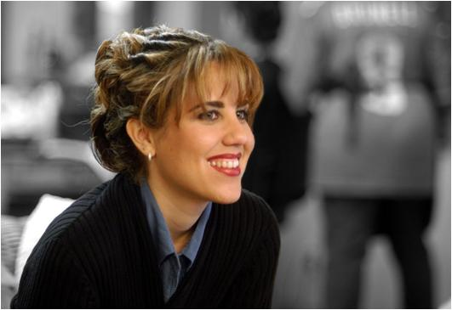
Active Listening: Component #2 What You Say
Reflective listening is giving back to the client the message you received.
Non-reflective listening is attentive silence with
short verbal responses that serve to encourage client communication.

Slide 27
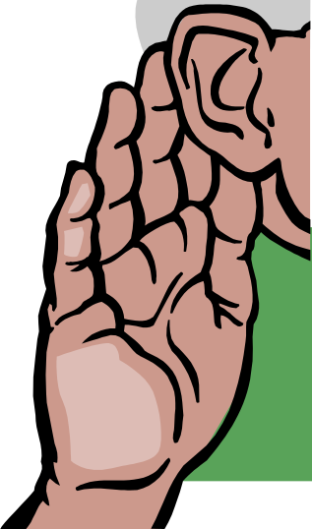
Specific Techniques for
Reflective Listening
Paraphrasing - communicating back client
messages in your own words
Clarifying – asking to explain details you do not fully understand
Summarizing – connecting segments of the conversation into a meaningful whole
Reflecting Feelings – mirroring back the
client’s emotions & attitudes

Slide 28
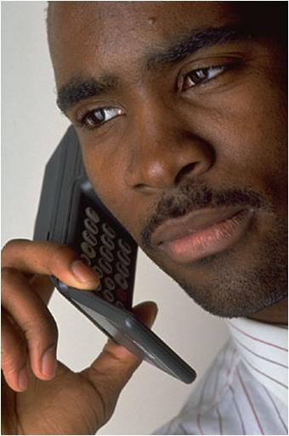
Examples of Non-Reflective Listening Responses
“All right”
“Please continue”
“Yes”
“I see”
Notice how these responses are
non-judgmental & encourage the client to speak.

Slide 29

Active Listening: Component #3
What you Observe
Counselors pay attention to what clients say and how they say it.
Verbal behaviors - tone, inflection, pace, sighing, crying, shouting
Non-verbal behaviors - avoidance of eye contact, closed off posture, head shaking or nodding, nervousness, smiling

Slide 30
EXERCISE
Words to Describe Emotions
Happy | Sad | Angry | Afraid | Confused
Content | Depressed | Furious | Scared | Conflicted
Elated | Dejected | Irate | Insecure | Troubled
Delighted | Despondent | Agitated | Nervous | Undecided
Glad | Glum | Dismayed | Fearful | Lost
Satisfied | Hurt | Fuming | Unsure | Mixed up
Client emotions can be identified through verbal statements (what is said) and verbal behavior (how it is said). Let’s start by identifying client emotions from what is said. Four clients will each make a verbal statement.
For each space provided, think of a word to describe the emotion communicated. It is helpful to ask yourself: “How would I feel in a similar circumstance?” You may use words from the list provided that describe common emotions or use your own descriptive words. Continue to next slide

Slide 31
EXERCISE (Continued)
1) Sarah: “My ex-husband thinks I’m living high off the hog. Boy, if he only knew!”
Emotions: _________________________________________________
2) Al: “I never thought I would even consider bankruptcy, but my credit is
such a mess now anyway – what difference does it make?”
Emotions: _________________________________________________
3) Amy: “Right now, I’m working a lot of lunch shifts but I should get some weekend nights soon. There are people there that make two or three hundred dollars in a night!”
Emotions: _________________________________________________
4) Ray: “Sometimes I think I’m just not with it. Ever hear of the absent-
minded professor?”
Emotions: _________________________________________________

Slide 32

Unit 7 Summary
  1. There are 3 components to active listening – what you do, what you say & what you observe.
  2. Effective counselors use reflective listening to reflect back client messages ensuring that the correct information has been received.
  3. Counselors use non-reflective listening to show interest & to encourage the client.
  4. It is important to listen not only to what is said but also how it said.

Slide 33

Unit 8: Interviewing Skills
Good interviewers:
Ask short, direct questions
Ask one question at a time
Wait for an answer
Do not answer their own
questions
Remain non-judgmental

Slide 34

2 Types of Questions
Use open-ended questions:
  to ask for a statement of the problem
  to explore alternatives to solving the problem
  to refocus the client
  to ask the client’s opinion
Use closed-ended questions:
  to obtain specific information
  to ask to clarify a statement
  to co-ordinate or schedule future plans

Slide 35

Open-ended questions
Open-ended questions are used for the following reasons:
1. To ask for a statement of the problem.
For example:
“How may I help you?”
“What is the nature of the problem?”
2. To explore alternatives to solving the problem.
For example:
“How have you dealt with this before?”
“Have you thought about…?”

Slide 36

Open-ended questions
3. To refocus the client back to the topic at hand.
For example:
“Let’s get back to your unsecured debt. What solutions have you sought out before?”
4. To ask the client’s opinion concerning an option or course of action.
For example:
“How does that sound to you?”
“What do you think about this solution?”

Slide 37

Closed-ended questions
Closed-ended questions are asked for the following reasons:
1. To obtain specific information.
For example:
“Did you sign a lease?”
“Who is your employer?”
2. To ask the client to clarify a statement you did not fully understand.
For example:
“I’m not sure I understand. Are you saying you co-signed on the loan?”
3. To coordinate or schedule future plans.
For example:
“Can you fax me your last billing statement?”
“Do you think you can call tomorrow with that information?”

Slide 38
Unit 8 Summary
1. Good interviewers ask short, direct questions.
2. Good interviewers wait for clients to respond to their questions.
3. Open-ended questions solicit longer answers concerning ideas, feelings, and opinions.
4. Closed-ended questions seek factual information & can be answered with a "yes"” or "no"” response or a short phrase.

Slide 39

This Concludes Module II Review
Great Job!

