Slide 1


Keys to Success
Module III Review

Slide 2

Solving Financial Problems
Module III considers the process of solving problems from the client’s initial contact to the creation of the action plan.
The Problem-Solving Process
Where the Client Is Now
Where the Client Wants To Go
How the Client Will Get There

Slide 3
Unit 9: The Problem-Solving Process
The Problem-Management/Opportunity-Development Model
describes the helping process as:
“Managing problems more effectively & developing opportunities more fully”
Compliments financial problem-solving - managing problems (reducing debt) & developing opportunities (increasing income).

Slide 4

Problem solving is a natural process
People are naturally motivated to resolve issues, conflicts & dilemmas.
7 Steps that occur naturally:
1. Awareness of the problem. Financial
stress or dissatisfaction.
2. Problem creates urgency. Financial issues interfere with personal & business life.
3. The search begins. The individual starts to explore ways to resolve the problem or issue.

Slide 5

Natural problem-solving process (continued)
Decisions, decisions. The individual considers the consequences of the various alternatives.
What if I did nothing? Possible solutions are weighed against simply ignoring the problem.
I’ve made a decision! The individual makes an intellectual decision to follow a course of action.
“C” is for commitment. The individual makes an emotion commitment to act.
How do these two differ?

Slide 6

Steps toward a solution…
Determine where “Ray” is in the problem-solving process.
“What you’re telling me sounds good but I just need some more time to think this through and go over the numbers. Based on interest rates, I know my debt is just going to increase but my income—that’s a variable I am not comfortable with. My unemployment benefits won’t last indefinitely. Of course, I will get a job. Software designers are supposed to be in demand.”

Slide 7

People often get stuck on a particular step…
Determine where “Sarah” is in the problem-solving process:
“If I had all the child support due to me, I could pay off my debt and then some. You know, they started to garnish his wages and then guess what? He lost his job!”

Slide 8

Problem Solving through Counseling
Counseling Process:
Where the Client is
Where the client wants to go
Goals
Current Scenario
Preferred Scenario
Getting There

Slide 9

Unit 9 Summary
The Problem-Management/Opportunity-Development Model describes the helping process inherent in all counseling.
People are naturally motivated to resolve financial dilemmas.
Counseling facilitates the natural process individuals follow to find solutions.

Slide 10

Unit 10: Where the Client is Now

Slide 11
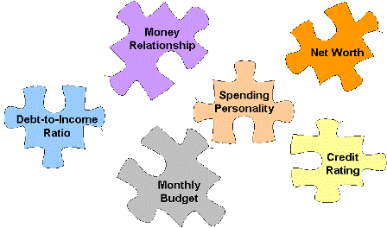
Assessing the client’s financial condition requires budget analysis… and learning about money behaviors. What motivates spending?

Slide 12
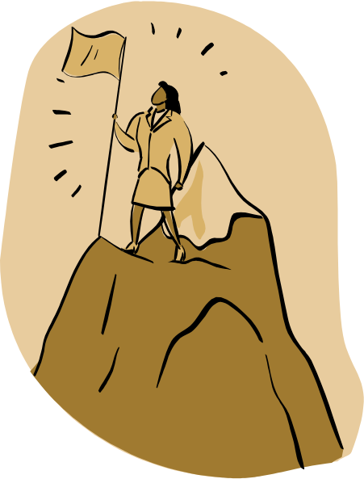

Net Worth
Assets
Liabilities
Net Worth
Net Worth
Examples:
House
Car
Boat
Investments
$$$$$
Examples:
Mortgage
Loans
Credit card debt
Utility bills

Slide 13

How much are you worth?
Steps in calculating net worth
Identify all items of value
Determine market value
*What are some ways to determine value of assets?
*What is typically the greatest liability to consumers?
*Give an example of a liquid asset.

Slide 14

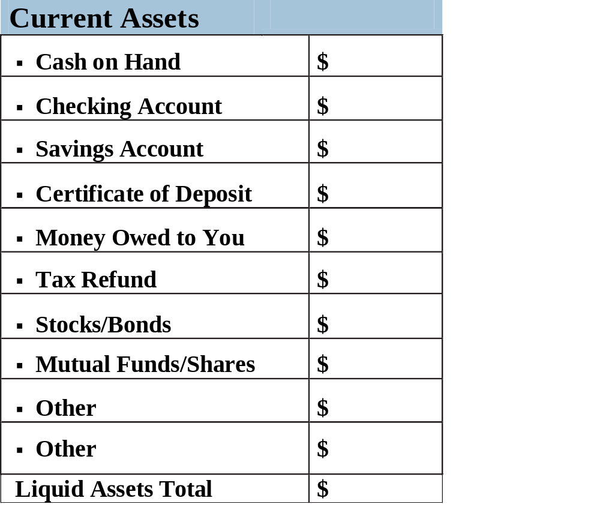
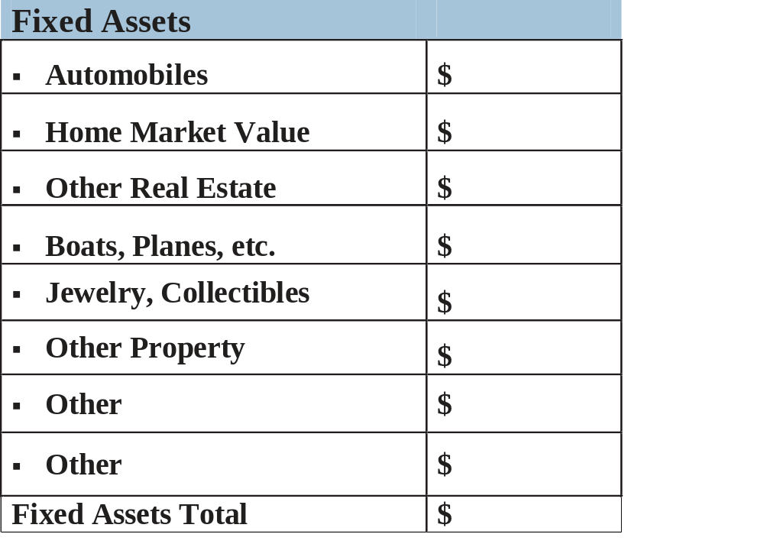
Types of Assets

Slide 15

Budget Analysis
What’s coming in? What’s going out?
- Know the difference between gross & net income
- Breakdown expenses into fixed, variable & discretionary
Compare expense categories to a spending percentage guideline.
- The Bureau of Labor Statistics is one source.
Track daily spending
  - Don’t skip days
  - Record every expense
  - Record expense immediately
  - Write down costs to the penny

Slide 16
Expense Breakdown
Fixed
Expenses
Variable Expenses
Discretionary Expenses
Fixed
Expenses
Variable
Expenses
Discretionary
Expenses
Expenses
Don’t vary
Do vary
Can Control
Example
Mortgage
Utilities
Concert tickets

Slide 17
Monthly Budget
Net Income/month | 1920 | Percentage of Income
Housing | 750 | 39%
Utilities | 219 | 11%
Automobiles | 430 | 22%
Food | 320 | 17%
Clothing | 115 | 6%
Medical | 0 | 0%
Personal | 140 | 7%
Unsecured Debt | 3500/200 | 10%
Total Expenses | 2174 | 1920 - 2174 = -254.00
Spending Percentage Guide
25-35%
5-10%
10-15%
5-15%
2-7%
5-10%
5-10%
5-10%
www.bls.gov

Slide 18
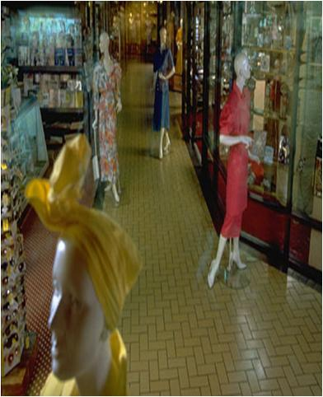
Spending Personalities
1. The Fanatical Shopper
Extreme bargain hunting
2. The Impulsive Spender
Quick, unplanned purchases
3. The Passive Spender
Easily persuaded by salesperson

Slide 19

Spending Personalities
4. The Ulterior Motive Spender
Shop to escape or get revenge
5. The Esteem Spender
Shop to impress
6. Special Interest Spender
Spend on hobbies or addictions
7. Hot Potato Spender
May panic & then buy quickly

Slide 20
Destructive Money Beliefs
I deserve it!
I don’t expect much
I’m waiting for a miracle
I’m showing them I really care
I’m not like everybody else
I need a fix -- now!
I’m not good with money
I will impress you
I believe money corrupts people
It doesn’t really matter

Slide 21

3 A’s Of Money Relationships
Money & Achievement
Work hard & want something tangible to show for it
Money & Approval
Want everybody to like them
Money & Agitation
Purchase items based on emotions
*Which “A” best describes your relationship with money?

Slide 22

Unit 10 Summary
Budget analysis along with net worth & debt-to-income ratio calculations help to assess the client’s current financial situation.
Spending percentage guides are a good objective measure of how well money is spent in each budget category.
Clients will exhibit a variety of spending personalities & relationships with money.

Slide 23

Unit 11: Where the Client Wants To Go

Slide 24
Life-Cycle Planning
C A R E E R S A V I N G S D E B T I N S U R A N C E I N V E S T M E N T E S T A T E RETIREMENT
2
3
1
4
7
6
5

Slide 25

Four Steps to Planning:
State goals in specific terms
Create a plan to achieve each goal.
Evaluate progress toward each goal.
Decide whether to keep working toward a goal or to focus on a new one.

Slide 26

Goals Must Be:
Specific
Measurable
Viable

Slide 27


Which of the following describes a measurable
and realistic goal?
Martha told her counselor that her goal was to improve her financial health. She was going to start today by reducing her spending.
Martha told her counselor that her goal was to improve her financial health by finding a second part-time job to improve her debt-to income ratio. She hoped to reduce her spending by 90% this month.
Martha told her counselor that her goal was to improve her financial health by finding a second part-time job to improve her debt-to income ratio. She hoped to reduce her spending by 10% this month.

Slide 28
Maslow’s Hierarchy of Needs
To reach your full potential
To be appreciated & heard
To belong & be excepted
To be safe from physical harm
To have food, clothing
& shelter
Self-
Actualization
Needs for Self-Actualization
Need for Self-Esteem
Need for Love
Need for Love and Belonging
Need for Love and Belonging
Needs for Safety
Needs for Safety
Physiological Needs
Physiological Needs

Slide 29
EXERCISE
Does Your Spending Reflect Your Values?
When making your financial plans, it is important to reflect on what is truly important to you.
Step 1: Take a moment to think about what is most important to you. List the top five things you most value in life. For example, time with my family, a beautiful home, traveling, etc.
Step 2: For each value you have listed, think of 3 ways that the money you have today can help you realize that particular value. For example, if you value romance, you might list a vacation, fresh flowers or spending on a baby-sitter.

Slide 30
Unit 11 Summary
  Financial goals shift throughout the life-span.
  Goals need to be defined in specific terms, be measurable & viable.
  Maslow’s Hierarchy of Needs is a tool to help evaluate an individual’s needs, wants & desires.
  It’s important to determine what you value in life & evaluate whether your current spending aligns with those vales.

Slide 31

Unit 12: How the Client Will Get There

Slide 32
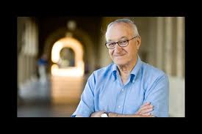
Bandura’s Self-Efficacy
Albert Bandura theorized that an individual's willingness to take action depends on the presence of two necessary conditions:
Outcome expectations – the action will result in the desired outcome.
Self-efficacy expectations – the individual believes he/she can do it.

Slide 33

Self-Efficacy: The Can-Do Attitude!
You can help client’s develop self-efficacy by:
Monitoring progress. Acknowledging small successes can help build confidence to tackle bigger problems.
Inspiring by example. Seeing is believing & believing is what self-efficacy is all about.
Encouraging & challenging. Self-defeating beliefs need to be challenged & replaced by the idea that desired outcomes are not only possible but also realistic.
Helping clients overcome anxiety. Fear of failure is a sure recipe for non-action. Help clients overcome fear with solid facts.

Slide 34
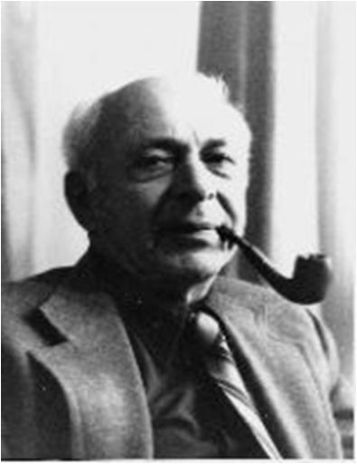
Rotter’s Locus Of Control
According to J.B. Rotter, each of us operates with either an internal or external locus of control.
Internal Locus of Control
consequences and outcomes are a result of individual’s actions
External Locus of Control
events & circumstances are beyond the individual’s control

Slide 35
Do you have an internal or external locus of control?
Complete…
ROTTER'S LOCUS OF CONTROL SCALE
…and find out!

Slide 36

The Spending Plan
A monthly plan has 4 primary benefits:
Helps to identify overspending
Promotes honest interpersonal
communication & accountability
Increases motivation
Tracks your success

Slide 37
Economizing
Strategies | Examples
Substituting | Dry clean own clothes
Conserving | Preventative car maintenance
Cooperating | Share babysitting
Utilize community resources | Library

Slide 38

Unit 12 Summary
  In order for an individual to take action, a client must believe the action will result in a desired outcome & they have the ability to make it happen.
  Individuals may possess an external or internal locus of control.
  There are 4 primary benefits of keeping a spending plan: helps pinpoint problem spending, promotes honest communication, increases motivation & tracks progress.
  There are 4 ways to economize: substituting, conserving, co-operating & utilizing community resources.

Slide 39

This Concludes Module III Review

