Slide 1
The real part of the eigenvalues of a 3x3 non-Hermitian Hamiltonian
(coupled-photonic-cavity system)
June 2022
Jinyan Miao

Slide 2
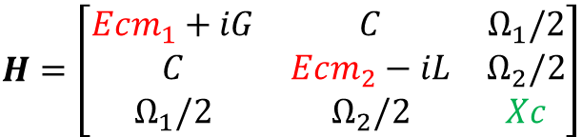

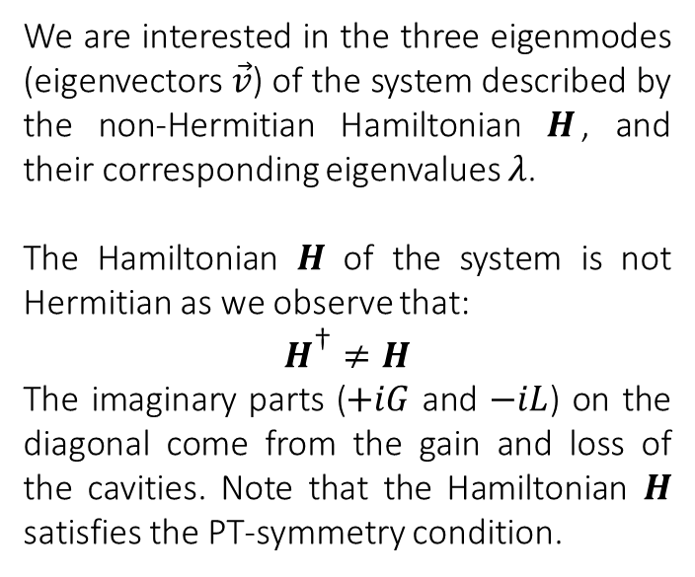
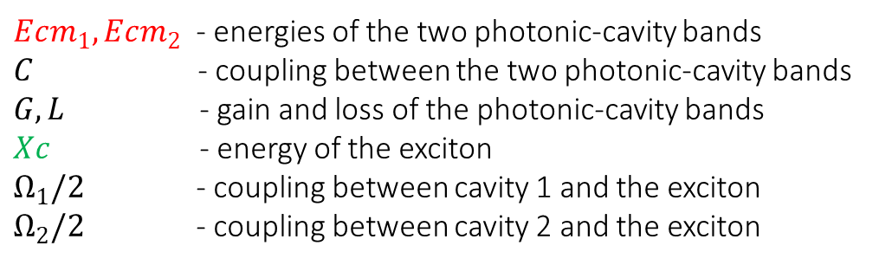
The non-Hermitian Hamiltonian
$$H\vec{v}=λ\vec{v}$$
$$H=\left[\begin{matrix}Ecm_{1}+iG & C & Ω_{1}/2 \\ C & Ecm_{2}−iL & Ω_{2}/2 \\ Ω_{1}/2 & Ω_{2}/2 & Xc\end{matrix}\right]$$
We are interested in the three eigenmodes (eigenvectors $\vec{v}$) of the system described by the non-Hermitian Hamiltonian $H$, and their corresponding eigenvalues $λ$.
The Hamiltonian $H$ of the system is not Hermitian as we observe that:
$$H^{\text{†}}≠H$$
The imaginary parts ($+iG$ and $−iL$) on the diagonal come from the gain and loss of the cavities. Note that the Hamiltonian $H$ satisfies the PT-symmetry condition.
$Ecm_{1}, Ecm_{2}$ - energies of the two photonic-cavity bands
$C$ - coupling between the two photonic-cavity bands
$G, L$ - gain and loss of the photonic-cavity bands
$Xc$ - energy of the exciton
$Ω_{1}/2$ - coupling between cavity 1 and the exciton
$Ω_{2}/2$ - coupling between cavity 2 and the exciton

Slide 3
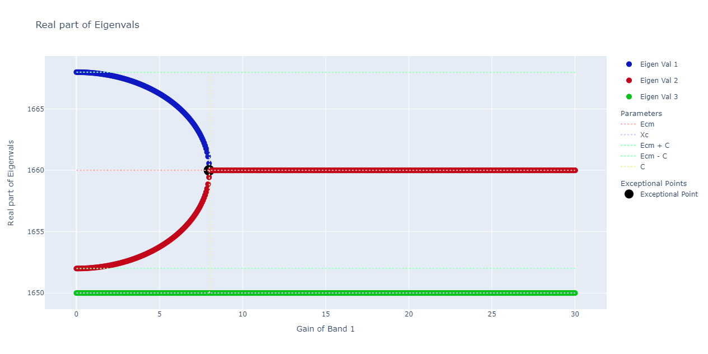

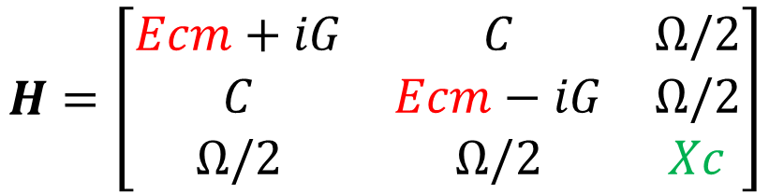

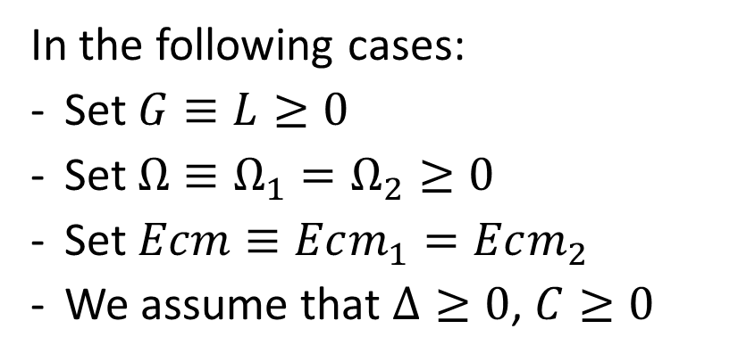
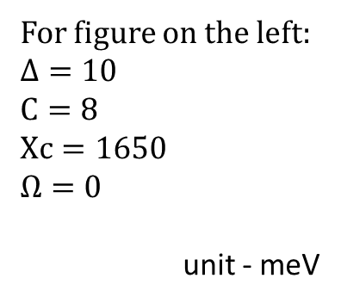
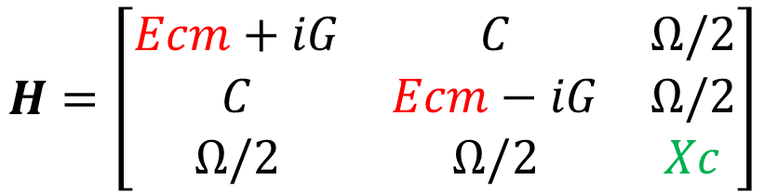



In the following cases:
Set $G≡L≥0$
Set $Ω≡Ω_{1}=Ω_{2}≥0$
Set $Ecm≡Ecm_{1}=Ecm_{2}$
We assume that $Δ≥0$, $C≥0$
$$H=\left[\begin{matrix}Ecm+iG & C & Ω/2 \\ C & Ecm−iG & Ω/2 \\ Ω/2 & Ω/2 & Xc\end{matrix}\right]$$
$$H=\left[\begin{matrix}Ecm+iG & C & Ω/2 \\ C & Ecm−iG & Ω/2 \\ Ω/2 & Ω/2 & Xc\end{matrix}\right]$$
Define detuning $Δ≡Ecm−Xc$
For figure on the left:
$$Δ=10$$
$$C=8$$
$$Xc=1650$$
$$Ω=0$$
unit - meV
$$C=8$$
$$Xc=1650$$
$$Δ=10$$
The plot shows the real part of the three eigenvalues of $H$

Slide 4
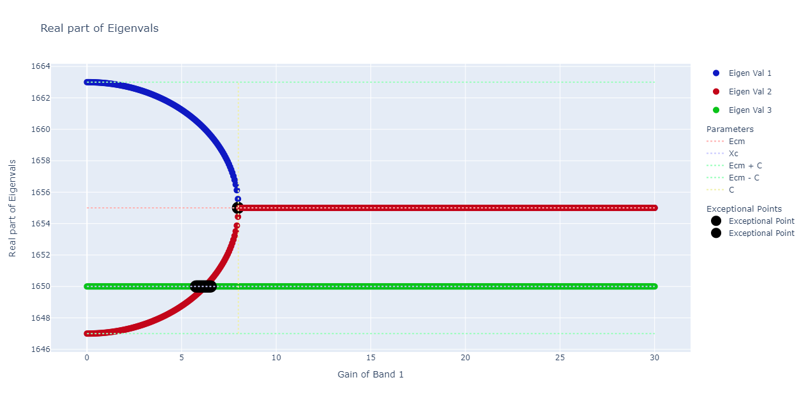
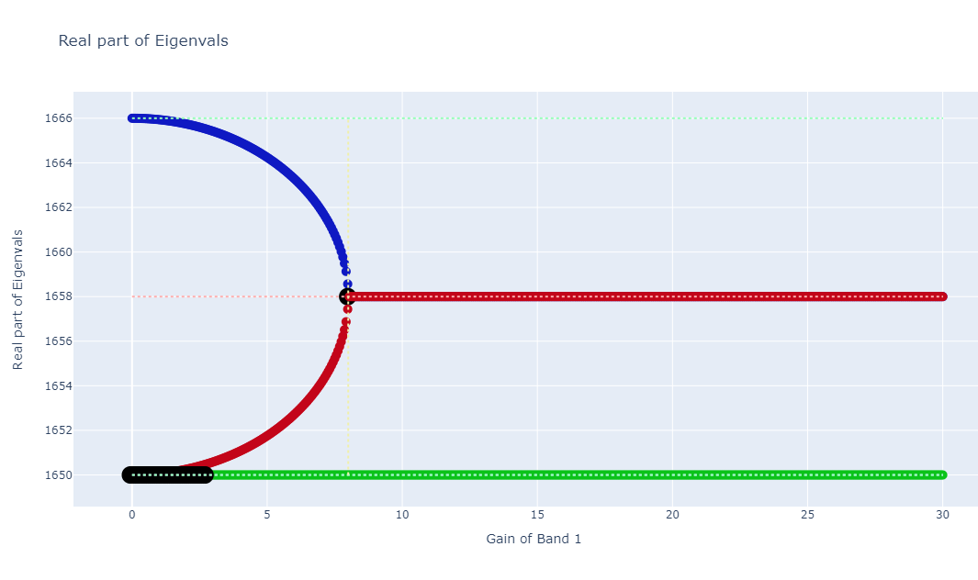
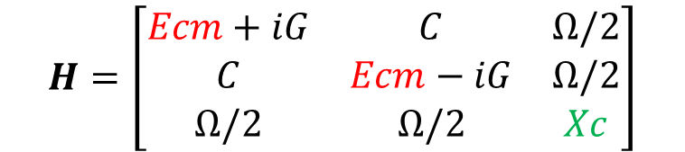
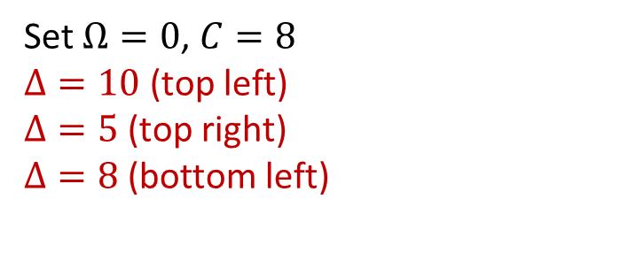
$$H=\left[\begin{matrix}Ecm+iG & C & Ω/2 \\ C & Ecm−iG & Ω/2 \\ Ω/2 & Ω/2 & Xc\end{matrix}\right]$$
Set $Ω=0$, $C=8$
$Δ=10$ (top left)
$Δ=5$ (top right)
$Δ=8$ (bottom left)

Slide 5
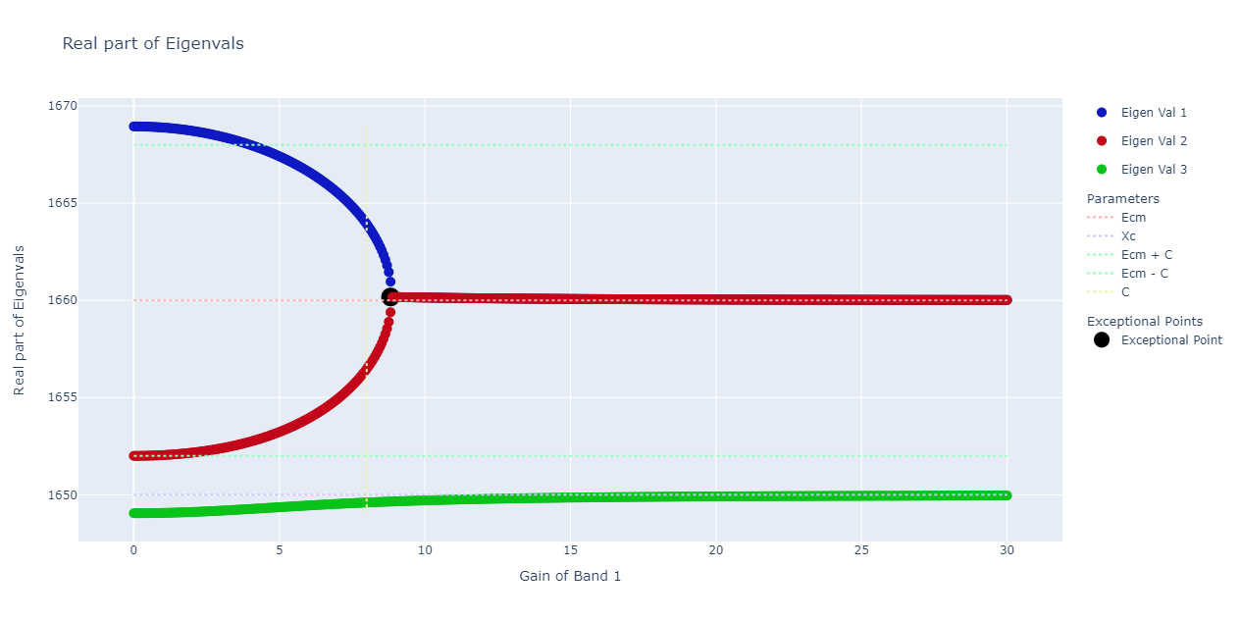
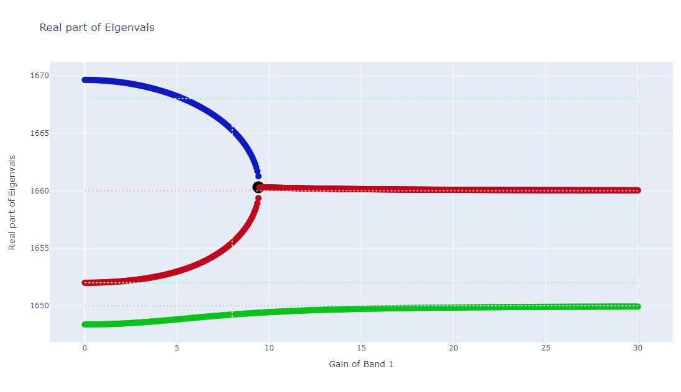
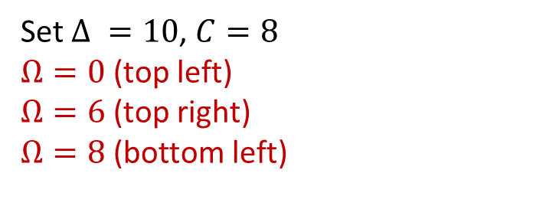
$$H=\left[\begin{matrix}Ecm+iG & C & Ω/2 \\ C & Ecm−iG & Ω/2 \\ Ω/2 & Ω/2 & Xc\end{matrix}\right]$$
Set $Δ =10$, $C=8$
$Ω=0$ (top left)
$Ω=6$ (top right)
$Ω=8$ (bottom left)

Slide 6
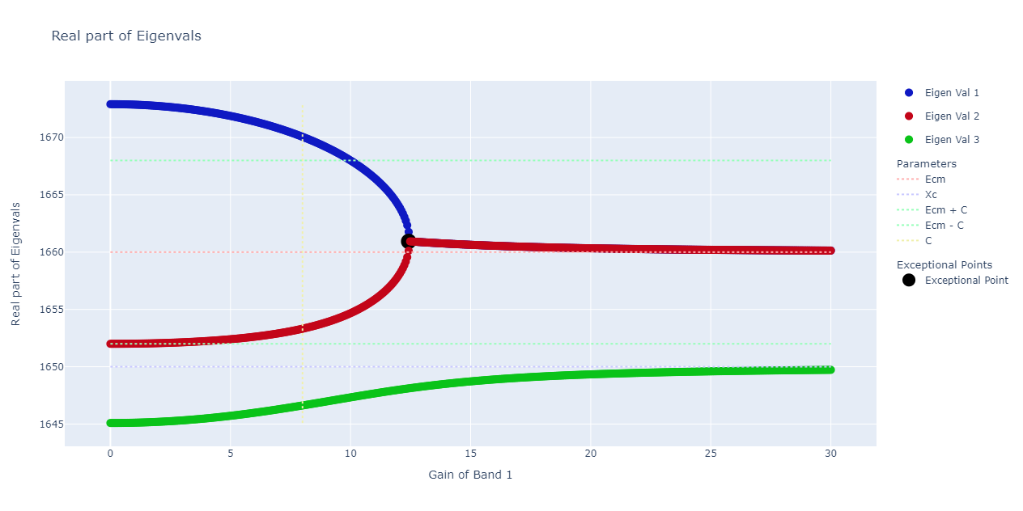
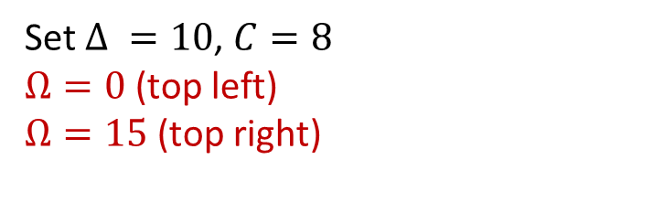
$$H=\left[\begin{matrix}Ecm+iG & C & Ω/2 \\ C & Ecm−iG & Ω/2 \\ Ω/2 & Ω/2 & Xc\end{matrix}\right]$$
There is an anti-crossing behavior between the green curve and the red curve when we fix detuning and coupling between cavities while increasing the coupling between the cavity and the exciton
Set $Δ =10$, $C=8$
$Ω=0$ (top left)
$Ω=15$ (top right)

Slide 7
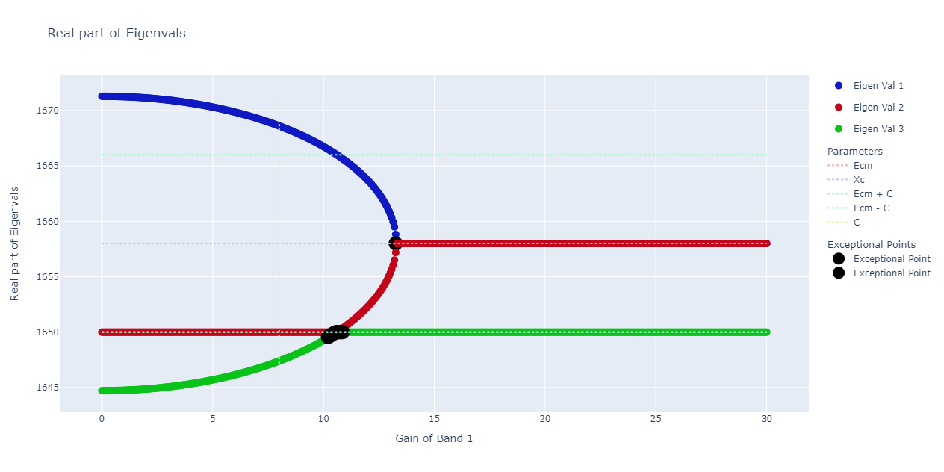
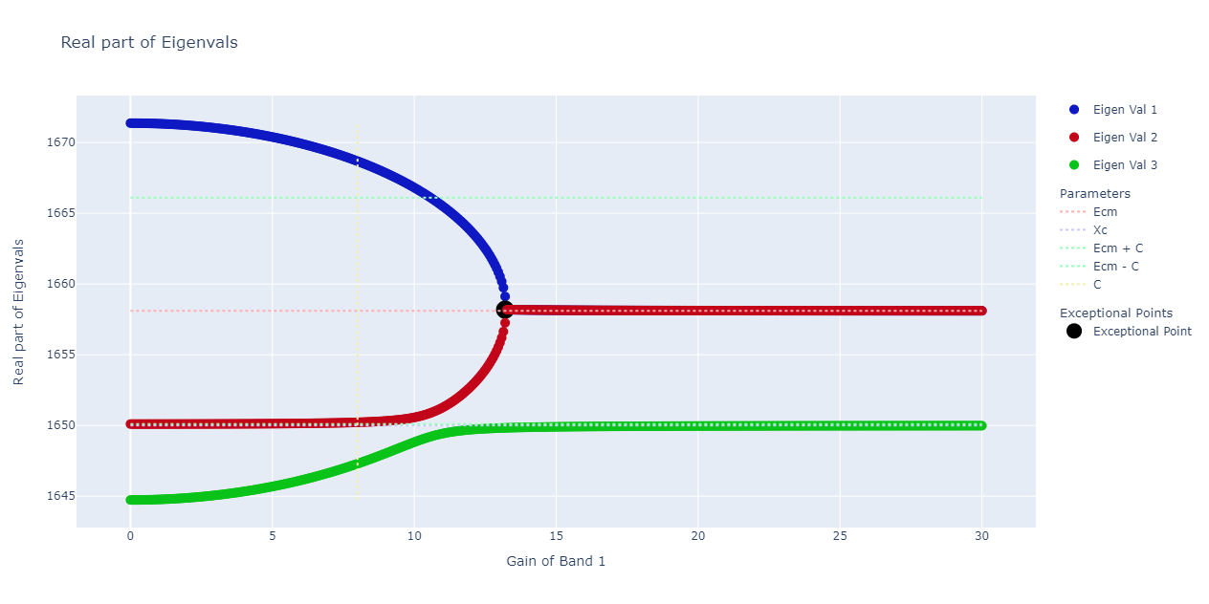
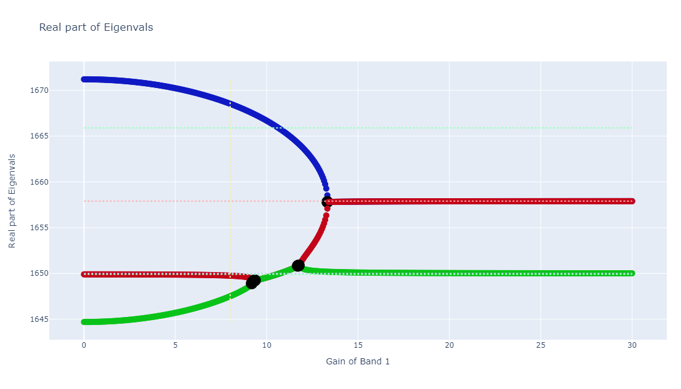
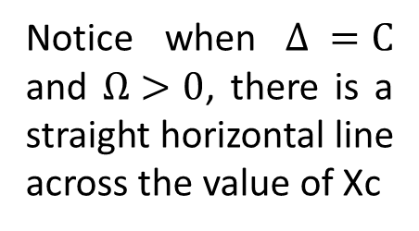
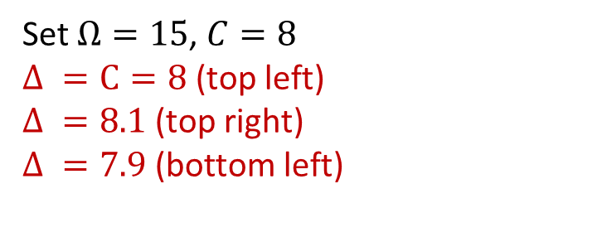
$$H=\left[\begin{matrix}Ecm+iG & C & Ω/2 \\ C & Ecm−iG & Ω/2 \\ Ω/2 & Ω/2 & Xc\end{matrix}\right]$$
Set $Ω=15$, $C=8$
$Δ =C=8$ (top left)
$Δ =8.1$ (top right)
$Δ =7.9$ (bottom left)
Notice when $Δ =C$ and $Ω>0$, there is a straight horizontal line across the value of Xc

Slide 8
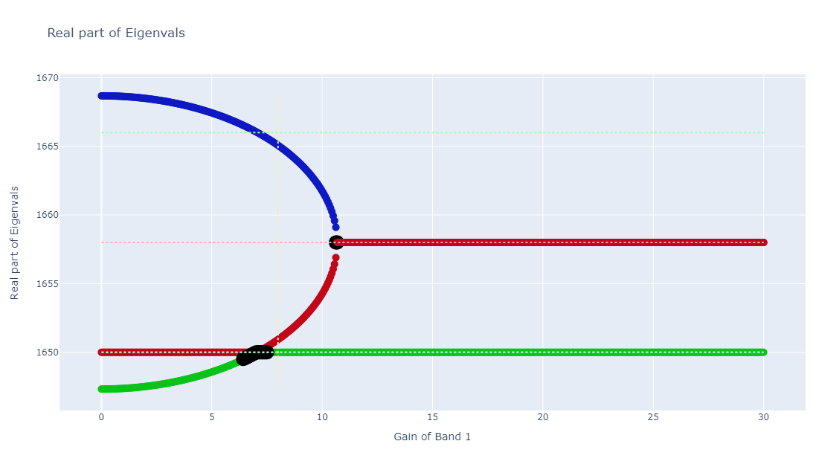
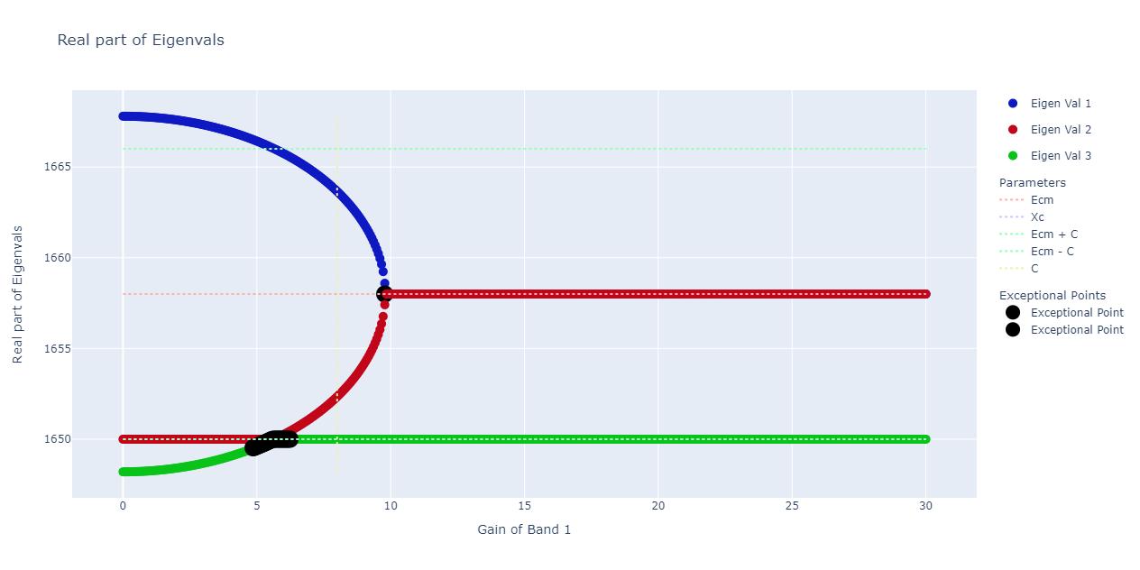
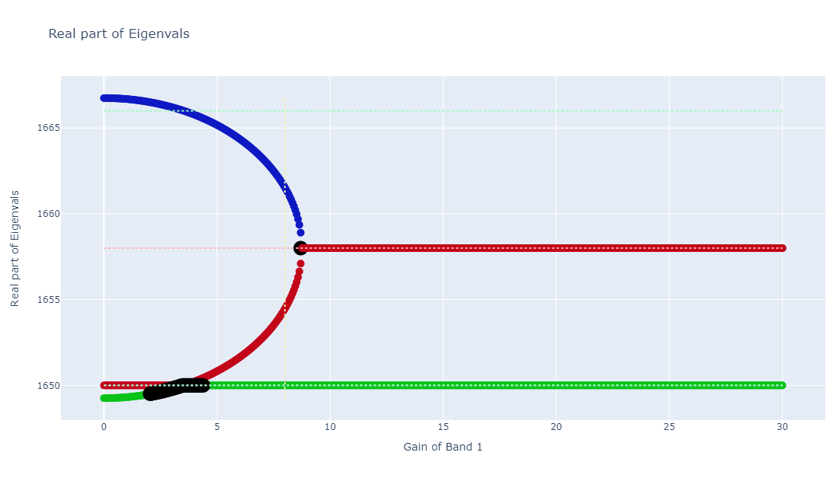
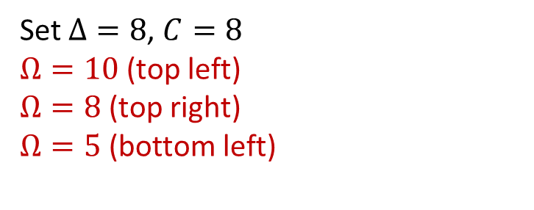
$$H=\left[\begin{matrix}Ecm+iG & C & Ω/2 \\ C & Ecm−iG & Ω/2 \\ Ω/2 & Ω/2 & Xc\end{matrix}\right]$$
Set $Δ=8$, $C=8$
$Ω=10$ (top left)
$Ω=8$ (top right)
$Ω=5$ (bottom left)

Slide 9
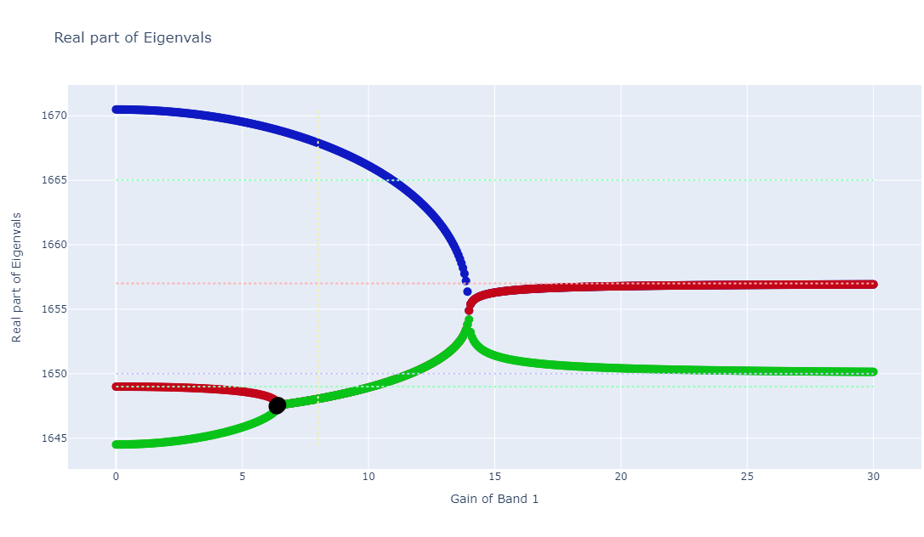
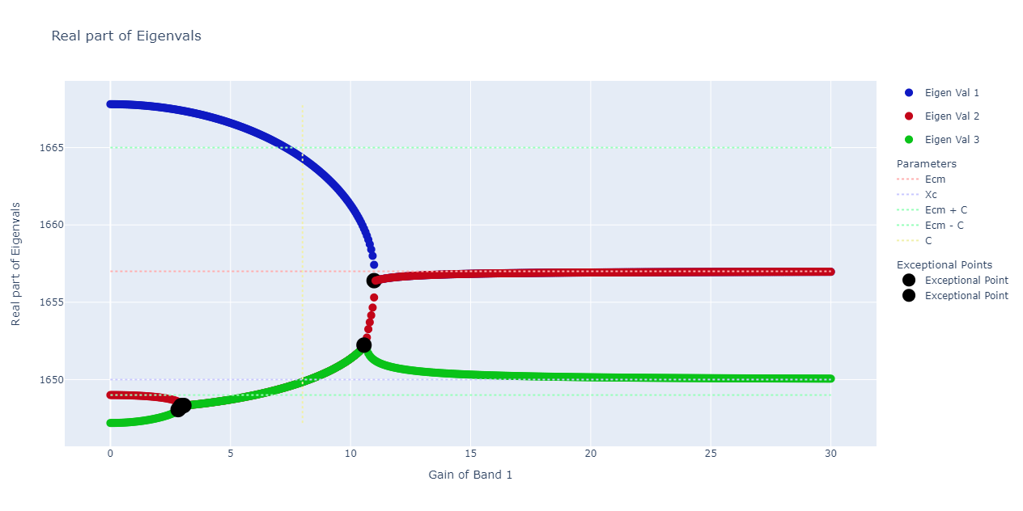
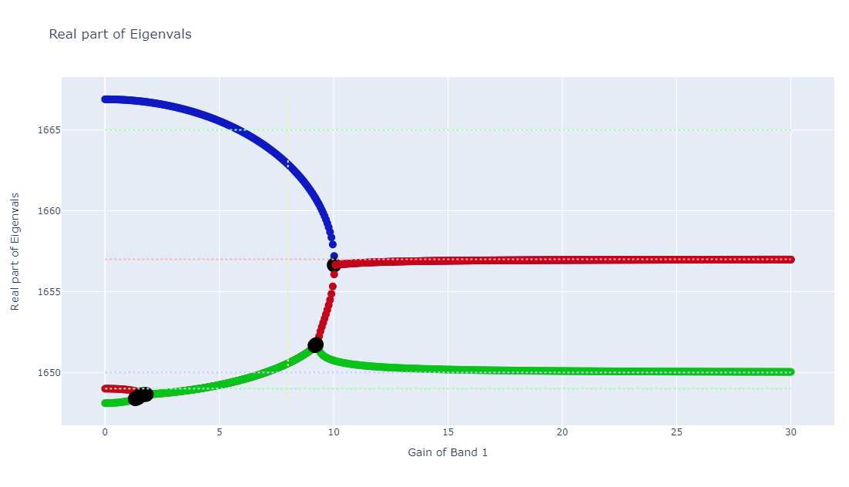
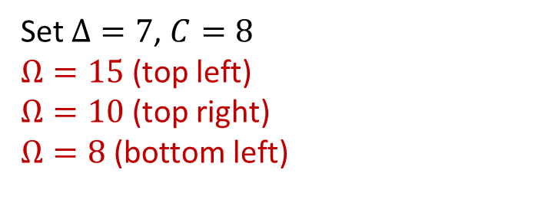
$$H=\left[\begin{matrix}Ecm+iG & C & Ω/2 \\ C & Ecm−iG & Ω/2 \\ Ω/2 & Ω/2 & Xc\end{matrix}\right]$$
Set $Δ=7$, $C=8$
$Ω=15$ (top left)
$Ω=10$ (top right)
$Ω=8$ (bottom left)

Slide 10
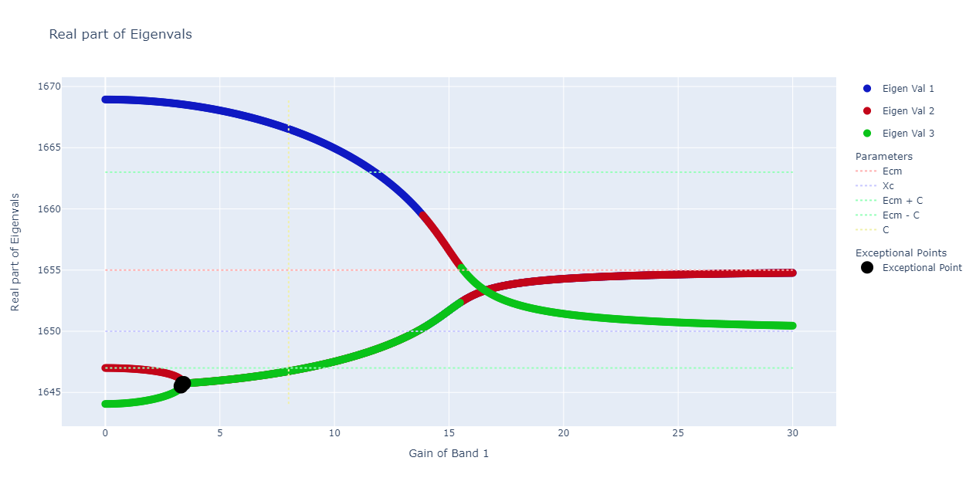
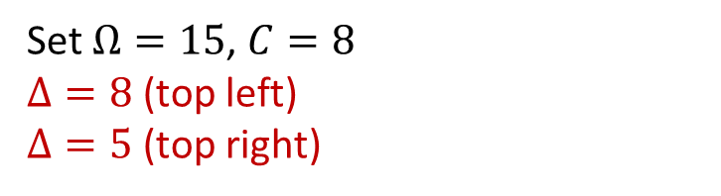
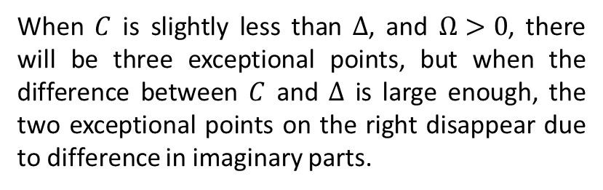
When $C$ is slightly less than $Δ$, and $Ω>0$, there will be three exceptional points, but when the difference between $C$ and $Δ$ is large enough, the two exceptional points on the right disappear due to difference in imaginary parts.
$$H=\left[\begin{matrix}Ecm+iG & C & Ω/2 \\ C & Ecm−iG & Ω/2 \\ Ω/2 & Ω/2 & Xc\end{matrix}\right]$$
Set $Ω=15$, $C=8$
$Δ=8$ (top left)
$Δ=5$ (top right)

Slide 11
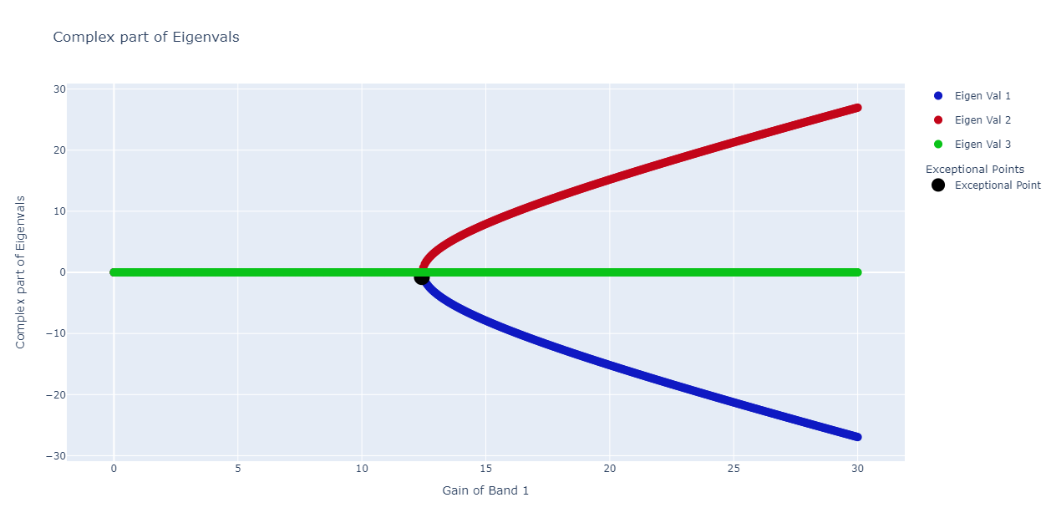

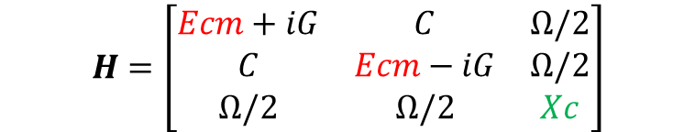
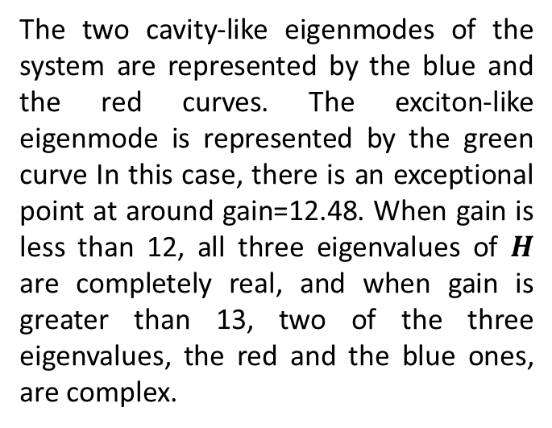
Exceptional Points
$$H=\left[\begin{matrix}Ecm+iG & C & Ω/2 \\ C & Ecm−iG & Ω/2 \\ Ω/2 & Ω/2 & Xc\end{matrix}\right]$$
Set $Δ =10$, $C=8$, $Ω=15$
Top is the real part of the eigenvalues
Bottom is the complex part
The two cavity-like eigenmodes of the system are represented by the blue and the red curves. The exciton-like eigenmode is represented by the green curve In this case, there is an exceptional point at around gain=12.48. When gain is less than 12, all three eigenvalues of $H$ are completely real, and when gain is greater than 13, two of the three eigenvalues, the red and the blue ones, are complex.

Slide 12
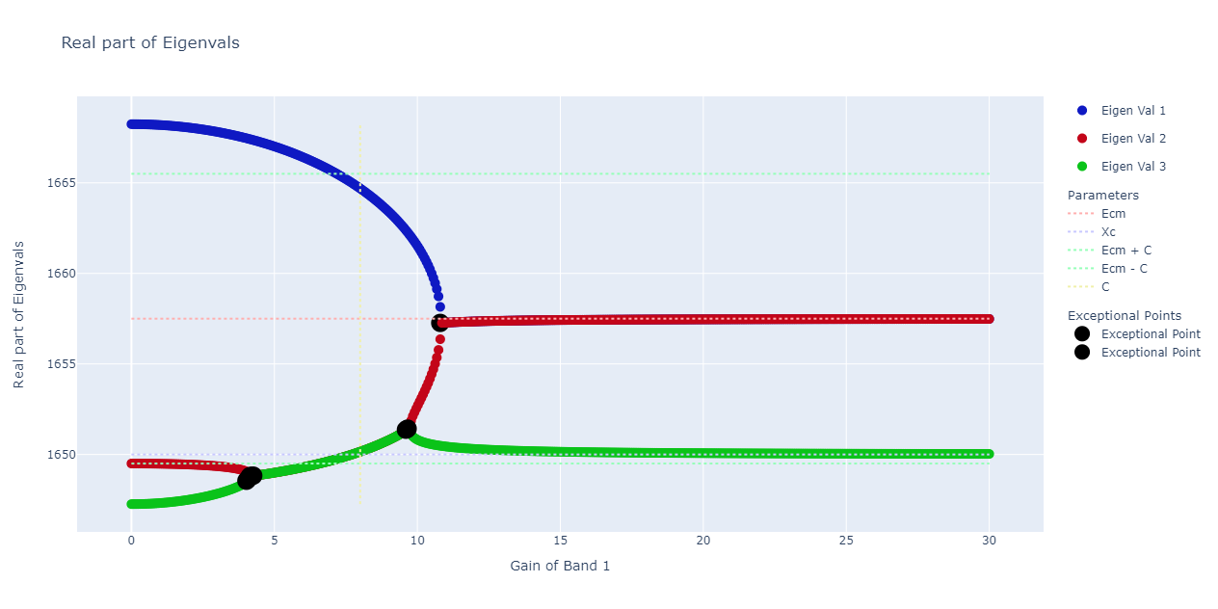
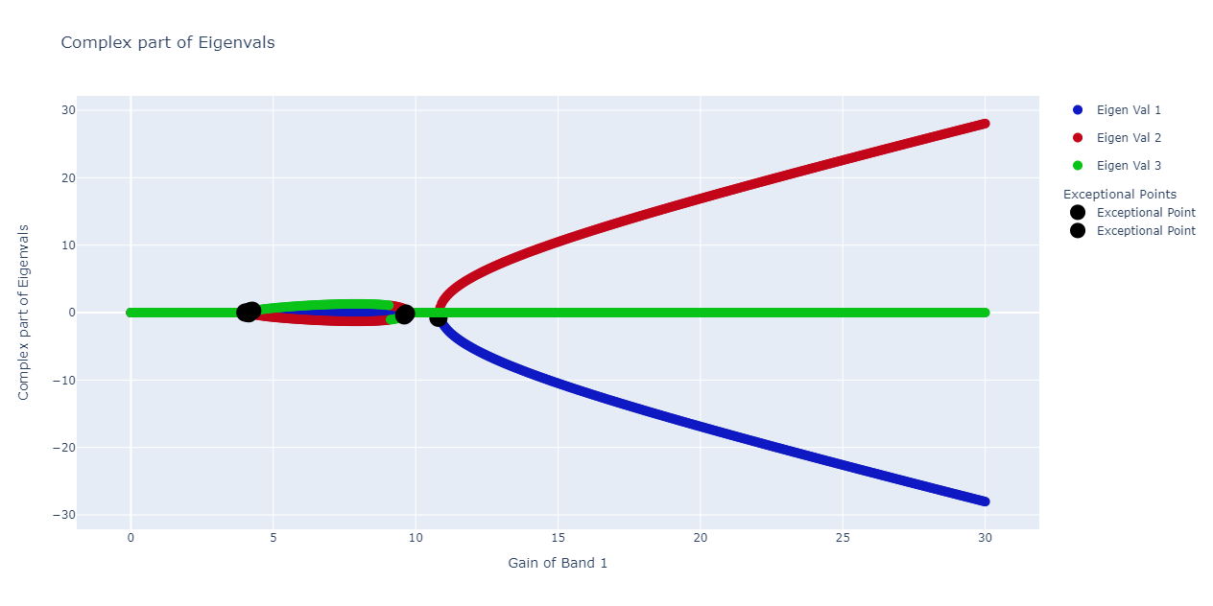

Exceptional Points
Set $Δ =7.5$, $C=8$, $Ω=10$
Top is the real part of the eigenvalues
Bottom is the complex part
In this case, there are three exceptional points, at round gain equals to 4.2, 9.7 and 10.8. At each exceptional point, the eigenvalues either (1) change from all real to partially complex or (2) change from partially complex to all real. The system goes from unbroken PT-symmetric state to broken PT-symmetric phase at the first EP, and then back to the unbroken PT-symmetric phase at the second EP, and again to broken PT-symmetric phase at the third EP.

Slide 13
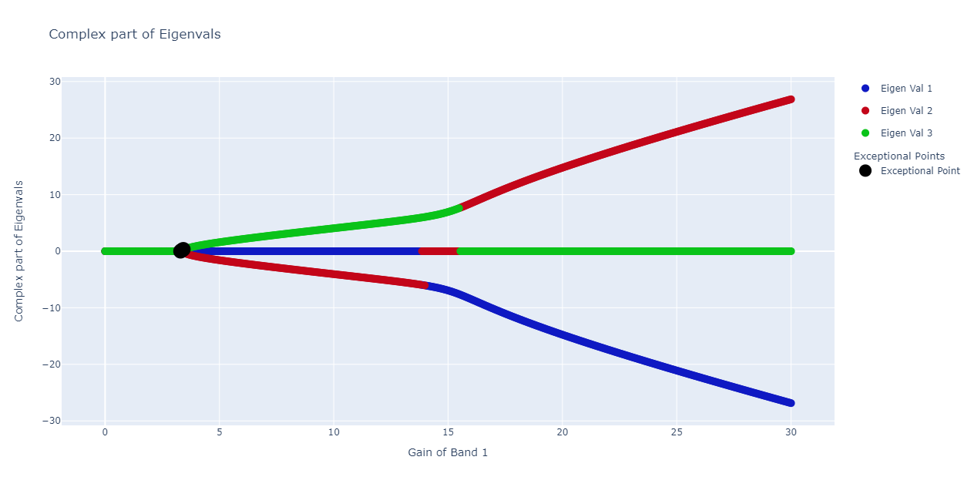

Exceptional Points
Set $Δ =5$, $C=8$, $Ω=15$
Top is the real part of the eigenvalues
Bottom is the complex part
In this case, there is only one exceptional point at around gain=3.4, where the red and the green curves, representing the eigenvalues correspond to one of the cavity-like eigenmode and the exciton-like eigenmode, respectively, change from completely real to complex. The system goes from unbroken PT-symmetric phase to broken PT-symmetric phase.

Slide 14
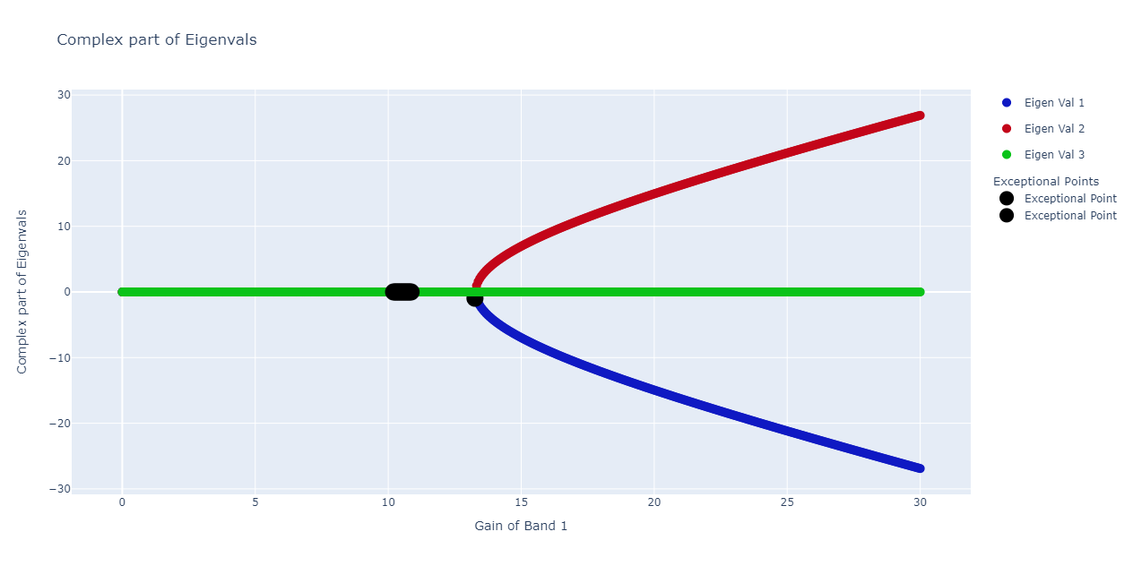

Exceptional Points
Set $Δ =8$, $C=8$, $Ω=15$
Top is the real part of the eigenvalues
Bottom is the complex part
In this case, there are two exceptional points, at round gain equals to 10.6 and 13.3. The system goes from unbroken PT-symmetric state to broken PT-symmetric state (at the first EP), and unbroken PT-symmetric phase to broken PT-symmetric phase.

Slide 15
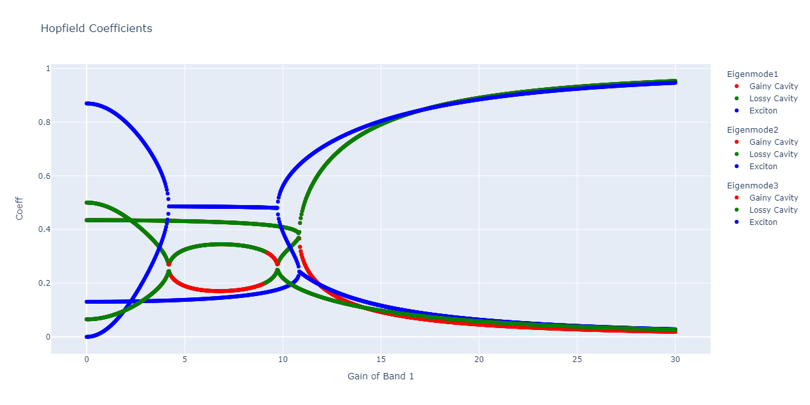
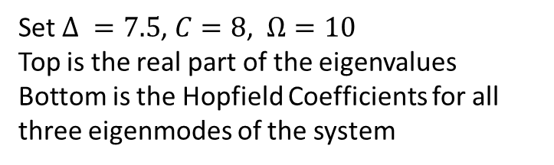
Exceptional Points
Set $Δ =7.5$, $C=8$, $Ω=10$
Top is the real part of the eigenvalues
Bottom is the Hopfield Coefficients for all three eigenmodes of the system
Notice that the curves of the Hopfield coefficients are connected to each other at those exceptional points, even though the connections are not smooth. The connection between curves corresponds to the degeneracy of the corresponding pair of the eigenvalues of the system.
We believe that this implies there are some phase transitioning happening at those exceptional points. The system is free to go from one eigenmode to the other.

Slide 16
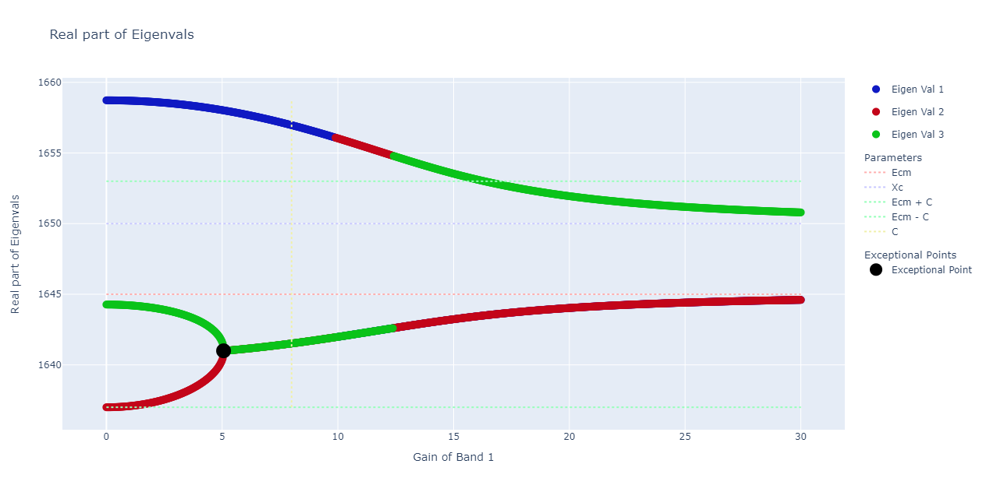
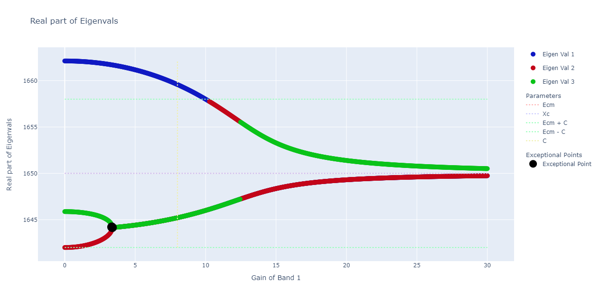

Negative Detuning
Set $Δ=−5$ (top), and set $Δ=0$ (bottom)
One might expect to see a symmetry between the positive detuning and the negative detuning, but this is not true in our system. In fact, when we have negative detuning, there will be always one and only one exceptional point between the two cavity-like eigenmodes.

Slide 17
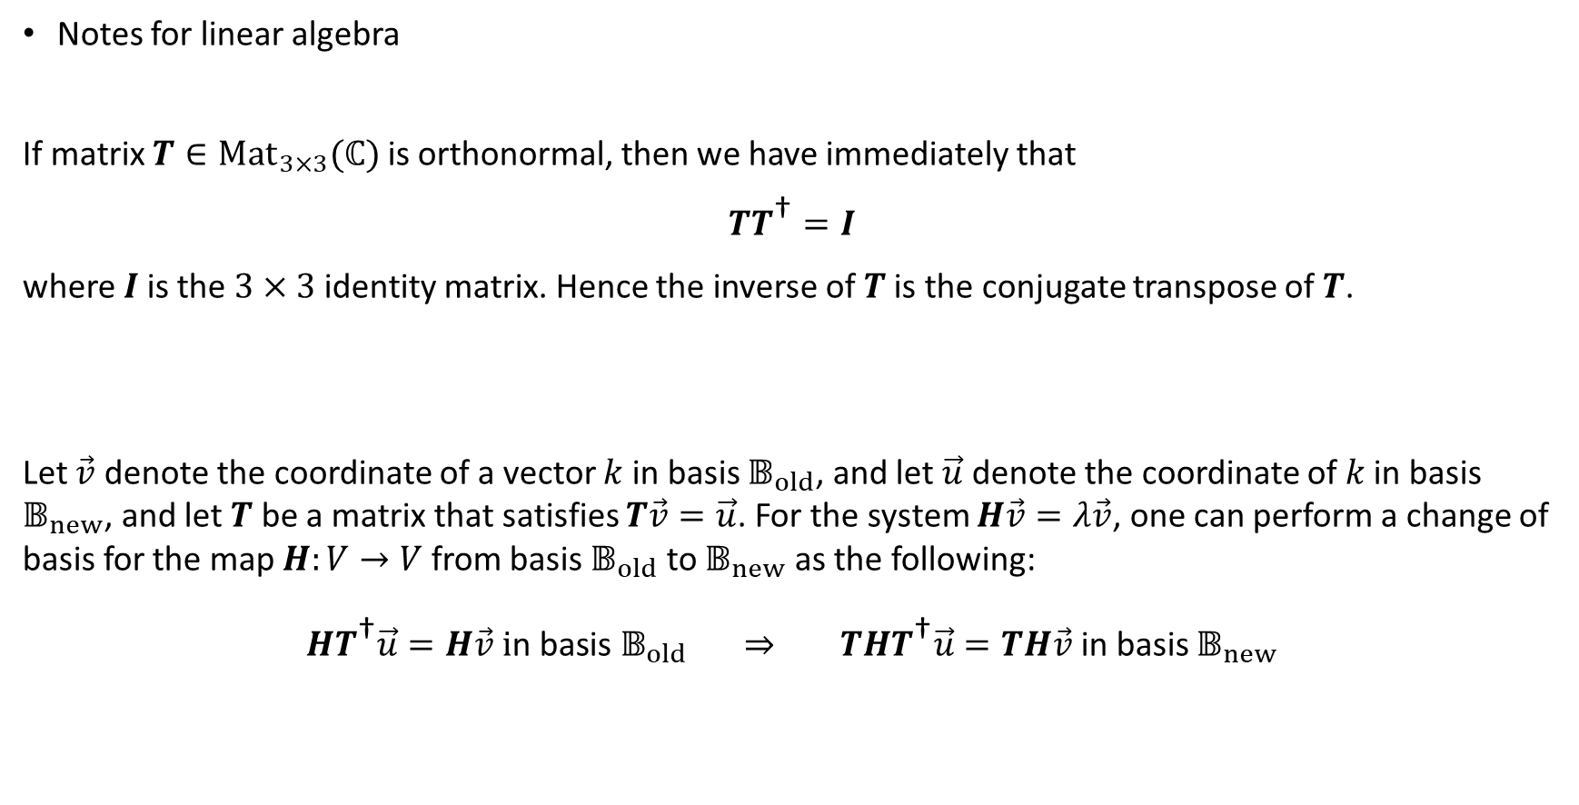
Notes for linear algebra
If matrix $T∈{Mat}_{3×3}(ℂ)$ is orthonormal, then we have immediately that
$TT^{\text{†}}=I$
where $I$ is the $3×3$ identity matrix. Hence the inverse of $T$ is the conjugate transpose of $T$.
Let $\vec{v}$ denote the coordinate of a vector $k$ in basis $𝔹_{old}$, and let $\vec{u}$ denote the coordinate of $k$ in basis $𝔹_{new}$, and let $T$ be a matrix that satisfies $T\vec{v}=\vec{u}$. For the system $H\vec{v}=λ\vec{v}$, one can perform a change of basis for the map $H:V→V$ from basis $𝔹_{old}$ to $𝔹_{new}$ as the following:
$HT^{\text{†}}\vec{u}=H\vec{v} \text{i}\text{n} \text{basis} 𝔹_{old} ⇒ THT^{\text{†}}\vec{u}=TH\vec{v}$ in basis $𝔹_{new}$

Slide 18

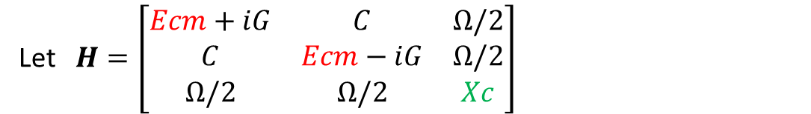
$$T=\left[\begin{matrix}1/\sqrt{2} & 1/\sqrt{2} & 0 \\ 1/\sqrt{2} & −1/\sqrt{2} & 0 \\ 0 & 0 & 1\end{matrix}\right]$$
Let $H=\left[\begin{matrix}Ecm+iG & C & Ω/2 \\ C & Ecm−iG & Ω/2 \\ Ω/2 & Ω/2 & Xc\end{matrix}\right]$
Then $THT^{\text{†}}=\left[\begin{matrix}Ecm+C & iγ & Ω/\sqrt{2} \\ iγ & Ecm−C & 0 \\ Ω/\sqrt{2} & 0 & Xc\end{matrix}\right]=\left[\begin{matrix}Xc+Δ+C & iγ & Ω/\sqrt{2} \\ iγ & Xc+Δ−C & 0 \\ Ω/\sqrt{2} & 0 & Xc\end{matrix}\right]$
Here we note that coupling between $Ecm−C$ and $Xc$ is exactly 0

