Slide 1
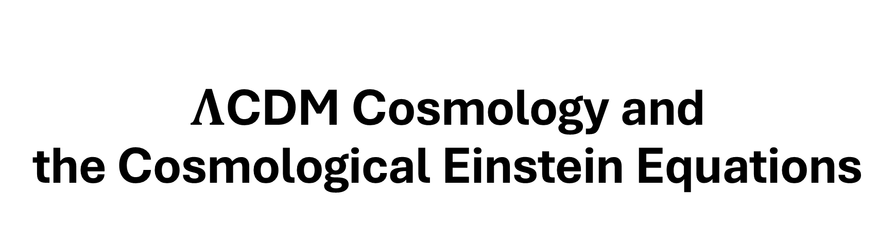
$Λ$CDM Cosmology and the Cosmological Einstein Equations
Presented By
Jinyan Miao

Slide 2
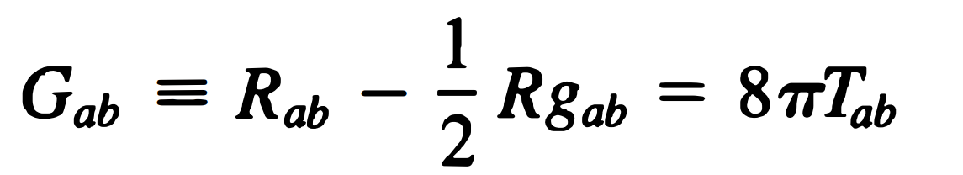
Einstein Equations
Geometry of spacetime
Matter in spacetime
Have studied:
Schwarzschild Metric, Kerr Black Hole
Gravitational Radiation
Null Geometry, Causal Structure
To study Cosmology:
Friedmann–Lemaître–Robertson–Walker Metric (FLRW metric)

Slide 3
Homogeneity and Isotropy
Intuition & Physical Meaning:
=> The Universe is HOMOGENEOUS (there is no privileged position in space)
=> The Universe is ISOTROPIC (no preferred directions to look into in space)
We proceed with these two assumptions for the rest of today’s presentation
In a Very LARGE SCALE

Slide 4
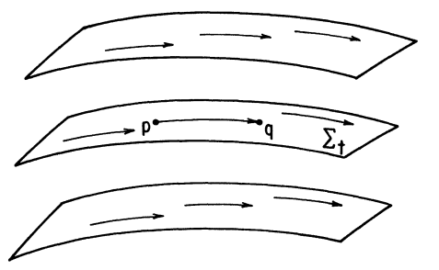
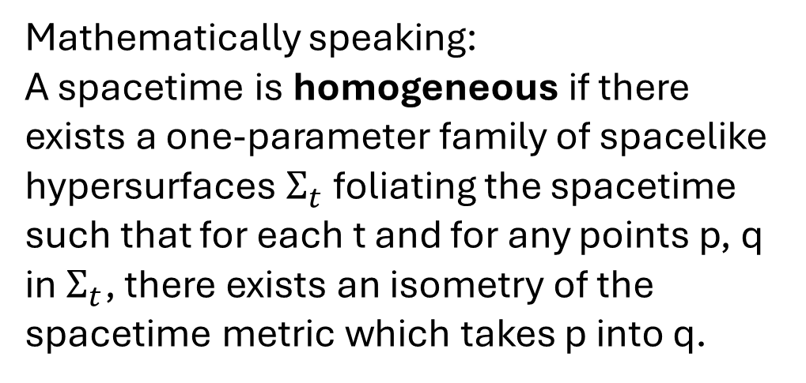
Homogeneity and Isotropy
Intuition & Physical Meaning:
=> The Universe is HOMOGENEOUS (there is no privileged position in space)
=> The Universe is ISOTROPIC (no preferred directions to look into in space)
In a Very LARGE SCALE
Mathematically speaking:
A spacetime is homogeneous if there exists a one-parameter family of spacelike hypersurfaces $Σ_{t}$ foliating the spacetime such that for each t and for any points p, q in $Σ_{t}$, there exists an isometry of the spacetime metric which takes p into q.

Slide 5
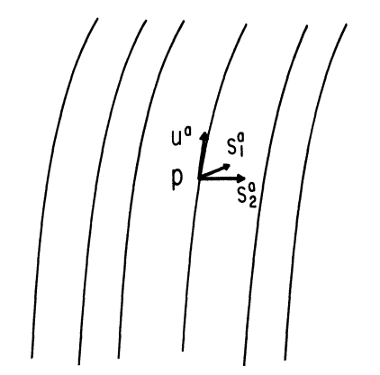
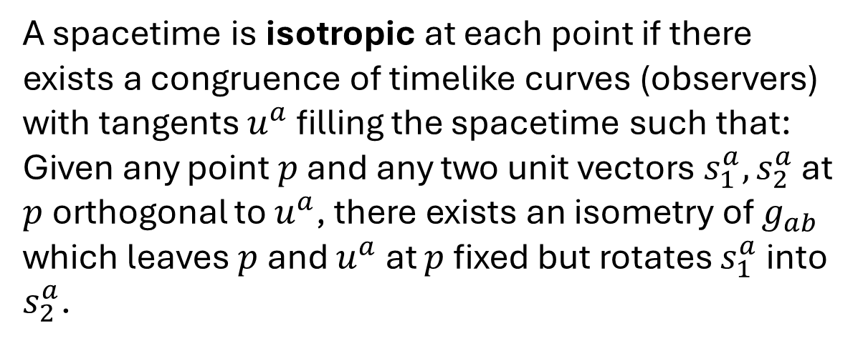
Homogeneity and Isotropy
Intuition & Physical Meaning:
=> The Universe is HOMOGENEOUS (there is no privileged position in space)
=> The Universe is ISOTROPIC (no preferred directions to look into in space)
In a Very LARGE SCALE
A spacetime is isotropic at each point if there exists a congruence of timelike curves (observers) with tangents $u^{a}$ filling the spacetime such that: Given any point $p$ and any two unit vectors $s_{1}^{a}, s_{2}^{a}$ at $p$ orthogonal to $u^{a}$, there exists an isometry of $g_{ab}$ which leaves $p$ and $u^{a}$ at $p$ fixed but rotates $s_{1}^{a}$ into $s_{2}^{a}$.

Slide 6

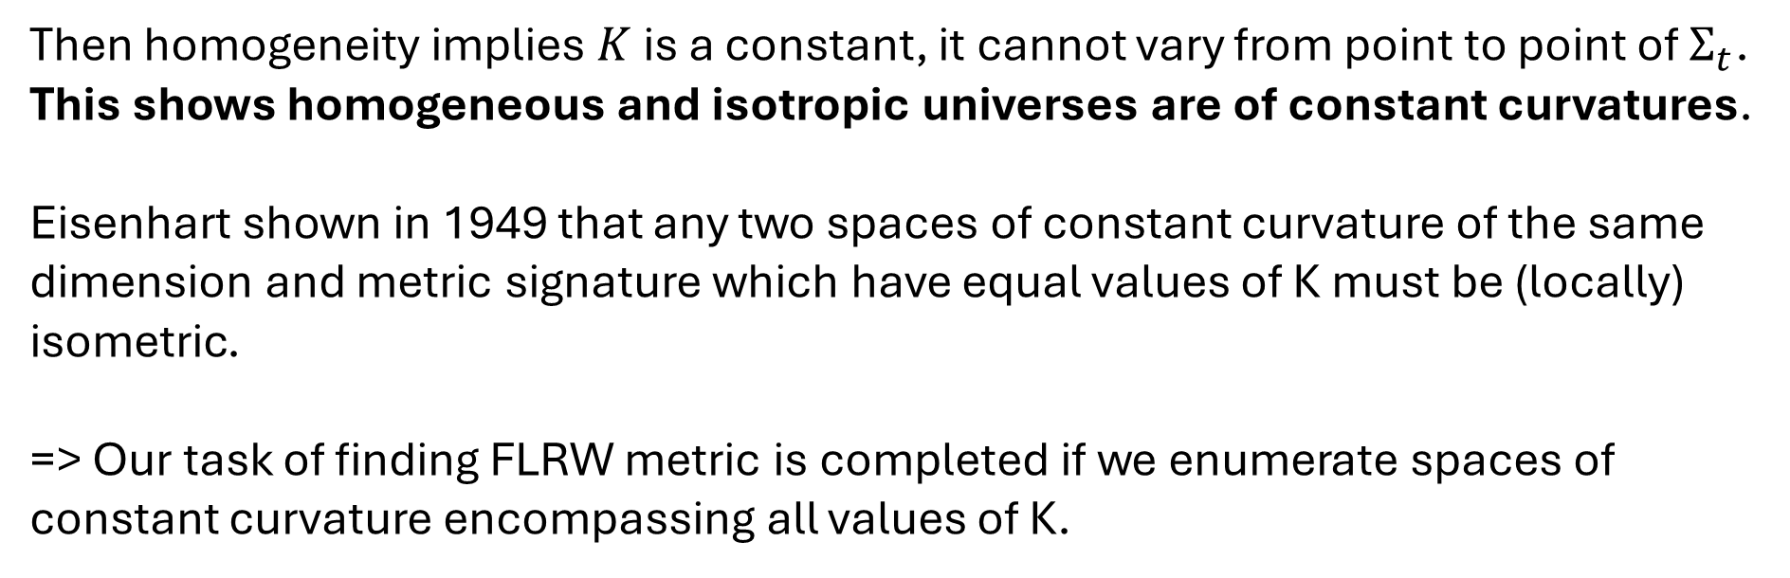
FLRW Metric
[Wald, pp. 94] With isotropy, one can argue Riemann tensor on $Σ_{t}$ satisfies
Then homogeneity implies $K$ is a constant, it cannot vary from point to point of $Σ_{t}$. This shows homogeneous and isotropic universes are of constant curvatures.
Eisenhart shown in 1949 that any two spaces of constant curvature of the same dimension and metric signature which have equal values of K must be (locally) isometric.
=> Our task of finding FLRW metric is completed if we enumerate spaces of constant curvature encompassing all values of K.

Slide 7
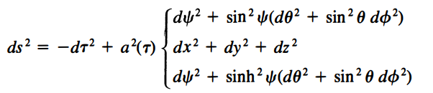

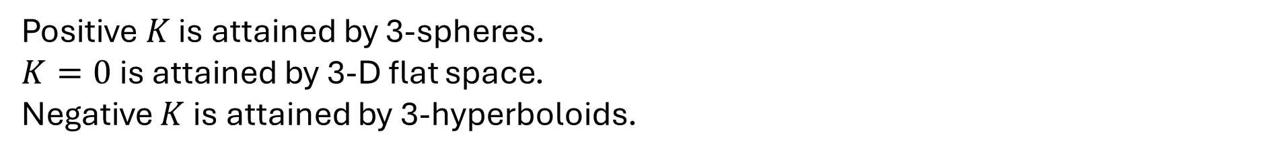
FLRW Metric
Positive $K$ is attained by 3-spheres.
$K=0$ is attained by 3-D flat space.
Negative $K$ is attained by 3-hyperboloids.
Friedmann–Lemaître–Robertson–Walker Metric (FLRW metric)
To determine $a(τ)$, we return to Einstein’s Equation.

Slide 8


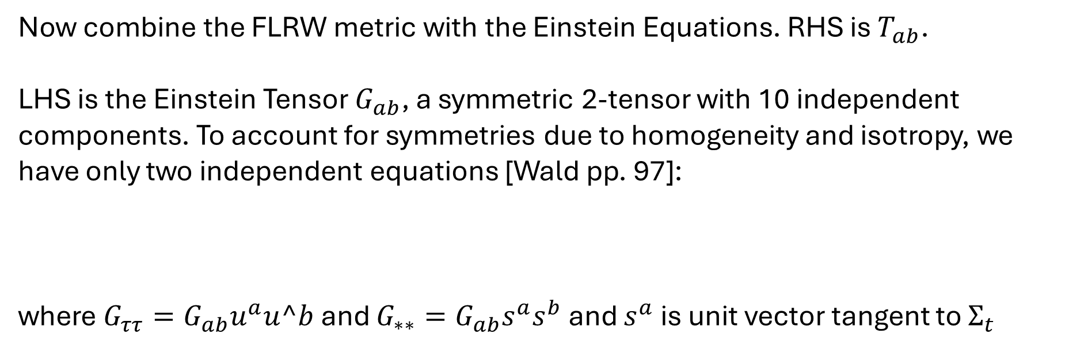
Dynamics of the Universe
The most general form of stress-energy tensor can take and being consistent with homogeneity and isotropy is that describing the general perfect fluid.
Now combine the FLRW metric with the Einstein Equations. RHS is $T_{ab}$.
LHS is the Einstein Tensor $G_{ab}$, a symmetric 2-tensor with 10 independent components. To account for symmetries due to homogeneity and isotropy, we have only two independent equations [Wald pp. 97]:
where $G_{ττ}=G_{ab}u^{a}u^b$ and $G_{∗∗}=G_{ab}s^{a}s^{b}$ and $s^{a}$ is unit vector tangent to $Σ_{t}$

Slide 9


Dynamics of the Universe
Plug in the FLRW metric and we obtain the first and second Friedmann Equations
where $k=1$ for sphere, $k=0$ for flat space, and $k=−1$ for hyperbolic space.
They describe the dynamics of the universe.

Slide 10
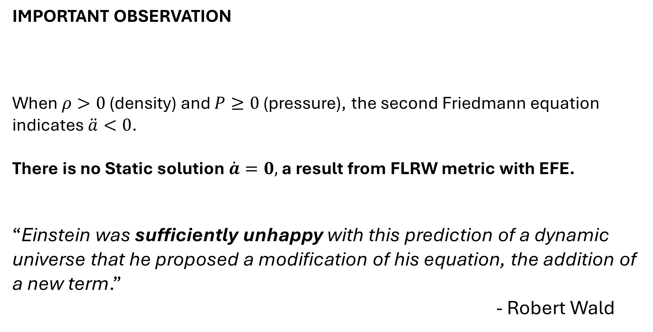
Static Solution
IMPORTANT OBSERVATION
When $ρ>0$ (density) and $P≥0$ (pressure), the second Friedmann equation indicates $\ddot{a}<0$.
There is no Static solution $\dot{a}=0,$ a result from FLRW metric with EFE.
“Einstein was sufficiently unhappy with this prediction of a dynamic universe that he proposed a modification of his equation, the addition of a new term.”
- Robert Wald

Slide 11


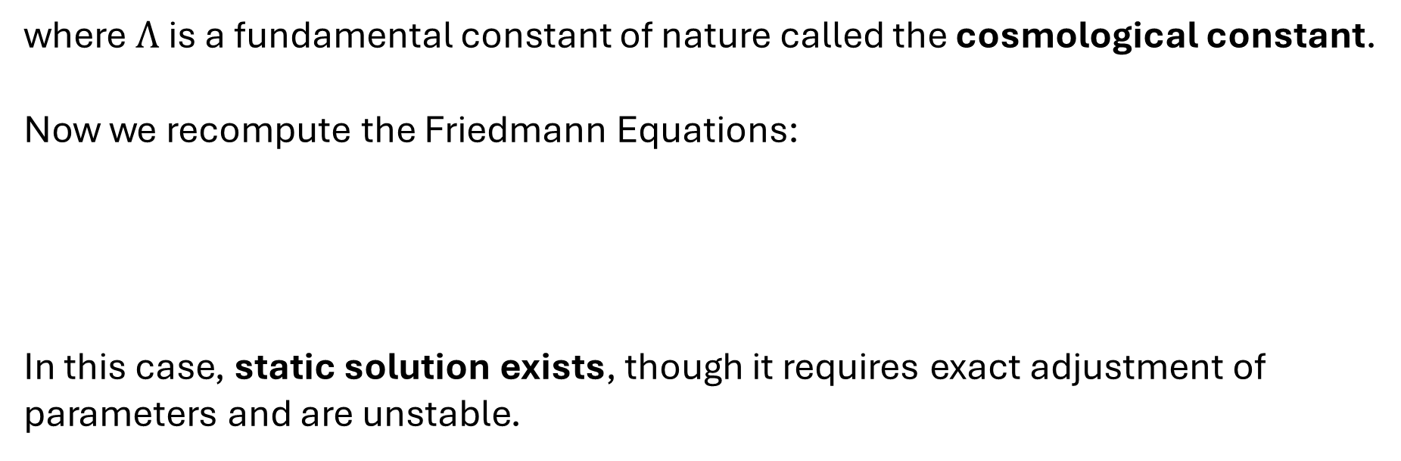
Static Solution
where $Λ$ is a fundamental constant of nature called the cosmological constant.
Now we recompute the Friedmann Equations:
In this case, static solution exists, though it requires exact adjustment of parameters and are unstable.

Slide 12

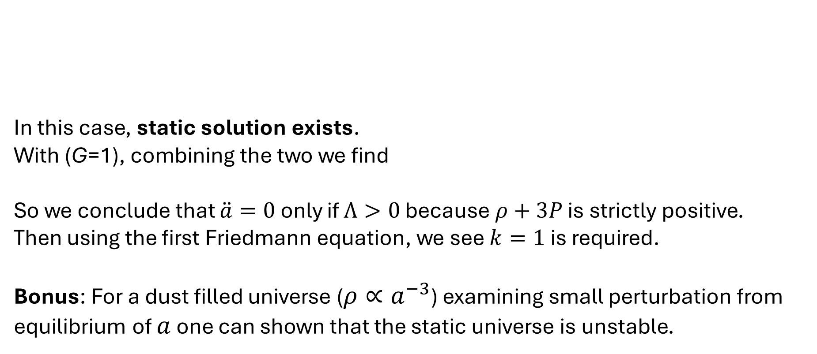
Static Solution
In this case, static solution exists.
With (G=1), combining the two we find
So we conclude that $\ddot{a}=0$ only if $Λ>0$ because $ρ+3P$ is strictly positive.
Then using the first Friedmann equation, we see $k=1$ is required.
Bonus: For a dust filled universe ($ρ∝a^{−3}$) examining small perturbation from equilibrium of $a$ one can shown that the static universe is unstable.

Slide 13


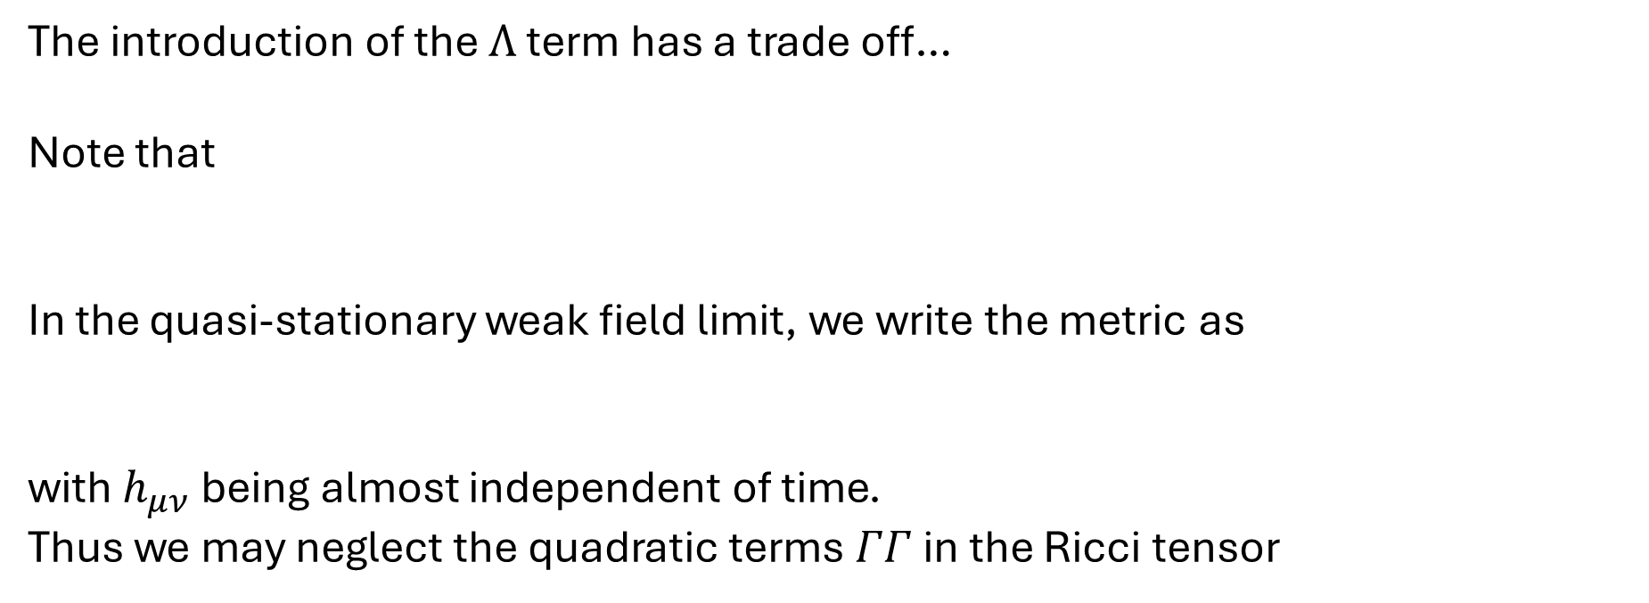
Newtonian Limit
The introduction of the $Λ$ term has a trade off…
Note that
In the quasi-stationary weak field limit, we write the metric as
with $h_{μν}$ being almost independent of time.
Thus we may neglect the quadratic terms $ΓΓ$ in the Ricci tensor

Slide 14


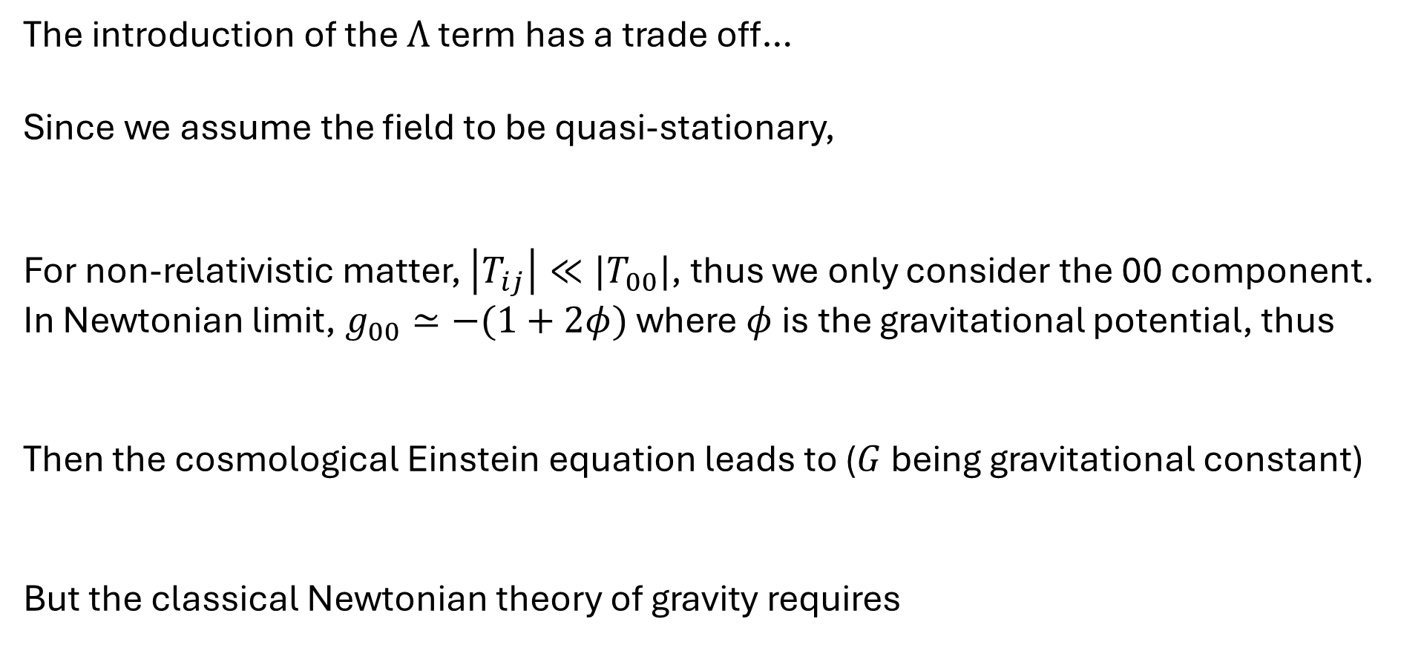
Newtonian Limit
The introduction of the $Λ$ term has a trade off…
Since we assume the field to be quasi-stationary,
For non-relativistic matter, $\left|T_{ij}\right|≪|T_{00}|$, thus we only consider the 00 component.
In Newtonian limit, $g_{00}≃−(1+2φ)$ where $φ$ is the gravitational potential, thus
Then the cosmological Einstein equation leads to ($G$ being gravitational constant)
But the classical Newtonian theory of gravity requires

Slide 15
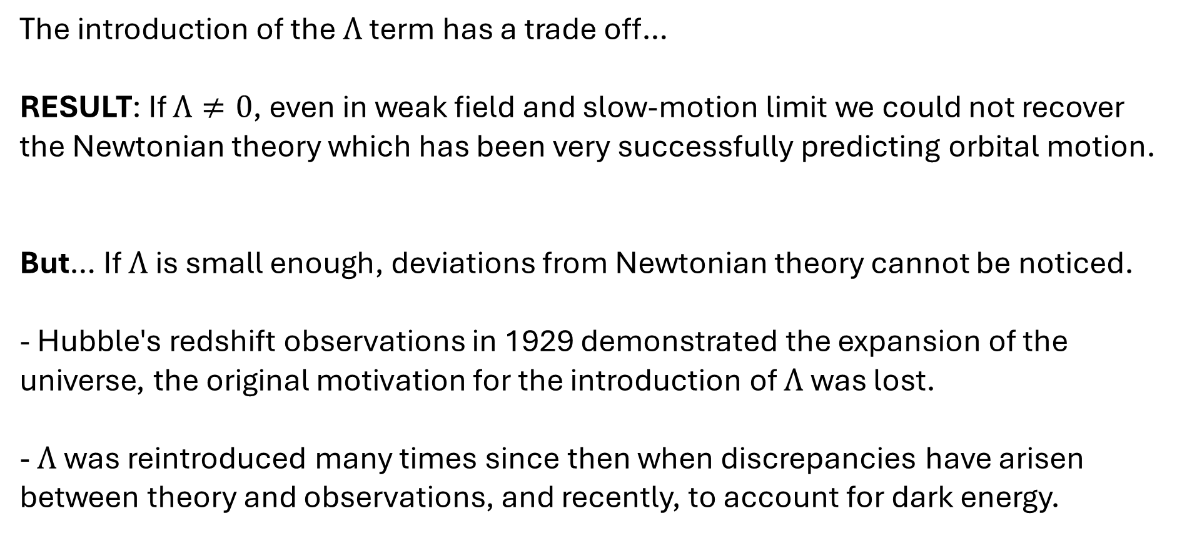
Newtonian Limit
The introduction of the $Λ$ term has a trade off…
RESULT: If $Λ≠0$, even in weak field and slow-motion limit we could not recover the Newtonian theory which has been very successfully predicting orbital motion.
But… If $Λ$ is small enough, deviations from Newtonian theory cannot be noticed.
- Hubble's redshift observations in 1929 demonstrated the expansion of the universe, the original motivation for the introduction of $Λ$ was lost.
- $Λ$ was reintroduced many times since then when discrepancies have arisen between theory and observations, and recently, to account for dark energy.

Slide 16

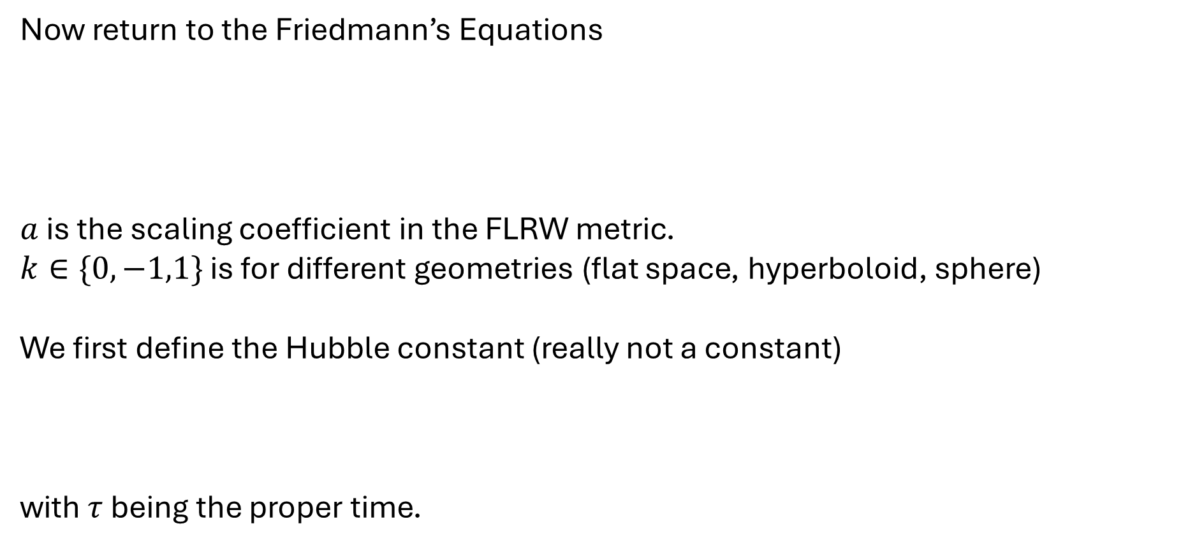
Hubble’s Law
Now return to the Friedmann’s Equations
$a$ is the scaling coefficient in the FLRW metric.
$k∈\{0,−1,1\}$ is for different geometries (flat space, hyperboloid, sphere)
We first define the Hubble constant (really not a constant)
with $τ$ being the proper time.

Slide 17
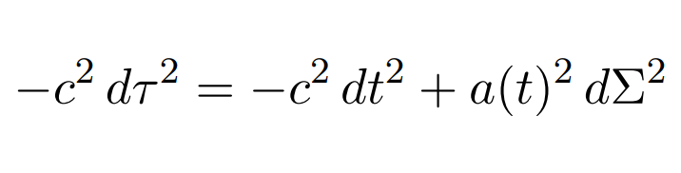

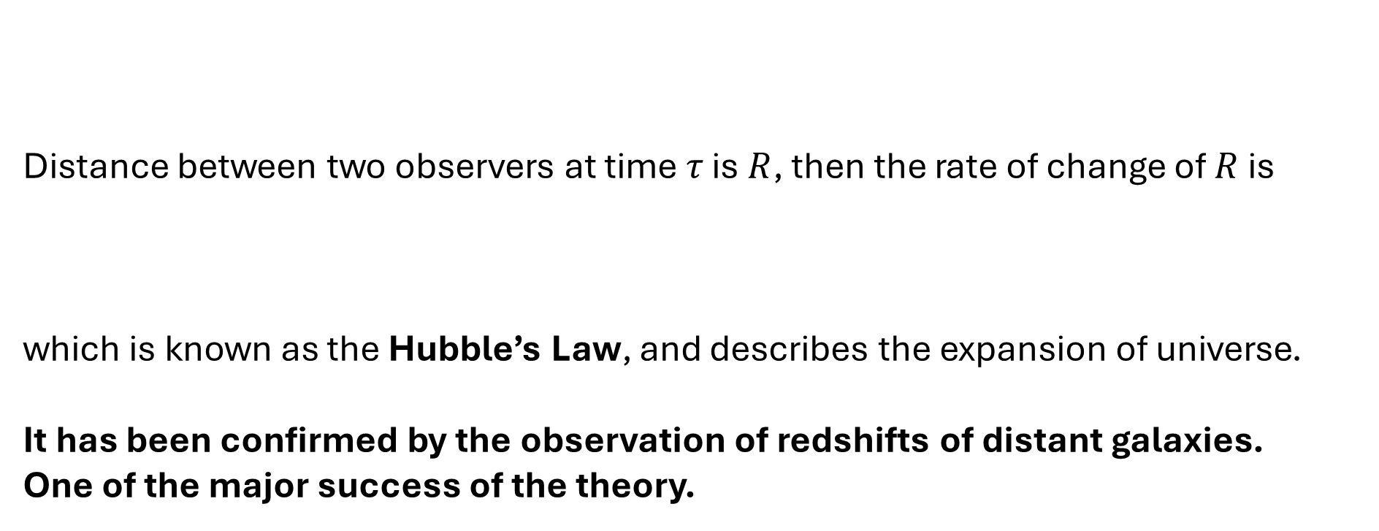
Hubble’s Law
Distance between two observers at time $τ$ is $R$, then the rate of change of $R$ is
which is known as the Hubble’s Law, and describes the expansion of universe.
It has been confirmed by the observation of redshifts of distant galaxies.
One of the major success of the theory.

Slide 18

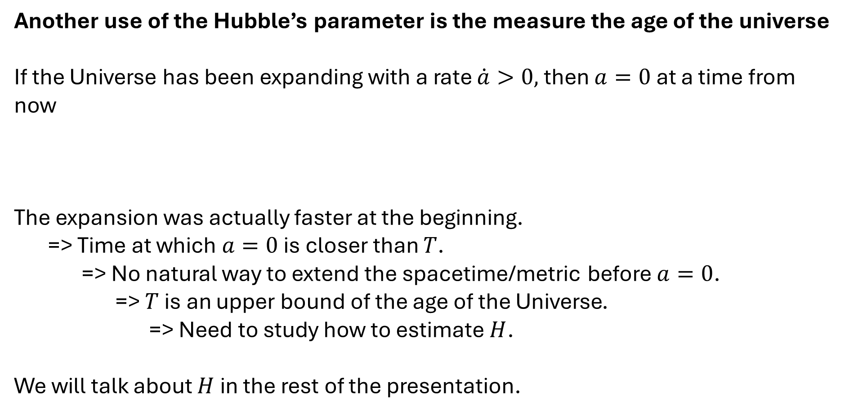
Fate of the Universe
Another use of the Hubble’s parameter is the measure the age of the universe
If the Universe has been expanding with a rate $\dot{a}>0,$ then $a=0$ at a time from now
The expansion was actually faster at the beginning.
=> Time at which $a=0$ is closer than $T$.
=> No natural way to extend the spacetime/metric before $a=0$.
=> $T$ is an upper bound of the age of the Universe.
=> Need to study how to estimate $H$.
We will talk about $H$ in the rest of the presentation.

Slide 19

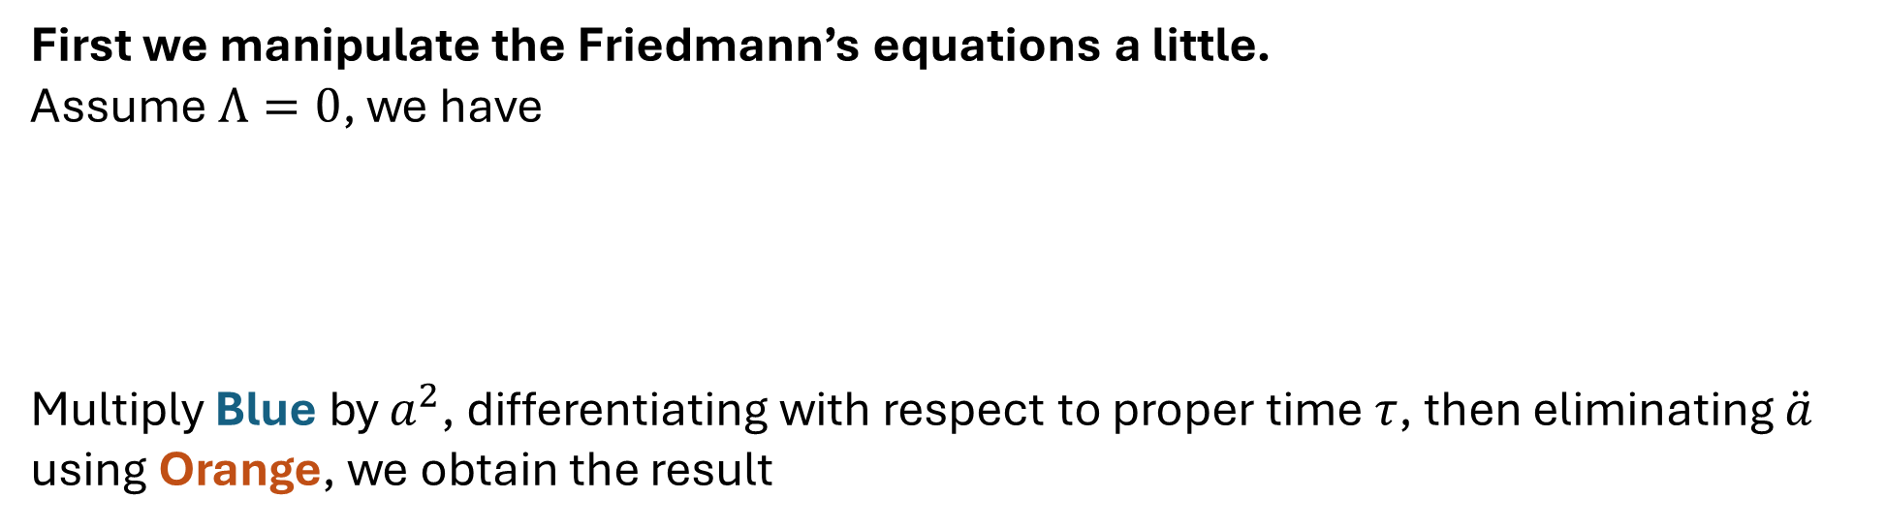
Matter in the Universe
First we manipulate the Friedmann’s equations a little.
Assume $Λ=0$, we have
Multiply Blue by $a^{2}$, differentiating with respect to proper time $τ$, then eliminating $\ddot{a}$ using Orange, we obtain the result

Slide 20
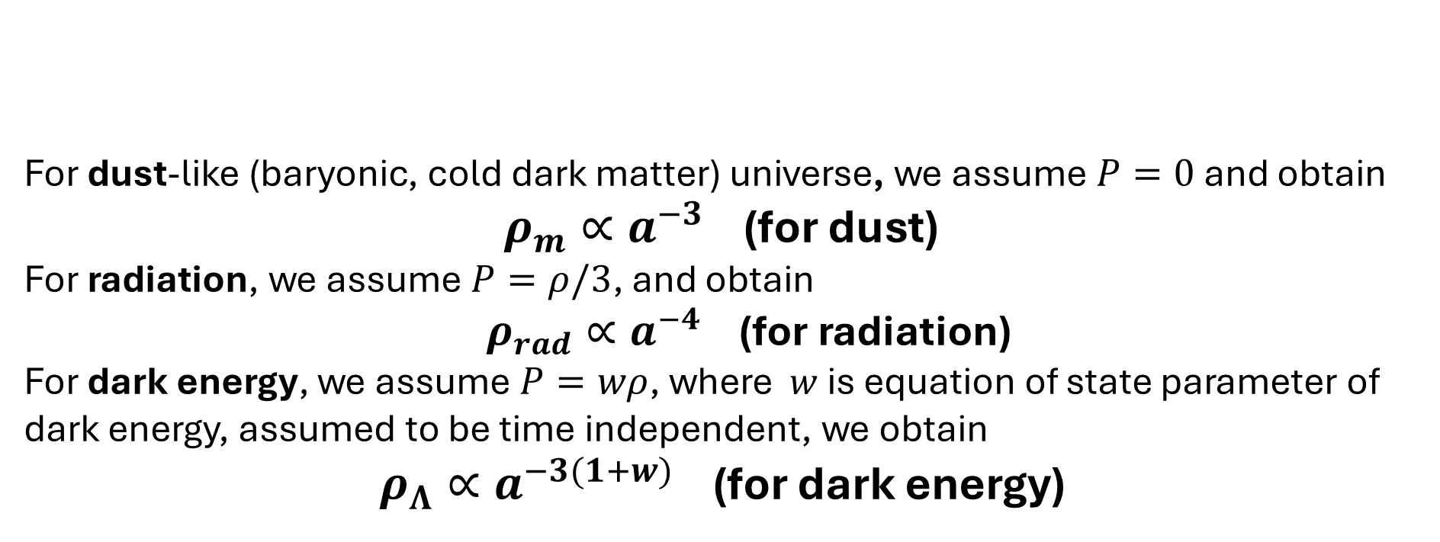
Matter in the Universe
For dust-like (baryonic, cold dark matter) universe, we assume $P=0$ and obtain
$ρ_{m}∝a^{−3}$ (for dust)
For radiation, we assume $P=ρ/3$, and obtain
$ρ_{rad}∝a^{−4}$ (for radiation)
For dark energy, we assume $P=wρ$, where $w$ is equation of state parameter of dark energy, assumed to be time independent, we obtain
$ρ_{Λ}∝a^{−3(1+w)}$ (for dark energy)

Slide 21
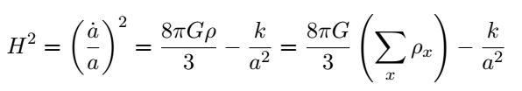
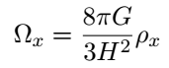

Matter in the Universe
From the first Friedmann equation, and the definition of Hubble constant,
with $x$ being be dust/radiation/dark energy etc. Define density parameter $Ω_{x}$,

Slide 22
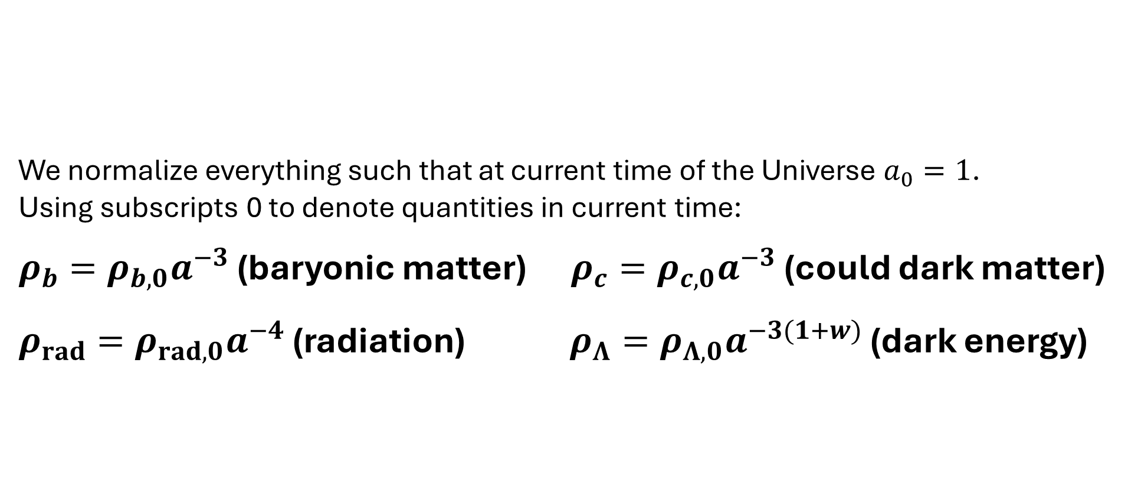
𝚲CDM Cosmology
We normalize everything such that at current time of the Universe $a_{0}=1$.
Using subscripts 0 to denote quantities in current time:
$ρ_{b}=ρ_{b,0}a^{−3}$ (baryonic matter) $ρ_{c}=ρ_{c,0}a^{−3}$ (could dark matter)
$ρ_{rad}=ρ_{rad,0}a^{−4}$ (radiation) $ρ_{Λ}=ρ_{Λ,0}a^{−3(1+w)}$ (dark energy)

Slide 23
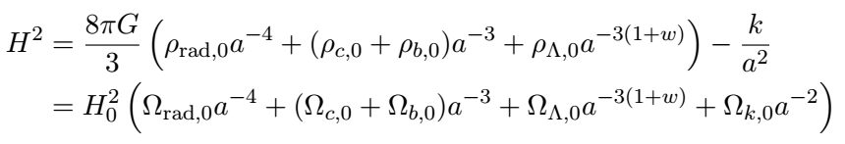
𝚲CDM Cosmology
Computation

Slide 24
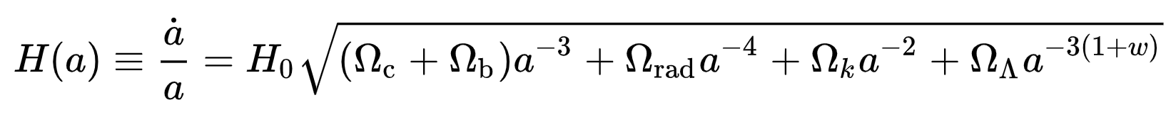

𝚲CDM Cosmology
Final Result
(subscripts 0 in $Ω$ dropped)
𝚲CDM cosmology is a mathematical model (from GR) of the Big Bang theory.
1. Dark Energy ($Λ$),
2. Cold dark matter (c),
3. Curvature of space (k),
4. Ordinary matter (b), and radiation (rad).
Cosmologist uses data to find precise $H_{0}$, $w$, $Ω_{x}$ and so on.

Slide 25

𝚲CDM Cosmology
Note:
The model includes a single originating event, the Big Bang, and we can estimate the age of the Universe using the model.
Using the redshift of the radiation.
Define a redshift parameter $z$, it can be shown that
$\left(1+z\right)=a_{0}/a$

Slide 26

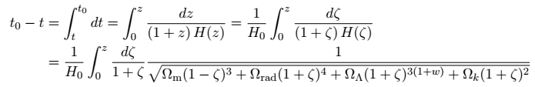
𝚲CDM Cosmology
Then we know
Thus according to the model, the age of the Universe is at most (13.8 billion years)

Slide 27
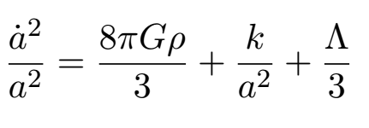
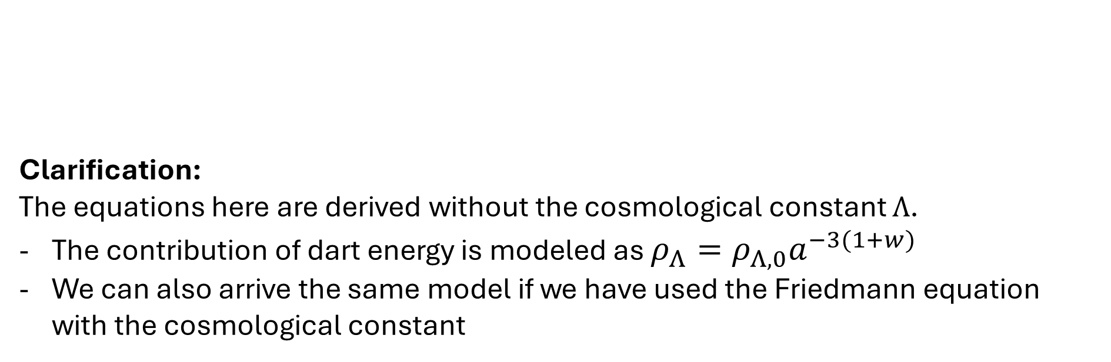
𝚲CDM Cosmology
Clarification:
The equations here are derived without the cosmological constant $Λ$.
The contribution of dart energy is modeled as $ρ_{Λ}=ρ_{Λ,0}a^{−3(1+w)}$
We can also arrive the same model if we have used the Friedmann equation with the cosmological constant

Slide 28


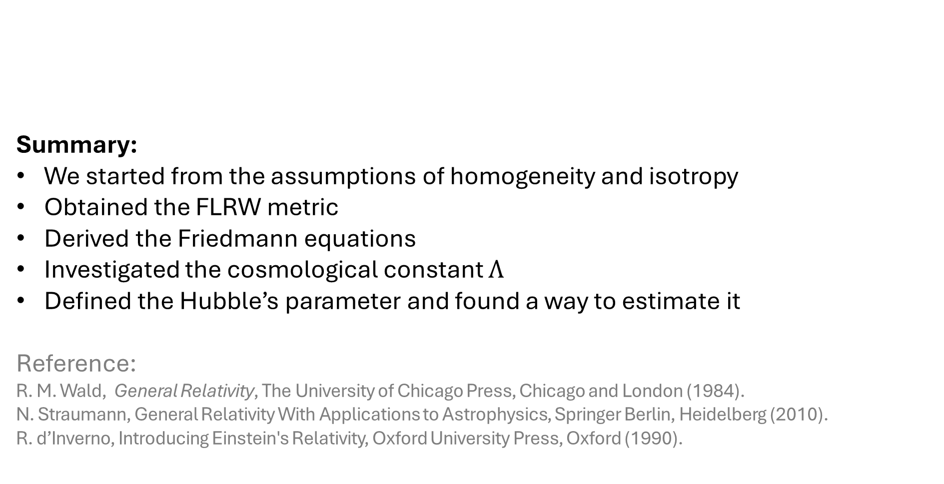
𝚲CDM Cosmology
Summary:
We started from the assumptions of homogeneity and isotropy
Obtained the FLRW metric
Derived the Friedmann equations
Investigated the cosmological constant $Λ$
Defined the Hubble’s parameter and found a way to estimate it
Reference:
R. M. Wald, General Relativity, The University of Chicago Press, Chicago and London (1984).
N. Straumann, General Relativity With Applications to Astrophysics, Springer Berlin, Heidelberg (2010).
R. d’Inverno, Introducing Einstein's Relativity, Oxford University Press, Oxford (1990).

Slide 29
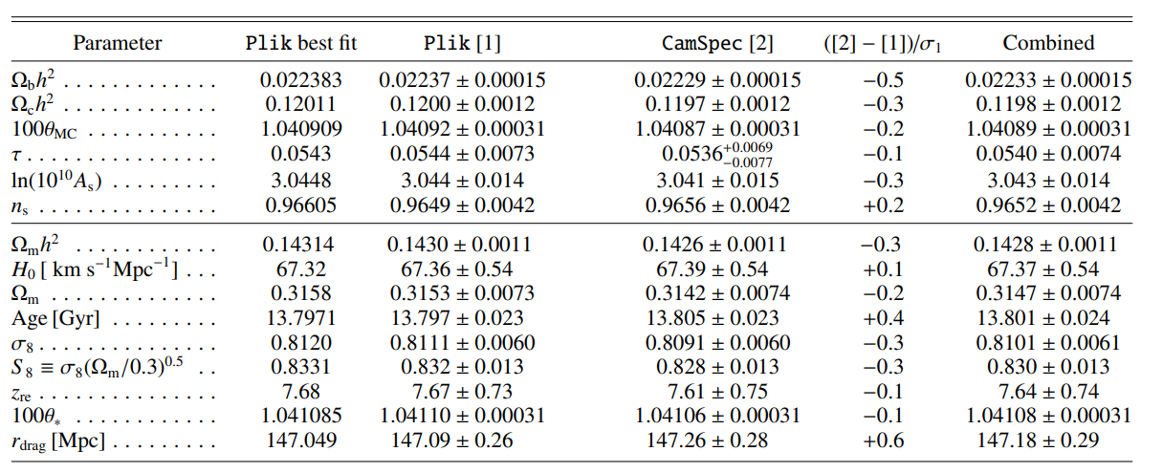
Research in Cosmology
Planck Collaboration, Planck 2018 results. VI. Cosmological parameters, arXiv E-Prints, arXiv:1807.06209 (2018).

Slide 30
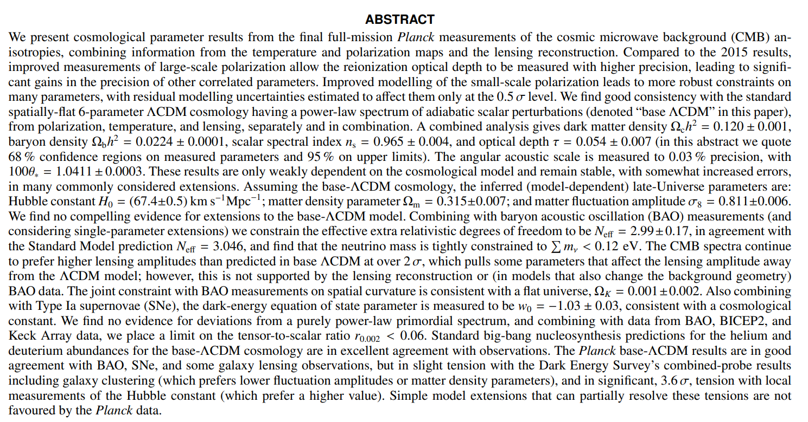

Slide 31
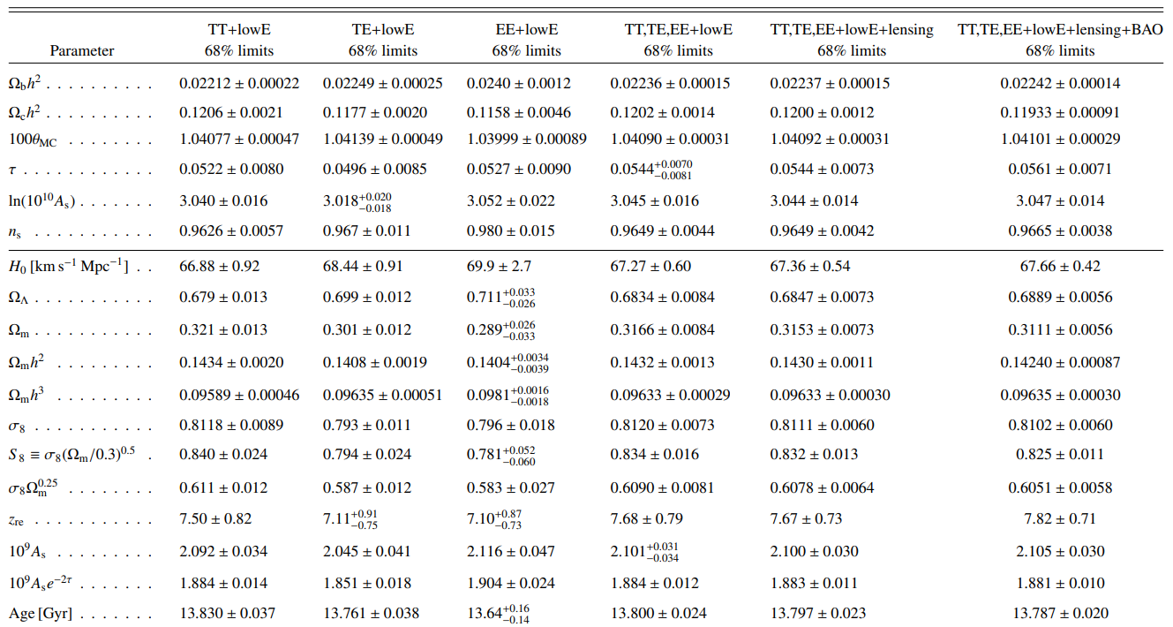

Slide 32
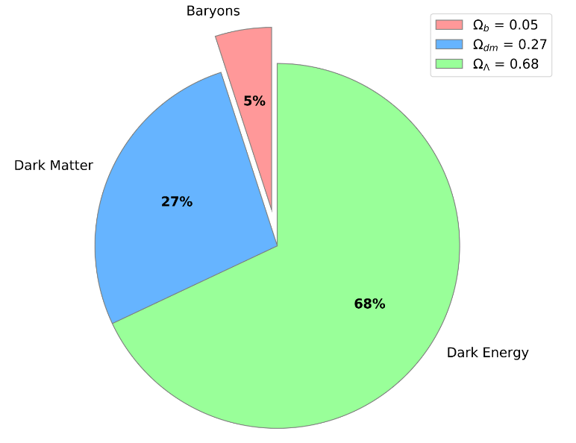
Research in Cosmology

