Slide 1

Two-level System and the Rydberg Blockade CNOT Gate
Presented by
Jinyan Miao

Slide 2
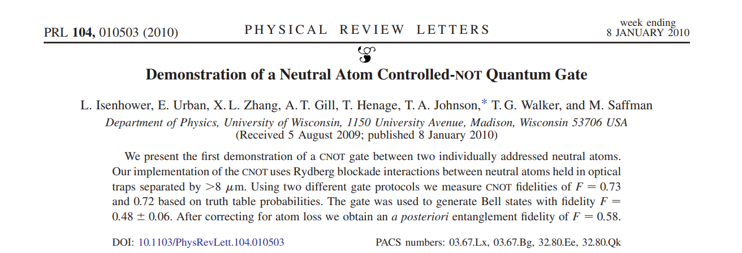
Overview
Objective: Understand the physics in building the Rydberg atom CNOT gate
Two-level systems (theory and numerical results)
Rydberg atom (why and how to use it)
Methods in studying two-level systems

Slide 3





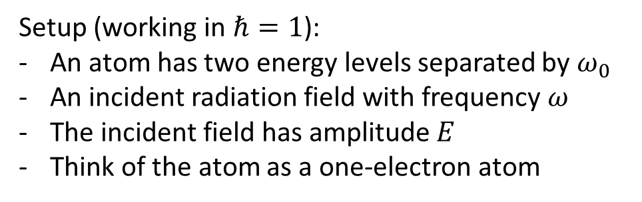
Two-level System
A model describing an atom interacting with an external field
Write the Hamiltonian of the atom and the interaction
The evolution of a given state is described by the time-dependent Schrodinger equation
Setup (working in $ℏ=1$):
An atom has two energy levels separated by $ω_{0}$
An incident radiation field with frequency $ω$
The incident field has amplitude $E$
Think of the atom as a one-electron atom
$$|1⟩$$
$$ω$$
$$ω_{0}$$
$$|0⟩$$

Slide 4




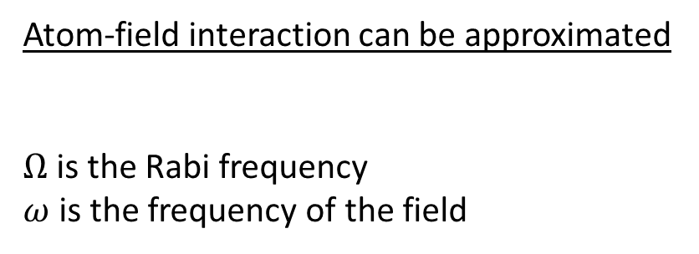


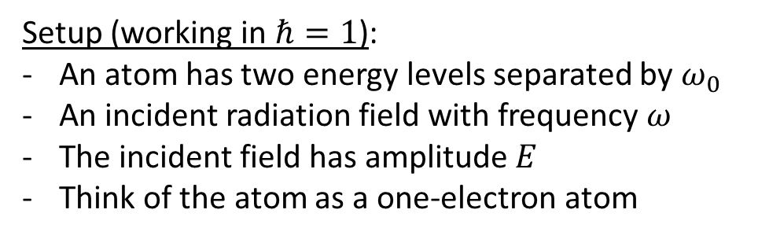

Two-level System
Setup (working in $ℏ=1$):
An atom has two energy levels separated by $ω_{0}$
An incident radiation field with frequency $ω$
The incident field has amplitude $E$
Think of the atom as a one-electron atom
Atom-field interaction can be approximated
$Ω$ is the Rabi frequency
$ω$ is the frequency of the field
$$V_{AF}\left(t\right)≈−\hat{μ}⋅E\left(t\right)=e\hat{r}⋅E\left(t\right)= Ωcos(ωt)$$
The total Hamiltonian has the form
with the bare atom Hamiltonian
and the interaction Hamiltonian
$$|1⟩$$
$$δ$$
$$\hat{H}={\hat{H}}_{atom}+{\hat{H}}_{int}$$
$$ω_{0}/2$$
$$0$$
$${\hat{H}}_{atom}=(ω_{0}/2) |1⟩⟨1|−(ω_{0}/2)|0⟩⟨0|={−(ω_{0}/2)σ}_{z}$$
$$ω$$
$$ω_{0}/2$$
$$|0⟩$$
$${\hat{H}}_{int}=Ωcos(ωt)|1⟩⟨2|+Ωcos(ωt)|2⟩⟨1|=Ω\cos\left(ωt\right)σ_{x}$$

Slide 5

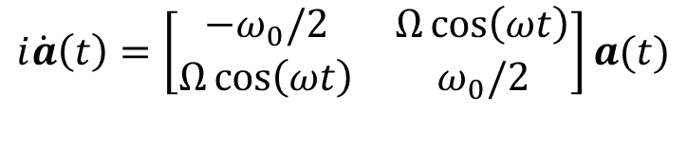


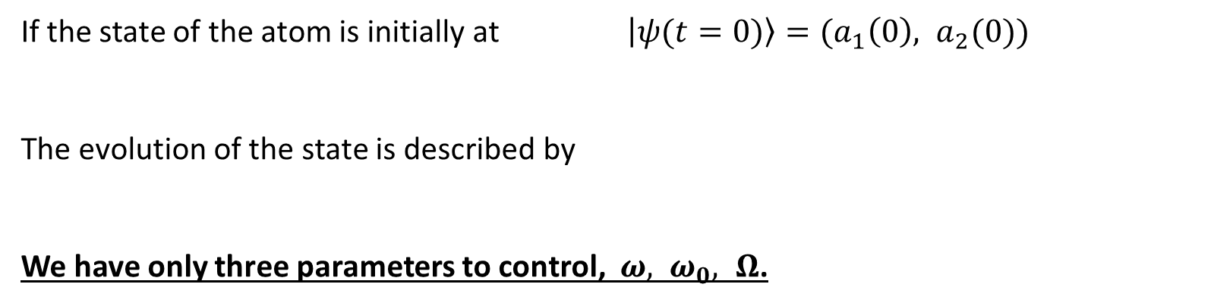


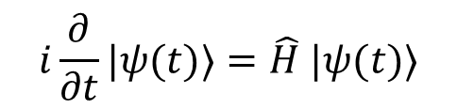



Evolution of a State
$$|1⟩$$
$$δ$$
The total Hamiltonian
Time-dependent Schrodinger equation
$$\hat{H}=−{(ω_{0}/2)σ}_{z}+Ω\cos\left(ωt\right)σ_{x}$$
$$ω_{0}/2$$
$$0$$
$$ω$$
$$i\frac{∂}{∂t}|ψ(t)⟩=\hat{H} |ψ(t)⟩$$
$$ω_{0}/2$$
$$|0⟩$$
If the state of the atom is initially at $\left|ψ(t=0)\right\rangle =(a_{1}\left(0\right), a_{2}(0))$
The evolution of the state is described by
We have only three parameters to control, $ω, ω_{0}, Ω$.
$$i\dot{a}\left(t\right)=\left[\begin{matrix}−ω_{0}/2 & Ω\cos\left(ωt\right) \\ Ω\cos\left(ωt\right) & ω_{0}/2\end{matrix}\right]a(t)$$

Slide 6
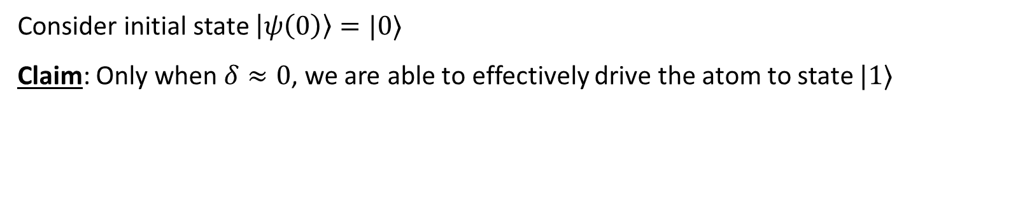
Evolution of a State
$$|1⟩$$
$$δ$$
The total Hamiltonian
Time-dependent Schrodinger equation
$$\hat{H}=−{(ω_{0}/2)σ}_{z}+Ω\cos\left(ωt\right)σ_{x}$$
$$ω_{0}/2$$
$$0$$
$$ω$$
$$i\frac{∂}{∂t}|ψ(t)⟩=\hat{H} |ψ(t)⟩$$
$$ω_{0}/2$$
$$|0⟩$$
Consider initial state $\left|ψ\left(0\right)\right\rangle =|0⟩$
Claim: Only when $δ≈0$, we are able to effectively drive the atom to state $|1⟩$

Slide 7
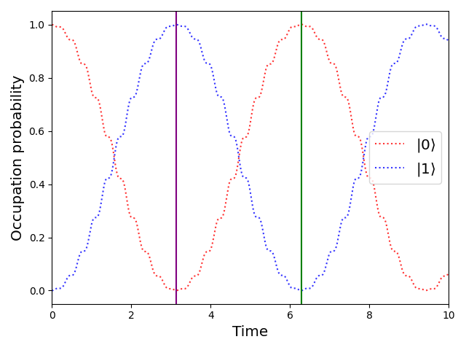
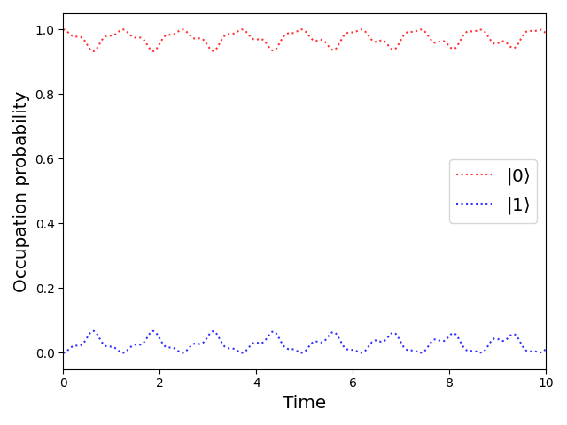





Rabi Oscillation
Consider initial state $\left|ψ\left(0\right)\right\rangle =|0⟩$
Claim: Only when $δ≈0$, we are able to effectively drive the atom to state $|1⟩$
$$ω/ω_{0}\text{=1}$$
$$ω/ω_{0}\text{=}\text{0.5}$$
$2π$-pulse $T=2πΩ_{0}$
$π$-pulse

Slide 8
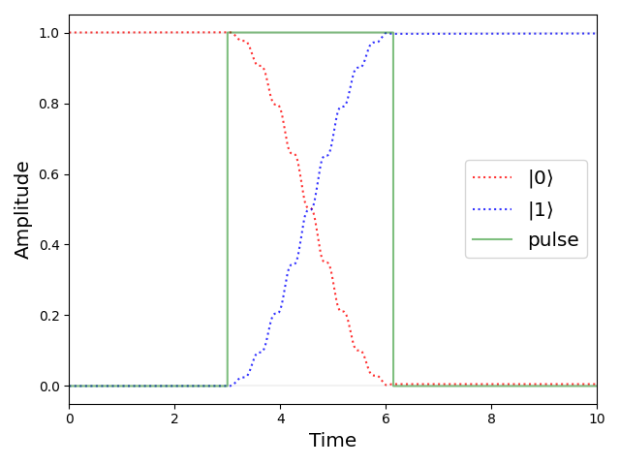
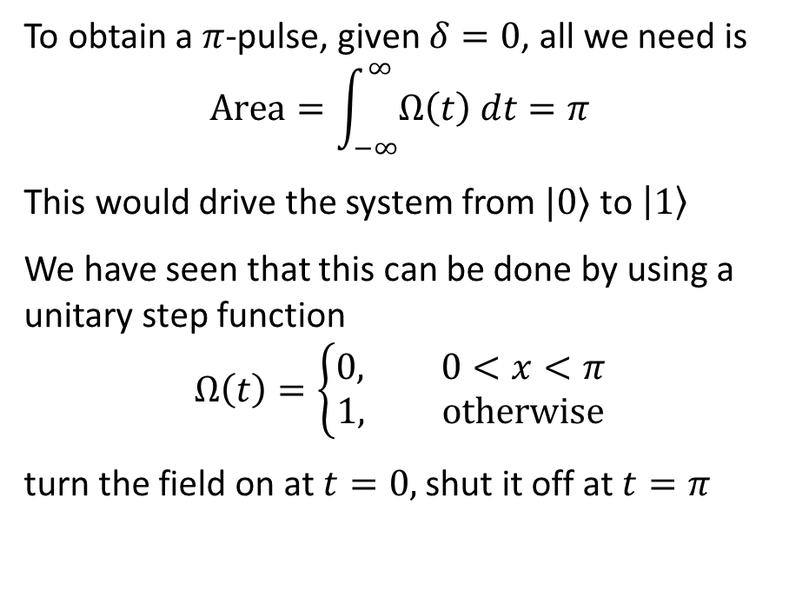
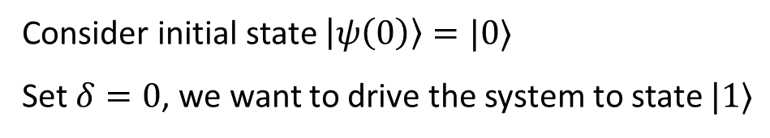
A $π$-pulse Drive
Consider initial state $\left|ψ\left(0\right)\right\rangle =|0⟩$
Set $δ=0$, we want to drive the system to state $|1⟩$
To obtain a $π$-pulse, given $δ=0$, all we need is
$$Area=\int_{−∞}^{∞}{Ω\left(t\right) dt}=π$$
This would drive the system from $|0⟩$ to $\left|1\right\rangle$
We have seen that this can be done by using a unitary step function
$$Ω\left(t\right)=\left\{\begin{aligned}0, 0<x<π \\ &1, otherwise\end{aligned}\right.$$
turn the field on at $t=0,$shut it off at $t=π$

Slide 9
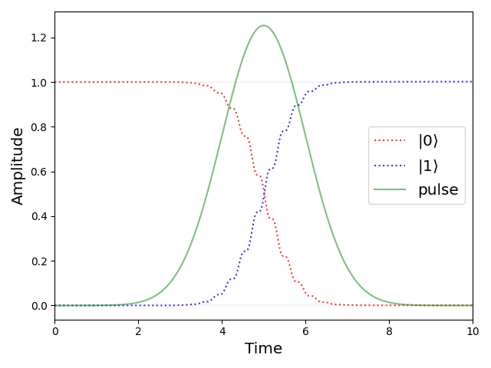
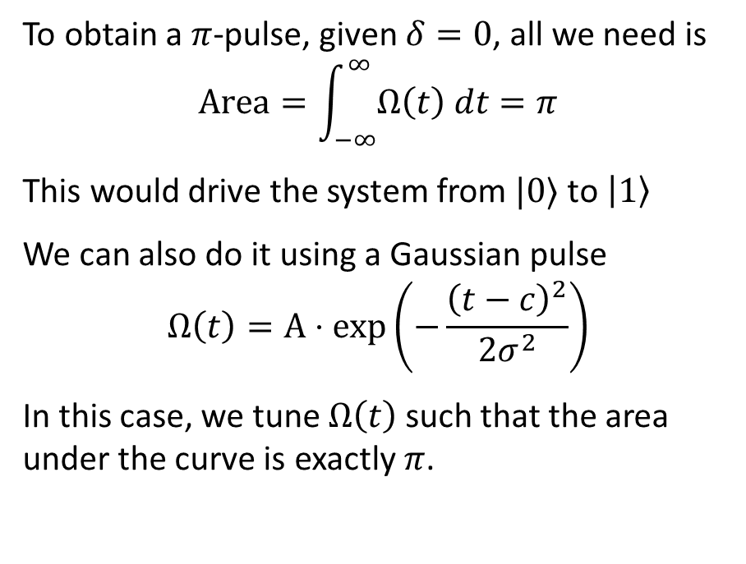
A $π$-pulse Drive
Consider initial state $\left|ψ\left(0\right)\right\rangle =|0⟩$
Set $δ=0$, we want to drive the system to state $|1⟩$
To obtain a $π$-pulse, given $δ=0$, all we need is
$$Area=\int_{−∞}^{∞}{Ω\left(t\right) dt}=π$$
This would drive the system from $|0⟩$ to $\left|1\right\rangle$
We can also do it using a Gaussian pulse
$$Ω\left(t\right)=A⋅exp\left(−\frac{{\left(t−c\right)}^{2}}{2σ^{2}}\right)$$
In this case, we tune $Ω\left(t\right)$ such that the area under the curve is exactly $π$.

Slide 10


Short Summary
Dynamics of the two-level system is described by
Only when $δ≈0$, we are able to effectively drive the atom to state $|1⟩$
We want area under $Ω\left(t\right)$ to be $π$ to obtain a $π$-pulse which drives $\left|0\right\rangle ↔|1⟩$
$$\hat{H}=−{(ω_{0}/2)σ}_{z}+Ω\cos\left(ωt\right)σ_{x}$$

Slide 11

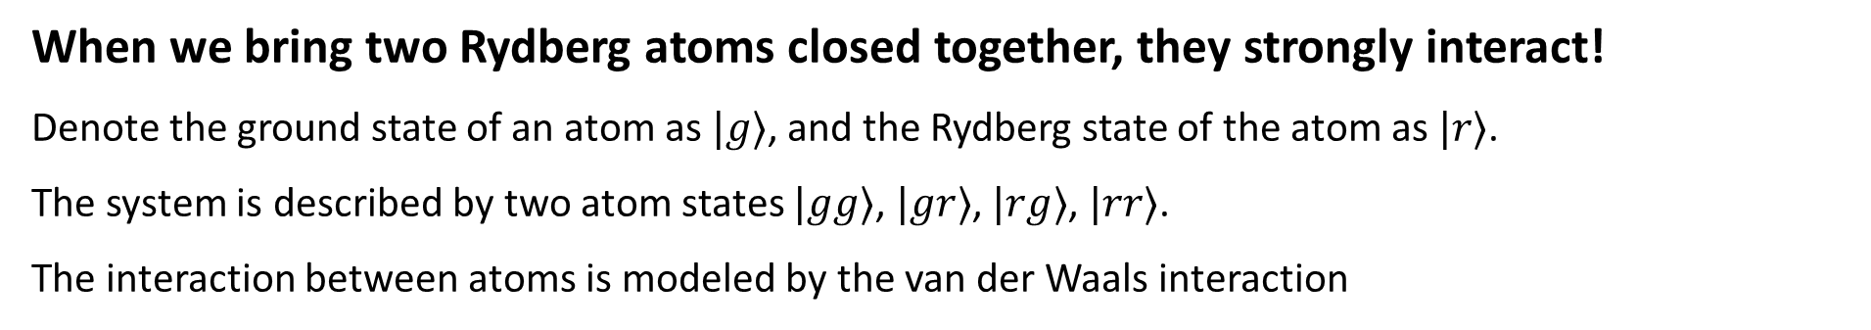
The Rydberg Blockade Mechanism
Another key component: Rydberg Atoms
A Rydberg atom is an excited atom with electrons that have very high principal quantum numbers
High principal quantum number means that the electrons are far from the nucleus
Thus the atom is very sensitive to external electric field
When we bring two Rydberg atoms closed together, they strongly interact!
Denote the ground state of an atom as $|g⟩$, and the Rydberg state of the atom as $|r⟩$.
The system is described by two atom states $|gg⟩$, $|gr⟩$, $|rg⟩$, $|rr⟩$.
The interaction between atoms is modeled by the van der Waals interaction
$C_{6}$ is the van der Waals coefficient; $R$ is the distance between two atoms

Slide 12

The Rydberg Blockade Mechanism
When we bring two Rydberg atoms closed together, they strongly interact
Resulting dynamics:
In the limit $\left|C_{6}\right|/R^{6}≪Ω$, only small perturbation
In the limit $\left|C_{6}\right|/R^{6}≫Ω$, $|rr⟩$ state is effectively decoupled from the dynamics
$C_{6}$ is the van der Waals coefficient; $R$ is the distance between two atoms
Rydberg Blockade
The distance at which the blockade sets in is called the blockade radius, $R_{b}$

Slide 13
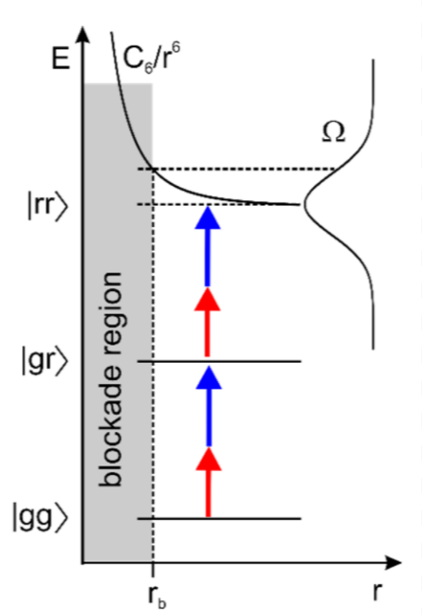



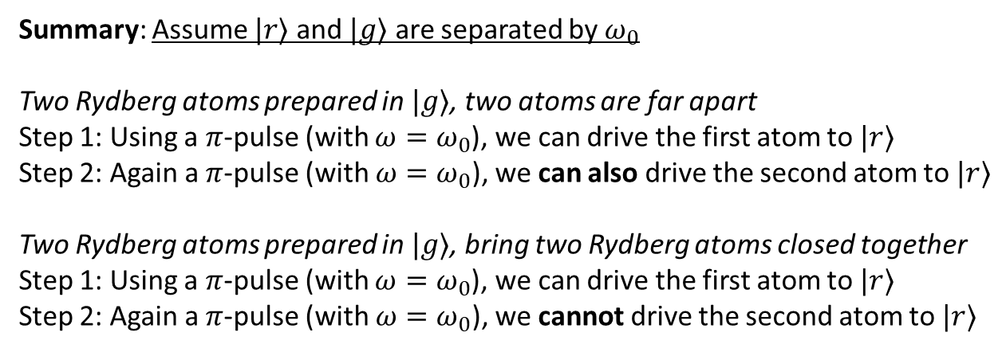



The Rydberg Blockade Mechanism
Resulting dynamics:
When $\left|C_{6}\right|/R^{6}≪Ω$, only small perturbation
When $\left|C_{6}\right|/R^{6}≫Ω$, Rydberg blockade
$$R^{6}$$
$π$ pulse
Summary: Assume $|r⟩$ and $|g⟩$ are separated by $ω_{0}$
Two Rydberg atoms prepared in $|g⟩$, two atoms are far apart
Step 1: Using a $π$-pulse (with $ω=ω_{0}$), we can drive the first atom to $|r⟩$
Step 2: Again a $π$-pulse (with $ω=ω_{0}$), we can also drive the second atom to $|r⟩$
Two Rydberg atoms prepared in $|g⟩$, bring two Rydberg atoms closed together
Step 1: Using a $π$-pulse (with $ω=ω_{0}$), we can drive the first atom to $|r⟩$
Step 2: Again a $π$-pulse (with $ω=ω_{0}$), we cannot drive the second atom to $|r⟩$
$π$ pulse
$$R_{b}$$
$$R$$

Slide 14
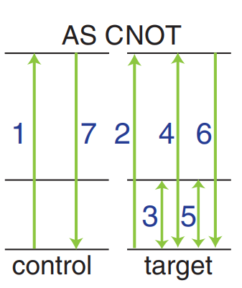
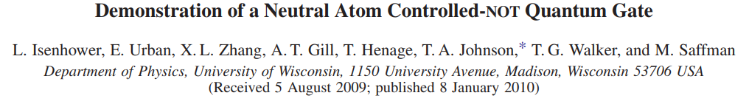
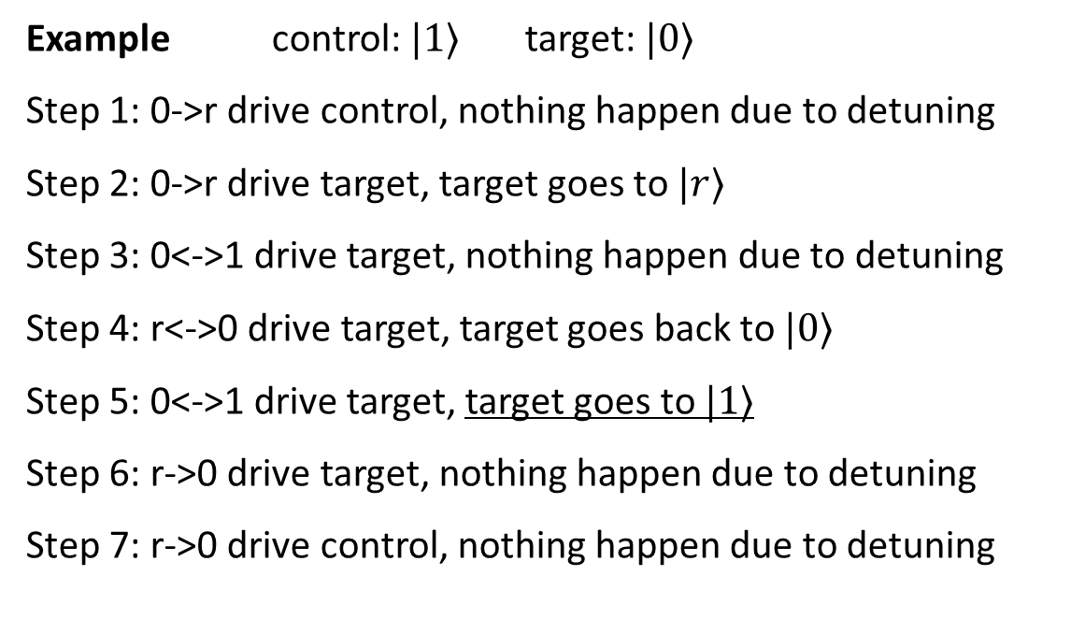
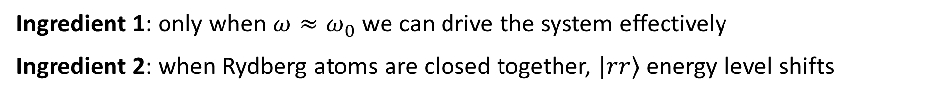



Rydberg Blockade CNOT Gate
Ingredient 1: only when $ω≈ω_{0}$ we can drive the system effectively
Ingredient 2: when Rydberg atoms are closed together, $|rr⟩$ energy level shifts
Example control: $|1⟩$ target: $|0⟩$
Step 1: 0->r drive control, nothing happen due to detuning
Step 2: 0->r drive target, target goes to $|r⟩$
Step 3: 0<->1 drive target, nothing happen due to detuning
Step 4: r<->0 drive target, target goes back to $|0⟩$
Step 5: 0<->1 drive target, target goes to $|1⟩$
Step 6: r->0 drive target, nothing happen due to detuning
Step 7: r->0 drive control, nothing happen due to detuning
$$|r⟩$$
$$|1⟩$$
$$|0⟩$$

Slide 15
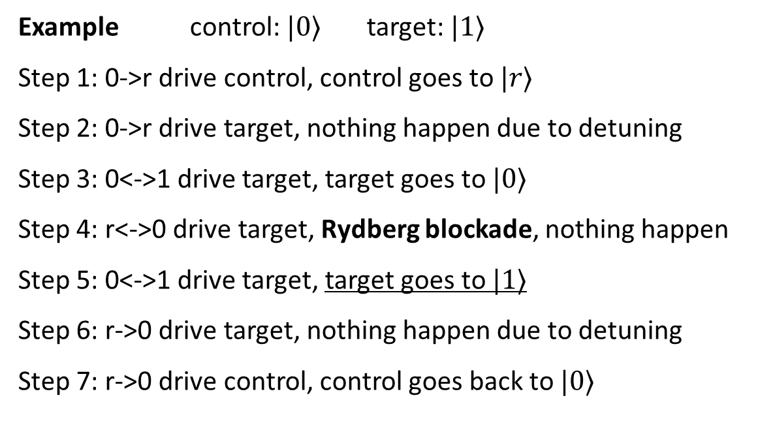
Rydberg Blockade CNOT Gate
Ingredient 1: only when $ω≈ω_{0}$ we can drive the system effectively
Ingredient 2: when Rydberg atoms are closed together, $|rr⟩$ energy level shifts
Example control: $|0⟩$ target: $|1⟩$
Step 1: 0->r drive control, control goes to $|r⟩$
Step 2: 0->r drive target, nothing happen due to detuning
Step 3: 0<->1 drive target, target goes to $|0⟩$
Step 4: r<->0 drive target, Rydberg blockade, nothing happen
Step 5: 0<->1 drive target, target goes to $|1⟩$
Step 6: r->0 drive target, nothing happen due to detuning
Step 7: r->0 drive control, control goes back to $|0⟩$
$$|r⟩$$
$$|1⟩$$
$$|0⟩$$

Slide 16
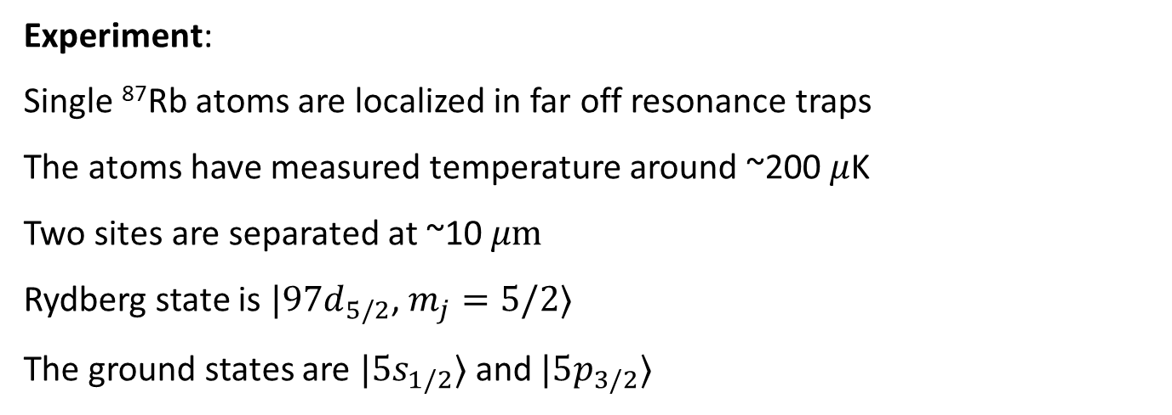



Rydberg Blockade CNOT Gate
The target atom is an effective spin-1/2 particle (a fermion)
When a 2$π$ rotation is implemented, there is a single qubit phase shift that need to be corrected.
Experiment:
Single ⁸⁷Rb atoms are localized in far off resonance traps
The atoms have measured temperature around ~200 $μ$K
Two sites are separated at ~10 $μm$
Rydberg state is $|97d_{5/2}$, $m_{j}=5/2⟩$
The ground states are $|5s_{1/2}⟩$ and $|5p_{3/2}⟩$
$$|r⟩$$
$$|1⟩$$
$$|0⟩$$

Slide 17
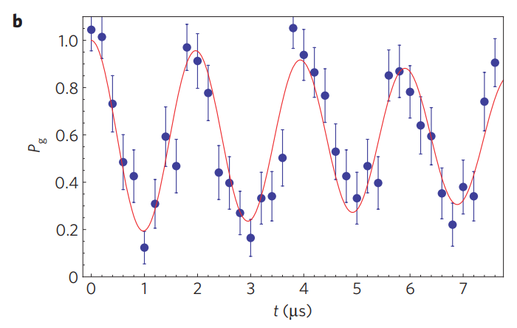

Rabi Oscillation
Rabi oscillation between $|1⟩$ and $|r⟩$ on the target site Fig. 2 in E. Urban et al., Nat. Phys. 5, 110 (2009)

Slide 18
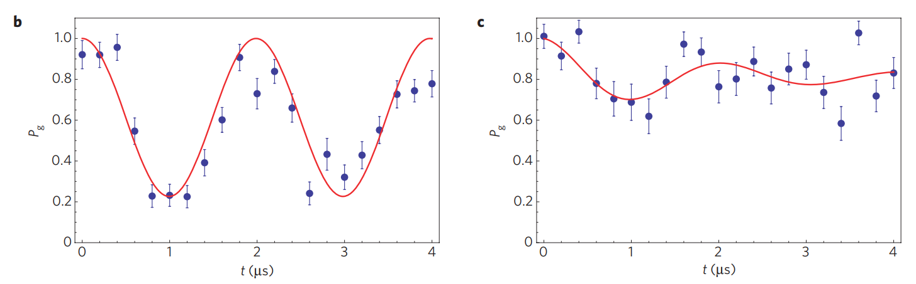
Rydberg Blockade
Rydberg Blockade
(left) Rabi oscillation on site 2 with site 1 in ground state
(right) Rabi oscillation on site 2 with site 1 in Rydberg state
Fig. 3 in E. Urban et al., Nat. Phys. 5, 110 (2009)

Slide 19
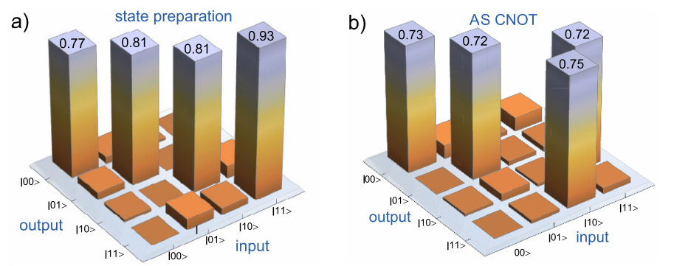
Fidelity
Measured probabilities for (a) state preparation, (b) AS-CNOT Fig. 3 in L. Isenhower et al., Phys. Rev. Lett. 104, 010503 (2010)

Slide 20
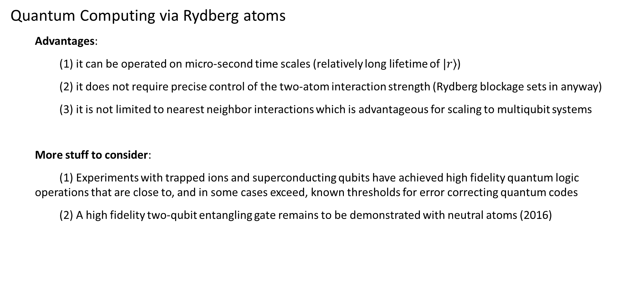
Summary
Quantum Computing via Rydberg atoms
Advantages:
(1) it can be operated on micro-second time scales (relatively long lifetime of $|r⟩$)
(2) it does not require precise control of the two-atom interaction strength (Rydberg blockage sets in anyway)
(3) it is not limited to nearest neighbor interactions which is advantageous for scaling to multiqubit systems
More stuff to consider:
(1) Experiments with trapped ions and superconducting qubits have achieved high fidelity quantum logic operations that are close to, and in some cases exceed, known thresholds for error correcting quantum codes
(2) A high fidelity two-qubit entangling gate remains to be demonstrated with neutral atoms (2016)

Slide 21

Periodicity in the Hamiltonian
Have introduced the two-level system model which has a time periodicity
General approaches to study periodicity in the Hamiltonian:
The Floquet theory (for time periodicity), has application in two-level system, time crystal, etc.
The Bloch theory (for special periodicity), has application in cold atom trapping, photonic crystal, etc.
$$\hat{H}=−{(ω_{0}/2)σ}_{z}+Ω\cos\left(ωt\right)σ_{x}$$
They provide methods for finding solutions to the Schrodinger equation by exploiting the temporal/spatial periodicity in the Hamiltonian.

Slide 22
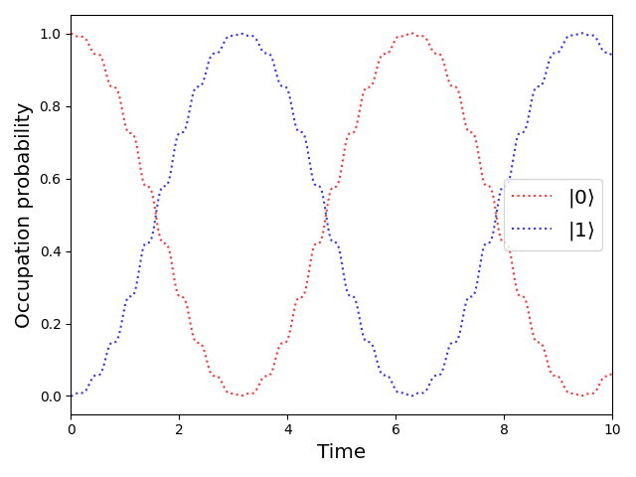

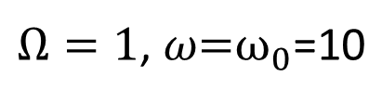

Floquet Theory
Motivation
$$\hat{H}=−{(ω_{0}/2)σ}_{z}+Ω\cos\left(ωt\right)σ_{x}$$
$Ω=1$, $ω\text{=}ω_{0}\text{=1}\text{0}$
$$Ω=1, ω=5, ω_{0}=10$$

Slide 23
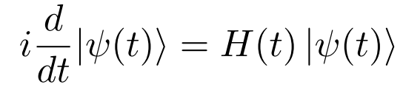





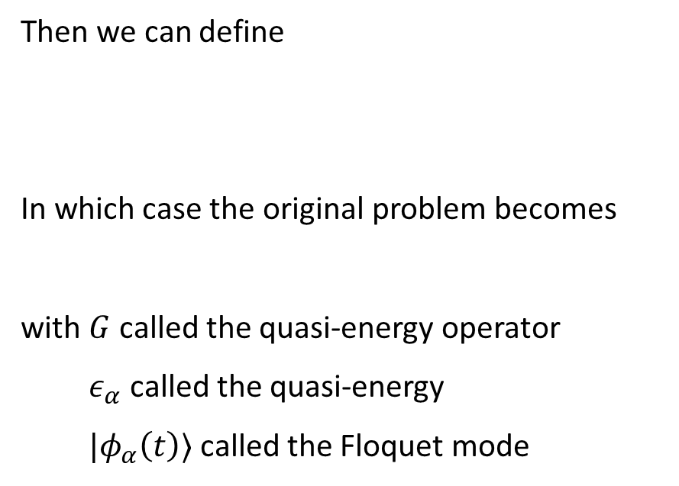
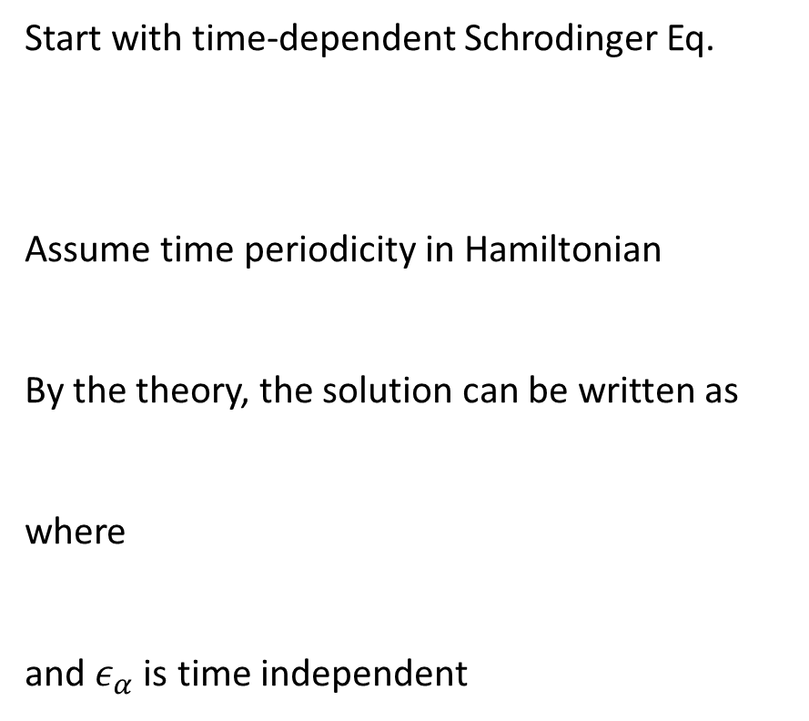
Floquet Theory
Start with time-dependent Schrodinger Eq.
Assume time periodicity in Hamiltonian
By the theory, the solution can be written as
where
and $ε_{α}$ is time independent
Then we can define
In which case the original problem becomes
with $G$ called the quasi-energy operator
$ε_{α}$ called the quasi-energy
$|φ_{α}\left(t\right)⟩$ called the Floquet mode

Slide 24




The Floquet Modes
What is truly helpful is periodicity enables Fourier transformation
Defining $ω=2π/T$. We can write
where
Then

Slide 25

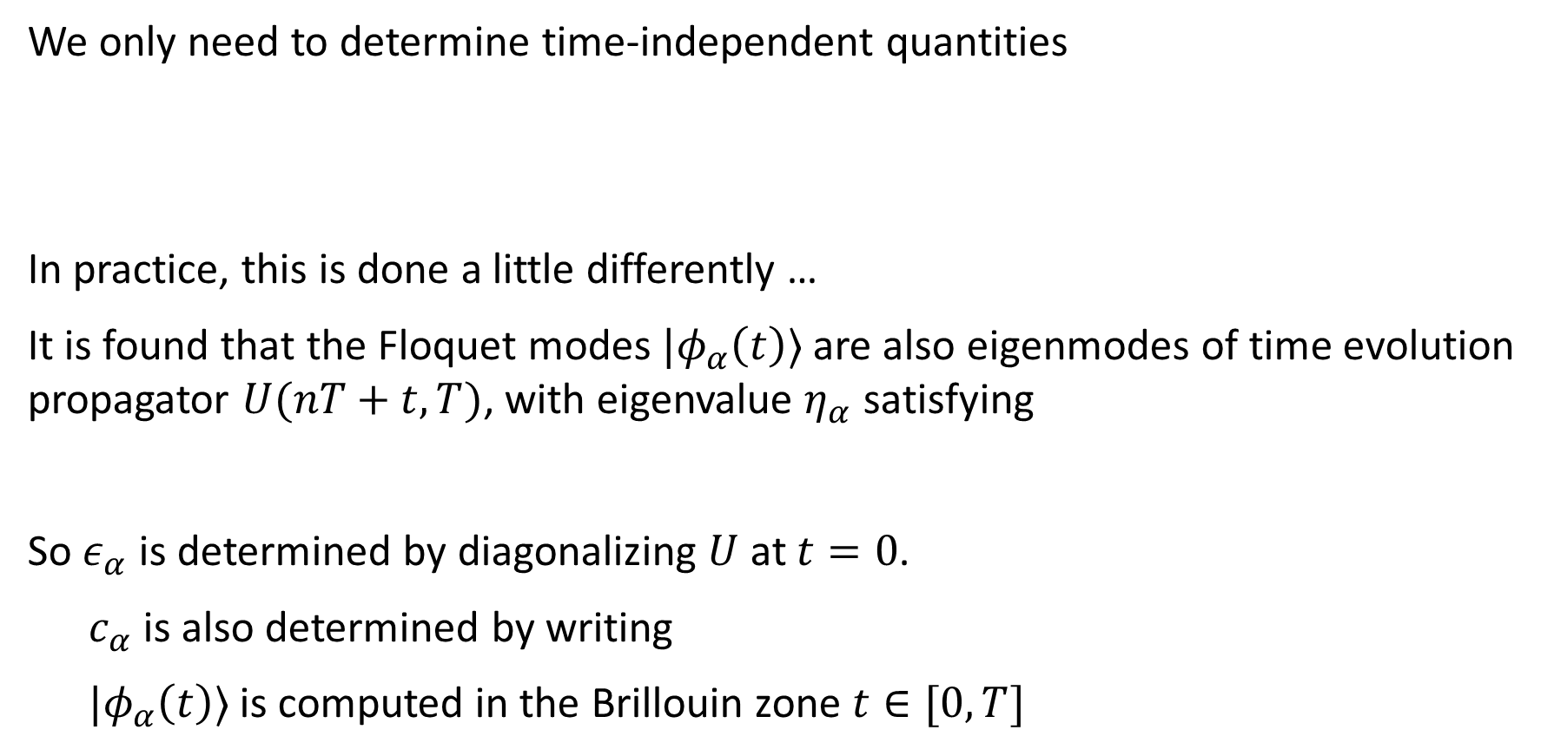
Floquet Modes
We only need to determine time-independent quantities
In practice, this is done a little differently …
It is found that the Floquet modes $|φ_{α}\left(t\right)⟩$ are also eigenmodes of time evolution propagator $U(nT+t,T)$, with eigenvalue $η_{α}$ satisfying
So $ε_{α}$ is determined by diagonalizing $U$ at $t=0$.
$c_{α}$ is also determined by writing
$|φ_{α}\left(t\right)⟩$ is computed in the Brillouin zone $t∈[0,T]$

Slide 26
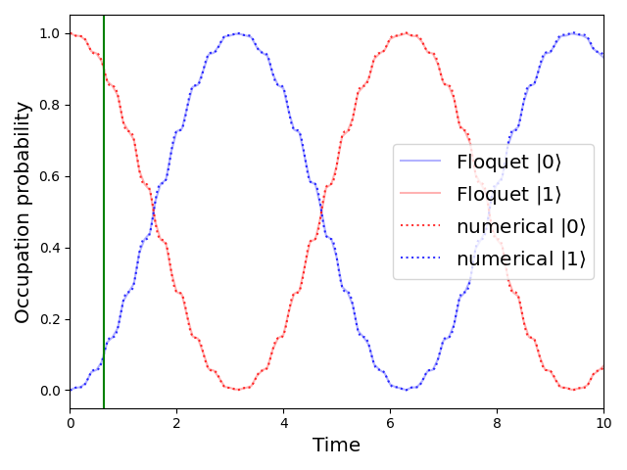
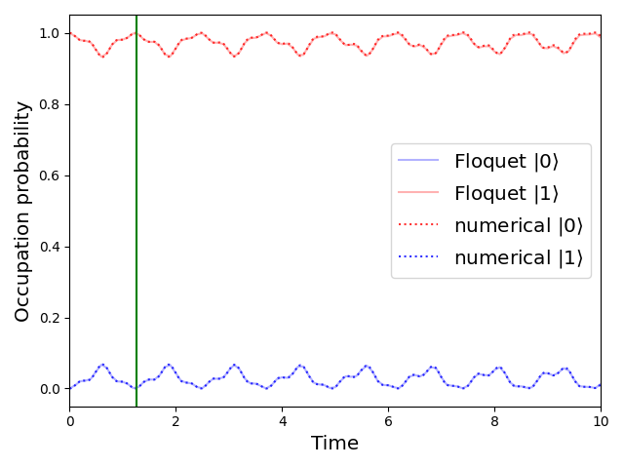




Solving the Two-level System
$Ω=1, { ω}_{0}=10, ω=10$
$Ω=1, { ω}_{0}=10, ω=5$
$$T=2π/ω$$
$$T=2π/ω$$
Solve the Floquet modes for one period, then ensemble the evolution

Slide 27


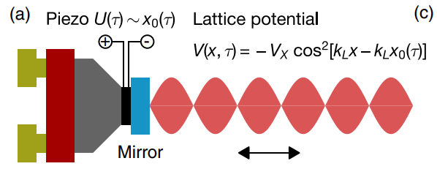
Optical Lattice with Floquet Engineering
Hamiltonian is periodic in both space and time
In 1-dimensional optical lattice, to implement lattice shaking, one employs a piezo-electric actuator, which moves the retro-reflecting mirror that defines the standing wave
K. Sandholzer , et al., Phys. rev. res. 4, 013056 (2022)

Slide 28

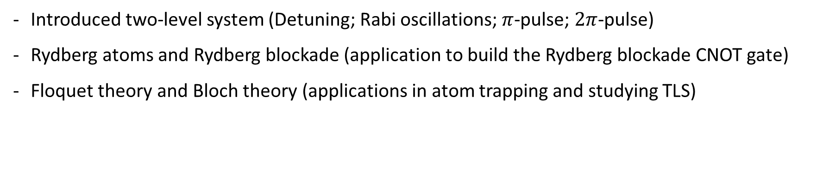
TLS and the Rydberg Blockade CNOT Gate
Introduced two-level system (Detuning; Rabi oscillations; $π$-pulse; $2π$-pulse)
Rydberg atoms and Rydberg blockade (application to build the Rydberg blockade CNOT gate)
Floquet theory and Bloch theory (applications in atom trapping and studying TLS)
Reference
[1] P. R. Berman and V. S. Malinovsky, Principles of Laser Spectroscopy and Quantum Optics (Princeton University Press, Princeton, NJ, USA, 2011).
[2] H. Weimer, Rydberg Atoms (lecture note on interacting Rydberg atoms, Leibniz University Hannover, Hanover, Germany, 2015)
[3] L. Isenhower, E. Urban, X. L. Zhang, A. T. Gill, T. Henage, T. A. Johnson, T. G. Walker, and M. Saffman, Phys. Rev. Lett. 104, 010503 (2010).
[4] E. Urban, T. A. Johnson, T. Henage, L. Isenhower, D. D. Yavuz, T. G. Walker and M. Saffman, Nat. Phys. 5, 110 (2009).
[5] L. Isenhower, Demonstration of Rydberg Blockade and a Neutral Atom CNOT Gate, Ph.D. thesis, University of Wisconsin – Madison, 2010.
[6] M. Saffman, J. Phys. B: At. Mol. Opt. Phys. 49, 202001 (2016).
[7] K. M. Maller, M. T. Lichtman, T. Xia, Y. Sun, M. J. Piotrowicz, A. W. Carr, L. Isenhower, and M. Saffman, Phys. Rev. A 92, 022336 (2015).
[8] F. Campaioli, J. H. Cole, and H. Hapuarachchi, arXiv:2303.16449 (2023).
[9] K. Viebahn, Introduction to Floquet theory, Bounder School for Condensed Matter and Material Physics (2020).
[10] K Sandholzer , A.-S. Walter, J. Minguzzi, Z. Zhu, K. Viebahn , and T. Esslinger, Phys. rev. res. 4, 013056 (2022).

Slide 29
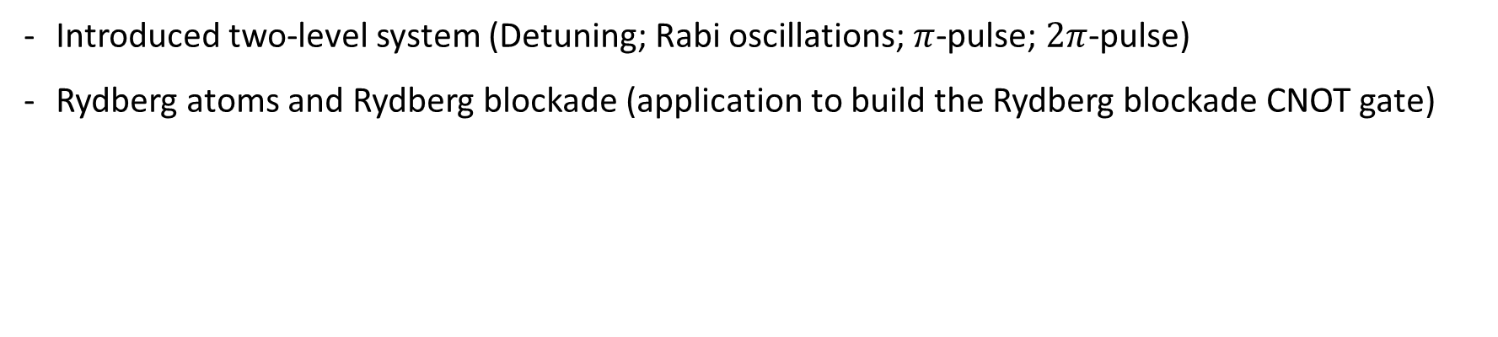
TLS and the Rydberg Blockade CNOT Gate
Introduced two-level system (Detuning; Rabi oscillations; $π$-pulse; $2π$-pulse)
Rydberg atoms and Rydberg blockade (application to build the Rydberg blockade CNOT gate)
Reference
[1] P. R. Berman and V. S. Malinovsky, Principles of Laser Spectroscopy and Quantum Optics (Princeton University Press, Princeton, NJ, USA, 2011).
[2] H. Weimer, Rydberg Atoms (lecture note on interacting Rydberg atoms, Leibniz University Hannover, Hanover, Germany, 2015)
[3] L. Isenhower, E. Urban, X. L. Zhang, A. T. Gill, T. Henage, T. A. Johnson, T. G. Walker, and M. Saffman, Phys. Rev. Lett. 104, 010503 (2010).
[4] E. Urban, T. A. Johnson, T. Henage, L. Isenhower, D. D. Yavuz, T. G. Walker and M. Saffman, Nat. Phys. 5, 110 (2009).
[5] L. Isenhower, Demonstration of Rydberg Blockade and a Neutral Atom CNOT Gate, Ph.D. thesis, University of Wisconsin – Madison, 2010.
[6] M. Saffman, J. Phys. B: At. Mol. Opt. Phys. 49, 202001 (2016).
[7] K. M. Maller, M. T. Lichtman, T. Xia, Y. Sun, M. J. Piotrowicz, A. W. Carr, L. Isenhower, and M. Saffman, Phys. Rev. A 92, 022336 (2015).

Slide 30
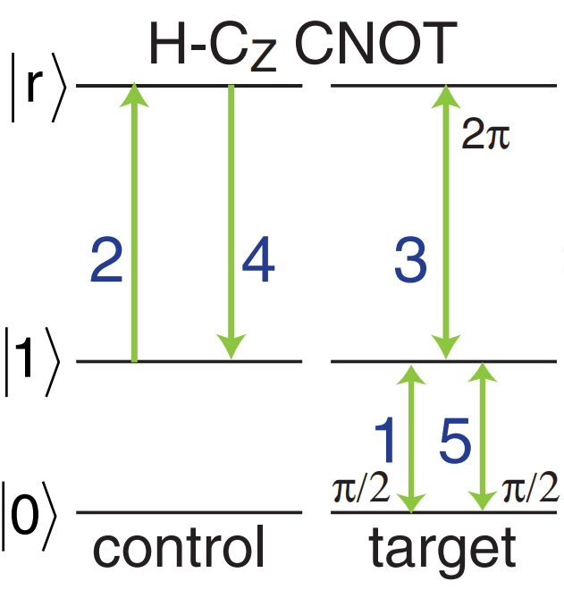
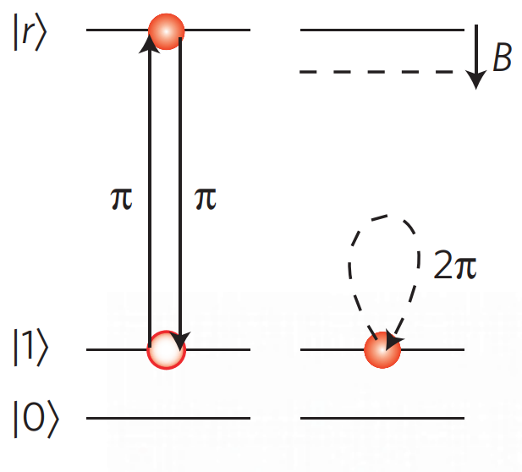



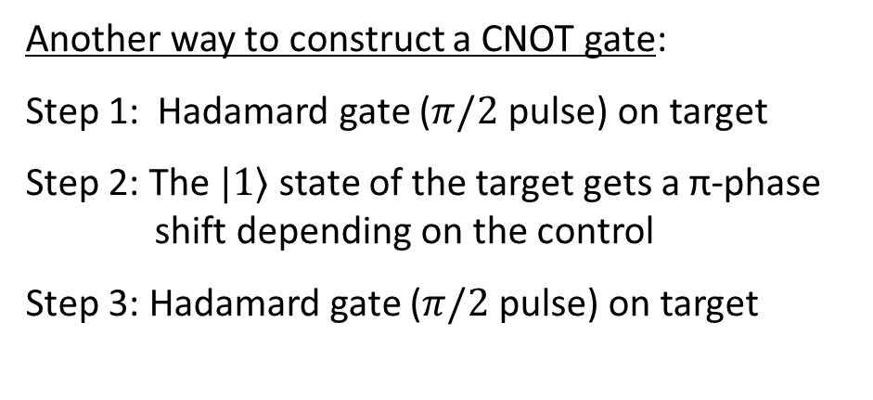
Rydberg Blockade CNOT Gate
Ingredient 1: only when $ω≈ω_{0}$ we can drive the system effectively
Ingredient 2: when Rydberg atoms are closed together, $|rr⟩$ energy level shifts
The target atom is an effective spin-1/2 particle (a fermion)
When a 2$π$ rotation is implemented, there is a single qubit phase shift that need to be corrected.
Another way to construct a CNOT gate:
Step 1: Hadamard gate ($π/2$ pulse) on target
Step 2: The $|1⟩$ state of the target gets a π-phase shift depending on the control
Step 3: Hadamard gate ($π/2$ pulse) on target
$$|r⟩$$
$$|1⟩$$
$$|0⟩$$

Slide 31



$$|r⟩$$
$$|1⟩$$
$$|0⟩$$

Slide 32



$$ω/ω_{0}\text{=1}$$
$2π$-pulse $T=2πΩ_{0}$
$π$-pulse

