Slide 1
Parity-time symmetry in Optical-based System
Jinyan Miao, Chulwon Lee
University of Michigan
Department of Physics

Slide 2
Contents
Hamiltonian operator
Photonic crystal cavities
Theory of PT-symmetry
Application of PT-symmetry

Slide 3
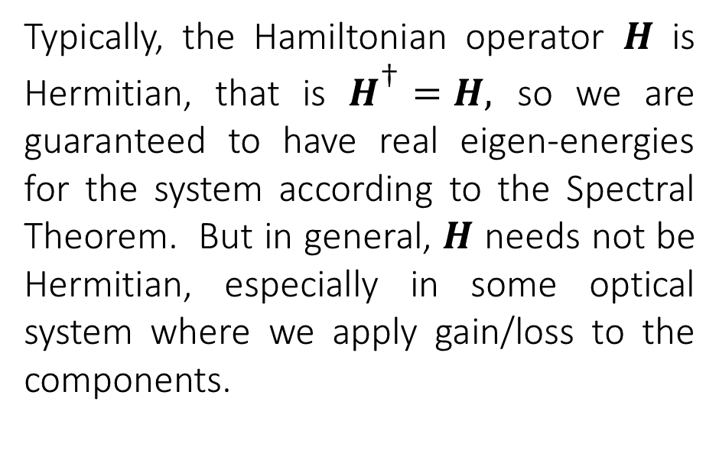
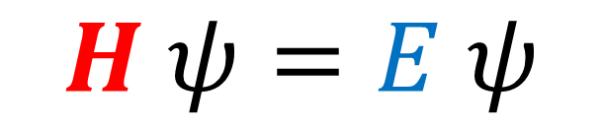
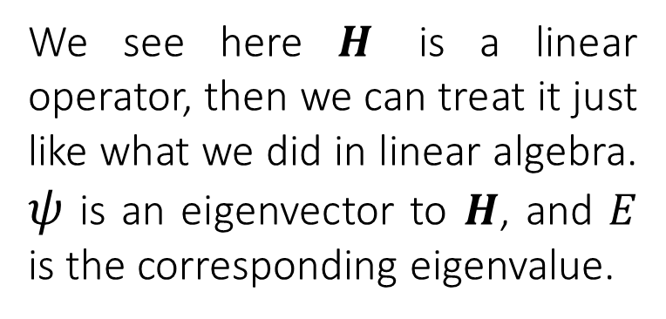
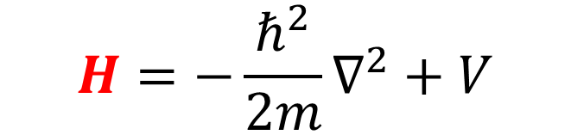
Hamiltonian operator
$$H ψ=E ψ$$
$$H=−\frac{ℏ^{2}}{2m}∇^{2}+V$$
Typically, the Hamiltonian operator $H$ is Hermitian, that is $H^{\text{†}}=H,$ so we are guaranteed to have real eigen-energies for the system according to the Spectral Theorem. But in general, $H$ needs not be Hermitian, especially in some optical system where we apply gain/loss to the components.
We see here $H$ is a linear operator, then we can treat it just like what we did in linear algebra. $ψ$ is an eigenvector to $H$, and $E$ is the corresponding eigenvalue.

Slide 4
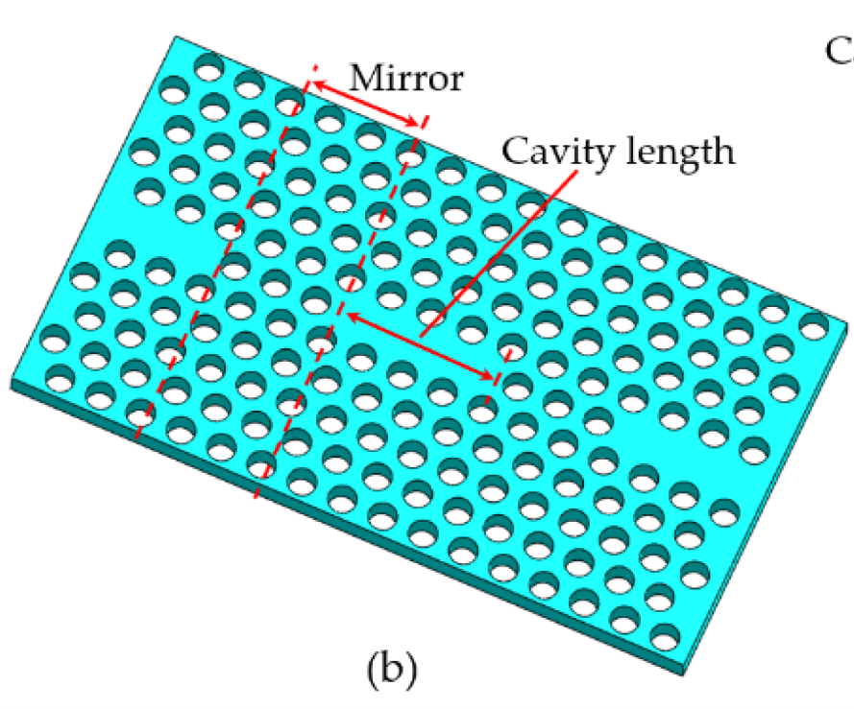
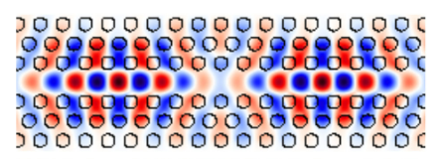
Photonic crystal cavities
Place two cavities closed together, so that they are coupled via tunnelling effect
Apply gain to one of them, and apply loss to the other one
Material with high index of refraction
EM wave of some specific frequency is trapped in this region in form of standing waves
When measure the frequency of the system, we get the frequency of the standing wave

Slide 5
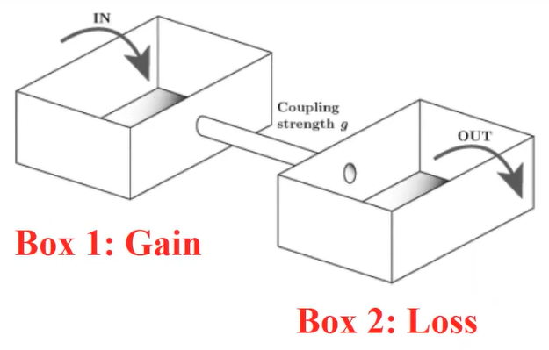

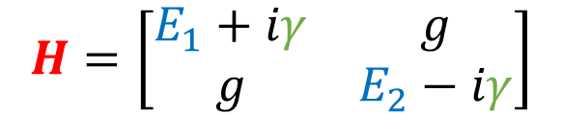
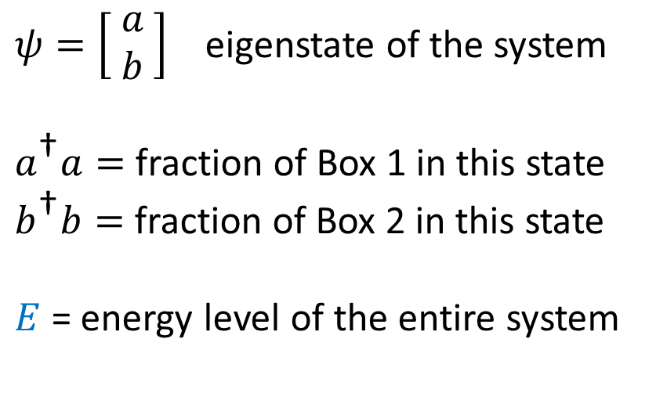


$$H ψ=E ψ$$
The Hamiltonian describes the total energy of a system
$$γ$$
$$H=\left[\begin{matrix}E_{1}+iγ & g \\ g & E_{2}−iγ\end{matrix}\right]$$
$$γ$$
$ψ=\left[\begin{matrix} a \\ b\end{matrix}\right]$ eigenstate of the system
$a^{\text{†}}a=$ fraction of Box 1 in this state
$b^{\text{†}}b=$ fraction of Box 2 in this state
$E$ = energy level of the entire system
$$E_{1}$$
$$E_{2}$$

Slide 6
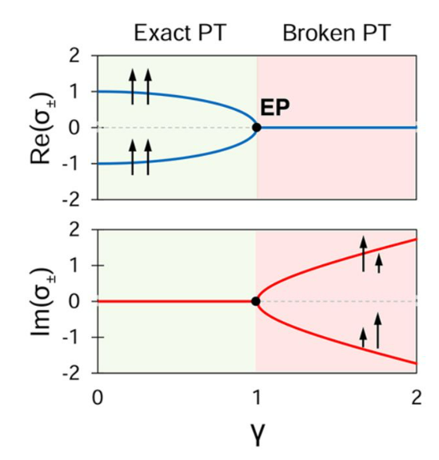
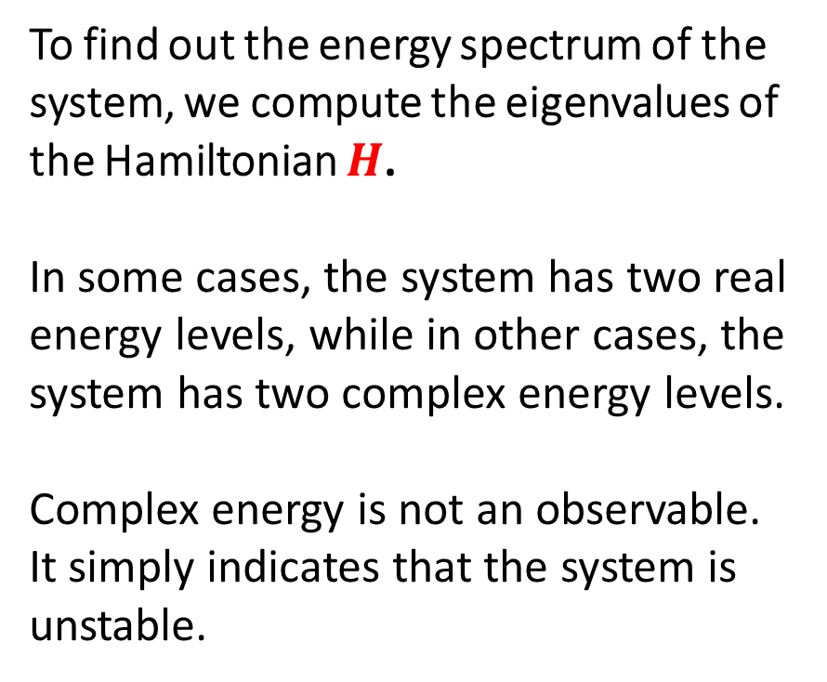
To find out the energy spectrum of the system, we compute the eigenvalues of the Hamiltonian $H$.
In some cases, the system has two real energy levels, while in other cases, the system has two complex energy levels.
Complex energy is not an observable.
It simply indicates that the system is unstable.

Slide 7
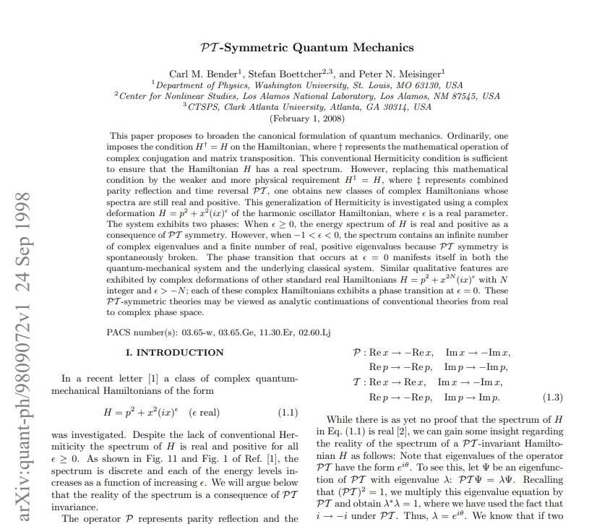

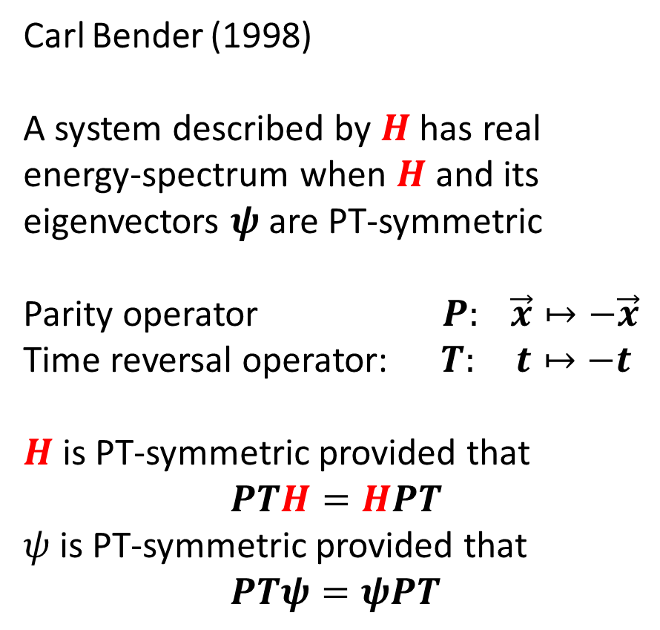
Carl Bender (1998)
A system described by $H$ has real energy-spectrum when $H$ and its eigenvectors $ψ$ are PT-symmetric
Parity operator $P: \vec{x}↦−\vec{x}$
Time reversal operator: $T: t↦−t$
$H$is PT-symmetric provided that
$PTH=HPT$
$ψ$ is PT-symmetric provided that
$PTψ=ψPT$
$$H ψ=E ψ$$

Slide 8
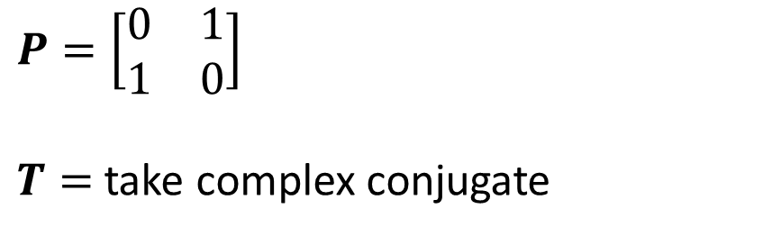


$$H ψ=E ψ$$
$$H=\left[\begin{matrix}E_{1}+iγ & g \\ g & E_{2}−iγ\end{matrix}\right]$$
$$P=\left[\begin{matrix}0 & 1 \\ 1 & 0\end{matrix}\right]$$
$T=$take complex conjugate

Slide 9
The theory of PT-symmetry
It tells you exactly when the system has real energy spectrum and when the system has complex energy spectrum. Just like the spectral theorem.
But spectral theorem, or talking about the Hermicity of an operator, is purely a mathematical construct. On the other hand, the parity-time symmetry of a system corresponds to conservations of momentum and energy.

Slide 10
Exceptional Point (EP)
The two energy levels degenerate into one at the EP. This behavior is desirable for building a microcavity sensor.
A small change in the environment (say, the gain of the photonic cavities) results in a rapid splitting in the energy levels.

Slide 11
References
Bender, Carl M., Stefan Boettcher, and Peter N. Meisinger. “PT-Symmetric Quantum Mechanics.” Journal of Mathematical Physics 40, no. 5 (1999): 2201–29. https://doi.org/10.1063/1.532860.
Miri, Mohammad-Ali, and Andrea Alù. “Exceptional Points in Optics and Photonics.” Science 363, no. 6422 (2019). https://doi.org/10.1126/science.aar7709.
“Photonic Crystal Cavities.” University of Oxford Department of Physics, March 22, 2021. https://www.physics.ox.ac.uk/research/group/quantum-optoelectronics/projects/photonic-crystal-cavities.
Xia, Ji, Qifeng Qiao, Guangcan Zhou, Fook Siong Chau, and Guangya Zhou. “Opto-Mechanical Photonic Crystal Cavities for Sensing Application.” Applied Sciences 10, no. 20 (2020): 7080. https://doi.org/10.3390/app10207080.
Jinyan Miao, Chulwon Lee
University of Michigan, Department of Physics

