Slide 1

The Application of Floquet Theory in Quantum Optics
Presented by
Jinyan Miao

Slide 2
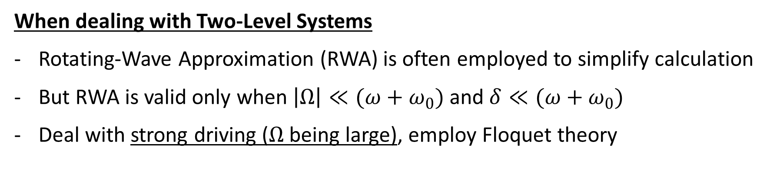
Motivation
When dealing with Two-Level Systems
Rotating-Wave Approximation (RWA) is often employed to simplify calculation
But RWA is valid only when $\left|Ω\right|≪(ω+ω_{0})$ and $δ≪(ω+ω_{0})$
Deal with strong driving ($Ω$ being large), employ Floquet theory
Floquet theory provides a method for finding solutions to the time-dependent Schrodinger equation by exploiting the temporal periodicity in the Hamiltonian.

Slide 3
Motivation
Floquet theory provides a method for finding solutions to the time-dependent Schrodinger equation by exploiting the temporal periodicity in the Hamiltonian.
The approach is of general validity and has been used to study:
Two-level systems
Optical lattice (with Floquet engineering)
Heat engines and laser cooling
Quantum optimal control
Time crystal
…

Slide 4
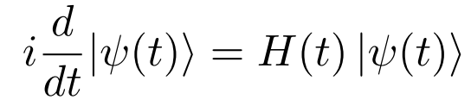





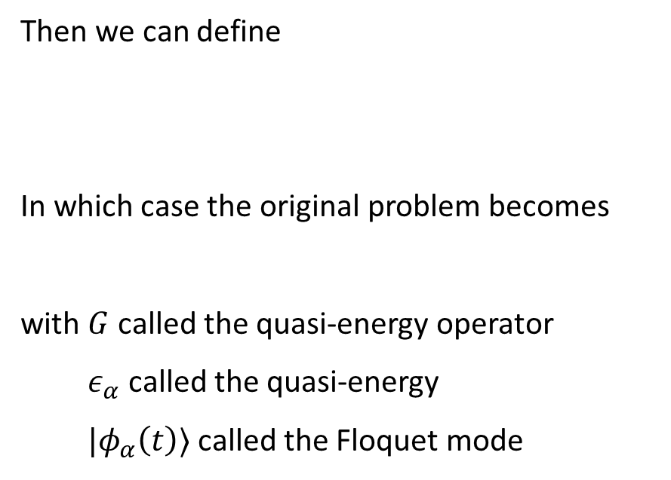
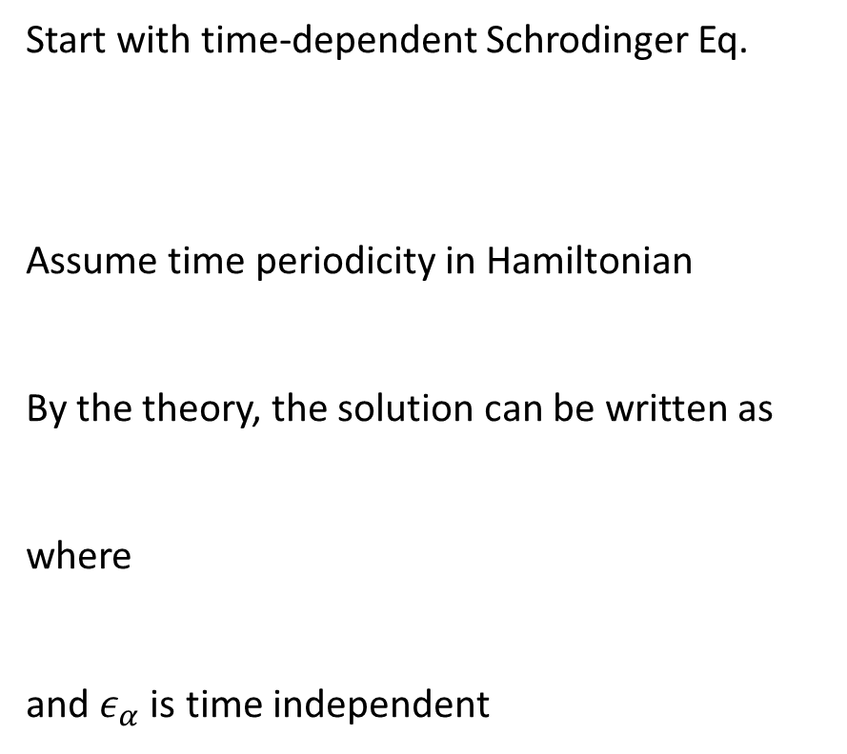
Floquet Theory
Start with time-dependent Schrodinger Eq.
Assume time periodicity in Hamiltonian
By the theory, the solution can be written as
where
and $ε_{α}$ is time independent
Then we can define
In which case the original problem becomes
with $G$ called the quasi-energy operator
$ε_{α}$ called the quasi-energy
$|φ_{α}\left(t\right)⟩$ called the Floquet mode

Slide 5




The Floquet Modes
What is truly helpful is periodicity enables Fourier transformation
Defining $ω=2π/T$. We can write
where
Then

Slide 6

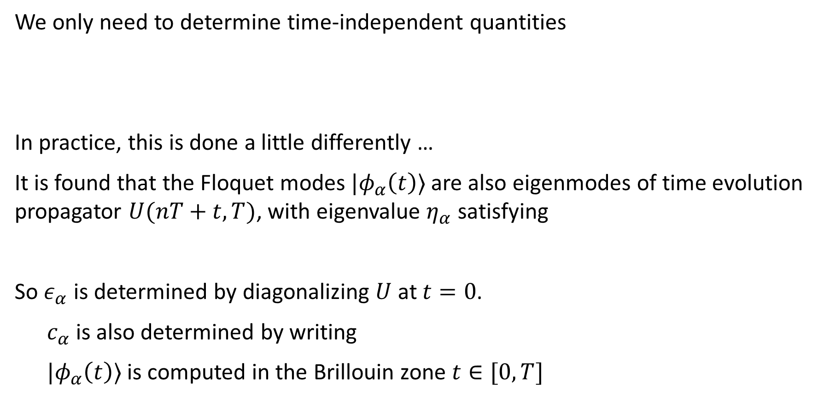
Floquet Modes
We only need to determine time-independent quantities
In practice, this is done a little differently …
It is found that the Floquet modes $|φ_{α}\left(t\right)⟩$ are also eigenmodes of time evolution propagator $U(nT+t,T)$, with eigenvalue $η_{α}$ satisfying
So $ε_{α}$ is determined by diagonalizing $U$ at $t=0$.
$c_{α}$ is also determined by writing
$|φ_{α}\left(t\right)⟩$ is computed in the Brillouin zone $t∈[0,T]$

Slide 7
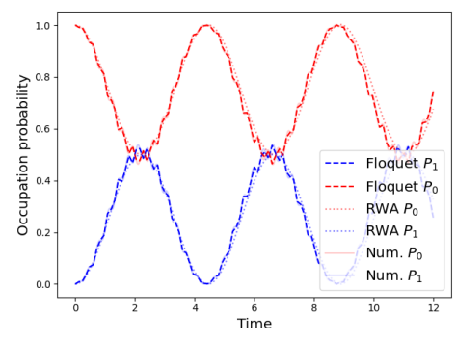
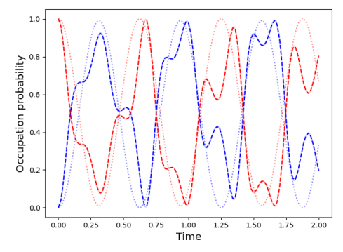


Solving the Two-level System without RWA
$Ω=1, { ω}_{0}=10, ω=9$
$Ω=10, { ω}_{0}=10, ω=9$
Solve the Floquet modes for one period, then ensemble the evolution

Slide 8


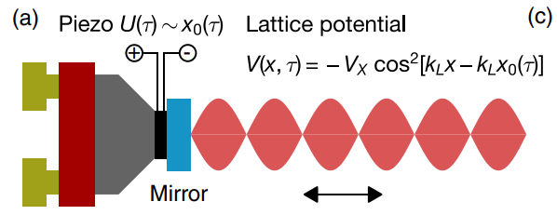
Optical Lattice with Floquet Engineering
Hamiltonian is periodic in both space and time
In 1-dimensional optical lattice, to implement lattice shaking, one employs a piezo-electric actuator, which moves the retro-reflecting mirror that defines the standing wave
K. Sandholzer , et al., Phys. rev. res. 4, 013056 (2022)

Slide 9
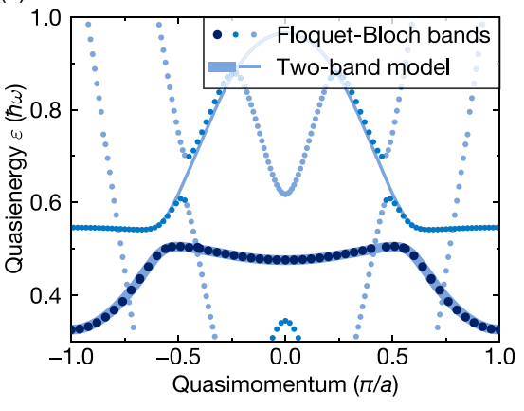


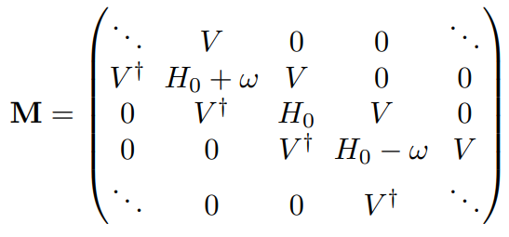
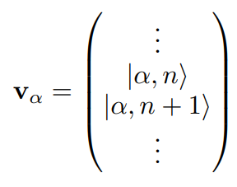

Optical Lattice with Floquet Engineering
Floquet-Bloch bands
Floquet engineered optical lattice
Features topological phenomena
Controlling cold atom systems
Transform the original Hamiltonian into a tight-binding model using Floquet theory
Describe the system by
[K. Sandholzer , et al., Phys. rev. res. 4, 013056 (2022)]

Slide 10

Summary
Floquet theory (periodicity in time)
Solving the two-level system (semiclassical approach)
Only need to solve Floquet modes for one period, then ensemble.
Introduced Floquet engineering in optical lattice
Reference
[1] F. Campaioli, J. H. Cole, and H. Hapuarachchi, arXiv:2303.16449 (2023).
[2] K. Viebahn, Introduction to Floquet theory, Bounder School for Condensed Matter and Material Physics (2020).
[3] K Sandholzer , A.-S. Walter, J. Minguzzi, Z. Zhu, K. Viebahn , and T. Esslinger, Phys. rev. res. 4, 013056 (2022).

