Slide 1
abstract LINE SHAPE
Free ppt template

Slide 2
CONCEPT
STRATEGY
DESIGN
SUMMARY

Slide 3
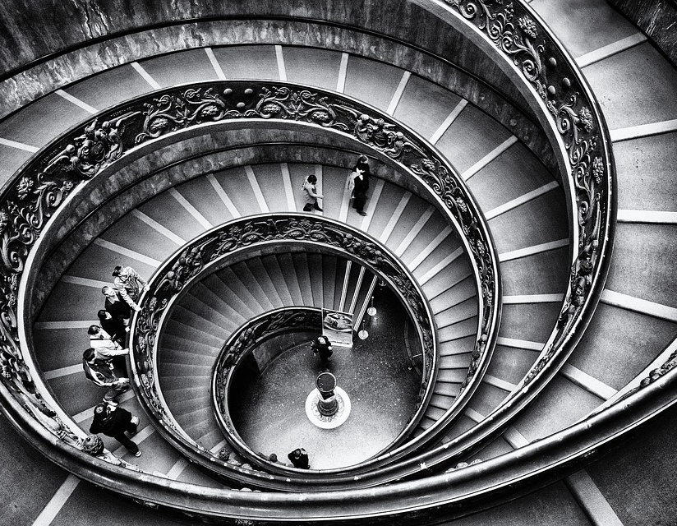
DESIGNED BY ADSTORE
The proper study of mankind is the science of design.
Good design is good business
DESIGN
DESIGN
CONCEPT
CONCEPT | STRATEGY | DESIGN | SUMMARY

Slide 4
abstract LINE SHAPE
Free ppt template

Slide 5
CONCEPT
STRATEGY
DESIGN
SUMMARY

Slide 6



DESIGNED BY ADSTORE
The proper study of mankind is the science of design.
PLANE SHIP CAR
Icon by flaticon.com
CONCEPT
CONCEPT | STRATEGY | DESIGN | SUMMARY

