Slide 1
RETRO BLUE
POWERPOINT TEMPLATE RELEASE

Slide 2
RETRO BLUE
POWERPOINT TEMPLATE RELEASE

Slide 3
DESIGN
RETRO BLUE
TEMPLATE
APPENDIX
INDEX
RETRO BLUE

Slide 4
DESIGN
RETRO BLUE
TEMPLATE
APPENDIX
INDEX
RETRO BLUE
ADSTOREPOST.COM

Slide 5
RETRO BLUE
DESIGNED BY ADSTOREPOST.COM
BACK
TO
1955s
I have a retro feel to my work, to my person, but I also have a futuristic view of what's possible. We can have people in pop that have more diverse looks and attitudes.

Slide 6
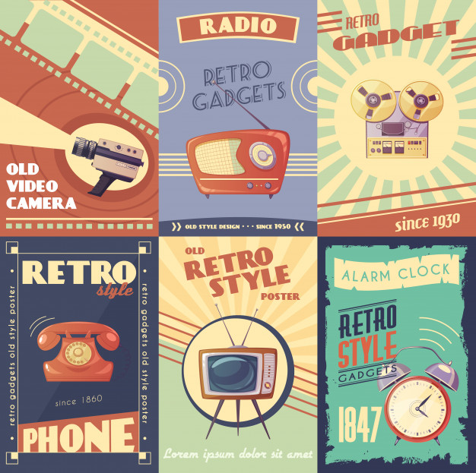
But when it's evergreen, evergreen
Designed by L@rgo. ADSTORE
The proper study of mankind is the science of design.
Good design is good business

