Slide 1
File Class
File Class is used to
Examine files and directories
Examine the list of files or directories on the hard drive
Create new files and directories on the hard drive
Create file stream objects
There are four constructors:
File myDir = new File(“C:\Temp”);
File myFile = new File(“C:\Temp\file.txt”);
File myFile = new File (myDir, “file.txt”);
File myFile = new File(“C:\Temp”, “file.txt”);

Slide 2
Testing and Checking File Objects
There are more than 30 methods that you can apply to File objects. These are a few:
getName()
getPath()
getParent()
Query Files and Directory
exists()
isDirectory()
isFile()
Creating and Modifying Files and Directories
renameTo(File path)
mkdir()
createNewFile()

Slide 3
File Class Example
public static void main(String[] args) {
File myDir = new File("C:/JavaTemp");
System.out.println(myDir + (myDir.isDirectory() ? " is " : " is not ")
+ "a directory");
File newDir = new File(myDir, "newDir");
newDir.mkdir();
String[] fileList = myDir.list();
for (String f : fileList) {
System.out.println(f);
}
}
Is JavaTemp a directory in C:\ drive?
Create a directory called “newDir” in C:\JavaTemp folder
list of files/directories in C:\JavaTemp

Slide 4
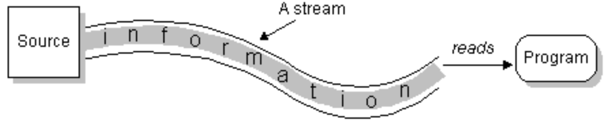
Input Stream
To bring in information, a program opens a stream on the source (a file, memory, a socket) and reads the information sequentially:

Slide 5
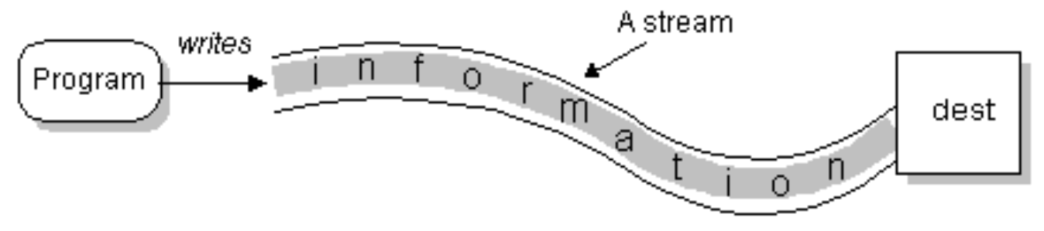
Output Stream
To output information, a program opens a stream to the destination (a file, memory, a socket) and writes the information sequentially:

Slide 6
IO Stream
No matter where the data is coming from or going to and no matter what its type, the algorithms for sequentially reading and writing data are :
Reading
open a stream
while more information{
read information
}
close the stream
Writing
open a stream
while more information{
write information
}
close the stream

Slide 7
Character and Binary Streams
The stream classes are divided into two class hierarchies, based on the data type:
Character Stream
Java stores its characters internally as 16-bit Unicode characters (2 bytes)
Characters streams are used for storing and retrieving text
Binary Stream
A series of bytes exactly as it appears in memory
No transformation of data takes place

Slide 8
Character and Binary Streams
Character Stream – streams, containing ‘text‘
Program
I
‘
M
A
S
T
R
I
N
G
\n
Device
Binary Streams, containing 8 – bit information
Program
01101001
11101101
00000000
Device

Slide 9
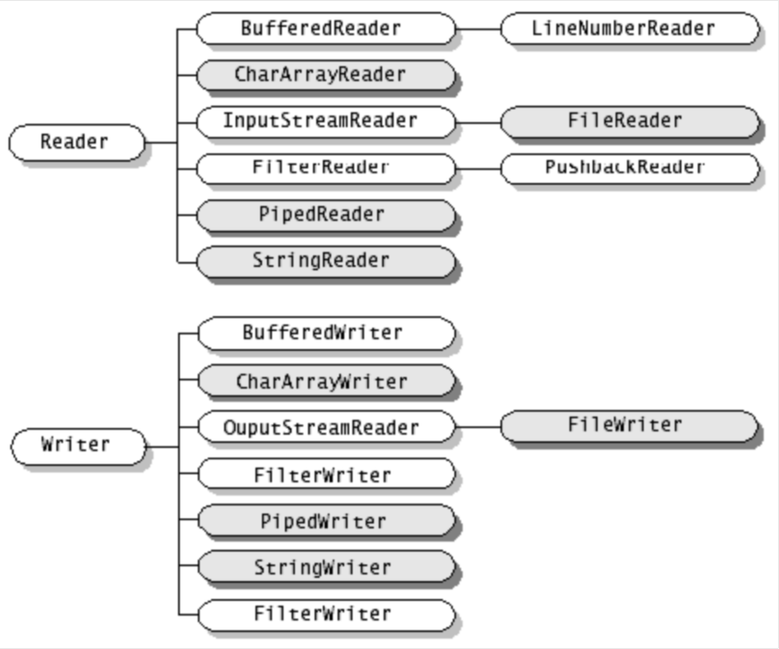
Character Stream Class Hierarchy

Slide 10
Stream Reader and Writer
Reader and Writer are the abstract superclasses in java.io for 16 bit character streams
Reader provides the methods and partial implementation for readers
Writer provides the methods and partial implementation for writers
Subclasses of Reader and Writer implement specialized streams and are divided into two categories
Most programs should use readers and writers to read and write textual information

Slide 11
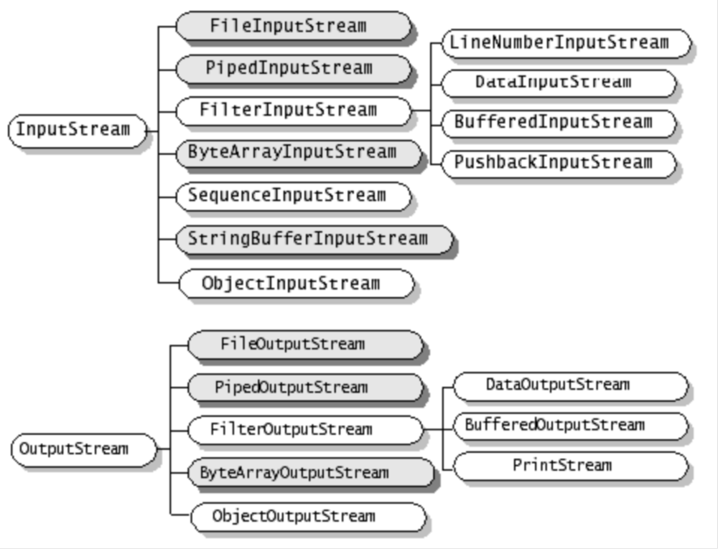
Binary Stream Class Hierarchy

Slide 12
Input/Output Binary Stream
InputStream and OutputStream are the abstract superclasses in java.io for 8 bit byte streams
InputStream provides the methods and partial implementation for input streams
OutputStream provides the methods and partial implementation for output streams
Subclasses of InputStream and OutputStreams implement specialized streams and are divided into two categories
Most programs should use input streams and output streams to read and write byte information such as images, sounds, etc

Slide 13
Character and Binary Stream Methods
Reader and InputStream define similar abstract methods but for different data types
Reader contains these methods for reading characters and arrays of characters:
int read()
int read(char cbuf[])
int read(char cbuf[], int offset, int length)
InputStream defines the same methods but for reading bytes and arrays of bytes
int read()
int read(byte cbuf[])
int read(byte cbuf[], int offset, int length)

Slide 14
Character and Binary Stream Methods
Writer and OutputStream define similar abstract method but for different data types
Writer contains these methods for writing characters, arrays of characters, and strings:
void write(int c)
void write(char cbuf[])
void write(char cbuf[], int offset, int length)
OutputStream defines the same methods but for writing bytes and arrays of bytes
void write(int c)
void write(byte cbuf[])
void write(byte cbuf[], int offset, int length)

Slide 15
Writing Textfiles
Class: FileWriter
Frequently used methods:

Slide 16
Writing Textfiles
Using FileWriter
is not very convenient (only String-output possible)
Is not efficient (every character is written in a single step, invoking a huge overhead)
Better: wrap FileWriter with processing streams
BufferedWriter
PrintWriter

Slide 17
Wrapping Textfiles
BufferedWriter:
Buffers output of FileWriter, i.e. multiple characters are processed together, enhancing efficiency
PrintWriter
provides methods for convenient handling, e.g. println()
( remark: the System.out.println() – method is a method of the PrintWriter-instance System.out ! )

Slide 18
Wrapping a Writer
A typical codesegment for opening a convenient, efficient textfile:
FileWriter out = new FileWriter("test.txt");
BufferedWriter b = new BufferedWriter(out);
PrintWriter p = new PrintWriter(b);
OR
PrintWriter p = new PrintWriter(
new BufferedWriter(
new FileWriter("test.txt")));

Slide 19
Reading Textfiles
Class: ReadText
Frequently used Methods:
(The other methods are used for
positioning, we don’t cover that here)

Slide 20
Wrapping a Reader
Again:
Using FileReader is not very efficient. Better wrap it with BufferedReader:
BufferedReader br = new BufferedReader(new FileReader(“name“));

Slide 21
EOF Detection
Detecting the end of a file (EOF):
Usually amount of data to be read is not known
Reading methods return ‘impossible‘ value if end of file is reached
Example:
FileReader.read returns -1
BufferedReader.readLine() returns ‘null‘
Typical code for EOF detection:
while ((c = myReader.read() != -1){ // read and check c
...do something with c
}

Slide 22
Example: Copying a Textfile
import java.io.*;
public class IOTest
{
public static void main(String[] args)
{
try{
BufferedReader myInput = new BufferedReader(new FileReader("IOTest.java"));
BufferedWriter myOutput = new BufferedWriter(new FileWriter("Test.txt"));
int c;
while ((c=myInput.read()) != -1)
myOutput.write(c);
myInput.close();
myOutput.close();
}catch(IOException e){}
}
}

Slide 23
Binary Files
Stores binary images of information identical to the binary images stored in main memory
Binary files are more efficient in terms of processing time and space utilization
drawback: not ‘human readable‘, i.e. you can‘t use a texteditor (or any standard-tool) to read and understand binary files

Slide 24
Binary Files
Example: writing of the integer ’42‘
TextFile: ‘4‘ ‘2‘ (internally translated to 2 16-bit representations of the characters ‘4‘ and ‘2‘)
Binary-File: 00101010, one byte
(= 42 decimal)

Slide 25
Writing Binary Files
Class: FileOutputStream
... see FileWriter
The difference:
No difference in usage, only in output format

Slide 26
Reading Binary Files
Class: FileInputStream
... see FileReader
The difference:
No difference in usage, only in output format

Slide 27
Binary vs. TextFiles
 | pro | con
Binary | Efficient in terms of time and space | Preinformation about data needed to understand content
Text | Human readable, contains redundant information | Not efficient

