Slide 1
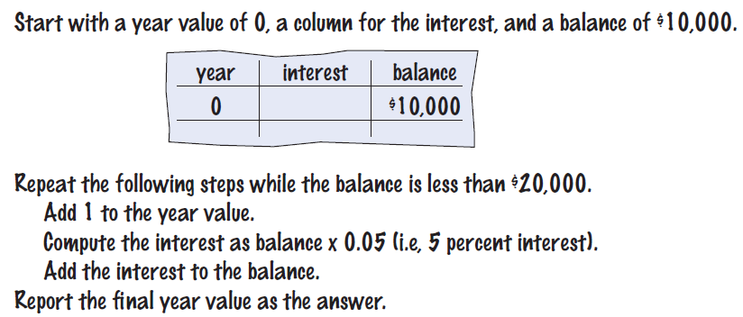

The while Loop
Examples of loop applications
Calculating compound interest
Simulations, event driven programs…
Compound interest algorithm (Chapter 1)
Steps

Slide 2
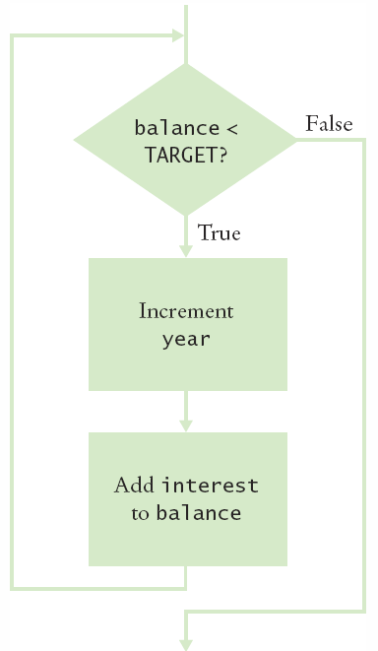
Planning the while Loop
A loop executes instructions
repeatedly while a condition is true.
while (balance < TARGET)
{
year++;
double interest = balance * RATE/100;
balance = balance + interest;
}

Slide 3
while Statement

Slide 4
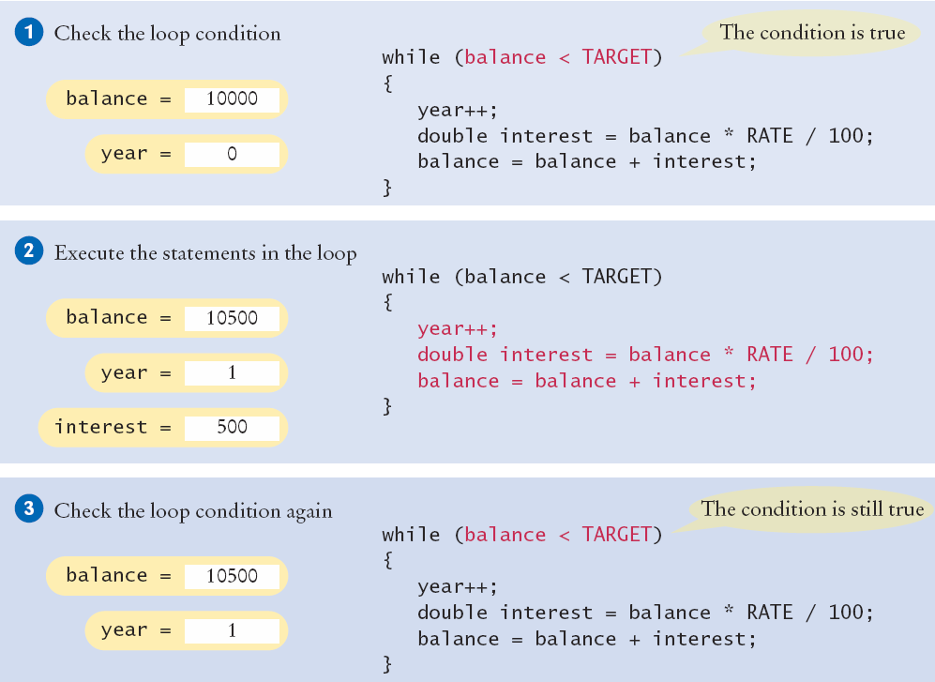
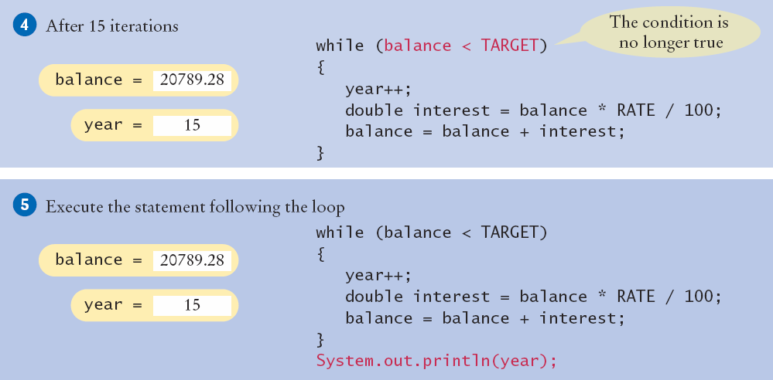
Execution of the Loop

Slide 5
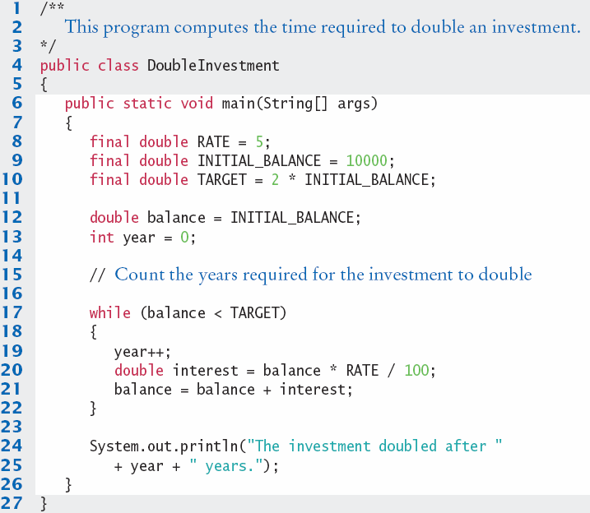

DoubleInvestment.java
Declare and initialize a variable outside of the loop to count years
Increment the years variable each time through

Slide 6
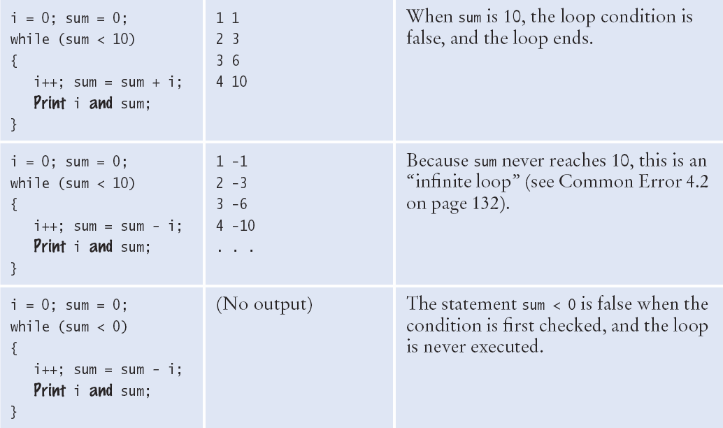
while Loop Examples (1)

Slide 7
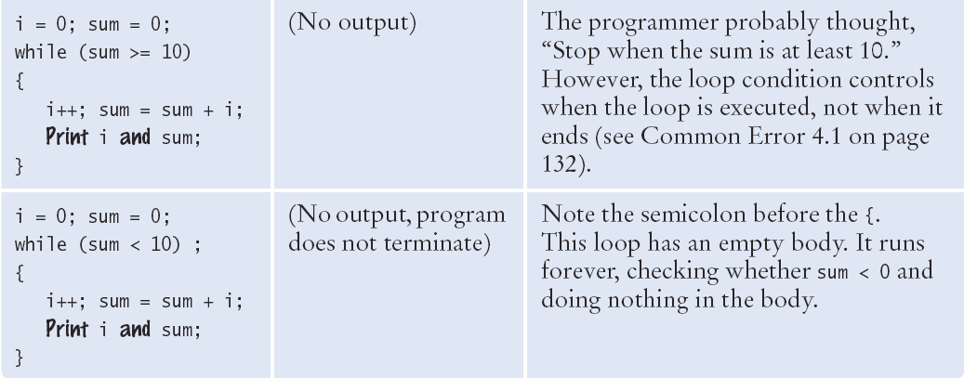
while Loop Examples (2)

Slide 8

Common Error
Don’t think “Are we there yet?”
The loop body will only execute if the test condition is True.
“Are we there yet?” should continue if False
If bal should grow until it reaches TARGET
Which version will execute the loop body?
while (bal < TARGET)
{
year++;
interest = bal * RATE;
bal = bal + interest;
}
while (bal >= TARGET)
{
year++;
interest = bal * RATE;
bal = bal + interest;
}

Slide 9
Common Error
Infinite Loops
The loop body will execute until the test condition becomes False.
What if you forget to update the test variable?
bal is the test variable (TARGET doesn’t change)
You will loop forever! (or until you stop the program)
while (bal < TARGET)
{
year++;
interest = bal * RATE;
}
bal = bal + interest;
}

Slide 10
Common Error
Off-by-One Errors
A ‘counter’ variable is often used in the test condition
Your counter can start at 0 or 1, but programmers often start a counter at 0
If I want to paint all 5 fingers, when I am done?
Start at 0, use < Start at 1, use <=
0, 1, 2, 3, 4 1, 2, 3, 4, 5
int finger = 0;
final int FINGERS = 5;
while (finger < FINGERS)
{
// paint finger
finger++;
}
int finger = 1;
final int FINGERS = 5;
while (finger <= FINGERS)
{
// paint finger
finger++;
}

Slide 11
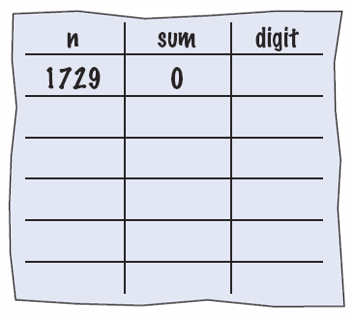
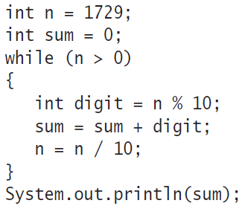
Hand-Tracing
Example: Calculate the sum of digits (1+7+2+9)
Make columns for key variables (n, sum, digit)
Examine the code and number the steps
Set variables to state before loop begins

Slide 12
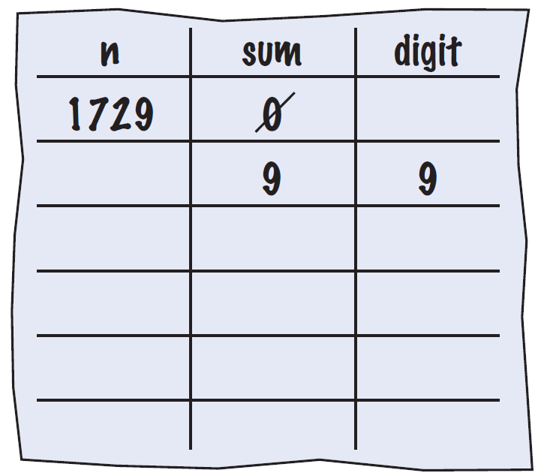
Tracing Sum of Digits
Start executing loop body statements changing variable values on a new line
Cross out values in previous line

Slide 13
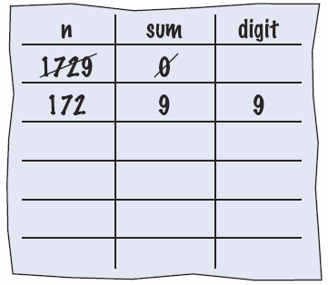
Tracing Sum of Digits
Continue executing loop statements changing variables
1729 / 10 leaves 172 (no remainder)

Slide 14
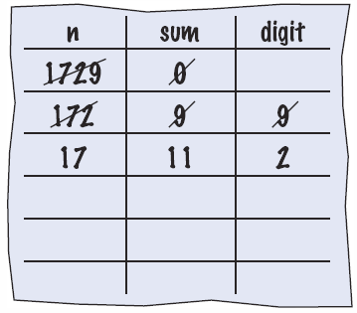
Tracing Sum of Digits
Test condition. If true, execute loop again
Variable n is 172, Is 172 > 0?, True!
Make a new line for the second time through and update variables

Slide 15
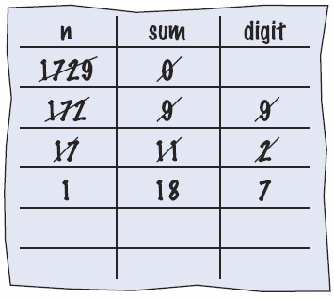
Tracing Sum of Digits
Third time through
Variable n is 17 which is still greater than 0
Execute loop statements and update variables

Slide 16
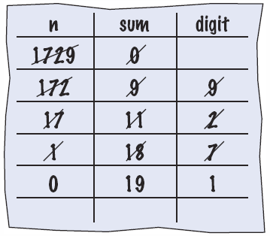
Tracing Sum of Digits
Fourth loop iteration:
Variable n is 1 at start of loop. 1 > 0? True
Executes loop and changes variable n to 0 (1/10 = 0)

Slide 17
Tracing Sum of Digits
Because n is 0, the expression(n > 0) is False
Loop body is not executed
Jumps to next statement after the loop body
Finally prints the sum!

Slide 18
Summary of the while Loop
while loops are very commonly used
Initialize variables before you test
The condition is tested BEFORE the loop body
This is called pre-test
The condition often uses a counter variable
Something inside the loop should change one of the variables used in the test
Watch out for infinite loops!

Slide 19
The for Loop
Use a for loop when you:
Can use an integer counter variable
Have a constant increment (or decrement)
Have a fixed starting and ending value for the counter
int i = 5; // initialize
while (i <= 10) // test
{
sum = sum + 1;
i++; // update
}
Use a for loop when a value runs from a starting point to an
ending point with a constant increment or decrement.
while version
for (int i = 5; i <= 10; i++)
{
sum = sum + i;
}
for version

Slide 20
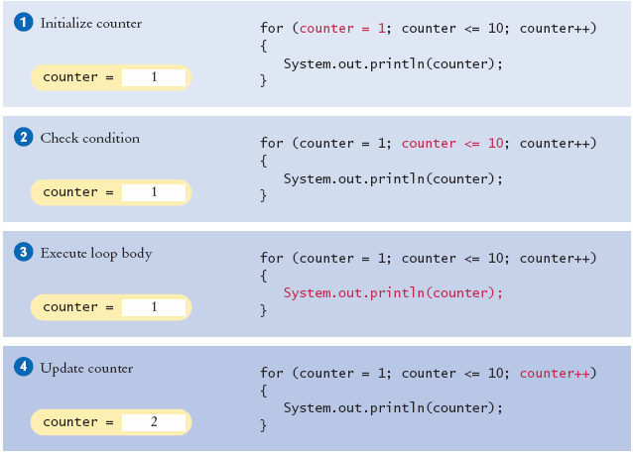

Execution of a for Loop
2
3
2
3
2
3

Slide 21
for Statement
Two semicolons separate the three parts
Initialization ; Condition ; Update

Slide 22
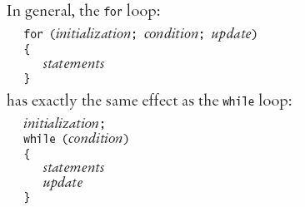
When to use a for Loop?
Yes, a while loop can do everything a for loop can do
Programmers like it because it is concise
Initialization
Condition
Update
All on one line!

Slide 23
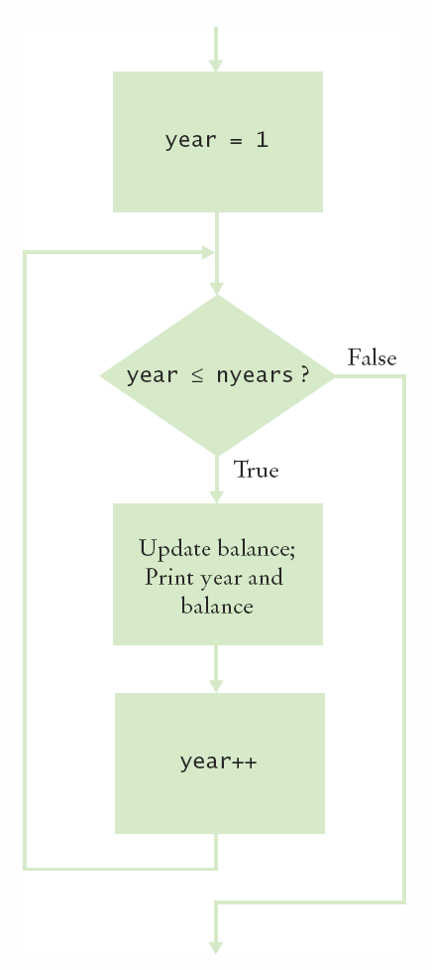
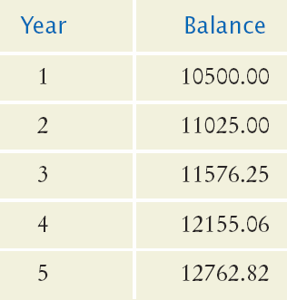
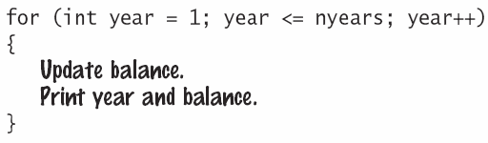
Planning a for Loop
Print the balance at the end of each year for a number of years

Slide 24
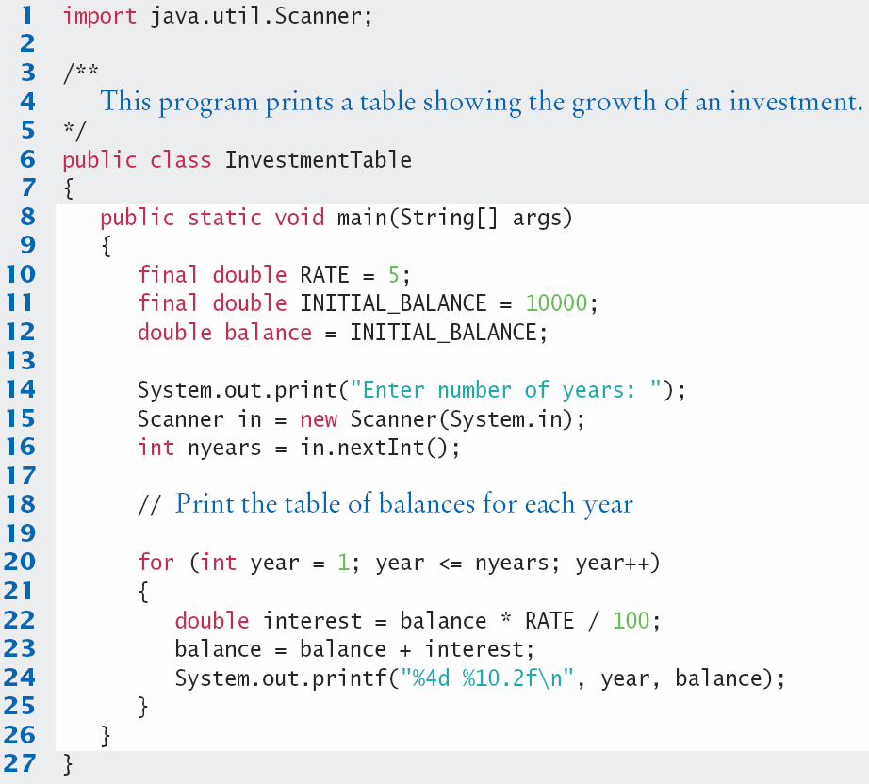
InvestmentTable.java
Setup variables
Get input
Loop
Calc
Output

Slide 25
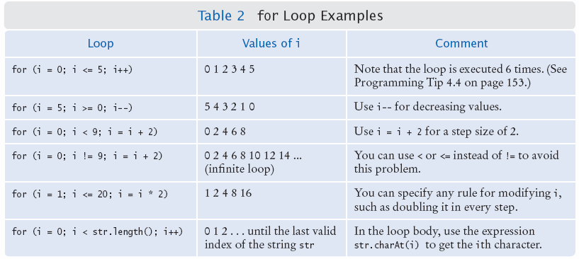
Good Examples of for Loops
Keep it simple!

Slide 26
for Loop variable Scope
for( int x = 1; x < 10; x = x + 1) {
// steps to do inside the loop
// You can use ‘x’ anywhere in this box
}
if (x > 100) // Error! x is out of scope!
Scope is the ‘lifetime’ of a variable.
When ‘x’ is declared in the for statement:
‘x’ exists only inside the ‘block’ of the for loop { }
Solution: Declare‘x’outside the for loop
int x;
for(x = 1; x < 10; x = x + 1)

Slide 27

Programming Tip
Use for loops for their intended purposes only
Increment (or decrement) by a constant value
Do not update the counter inside the body
Update in the third section of the header
Most counters start at one ‘end’ (0 or 1)
Many programmers use an integer named i for ‘index’ or ‘counter’ variable in for loops
for (int counter = 1; counter <= 100; counter++)
{
if (counter % 10 == 0) // Skip values divisible by 10
{
counter++; // Bad style: Do NOT update the counter inside loop
}
System.out.println(counter);
}

Slide 28

Programming Tip
Count Iterations
Many bugs are ‘off by one’ issues
One too many or one too few
How many posts are there?
How many pairs of rails are there?
Painting rail 1
Painting rail 2
Painting rail 3
Painting rail 4
final int RAILS = 5;
for (int i = 1; i < RAILS; i++ )
{
System.out.println("Painting rail “ + i);
}

Slide 29
Summary of the for Loop
for loops are very commonly used
They have a very concise notation
Initialization ; Condition ; Update
Initialization happens once at the start
Condition is tested every time BEFORE executing the body (pre-test)
Increment is done at the end of the body
Great for integer counting, String (array) processing and more

Slide 30
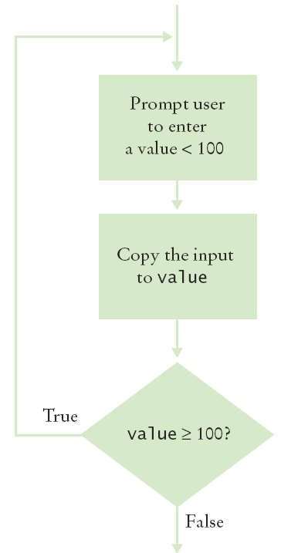
The do Loop
Use a do loop when you want to:
Execute the body at least once
Test the condition AFTER your first loop
int i = 1; // initialize
final int FINGERS = 5;
do
{
// paint finger
i++; // update
}
while (i <= FINGERS); // test
Note the semicolon at the end!

Slide 31
do Loop Example
User Input Validation:
Range check a value entered
User must enter something to validate first!
int value;
do
{
System.out.println(“Enter an integer < 100: ”);
value = in.nextInt();
}
while (value >= 100); // test

Slide 32
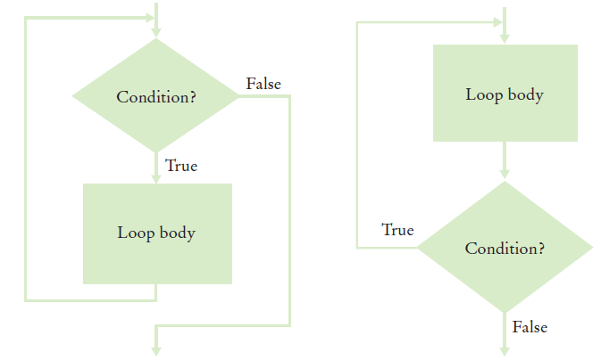
Programming Tip
Flowcharts for loops
To avoid ‘spaghetti code’, never have an arrow that points inside the loop body
while and for
test before
do tests
after

Slide 33

Processing Sentinel Values
Sentinel values are often used:
When you don’t know how many items are in a list, use a ‘special’ character or value to signal no more items.
For numeric input of positive numbers, it is common to use the value -1:
salary = in.nextDouble();
while (salary != -1)
{
sum = sum + salary;
count++;
salary = in.nextDouble();
}
A sentinel value denotes the end of a data set, but it is not part of the data.

Slide 34
Averaging a set of values
Declare and initialize a ‘sum’ variable to 0
Declare and initialize a ‘count’ variable to 0
Declare and initialize an ‘input’ variable to 0
Prompt user with instructions
Loop until sentinel value is entered
Save entered value to input variable
If input is not -1 (sentinel value)
Add input to sum variable
Add 1 to count variable
Make sure you have at least one entry before you divide!
Divide sum by count and output. Done!

Slide 35
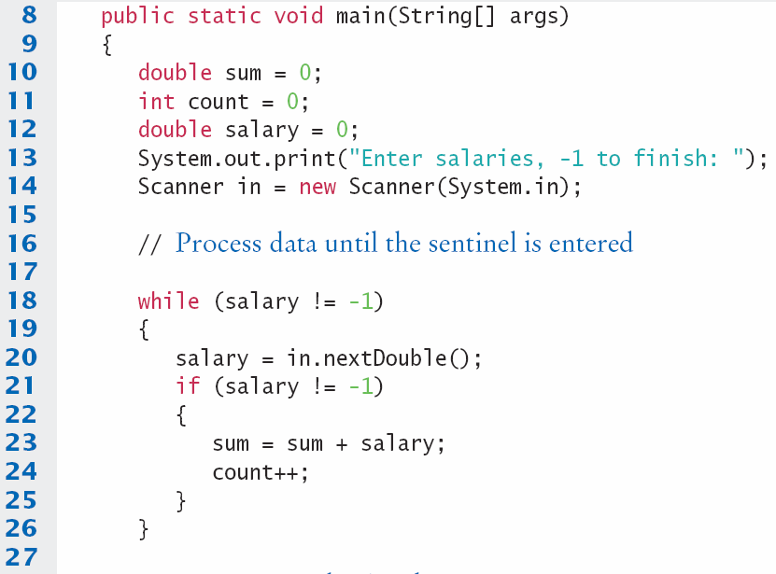
SentinelDemo.java (1)
Outside the while loop, declare and initialize variables to use
Since salary is initialized to 0, the while loop statements will be executed
Input new salary and compare to sentinel
Update running sum and count to average later

Slide 36
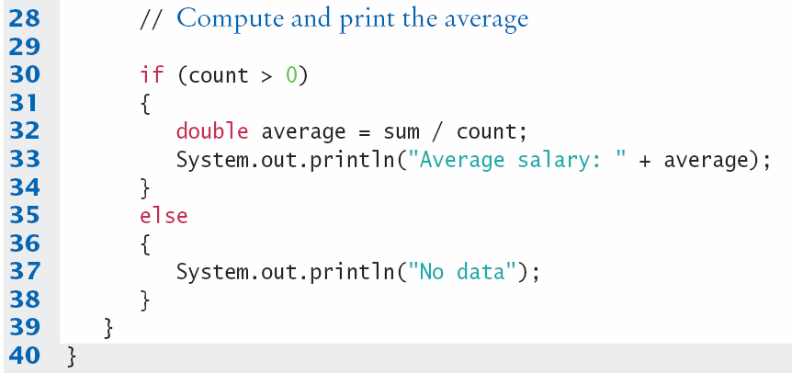
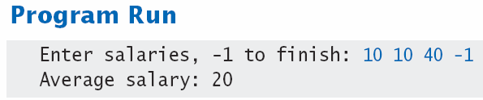
SentinelDemo.java (2)
Prevent divide by 0
Calculate and output the average salary using sum and count variables

Slide 37
Boolean variables and sentinels
A boolean variable can be used to control a loop
Sometimes called a ‘flag’ variable
System.out.print("Enter salaries, -1 to finish: ");
boolean done = false;
while (!done)
{
value = in.nextDouble();
if (value == -1)
{
done = true;
}
else
{
// Process value
}
}
Initialize done so that loop will execute
Set done ‘flag’ to true if sentinel value is found

Slide 38
Common Loop Algorithms
1: Sum and Average Value
2: Maximum and Minimum

Slide 39
Sum and Average Examples
double total = 0;
while (in.hasNextDouble())
{
double input = in.nextDouble();
total = total + input;
}
Sum of Values
Initialize total to 0
Use while loop with sentinel
double total = 0;
int count = 0;
while (in.hasNextDouble())
{
double input = in.nextDouble();
total = total + input;
count++;
}
double average = 0;
if (count > 0)
{ average = total / count; }
Average of Values
Use Sum of Values
Initialize count to 0
Increment per input
Check for count 0
Before divide!

Slide 40
Maximum and Minimum
double largest = in.nextDouble();
while (in.hasNextDouble())
{
double input = in.nextDouble();
if (input > largest)
{
largest = input;
}
}
double smallest = in.nextDouble();
while (in.hasNextDouble())
{
double input = in.nextDouble();
if (input > smallest)
{
smallest = input;
}
}
Get first input value
This is the largest (or smallest) that you have seen so far!
Loop while you have a valid number (non-sentinel)
Get another input value
Compare new input to largest (or smallest)
Update largest (or smallest) if necessary

Slide 41
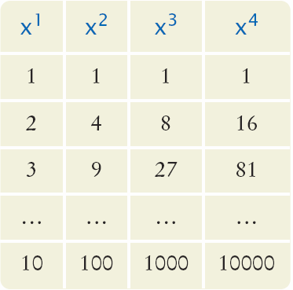
Nested Loops
How would you print a table with rows and columns?
Print top line (header)
Use a for loop
Print table body…
How many rows?
How many columns?
Loop per row
Loop per column

Slide 42
Flowchart of a Nested Loop
x = 1
x <= 10?
True
n= 1
Inner Loop
False
n <= 4?
True
Print x^n
False
n++
Print new line
x++
Done

Slide 43
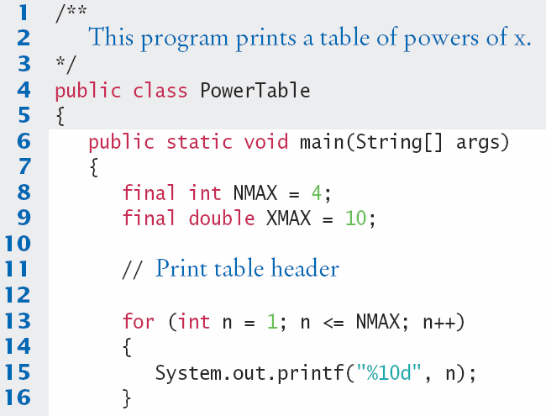
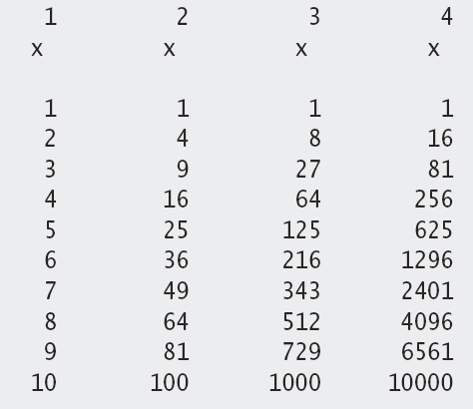
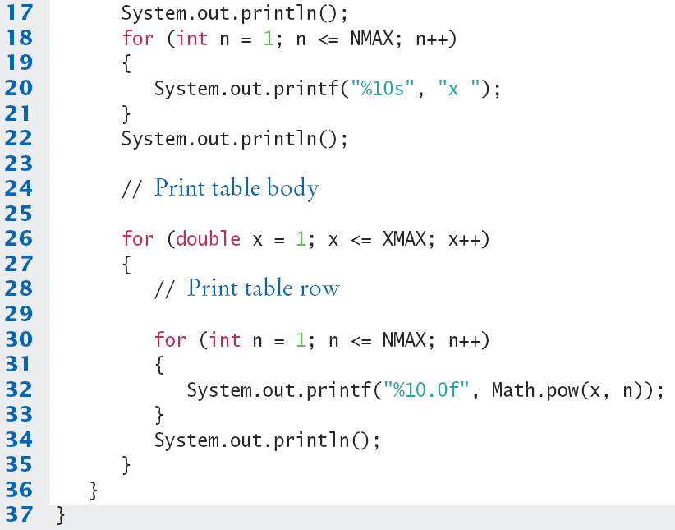
PowerTable.java
Body of outer loop
Body of inner loop

Slide 44
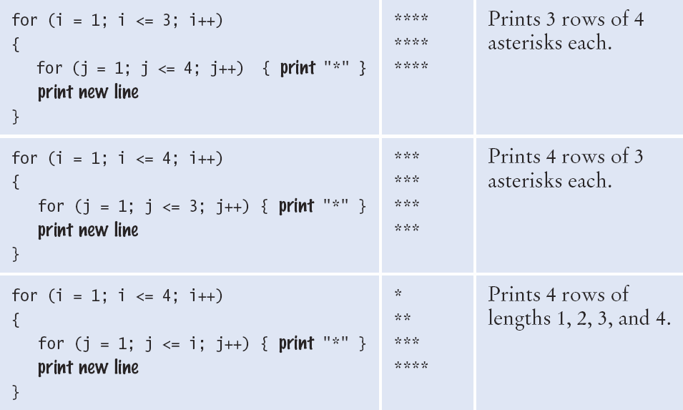
Nested Loop Examples (1)

Slide 45
Nested Loop Examples (2)

Slide 46
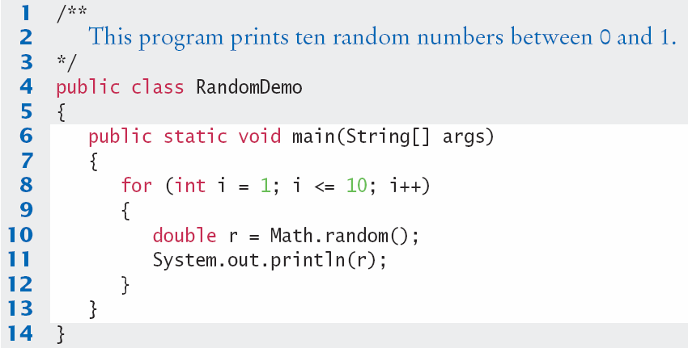
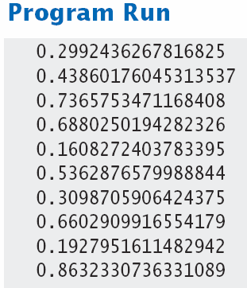
RandomDemo.java

Slide 47
Random Numbers/Simulations
Games often use random numbers to make things interesting
Rolling Dice
Spinning a wheel
Pick a card
A simulation usually involves looping through a sequence of events
Days
Events

