Slide 1
Java Statements and Expressions
All tasks that you want to accomplish can be broken down into statements
Statements represent a single action that is taken
int age = 30 ;
import java.awt.Graphics ;
System.out.println(“Your not the boss of me!”) ;
player.score = 41367 ;
Statements end with a semicolon
Statements may be grouped into a block using curly braces ({ and })
if (a < b) { z = a ;
w = b ; }
An expression is a statement that results in a value being produced.

Slide 2
Block Statements
Statements in Java are grouped into blocks
Beginning and ending of the blocks are marked with
{ - a left brace to start the block
} - a right brace to end the block
Blocks can be nested inside other blocks
Blocks create a local scope for variables declared in the block
DEFINITION - The term “scope” refers to the part of a program in which a variable exists and can be used. When the program leaves the scope of a variable, that variable no longer exists
void testBlock() { int x = 10 ; // x can only be used inside method
{ // start of a block
int y = 40 ; // y can only be used inside block
y = y + x ;
} // end of the block - y is destroyed
} // end of the method - x is destroyed

Slide 3
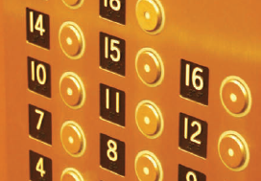
The if Statement
A computer program often needs to make decisions based on input, or circumstances
For example, buildings often ‘skip’ the 13th floor, and elevators should too
The 14th floor is really the 13th floor
So every floor above 12 is really ‘floor - 1’
If floor > 12, Actual floor = floor - 1
The two keywords of the if statement are:
if
else
The if statement allows a program to carry out different actions depending on the nature of the data to be processed.

Slide 4
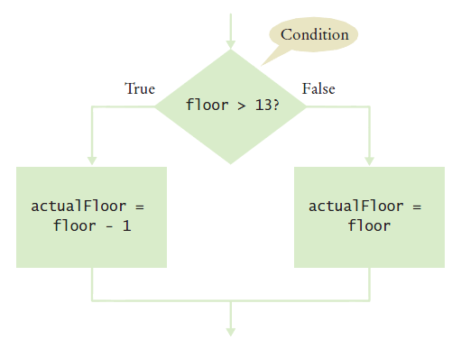
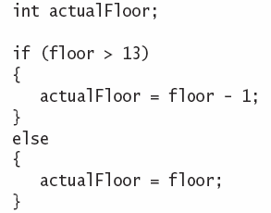
Flowchart of the if statement
One of the two branches is executed once
True (if) branch or False (else) branch

Slide 5
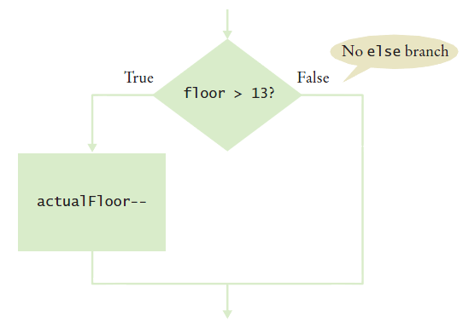
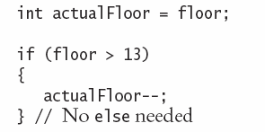
Flowchart with only true branch
An if statement may not need a ‘False’ (else) branch

Slide 6
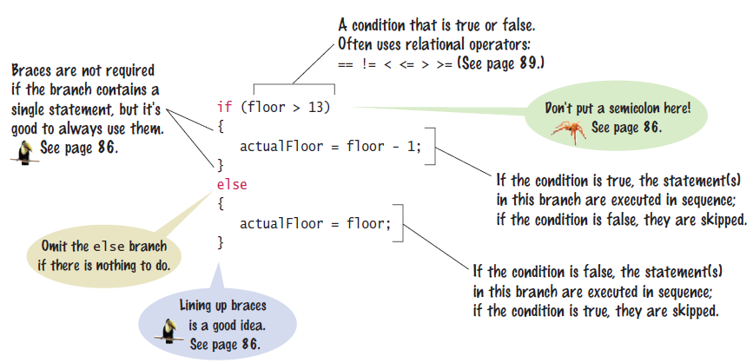
The if statement

Slide 7
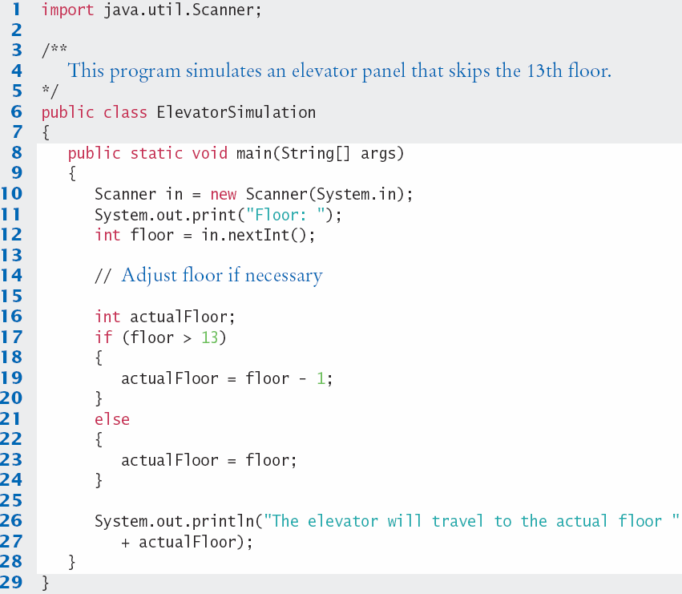
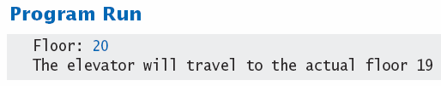
ElevatorSimulation.java

Slide 8




Tips On Using Braces
Line up all pairs of braces vertically
Lined up Not aligned (saves lines)
Always use braces
Although single statement clauses do not require them
Most programmer’s editors have a tool to align matching braces.

Slide 9
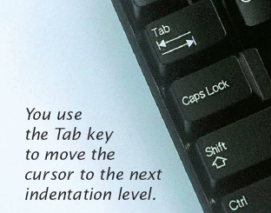
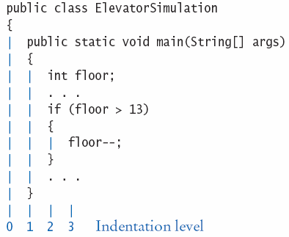
Tips on indenting blocks
Use Tab to indent a consistent number of spaces
This is referred to as ‘block- structured’ code. Indenting consistently makes code much easier for humans to follow.

Slide 10

Common Error
A semicolon after an if statement
It is easy to forget and add a semicolon after an if statement.
The true path is now the space just before the semicolon
The ‘body’ (between the curly braces) will always be executed in this case
if (floor > 13) ;
{
floor--;
}

Slide 11
The Conditional Operator
A ‘shortcut’ you may find in existing code
It is not used in this book
Includes all parts of an if-else clause, but uses:
? To begin the true branch
: To end the true branch and start the false branch
Condition
True branch
False branch
actualFloor = floor > 13 ? floor - 1 : floor;

Slide 12
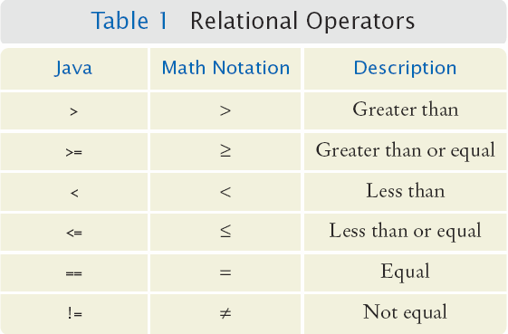
Comparing Numbers and Strings
Every if statement has a condition
Usually compares two values with an operator
if (floor > 13) ..
if (floor >= 13)
..
if (floor < 13) ..
if (floor <= 13)
..
if (floor == 13) ..
Beware!

Slide 13
Comparisons

Slide 14
Operator Precedence
The comparison operators have lower precedence than arithmetic operators
Calculations are done before the comparison
Normally your calculations are on the ‘right side’ of the comparison or assignment operator
Calculations
actualFloor = floor + 1;
if (floor > height + 1)

Slide 15
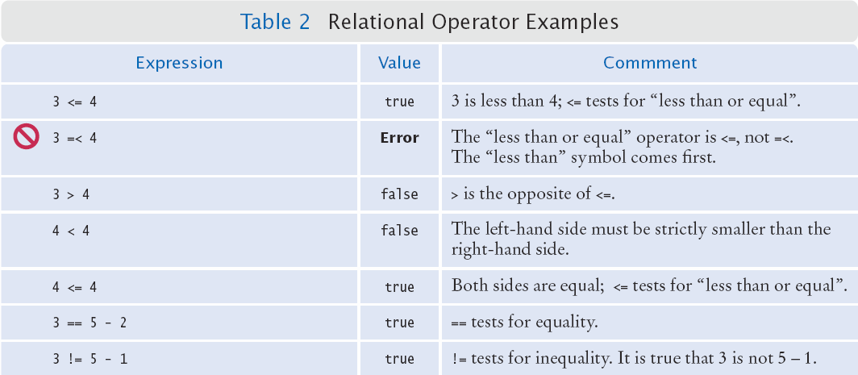
Relational Operator Use (1)

Slide 16
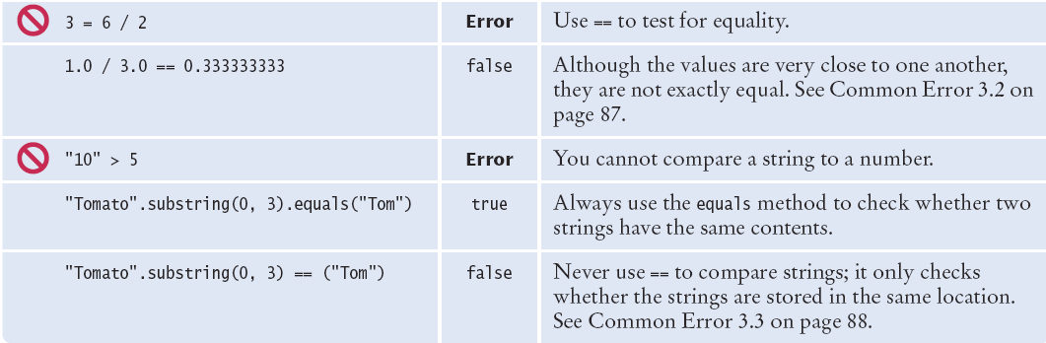
Relational Operator Use (2)

Slide 17
Common Error
Comparison of Floating-Point Numbers
Floating-point numbers have limited precision
Round-off errors can lead to unexpected results
double r = Math.sqrt(2.0);
if (r * r == 2.0)
{
System.out.println("Math.sqrt(2.0) squared is 2.0");
}
else
{
System.out.println("Math.sqrt(2.0) squared is not 2.0 but " + r * r);
}
Output:
Math.sqrt(2.0) squared is not 2.0 but 2.00000000000000044

Slide 18

The use of EPSILON
Use a very small value to compare the difference if floating-point values are ‘close enough’
The magnitude of their difference should be less than some threshold
Mathematically, we would write that x and y are close enough if:
final double EPSILON = 1E-14;
double r = Math.sqrt(2.0);
if (Math.abs(r * r - 2.0) < EPSILON)
{
System.out.println("Math.sqrt(2.0) squared is approx. 2.0");
}

Slide 19
Common Error
Using == to compare Strings
== compares the locations of the Strings
Java creates a new String every time a new word inside double-quotes is used
If there is one that matches it exactly, Java re-uses it
String nickname = "Rob";
. . .
if (nickname == "Rob") // Test is true
String name = "Robert";
String nickname = name.substring(0, 3);
. . .
if (nickname == "Rob") // Test is false

Slide 20


Implementing an if Statement
Decide on a branching condition
Write pseudocode for the true branch
Write pseudocode for the false branch
Double-check relational operators
Test values below, at, and above the comparison (127, 128, 129)

Slide 21


Implementing an if Statement (cont.)
Remove duplication
Test both branches
Write the code in Java

Slide 22
Implemented Example
The university bookstore has a Kilobyte Day sale every October 24, giving an 8 percent discount on all computer accessory purchases if the price is less than $128, and a 16 percent discount if the price is at least $128.
if (originalPrice < 128)
{
discountRate = 0.92;
}
else
{
discountRate = 0.84;
}
discountedPrice = discountRate * originalPrice;

Slide 23
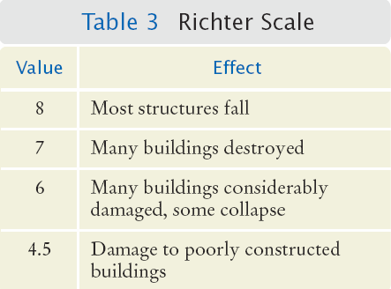
Multiple Alternatives
What if you have more than two branches?
Count the branches for the following earthquake effect example:
8 (or greater)
7 to 7.99
6 to 6.99
4.5 to 5.99
Less than 4.5
When using multiple if statements, test general conditions after more specific conditions.

Slide 24
Flowchart of Multiway branching
True
> 8.0?
Most Structures Fall
False
>= 7.0?
True
Many Buildings Destroyed
False
>= 6.0?
True
Many buildings considerably damaged, some collapse
False
>= 4.5?
True
Damage to poorly constructed buildings
False
No destruction of buildings

Slide 25
if, else if multiway branching
if (richter >= 8.0) // Handle the ‘special case’ first
{
System.out.println("Most structures fall");
}
else if (richter >= 7.0)
{
System.out.println("Many buildings destroyed");
}
else if (richter >= 6.0)
{
System.out.println("Many buildings damaged, some collapse");
}
else if (richter >= 4.5)
{
System.out.println("Damage to poorly constructed buildings");
}
else // so that the ‘general case’ can be handled last
{
System.out.println("No destruction of buildings");
}

Slide 26
What is wrong with this code?
if (richter >= 8.0)
{
System.out.println("Most structures fall");
}
if (richter >= 7.0)
{
System.out.println("Many buildings destroyed");
}
if (richter >= 6.0)
{
System.out.println("Many buildings damaged, some collapse");
}
if (richter >= 4.5)
{
System.out.println("Damage to poorly constructed buildings");
}

Slide 27
Another way to multiway branch
The switch statement chooses a case based on an integer value.
int digit = . . .;
switch (digit)
{
case 1: digitName = "one"; break;
case 2: digitName = "two"; break;
case 3: digitName = "three"; break;
case 4: digitName = "four"; break;
case 5: digitName = "five"; break;
case 6: digitName = "six"; break;
case 7: digitName = "seven"; break;
case 8: digitName = "eight"; break;
case 9: digitName = "nine"; break;
default: digitName = ""; break;
}
break ends each case
default catches all other values
If the break is missing, the case falls through to the next case’s statements.

Slide 28
Nested Branches
You can nest an if inside either branch of an if statement.
Simple example: Ordering drinks
Ask the customer for their drink order
if customer orders wine
Ask customer for ID
if customer’s age is 21 or over
Serve wine
Else
Politely explain the law to the customer
Else
Serve customers a non-alcoholic drink

Slide 29
Flowchart of a Nested if
Ask for order
Nested if-else inside true branch of an if statement.
Three paths
Wine?
True
Check ID
False
>= 21?
True
Serve wine
Serve non-alcoholic drink
False
Read law
Done

Slide 30
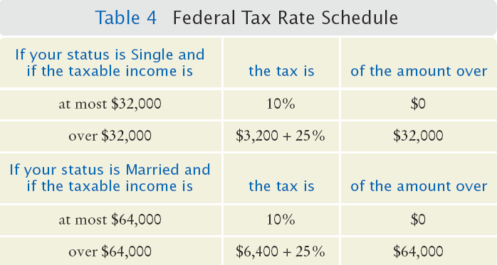
Tax Example: Nested ifs
Four outcomes (branches)
Single
<= 32000
> 32000
Married
<= 64000
> 64000

Slide 31
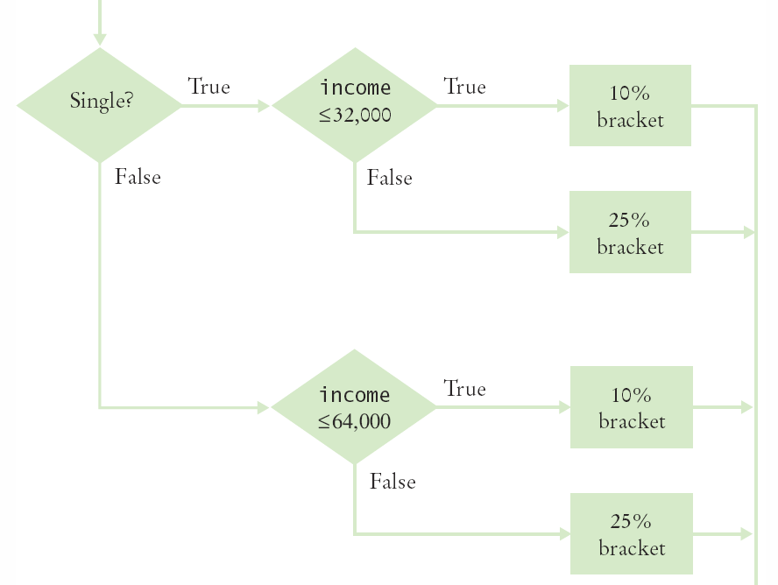
Flowchart for Tax Example
Four branches

Slide 32
Common Error
The Dangling else Problem
When an if statement is nested inside another if statement, the following can occur:
The indentation level suggests that the else is related to the if country (“USA”)
Else clauses always associate to the closest if
double shippingCharge = 5.00; // $5 inside continental U.S.
if (country.equals("USA"))
if (state.equals("HI"))
shippingCharge = 10.00; // Hawaii is more expensive
else // Pitfall!
shippingCharge = 20.00; // As are foreign shipment

Slide 33
Enumerated Types
Java provides an easy way to name a finite list of values that a variable can hold
It is like declaring a new type, with a list of possible values
You can have any number of values, but you must include them all in the enum declaration
You can declare variables of the enumeration type:
And you can use the comparison operator with them:
public enum FilingStatus {
SINGLE, MARRIED,MARRIED_FILING_SEPARATELY }
FilingStatus status = FilingStatus.SINGLE;
if (status == FilingStatus.SINGLE) . . .

Slide 34

Boolean Variables
Boolean Variables
A Boolean variable is often called a flag because it can be either up (true) or down (false)
boolean is a Java data type
boolean failed = true;
Can be either true or false
Boolean Operators: && and ||
They combine multiple conditions
&& is the and operator
|| is the or operator

Slide 35
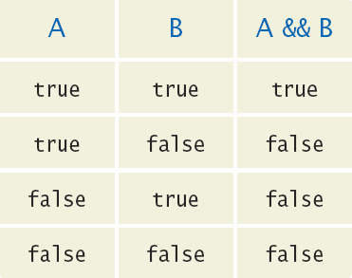
Combined Conditions: &&
Combining two conditions is often used in range checking
Is a value between two other values?
Both sides of the and must be true for the result to be true
if (temp > 0 && temp < 100)
{
System.out.println("Liquid");
}

Slide 36
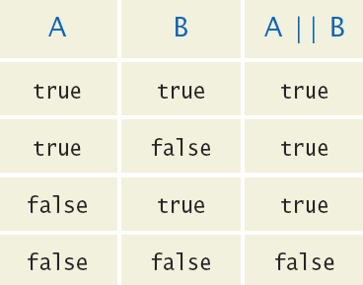
Combined Conditions: ||
If only one of two conditions need to be true
Use a compound conditional with an or:
If either is true
The result is true
if (balance > 100 || credit > 100)
{
System.out.println(“Accepted");
}

Slide 37
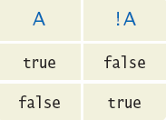
The not Operator: !
If you need to invert a boolean variable or comparison, precede it with !
If using !, try to use simpler logic:
if (!attending || grade < 60)
{
System.out.println(“Drop?");
}
if (attending && !(grade < 60))
{
System.out.println(“Stay");
}
if (attending && (grade >= 60))

Slide 38
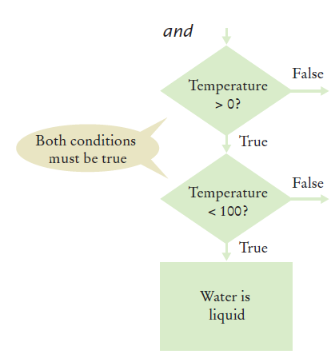
and Flowchart
if (temp > 0 && temp < 100)
{
System.out.println("Liquid");
}
This is often called ‘range checking’
Used to validate that input is between two values

Slide 39
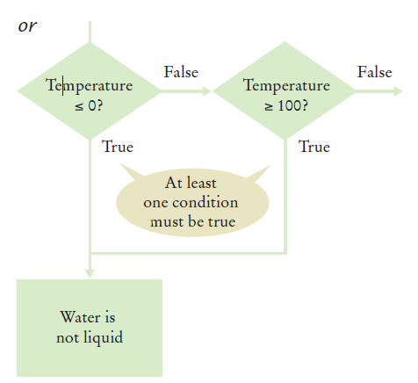
or Flowchart
Another form of ‘range checking’
Checks if value is outside a range
if (temp <= 0 || temp >= 100)
{
System.out.println(“Not Liquid");
}

Slide 40
Boolean Operator Examples

Slide 41
Boolean Operator Examples

Slide 42
Common Error
Combining Multiple Relational Operators
This format is used in math, but not in Java!
It requires two comparisons:
This is also not allowed in Java:
This also requires two comparisons:
if (0 <= temp <= 100) // Syntax error!
if (0 <= temp && temp <= 100)
if (input == 1 || 2) // Syntax error!
if (input == 1 || input == 2)

Slide 43
Common Error
Confusing && and ||Conditions
It is a surprisingly common error to confuse && and || conditions.
A value lies between 0 and 100 if it is at least 0 and at most 100.
It lies outside that range if it is less than 0 or greater than 100.
There is no golden rule; you just have to think carefully.

Slide 44
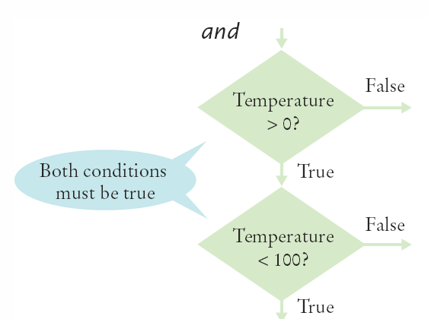
Short-Circuit Evaluation: &&
Combined conditions are evaluated from left to right
If the left half of an and condition is false, why look further?
A useful example:
if (temp > 0 && temp < 100)
{
System.out.println("Liquid");
}
Done!
if (quantity > 0 && price / quantity < 10)

Slide 45
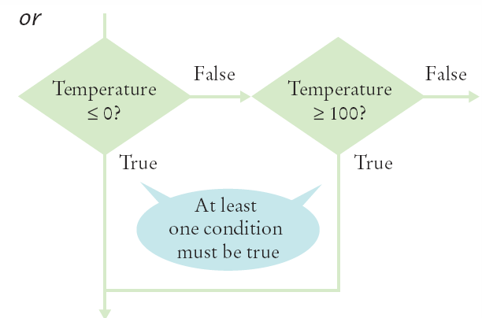
Short-Circuit Evaluation: ||
If the left half of the or is true, why look further?
Java doesn’t!
Don’t do these second:
Assignment
Output
if (temp <= 0 || temp >= 100)
{
System.out.println(“Not Liquid");
}
Done!

