Slide 1
Variables
Most computer programs hold temporary values in named storage locations
Programmers name them for easy access
There are many different types (sizes) of storage to hold different things
You ‘declare’ a variable by telling the compiler:
What type (size) of variable you need
What name you will use to refer to it

Slide 2
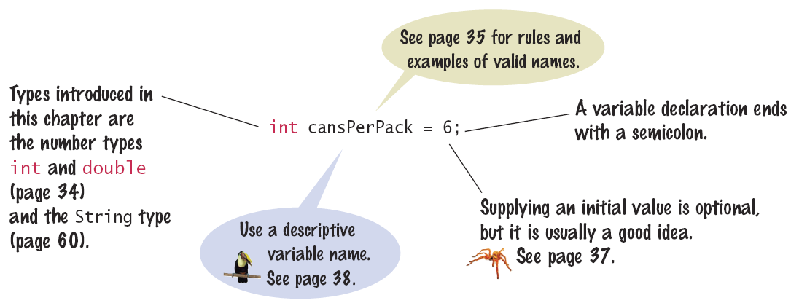
Variable Declaration
When declaring a variable, you often specify an initial value
This is also where you tell the compiler the size (type) it will hold

Slide 3

An Example: Soda Deal
Soft drinks are sold in cans and bottles. A store offers a six-pack of 12-ounce cans for the same price as a two-liter bottle. Which should you buy? (12 fluid ounces equal approximately 0.355 liters.)
List of variables: Type of Number
Number of cans per pack Whole number
Ounces per can Whole number
Ounces per bottle Number with fraction

Slide 4
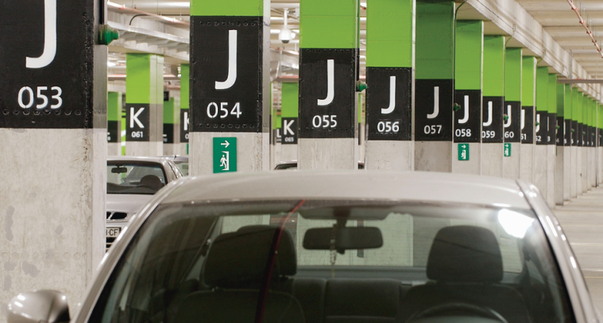
Variables and contents
Each variable has an identifier (name) and contents
You can (optionally) set the contents of a variable when you declare it
int cansPerPack = 6;
Imagine a parking space in a parking garage
Identifier: J053
Contents: Bob’s Chevy
cansPerPack
6
A variable is a storage location with a name

Slide 5
Example Declarations

Slide 6
Basic Data Types
Integer Types
byte: A very small number (-128 to +127)
short: A small number (-32768 to +32767)
int: A large number (-2,147,483,648 to +2,147,483,647)
long: A huge number
Floating Point Types
float: A huge number with decimal places
double: Much more precise, for heavy math
Other Types
boolean: true or false
char: One symbol in single quotes ‘a’

Slide 7


Why different types?
Back to the garage analogy, parking spaces may be different sizes for different types of vehicles
Bicycle
Motorcycle
Full Size
Electric Vehicle

Slide 8
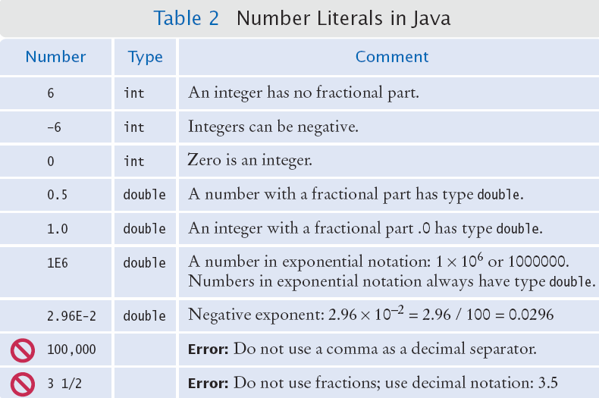
Number Literals in Java
Sometimes when you just type a number, the compiler has to ‘guess’ what type it is
amt = 6 * 12.0;
PI = 3.14;
canVol = 0.335;
Use the double
type for floating-
point numbers.

Slide 9
Floating-Point Numbers
Java stores numbers with fractional parts as ‘floating point’ numbers.
A ‘double’ is a double-precision floating point number: It takes twice the storage (52 bit mantissa) as the smaller ‘float’ (23 bit mantissa)

Slide 10

Naming Variables
Name should describe the purpose
‘canVolume’ is better than ‘cv’
Use These Simple Rules
1) Variable names must start with a letter or the
underscore ( _ ) character
Continue with letters (upper or lower case), digits or the underscore
2) You cannot use other symbols (? or %...) and spaces are not permitted
3) Separate words with ‘camelHump’ notation
Use upper case letters to signify word boundaries
4) Don’t use reserved ‘Java’ words (see Appendix C)

Slide 11
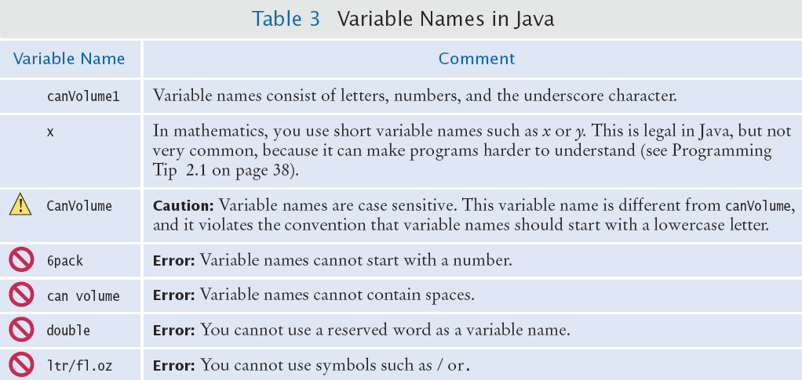
Variable Names in Java
Legal and illegal variable names

Slide 12
The Assignment Statement
Use the ‘assignment statement’ ( with an '=' ) to place a new value into a variable
int cansPerPack = 6; // declare & initialize
cansPerPack = 8; // assignment
Beware: The = sign is NOT used for comparison:
It copies the value on the right side into the variable on the left side
You will learn about the comparison operator in the next chapter

Slide 13
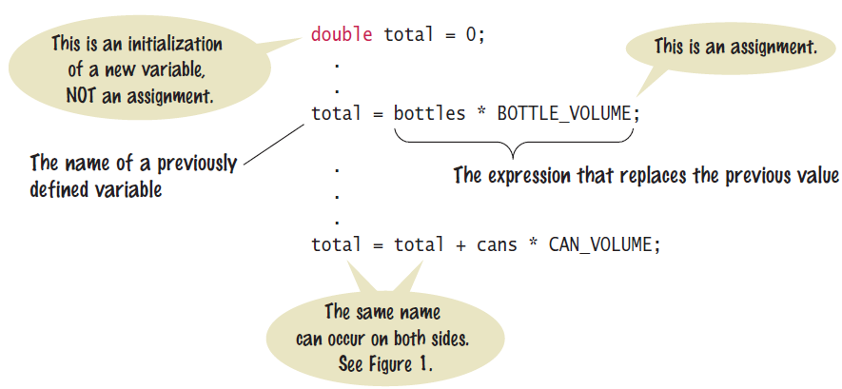
Assignment Syntax
The value on the right of the '=' sign is copied to the variable on the left

Slide 14
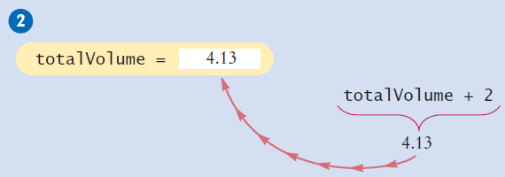
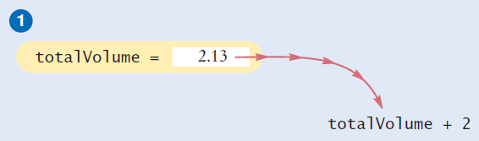
Updating a Variable
Step by Step:
totalVolume = totalVolume + 2;
Calculate the right hand side of the assignment Find the value of totalVolume, and add 2 to it
Store the result in the variable named on the left side of the assignment operator (totalVolume in this case)

Slide 15
Constants
When a variable is defined with the reserved word final, its value can never be changed
final double BOTTLE_VOLUME = 2;
It is good style to use named constants to explain numerical values to be used in calculations
Which is clearer?
double totalVolume = bottles * 2;
double totalVolume = bottles * BOTTLE_VOLUME;
A programmer reading the first statement may not understand the significance of the 2
Also, if the constant is used in multiple places and needs to be changed, only the initialization changes

Slide 16
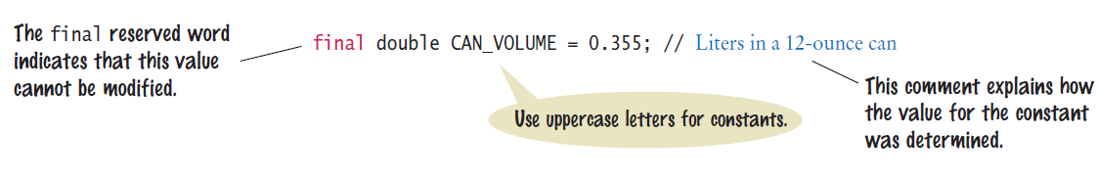
Constant Declaration
It is customary (not required) to use all UPPER_CASE letters for constants

Slide 17
Java Comments
There are three forms of comments:
1: // single line (or rest of line to right)
2: /*
multi-line – all comment until matching
*/
3: /**
multi-line Javadoc comments
*/
Use comments at the beginning of each program, and to clarify details of the code
Use comments to
add explanations for
humans who read
your code. The
compiler ignores
comments.

Slide 18
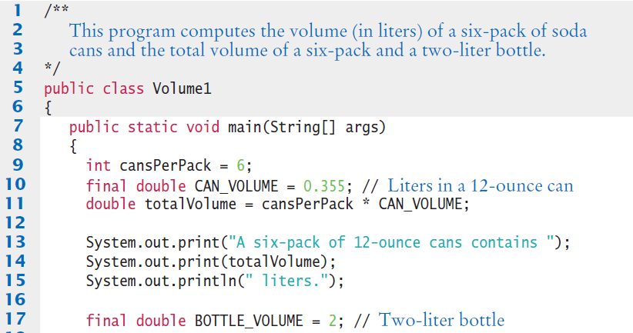
Java Comment Example
Lines 1 - 4 are Javadoc comments for the class Volume1
Lines 10 and 17 use single-line comment to clarify the unit of measurement

Slide 19

Common Error
Undeclared Variables
You must declare a variable before you use it: (i.e. above in the code)
double canVolume = 12 * literPerOunce; // ??
double literPerOunce = 0.0296;
Uninitialized Variables
You must initialize (i.e. set) a variable’s contents before you use it
int bottles;
int bottleVolume = bottles * 2; // ??

Slide 20
Common Error
Overflow means that storage for a variable cannot hold the result
int fiftyMillion = 50000000;
System.out.println(100 * fiftyMillion);
// Expected: 5000000000
Will print out 705032704
Why?
The result (5 billion) overflowed int capacity
Maximum value for an int is +2,147,483,647
Use a long instead of an int (or a double)

Slide 21
Common Error
Roundoff Errors
Floating point values are not exact
This is a limitations of binary values (no fractions):
double price = 4.35;
double quantity = 100;
double total = price * quantity;
// Should be 100 * 4.35 = 435.00
System.out.println(total); // Prints 434.99999999999999
You can deal with roundoff errors by rounding to the nearest integer (see Section 2.2.5) or by displaying a fixed number of digits after the decimal separator (see Section 2.3.2).

Slide 22
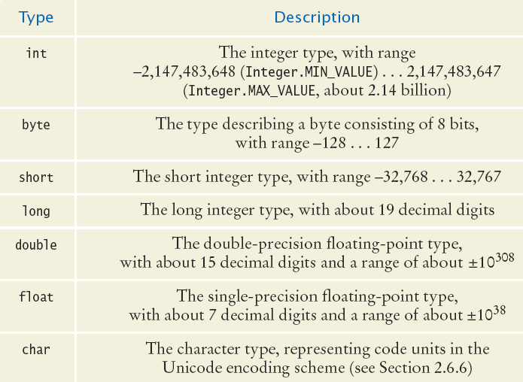
All of the Java Numeric Types
Whole Numbers (no fractions)
Floating point Numbers
Characters
(no math)
Each type has a range of values that it can hold

Slide 23
Value Ranges per Type
Integer Types
byte: A very small number (-128 to +127)
short: A small number (-32768 to +32767)
int: A large number (-2,147,483,648 to +2,147,483,647)
long: A huge number
Floating Point Types
float: A huge number with decimal places
double: Much more precise, for heavy math
Other Types
boolean: true or false
char: One symbol in single quotes ‘a’

Slide 24
Storage per Type (in bytes)
Integer Types
byte:
short:
int:
long:
Floating Point Types
float:
double:
Other Types
boolean:
char:

