Slide 1

METHODS

Slide 2
Chapter Goals
To be able to implement methods
To become familiar with the concept of parameter passing
To develop strategies for decomposing complex tasks into simpler ones
To be able to determine the scope of a variable
To learn how to think recursively (optional)
In this chapter, you will learn how to design and implement your own methods. Using the process of stepwise refinement, you will be able to break up complex tasks into sets of cooperating methods.

Slide 3

Contents
Methods as Black Boxes
Implementing Methods
Parameter Passing
Return Values
Methods without Return Values
Problem Solving:
Reusable Methods
Stepwise Refinement
Variable Scope
Recursive Methods (optional)

Slide 4
5.1 Methods as Black Boxes
A method is a sequence of instructions with a name
You declare a method by defining a named block of code
You call a method in order to execute its instructions
public static void main(String[] args)
{
double result = Math.pow(2, 3);
. . .
}
A method packages a computation consisting of multiple steps into a form that can be easily understood and reused.

Slide 5
What is a method?
Some methods you have already used are:
Math.pow()
String.length()
Character.isDigit()
Scanner.nextInt()
main()
They have:
May have a capitalized name and a dot (.) before them
A method name
Follow the same rules as variable names, camelHump style
( ) - a set of parenthesis at the end
A place to provide the method input information

Slide 6
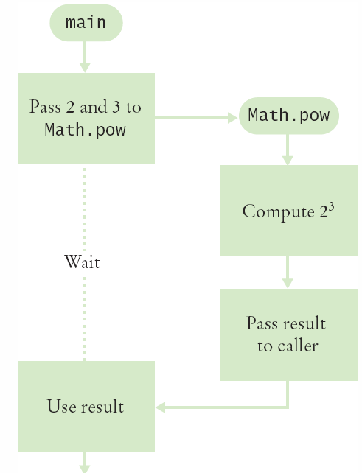
Flowchart of Calling a Method
public static void main(String[] args)
{
double result = Math.pow(2, 3);
. . .
}
One method ‘calls’ another
main calls Math.pow()
Passes two arguments
2 and 3
Math.pow starts
Uses variables (2, 3)
Does its job
Returns the answer
main uses result

Slide 7
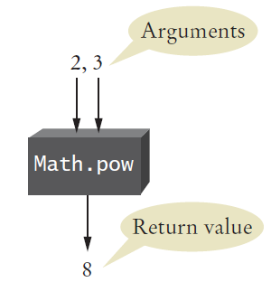
Arguments and Return Values
public static void main(String[] args)
{
double result = Math.pow(2,3);
. . .
}
main ‘passes’ two arguments (2 and 3) to Math.pow
Math.pow calculates and returns a value of 8 to main
main stores the return value to variable ‘result’

Slide 8
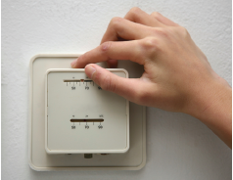
Black Box Analogy
A thermostat is a ‘black box’
Set a desired temperature
Turns on heater/AC as required
You don’t have to know how it really works!
How does it know the current temp?
What signals/commands does it send to the heater or A/C?
Use methods like ‘black boxes’
Pass the method what it needs to do its job
Receive the answer

Slide 9
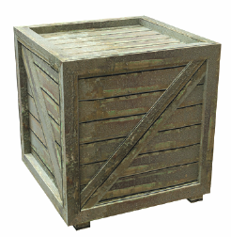
5.2 Implementing Methods
A method to calculate the volume of a cube
What does it need to do its job?
What does it answer with?
When writing this method:
Pick a name for the method (cubeVolume).
Declare a variable for each incoming argument
(double sideLength) (called parameter variables)
Specify the type of the return value ( double )
Add modifiers such as public static
(see Chapter 8)
When declaring a method, you provide a name for the method, a variable for each argument, and a type for the result
public static double cubeVolume(double sideLength)

Slide 10
Inside the Box
Then write the body of the method
The body is surrounded by curly braces { }
The body contains the variable declarations and statements that are executed when the method is called
It will also return the calculated answer
public static double cubeVolume(double sideLength)
{
double volume = sideLength * sideLength * sideLength;
return volume;
}

Slide 11
Back from the Box
The values returned from cubeVolume are stored in local variables inside main
The results are then printed out
public static void main(String[] args)
{
double result1 = cubeVolume(2);
double result2 = cubeVolume(10);
System.out.println("A cube of side length 2 has volume
" + result1);
System.out.println("A cube of side length 10 has volume
" + result2);
}

Slide 12
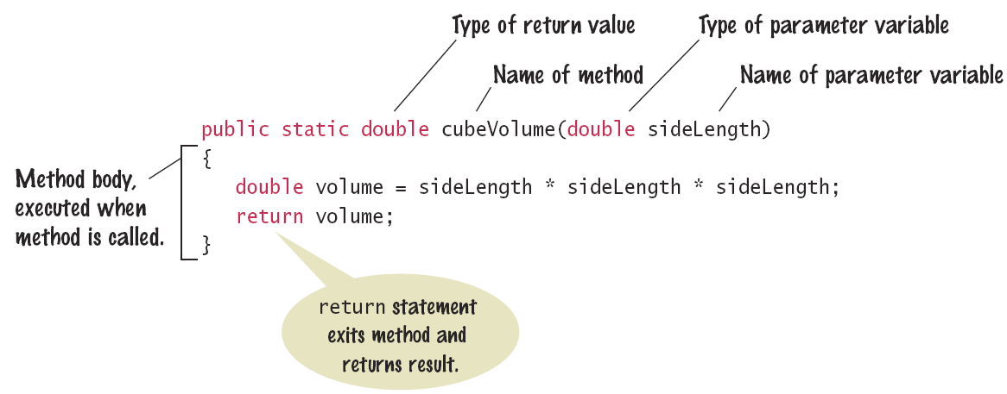
Syntax 5.1: Method Declaration

Slide 13
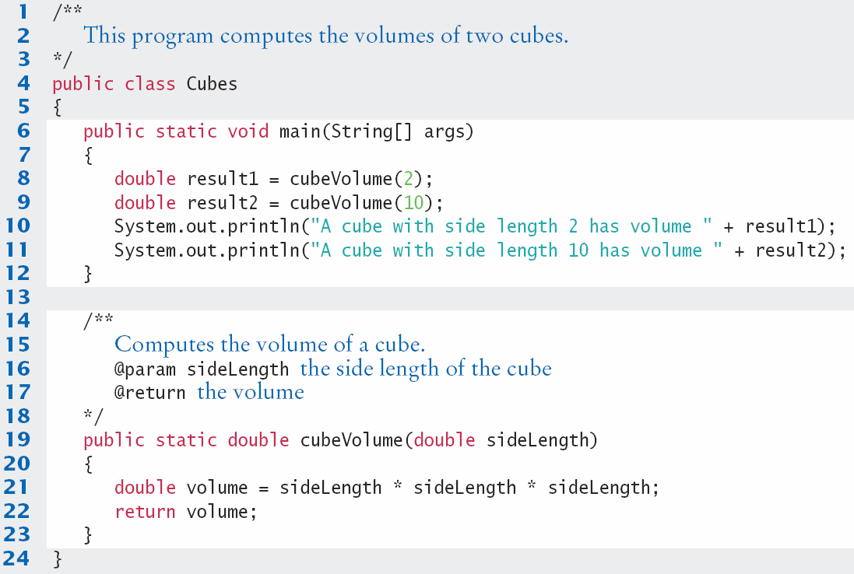
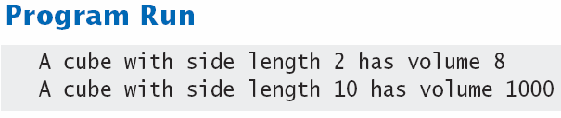
Cubes.java

Slide 14

Method Comments
Write a Javadoc comment above each method
Start with /**
Note the purpose of the method
@param Describe each parameter variable
@return Describe the return value
End with */
/**
Computes the volume of a cube.
@param sideLength the side length of the cube
@return the volume
*/
public static double cubeVolume(double sideLength)

Slide 15
5.3 Parameter Passing
Parameter variables receive the argument values supplied in the method call
They both must be the same type
The argument value may be:
The contents of a variable
A ‘literal’ value (2)
aka. ‘actual parameter’ or argument
The parameter variable is:
Declared in the called method
Initialized with the value of the argument value
Used as a variable inside the called method
aka. ‘formal parameter’
Calling Method
out
Argument value
Parameter variable
in
Called Method

Slide 16




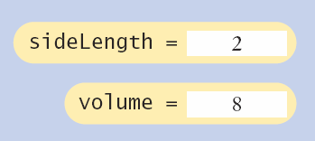
Parameter Passing Steps
public static void main(String[] args)
{
double result1 = cubeVolume(2);
. . .
}
public static double cubeVolume(double sideLength)
{
double volume = sideLength * sideLength * sideLength;
return volume;
}

Slide 17

Common Error 5.1
Trying to Modify Arguments
A copy of the argument values is passed
Called method (addTax) can modify local copy (price)
But not original
in calling method
total
public static void main(String[] args)
{
double total = 10;
addTax(total, 7.5);
}
total
10.0
copy
public static int addTax(double price, double rate)
{
double tax = price * rate / 100;
price = price + tax; // Has no effect outside the method
return tax;
}
price
10.75

Slide 18
5.4 Return Values
Methods can (optionally) return one value
Declare a return type in the method declaration
Add a return statement that returns a value
A return statement does two things:
Immediately terminates the method
Passes the return value back to the calling method
return type
public static double cubeVolume (double sideLength)
{
double volume = sideLength * sideLength * sideLength;
return volume;
}
The return value may be a value, a variable or a calculation
Type must match return type
return statement

Slide 19
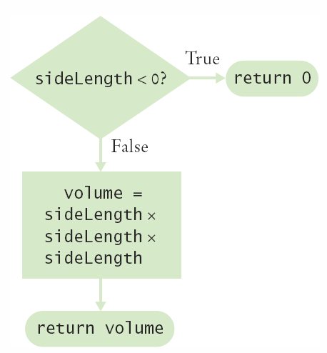
Multiple return Statements
A method can use multiple return statements
But every branch must have a return statement
public static double cubeVolume(double sideLength)
{
if (sideLength < 0)
{
return 0;
}
return sideLength * sideLength * sideLength;
}

Slide 20
Common Error 5.2
Missing return Statement
Make sure all conditions are handled
In this case, x could be equal to 0
No return statement for this condition
The compiler will complain if any branch has no return statement
public static int sign(double x)
{
if (x < 0) { return -1; }
if (x > 0) { return 1; }
// Error: missing return value if x equals 0
}

Slide 21
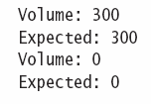
Implementing a Method: Steps
Describe what the method should do.
Determine the method’s “inputs”.
Determine the types of parameter values and the return value.
Write pseudocode for obtaining the desired result.
Implement the method body.
Test your method.
Design test cases and code
public static double pyramidVolume(double height, double baseLength)
{
double baseArea = baseLength * baseLength;
return height * baseArea / 3;
}

Slide 22

5.5 Methods without Return Values
Methods are not required to return a value
The return type of void means nothing is returned
No return statement is required
The method can generate output though!
...
boxString(“Hello”);
...
public static void boxString(String str)
{
int n = str.length();
for (int i = 0; i < n + 2; i++)
{ System.out.print("-"); }
System.out.println();
System.out.println("!" + str + "!");
for (int i = 0; i < n + 2; i++)
{ System.out.print("-"); }
System.out.println();
}

Slide 23
Using return Without a Value
You can use the return statement without a value
In methods with void return type
The method will terminate immediately!
public static void boxString(String str)
{
int n = str.length();
if (n == 0)
{
return; // Return immediately
}
for (int i = 0; i < n + 2; i++) { System.out.print("-"); }
System.out.println();
System.out.println("!" + str + "!");
for (int i = 0; i < n + 2; i++) { System.out.print("-"); }
System.out.println();
}

Slide 24
5.6 Problem Solving: Reusable Methods
Find Repetitive Code
May have different values but same logic
int hours;
do
{
System.out.print("Enter a value between 1 and 12: ");
hours = in.nextInt();
}
while (hours < 1 || hours > 12);
int minutes;
do
{
System.out.print("Enter a value between 0 and 59: ");
minutes = in.nextInt();
}
while (minutes < 0 || minutes > 59);
1 - 12
0 - 59

Slide 25
Write a ‘Parameterized’ Method
/**
Prompts a user to enter a value in a given range until the user
provides a valid input.
@param low the low end of the range
@param high the high end of the range
@return the value provided by the user
*/
public static int readValueBetween(int low, int high)
{
int input;
do
{
System.out.print("Enter between " + low + " and " + high + ": ");
Scanner in = new Scanner(System.in);
input = in.nextInt();
}
while (input < low || input > high);
return input;
}
1, 12
0, 59
8

Slide 26
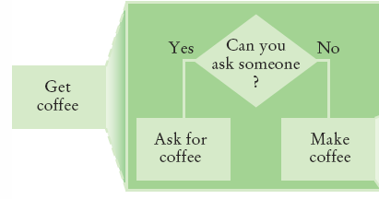
5.7 Problem Solving
Stepwise Refinement
To solve a difficult task, break it down into simpler tasks
Then keep breaking down the simpler tasks into even simpler ones, until you are left with tasks that you know how to solve

Slide 27
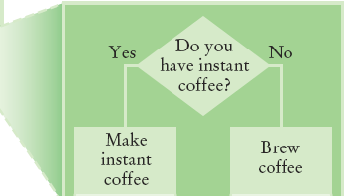
Get Coffee
If you must make coffee, there are two ways:
Make Instant Coffee
Brew Coffee

Slide 28
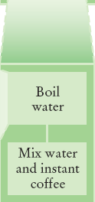
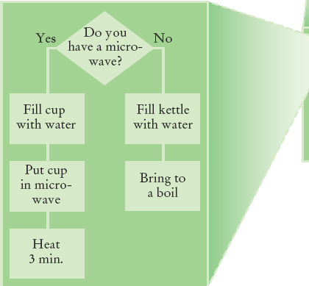
Instant Coffee
Two ways to boil water
1) Use Microwave
2) Use Kettle on Stove

Slide 29
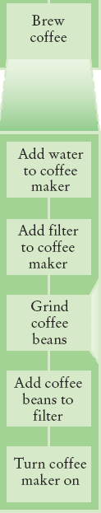
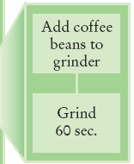
Brew Coffee
Assumes coffee maker
Add water
Add filter
Grind Coffee
Add beans to grinder
Grind 60 seconds
Fill filter with ground coffee
Turn coffee maker on
Steps are easily done

Slide 30
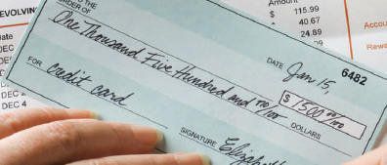
Stepwise Refinement Example
When printing a check, it is customary to write the check amount both as a number (“$274.15”) and as a text string (“two hundred seventy four dollars and 15 cents”). Write a program to turn a number into a text string.
Wow, sounds difficult!
Break it down
Let’s take the dollar part (274) and come up with a plan
Take an Integer from 0 – 999
Return a String
Still pretty hard…

Slide 31
Stepwise Refinement Example
Take it digit by digit (2, 7, 4) – left to right
Handle the first digit (hundreds)
If empty, we’re done with hundreds
Get first digit (Integer from 1 – 9)
Get digit name (“one”, “two ”, “three”…)
Add the word “ hundred”
Sounds easy!
Second digit (tens)
Get second digit (Integer from 0 – 9)
If 0, we are done with tens… handle third digit
If 1, … may be eleven, twelve.. Teens… Not easy!
Let’s look at each possibility left (1x-9x)…

Slide 32
Stepwise Refinement Example
If second digit is a 0
Get third digit (Integer from 0 – 9)
Get digit name (“”, “one”, “two”…) … Same as before?
Sounds easy!
If second digit is a 1
Get third digit (Integer from 0 – 9)
Return a String (“ten”, “eleven”, “twelve”…)
If second digit is a 2-9
Start with string “twenty”, “thirty”, “forty”…
Get third digit (Integer from 0 – 9)
Get digit name (“”, “one”, “two”…) … Same as before
Sounds easy!

Slide 33
Name the Sub-Tasks
digitName
Takes an Integer from 0 – 9
Return a String (“”, “one”, “two”…)
tensName (second digit >= 20)
Takes an Integer from 0 – 9
Return a String (“twenty”, “thirty”…) plus
digitName(third digit)
teenName
Takes an Integer from 0 – 9
Return a String (“ten”, “eleven”…)

Slide 34
Write Pseudocode
part = number (The part that still needs to be converted)
name = "" (The name of the number)
If part >= 100
name = name of hundreds in part + " hundred"
Remove hundreds from part.
If part >= 20
Append tensName(part) to name.
Remove tens from part.
Else if part >= 10
Append teenName(part) to name.
part = 0
If (part > 0)
Append digitName(part) to name.
Identify methods that we can use (or re-use!) to do the work.

Slide 35
Plan The Methods
Decide on name, parameter(s) and types and return type
String digitName (int number)
Return a String (“”, “one”, “two”…)
String tensName (int number)
Return a String (“twenty”, “thirty”…) plus
Return from digitName(thirdDigit)
String teenName (int number)
Return a String (“ten”, “eleven”…)

Slide 36
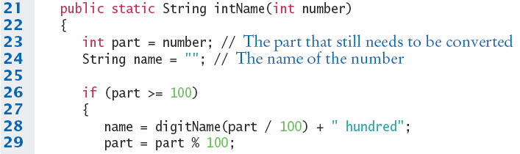
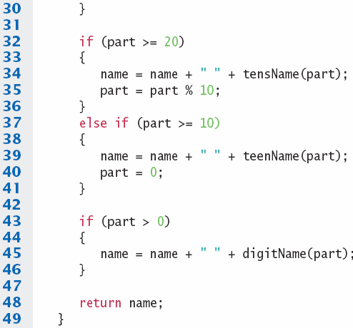
Convert to Java: intName method
main calls intName
Does all the work
Returns a String
Uses methods:
tensName
teenName
digitName

Slide 37
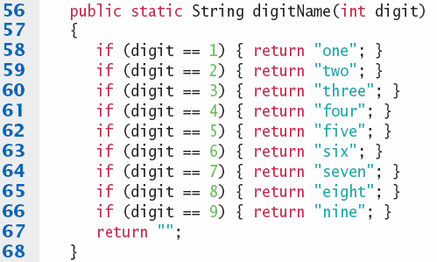
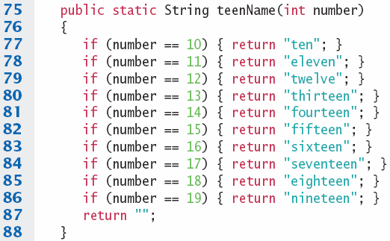
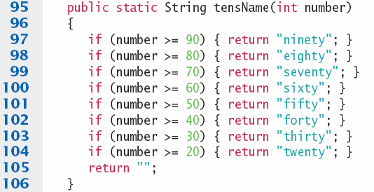

digitName, teenName, tensName

Slide 38
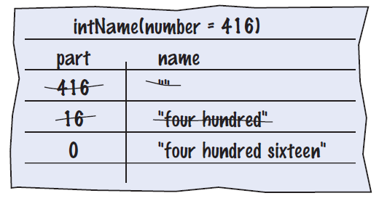

Programming Tips
Keep methods short
If more than one screen, break into ‘sub’ methods
Trace your methods
One line for each step
Columns for key variables
Use Stubs as you write larger programs
Unfinished methods that return a ‘dummy’ value
public static String digitName(int digit)
{
return "mumble";
}

