Slide 1
Goal
To understand the concepts of classes, objects and encapsulation
To implement instance variables, methods and constructors
To be able to design, implement, and test your own classes
To understand the behavior of object references, static variables and static methods
In this chapter, you will learn how to discover, specify, and implement your own classes, and how to use them in your programs.

Slide 2
Module Contents
Object-Oriented Programming
Implementing a Simple Class
Specifying the Public Interface of a Class
Designing the Data Representation
Implementing Instance Methods
Constructors
Testing a Class
Object References
Static Variables and Methods

Slide 3

Object-Oriented Programming
You have learned structured programming
Breaking tasks into subtasks
Writing re-usable methods to handle tasks
We will now study Objects and Classes
To build larger and more complex programs
To model objects we use in the world
A class describes objects with the same behavior. For example, a Car class describes all passenger vehicles that have a certain capacity and shape.

Slide 4
Objects and Programs
Java programs are made of objects that interact with each other
Each object is based on a class
A class describes a set of objects with the same behavior
Each class defines a specific set of methods to use with its objects
For example, the String class provides methods:
Examples: length() and charAt() methods
String greeting = “Hello World”;
int len = greeting.length();
char c1 = greeting.charAt(0);

Slide 5
Diagram of a Class
Private Data
Each object has its own private data that other objects cannot directly access
Methods of the public interface provide access to private data, while hiding implementation details:
This is called Encapsulation
Public Interface
Each object has a set of methods available for other objects to use
Class
Private Data
(Variables)
Public Interface
(Methods)

Slide 6

Implementing a Simple Class
Example: Tally Counter: A class that models a mechanical device that is used to count people
For example, to find out how many people attend a concert or board a bus
What should it do?
Increment the tally
Get the current total

Slide 7
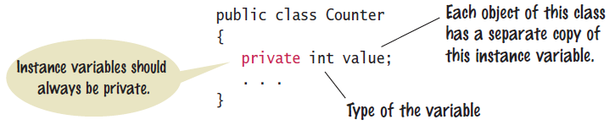
Tally Counter Class
Specify instance variables in the class declaration:
Each object instantiated from the class has its own set of instance variables
Each tally counter has its own current count
Access Specifiers / Access Qualifier
Classes (and interface methods) are public
Instance variables are always private

Slide 8
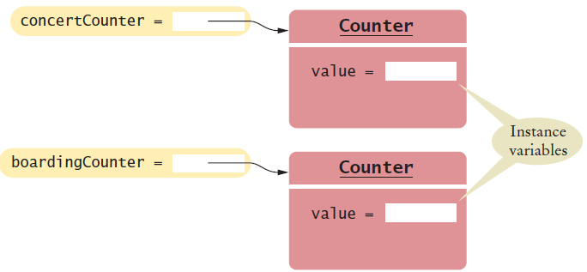
Instantiating Objects
Objects are created based on classes
Use the new operator to construct objects
Give each object a unique name (like variables)
You have used the new operator before:
Creating two instances of Counter objects:
Scanner in = new Scanner(System.in);
Class name
Object name
Class name
Counter concertCounter = new Counter();
Counter boardingCounter = new Counter();
Use the new operator to construct objects of a class.

Slide 9
Tally Counter Methods
Design a method named count that adds 1 to the instance variable
Which instance variable?
Use the name of the object
concertCounter.count()
boardingCounter.count()
public class Counter
{
private int value;
public void count()
{
value = value + 1;
}
public int getValue()
{
return value;
}
}

Slide 10
Public Interface of a Class
When you design a class, start by specifying the public interface of the new class
Example: A Cash Register Class
What tasks will this class perform?
What methods will you need?
What parameters will the methods need to receive?
What will the methods return?
Task | Method | Returns
Add the price of an item | addItem(double) | void
Get the total amount owed | getTotal() | double
Get the count of items purchased | getCount() | int
Clear the cash register for a new sale | clear() | void

Slide 11
Writing the Public Interface
/**
A simulated cash register that tracks the item count
and the total amount due.
*/
public class CashRegister
{
/**
Adds an item to this cash register.
@param price: the price of this item
*/
public void addItem(double price)
{
// Method body
}
/**
Gets the price of all items in the current sale.
@return the total price
*/
public double getTotal() ...
Javadoc style comments document the class and the behavior of each method
The method declarations make up the public interface of the class
The data and method bodies make up the private implementation of the class

Slide 12
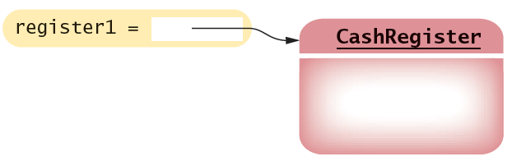
Non-static Methods Means…
We have been writing class methods using the static modifier:
For non-static (instance) methods, you must instantiate an object of the class before you can invoke methods
Then invoke methods of the object
public static void addItem(double val)
public void addItem(double val)
public static void main(String[] args)
{
// Construct a CashRegister object
CashRegister register1 = new CashRegister();
// Invoke a non-static method of the object
register1.addItem(1.95);
}

Slide 13
Accessor and Mutator Methods
Many methods fall into two categories:
1) Accessor Methods: 'get' methods
Asks the object for information without changing it
Normally return a value of some type
2) Mutator Methods: 'set' methods
Changes values in the object
Usually take a parameter that will change an instance variable
Normally return void
public double getTotal() { }
public int getCount() { }
public void addItem(double price) { }
public void clear() { }

Slide 14
Designing the Data Representation
An object stores data in instance variables
Variables declared inside the class
All methods inside the class have access to them
Can change or access them
What data will our CashRegister methods need?
Task | Method | Data Needed
Add the price of an item | addItem() | total, count
Get the total amount owed | getTotal() | total
Get the count of items purchased | getCount() | count
Clear the cash register for a new sale | clear() | total, count
An object holds instance variables that are accessed by methods

Slide 15

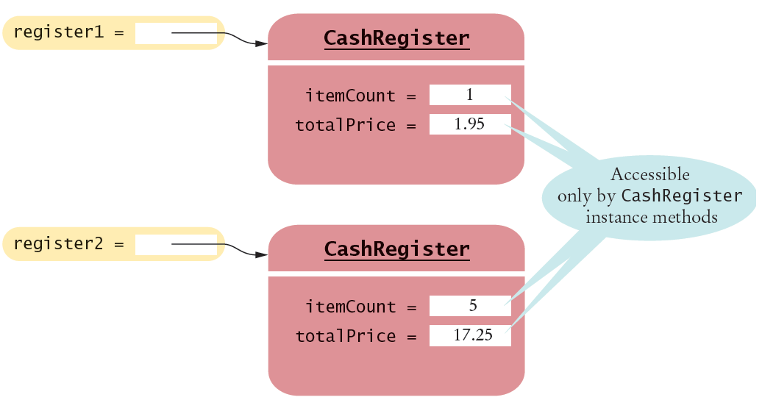
Instance Variables of Objects
Each object of a class has a separate set of instance variables.
The values stored in instance variables make up the state of the object.

Slide 16
Accessing Instance Variables
private instance variables cannot be accessed from methods outside of the class
public static void main(String[] args)
{
. . .
System.out.println(register1.itemCount); // Error
. . .
}
The compiler will not allow this violation of privacy
Use accessor methods of the class instead!
public static void main(String[] args)
{
. . .
System.out.println( register1.getCount() ); // OK
. . .
}
Encapsulation provides a public interface and hides the implementation details.

Slide 17
Implementing Instance Methods
Implement instance methods that will use the private instance variables
public void addItem(double price)
{
itemCount++;
totalPrice = totalPrice + price;
}
Task | Method | Returns
Add the price of an item | addItem(double) | void
Get the total amount owed | getTotal() | double
Get the count of items purchased | getCount() | int
Clear the cash register for a new sale | clear() | void

Slide 18
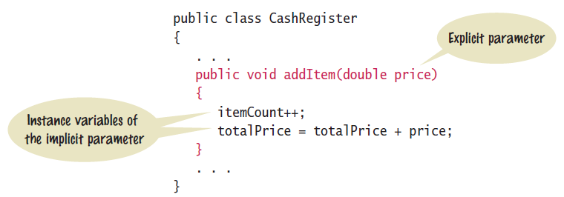
Instance Methods
Use instance variables inside methods of the class
There is no need to specify the implicit parameter (name of the object) when using instance variables inside the class
Explicit parameters must be listed in the method declaration

Slide 19
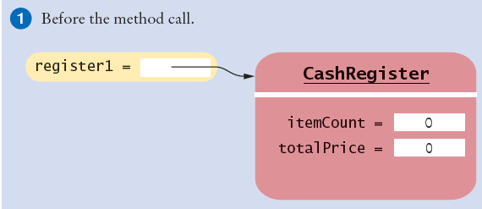
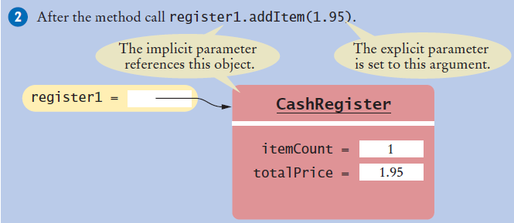
Implicit and Explicit Parameters
When an item is added, it affects the instance variables of the object on which the method is invoked
The object on which a method is applied is the implicit parameter

