Slide 1
Exception Handling
There are two aspects to dealing with run-time program errors:
Detecting Errors
This is the easy part. You can ‘throw’ an exception
Handling Errors
This is more complex. You need to ‘catch’ each possible exception and react to it appropriately
Handling recoverable errors can be done:
Simply: exit the program
User-friendly: As the user to correct the error
Use the throw statement to signal an exception
if (amount > balance)
{
// Now what?
}

Slide 2
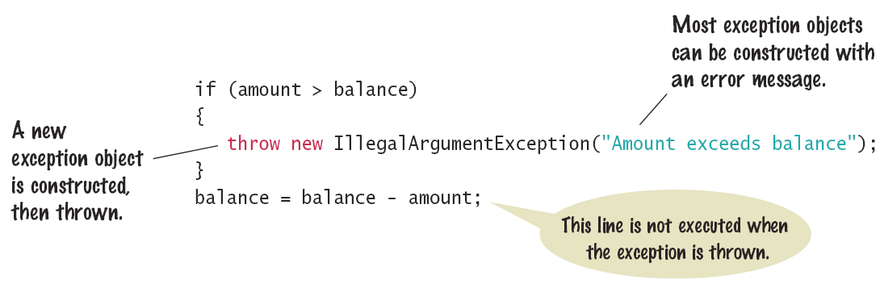
Throwing an Exception
When you throw an exception, you are throwing an object of an exception class
Choose wisely!
You can also pass a descriptive String to most exception objects
When you throw an exception, the normal control flow is terminated.

Slide 3
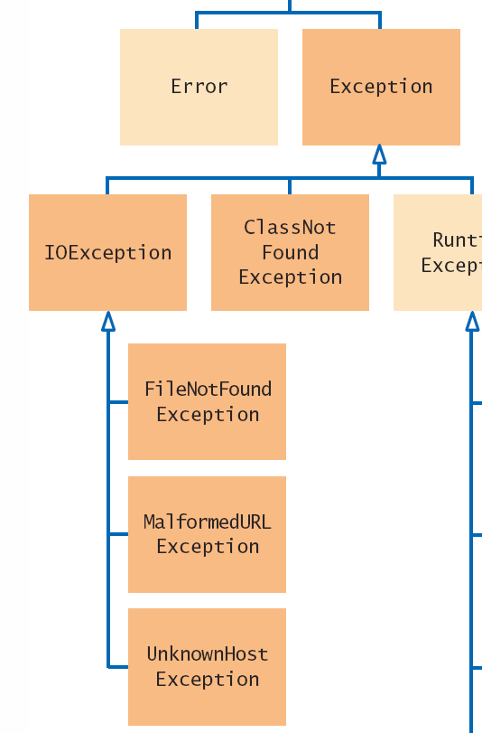
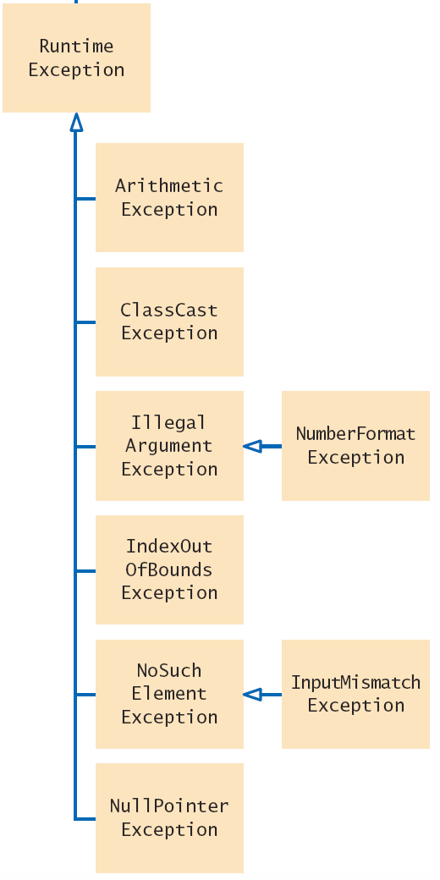

Exception Classes
Partial hierarchy of exception classes
More general are above
More specific are below
Darker are Checked exceptions

Slide 4
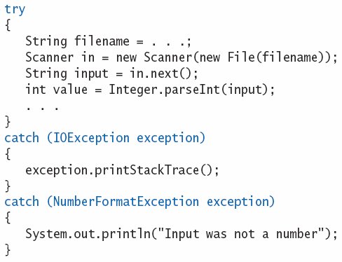
Catching Exceptions
Exceptions that are thrown must be ‘caught’ somewhere in your program
Surround method calls that can throw exceptions with a ‘try block’.
FileNotFoundException
NoSuchElementException
NumberFormatException
Write ‘catch blocks’ for each possible exception.
It is customary to name the exception parameter either ‘e’ or ‘exception’ in the catch block.

Slide 5
Catching Exceptions
When an exception is detected, execution ‘jumps’ immediately to the first matching catch block
IOException matches both FileNotFoundException and NoSuchElementException is not caught
FileNotFoundException
NoSuchElementException
NumberFormatException

Slide 6
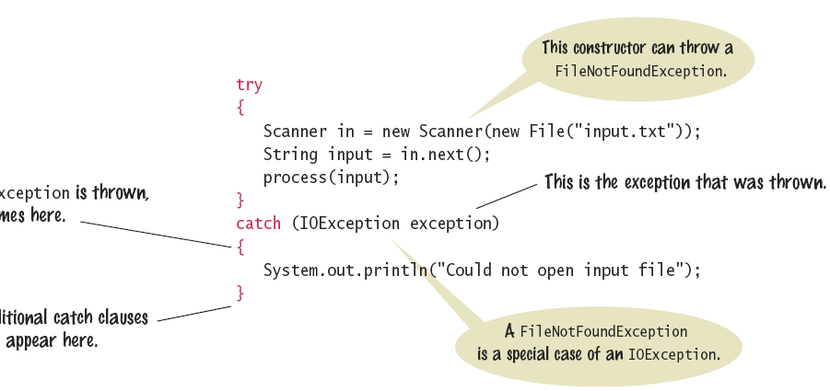
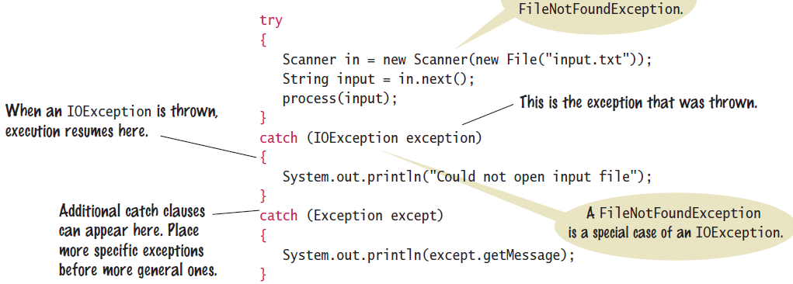
Catching Exceptions
Some exception handling options:
Simply inform the user what is wrong
Give the user another chance to correct an input error
Print a ‘stack trace’ showing the list of methods called
exception.printStackTrace();

Slide 7
Checked Exceptions
Throw/catch applies to three types of exceptions:
Error: Internal Errors
not considered here
Unchecked: RunTime Exceptions
Caused by the programmer
Compiler does not check how you handle them
Checked: All other exceptions
Not the programmer’s fault
Compiler checks to make sure you handle these
Shown darker in Exception Classes
Checked exceptions are due to circumstances that the programmer cannot prevent.

Slide 8
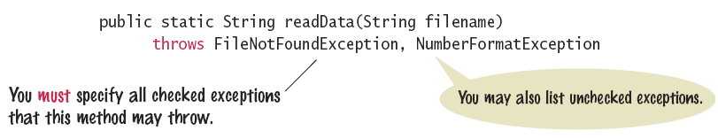
The throws Clause
Methods that use other methods that may throw exceptions must be declared as such
Declare all checked exceptions a method throws
You may also list unchecked exceptions

Slide 9
The throws Clause
If a method handles a checked exception internally, it will no longer throw the exception.
The method does not need to declare it in the throws clause
Declaring exceptions in the throws clause ‘passes the buck’ to the calling method to handle it or pass it along.

Slide 10
The finally clause
finally is an optional clause in a try/catch block
Used when you need to take some action in a method whether an exception is thrown or not.
The finally block is executed in both cases
Example: Close a file in a method in all cases
public void printOutput(String filename) throws IOException
{
PrintWriter out = new PrintWriter(filename);
try
{
writeData(out); // Method may throw an I/O Exception
}
finally
{
out.close();
}
}
Once a try block is entered, the statements in a finally clause are guaranteed to be executed, whether or not an exception is thrown.

Slide 11
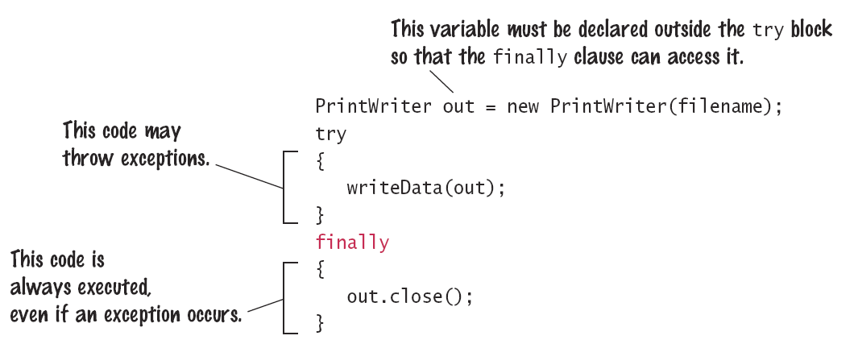
The finally Clause
Code in the finally block is always executed once the try block has been entered

Slide 12

Programming Tip
Throw Early
When a method detects a problem that it cannot solve, it is better to throw an exception rather than try to come up with an imperfect fix.
Catch Late
Conversely, a method should only catch an exception if it can really remedy the situation.
Otherwise, the best remedy is simply to have the exception propagate to its caller, allowing it to be caught by a competent handler.

Slide 13
Programming Tip
Do Not Squelch Exceptions
When you call a method that throws a checked exception and you haven’t specified a handler, the compiler complains.
It is tempting to write a ‘do-nothing’ catch block to ‘squelch’ the compiler and come back to the code later. Bad Idea!
Exceptions were designed to transmit problem reports to a competent handler.
Installing an incompetent handler simply hides an error condition that could be serious..

Slide 14
Programming Tip
Do not use catch and finally in the same try block
The finally clause is executed whenever the try block is exited in any of three ways:
1. After completing the last statement of the try block
2. After completing the last statement of a catch clause, if this try block caught an exception
3. When an exception was thrown in the try block and not caught
try
catch
finally

Slide 15
Handling Input Errors
File Reading Application Example
Goal: Read a file of data values
First line is the count of values
Remaining lines have values
Risks:
The file may not exist
Scanner constructor will throw an exception
FileNotFoundException
The file may have data in the wrong format
Doesn’t start with a count
NoSuchElementException
Too many items (count is too low)
IOException
3
1.45
-2.1
0.05

Slide 16
Handling Input Errors: main
Outline for method with all exception handling
boolean done = false;
while (!done)
{
try
{
// Prompt user for file name
double[] data = readFile(filename); // May throw exceptions
// Process data
done = true;
}
catch (FileNotFoundException exception)
{ System.out.println("File not found."); }
catch (NoSuchElementException exception)
{ System.out.println("File contents invalid."); }
catch (IOException exception)
{ exception.printStackTrace(); }
}

Slide 17
Handling Input Errors: readFile
Calls the Scanner constructor
No exception handling (no catch clauses)
finally clause closes file in all cases (exception or not)
throws IOException (back to main)
public static double[] readFile(String filename) throws IOException
{
File inFile = new File(filename);
Scanner in = new Scanner(inFile);
try
{
return readData(in); // May throw exceptions
}
finally
{
in.close();
}
}

Slide 18
Handling Input Errors: readData
No exception handling (no try or catch clauses)
throw creates an IOException object and exits
unchecked NoSuchElementException can occur
public static double[] readData(Scanner in) throws IOException
{
int numberOfValues = in.nextInt(); // NoSuchElementException
double[] data = new double[numberOfValues];
for (int i = 0; i < numberOfValues; i++)
{
data[i] = in.nextDouble(); // NoSuchElementException
}
if (in.hasNext())
{
throw new IOException("End of file expected");
}
return data;
}

Slide 19
Exception Object
try{
//Code that can throw one or more exception
} catch(FileNotFoundException e) {
System.out.println(e.getMessage());
//Code to handle the exception
}
The exception object (e.g. e) that is passed to a catch block can provide additional information about the nature of the problem.
You can use the exception object to call methods of the exception class or its super classes to get more information about the problem.

Slide 20
Defining a New Exception Class
An Exception is a class like any other class in Java. However, your exception classes must always be a subclass of Throwable class
Although you can derive from any of the standard exception classes, your best policy is to derive them from the Exception class
In the example below, MyExceptionClass provides two constructors (overloading constructor)
class MyExceptionClass extends Exception {
MyExceptionClass() {
super();
}
MyExceptionClass (String s) {
super(s);
}
}

Slide 21
Throwing the New Exception
As you saw earlier, you throw an exception with a statement that consists of the throw keyword
MyExceptionClass e = new MyExceptionClass ();
throw e;
MyExceptionClass e = new MyExceptionClass (“Uh-oh trouble”);
throw e;

Slide 22
Summary: Exceptions
To signal an exceptional condition, use the throw statement to throw an exception object.
When you throw an exception, processing continues in an exception handler.
Place statements that can cause an exception inside a try block, and the handler inside a catch clause.
Checked exceptions are due to external circumstances that the programmer cannot prevent.
The compiler checks that your program handles these exceptions.

Slide 23
Summary: Exceptions
Add a throws clause to a method that can throw a checked exception.
Once a try block is entered, the statements in a finally clause are guaranteed to be executed, whether or not an exception is thrown.
Throw an exception as soon as a problem is detected.
Catch it only when the problem can be handled.
When designing a program, ask yourself what kinds of exceptions can occur.
For each exception, you need to decide which part of your program can competently handle it.

