Slide 1
Reading and Writing Text Files
Text Files are very commonly used to store information
Both numbers and words can be stored as text
They are the most ‘portable’ types of data files
The Scanner class can be used to read text files
We have used it to read from the keyboard
Reading from a file requires using the File class
The PrintWriter class will be used to write text files
Using familiar print, println and printf tools

Slide 2
Text File Input
Create an object of the File class
Pass it the name of the file to read in quotes
Then create an object of the Scanner class
Pass the constructor the new File object
Then use Scanner methods such as:
next()
nextLine()
hasNextLine()
hasNext()
nextDouble()
nextInt()...
File inputFile = new File("input.txt");
Scanner in = new Scanner(inputFile);
while (in.hasNextLine())
{
String line = in.nextLine();
// Process line;
}

Slide 3
Text File Output
Create an object of the PrintWriter class
Pass it the name of the file to write in quotes
If output.txt exists, it will be emptied
If output.txt does not exist, it will create an empty file
PrintWriter is an enhanced version of PrintStream
System.out is a PrintStream object!
PrintWriter out = new PrintWriter("output.txt");
System.out.println(“Hello World!”);
Then use PrintWriter methods such as:
print()
println()
printf()
out.println("Hello, World!");
out.printf("Total: %8.2f\n", totalPrice);

Slide 4
Closing Files
You must use the close method before file reading and writing is complete
Closing a Scanner
while (in.hasNextLine())
{
String line = in.nextLine();
// Process line;
}
in.close();
Your text may not be saved to the file until you use the close method!
Closing a PrintWriter
out.println("Hello, World!");
out.printf("Total: %8.2f\n", totalPrice);
out.close();

Slide 5
Exceptions Preview
One additional issue that we need to tackle:
If the input or output file for a Scanner doesn’t exist, a FileNotFoundException occurs when the Scanner object is constructed.
The PrintWriter constructor can generate this exception if it cannot open the file for writing.
If the name is illegal or the user does not have the authority to create a file in the given location

Slide 6
And an important import or two..
Exception classes are part of the java.io package
Place the import directives at the beginning of the source file that will be using File I/O and exceptions
import java.io.File;
import java.io.FileNotFoundException;
import java.io.PrintWriter;
import java.util.Scanner;
public class LineNumberer
{
public void openFile() throws FileNotFoundException
{
. . .
}
}

Slide 7
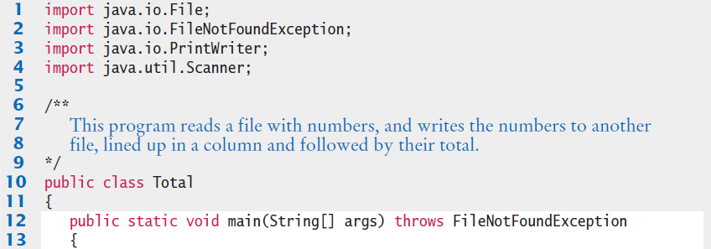
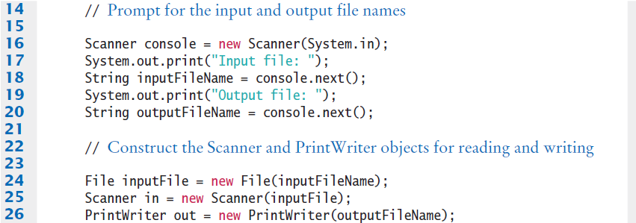
Example: Total.java (1)
More import statements required! Some examples may use import java.io.*;
Note the throws clause

Slide 8
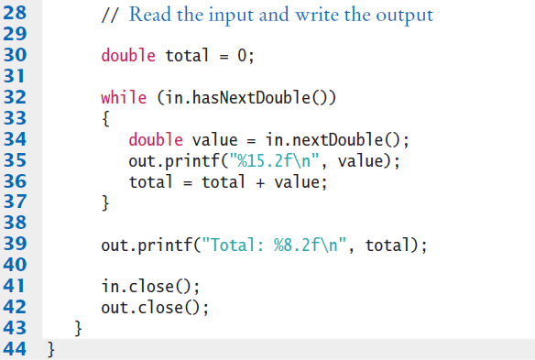
Example: Total.java (2)
Don’t forget to close the files before your program ends.

Slide 9

Common Error
Backslashes in File Names
When using a String literal for a file name with path information, you need to supply each backslash twice:
A single backslash inside a quoted string is the escape character, which means the next character is interpreted differently (for example, ‘\n’ for a newline character)
When a user supplies a filename into a program, the user should not type the backslash twice
File inputFile = new File("c:\\homework\\input.dat");

Slide 10
Common Error
Constructing a Scanner with a String
When you construct a PrintWriter with a String, it writes to a file:
This does not work for a Scanner object
It does not open a file. Instead, it simply reads through the String that you passed ( “input.txt” )
To read from a file, pass Scanner a File object:
or
PrintWriter out = new PrintWriter("output.txt");
Scanner in = new Scanner("input.txt"); // Error?
Scanner in = new Scanner(new File (“input.txt”) );
File myFile = new File("input.txt");
Scanner in = new Scanner(myFile);

Slide 11
Text Input and Output
In the following sections, you will learn how to process text with complex contents, and you will learn how to cope with challenges that often occur with real data.
Reading Words Example:
Mary had a little lamb
input
while (in.hasNext())
{
String input = in.next();
System.out.println(input);
}
Mary
had
a
little
lamb
output

Slide 12
Processing Text Input
There are times when you want to read input by:
Each Word
Each Line
One Number
One Character
Java provides methods of the Scanner and String classes to handle each situation
It does take some practice to mix them though!
Processing input is required for almost all types of programs that interact with the user.

Slide 13
Reading Words
In the examples so far, we have read text one line at a time
To read each word one at a time in a loop, use:
The Scanner object’s hasNext()method to test if there is another word
The Scanner object’s next() method to read one word
Input: Output:
while (in.hasNext())
{
String input = in.next();
System.out.println(input);
}
Mary
had
a
little
lamb
Mary had a little lamb

Slide 14
White Space
The Scanner’s next() method has to decide where a word starts and ends.
It uses simple rules:
It consumes all white space before the first character
It then reads characters until the first white space character is found or the end of the input is reached

Slide 15
White Space
What is whitespace?
Characters used to separate:
Words
Lines
Common | White Space
‘ ‘ | Space
\n | NewLine
\r | Carriage Return
\t | Tab
\f | Form Feed
“Mary had a little lamb,\n
her fleece was white as\tsnow”

Slide 16
The useDelimiter Method
The Scanner class has a method to change the default set of delimiters used to separate words.
The useDelimiter method takes a String that lists all of the characters you want to use as delimiters:
Scanner in = new Scanner(. . .);
in.useDelimiter(“,”);

Slide 17
The useDelimiter Method
Scanner in = new Scanner(. . .);
in.useDelimiter("[^A-Za-z]+");
You can also pass a String in regular expression format
inside the String parameter as in the example above.
[^A-Za-z]+ says that all characters that ^not either A-Z uppercase letters A through Z or a-z lowercase a through z are delimiters.
Search the Internet to learn more about regular expressions but it is not required for this course.

Slide 18
Reading Characters
There are no hasNextChar() or nextChar() methods of the Scanner class
Instead, you can set the Scanner to use an ‘empty’ delimiter ("")
next returns a one character String
Use charAt(0) to extract the character from the String at index 0 to a char variable
Scanner in = new Scanner(. . .);
in.useDelimiter("");
while (in.hasNext())
{
char ch = in.next().charAt(0);
// Process each character
}

Slide 19
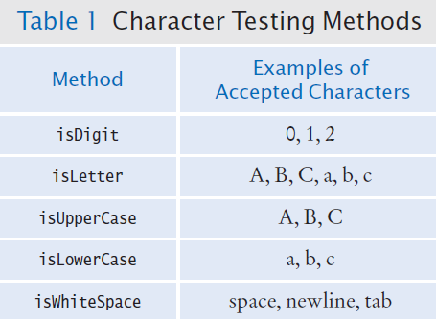
Classifying Characters
The Character class provides several useful methods to classify a character:
Pass them a char and they return a boolean
if ( Character.isDigit(ch) ) …

Slide 20
Reading Lines
Some text files are used as simple databases
Each line has a set of related pieces of information
This example is complicated by:
Some countries use two words
“United States”
It would be better to read the entire line and process it using powerful String class methods
nextLine() reads one line and consumes the ending ‘\n’
China 1330044605
India 1147995898
United States 303824646
while (in.hasNextLine())
{
String line = in.nextLine();
// Process each line
}

Slide 21
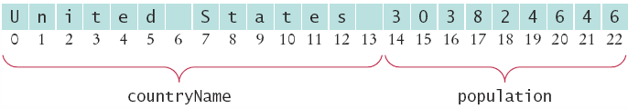
Breaking Up Each Line
Now we need to break up the line into two parts
Everything before the first digit is part of the country
Get the index of the first digit with Character.isdigit
int i = 0;
while (!Character.isDigit(line.charAt(i))) { i++; }

Slide 22
Breaking Up Each Line
Use String methods to extract the two parts
United States
String countryName = line.substring(0, i);
String population = line.substring(i);
// remove the trailing space in countryName
countryName = countryName.trim();
303824646
trim removes white space at the beginning and the end.

Slide 23
Or Use Scanner Methods
Instead of String methods, you can sometimes use Scanner methods to do the same tasks
Read the line into a String variable
Pass the String variable to a new Scanner object
Use Scanner hasNextInt to find the numbers
If not numbers, use next and concatenate words
United States 303824646
Scanner lineScanner = new Scanner(line);
String countryName = lineScanner.next();
while (!lineScanner.hasNextInt())
{
countryName = countryName + " " + lineScanner.next();
}
Remember the next method consumes white space.

Slide 24
Converting Strings to Numbers
Strings can contain digits, not numbers
They must be converted to numeric types
‘Wrapper’ classes provide a parseInt method
‘3’ | ‘0’ | ‘3’ | ‘8’ | ‘2’ | ‘4’ | ‘6’ | ‘4’ | ‘6’
String pop = “303824646”;
int populationValue = Integer.parseInt(pop);
‘3’ | ‘.’ | ‘9’ | ‘5’
String priceString = “3.95”;
int price = Double.parseInt(priceString);

Slide 25
Converting Strings to Numbers
Caution:
The argument must be a string containing only digits without any additional characters. Not even spaces are allowed! So… Use the trim method before parsing!
int populationValue = Integer.parseInt(pop.trim());

Slide 26
Safely Reading Numbers
Scanner nextInt and nextDouble can get confused
If the number is not properly formatted, an “Input Mismatch Exception” occurs
Use the hasNextInt and hasNextDouble methods to test your input first
They will return true if digits are present
If true, nextInt and nextDouble will return a value
If not true, they would ‘throw’ an ‘input mismatch exception’
if (in.hasNextInt())
{
int value = in.nextInt(); // safe
}

Slide 27
Reading Other Number Types
The Scanner class has methods to test and read almost all of the primitive types
What is missing?
Right, no char methods!
Data Type | Test Method | Read Method
byte | hasNextByte | nextByte
short | hasNextShort | nextShort
int | hasNextInt | nextInt
long | hasNextLong | nextLong
float | hasNextFloat | nextFloat
double | hasNextDouble | nextDouble
boolean | hasNextBoolean | nextBoolean

Slide 28
Mixing Number, Word and Line Input
nextDouble (and nextInt…) do not consume white space following a number
This can be an issue when calling nextLine after reading a number
There is a ‘newline’ at the end of each line
After reading 1330044605 with nextInt
nextLine will read until the ‘\n’ (an empty String)
China
1330044605
India
while (in.hasNextInt())
{
String countryName = in.nextLine();
int population = in.nextInt();
in.nextLine(); // Consume the newline
}

Slide 29
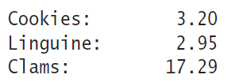
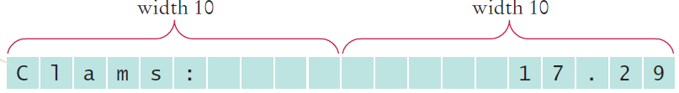
Formatting Output
Advanced System.out.printf
Can align strings and numbers
Can set the field width for each
Can left align (default is right)
Two format specifiers example:
%-10s : Left justified String, width 10
%10.2f : Right justified, 2 decimal places, width 10
System.out.printf("%-10s%10.2f", items[i] + ":", prices[i]);

Slide 30
printf Format Specifier
A format specifier has the following structure:
The first character is a %
Next, there are optional “flags” that modify the format, such as - to indicate left alignment. See Table 2 for the most common format flags
Next is the field width, the total number of characters in the field (including the spaces used for padding), followed by an optional precision for floating-point numbers
The format specifier ends with the format type, such as f for floating-point values or s for strings. See Table 3 for the most important formats

Slide 31
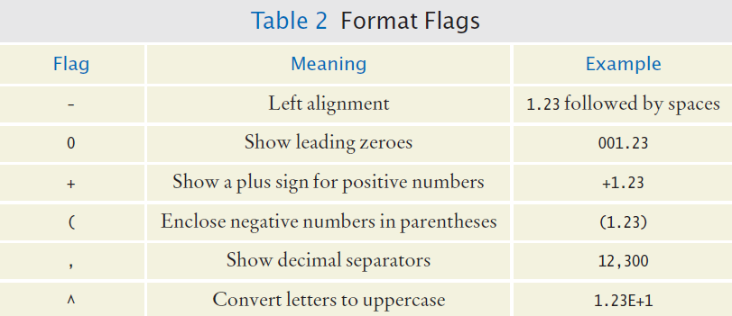
printf Format Flags

Slide 32
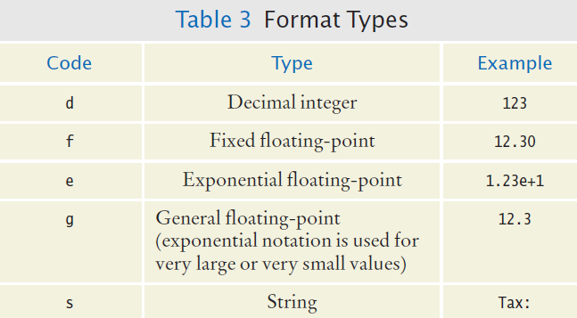
printf Format Types

