Slide 1
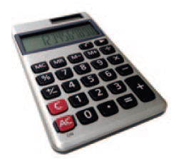


Arithmetic
Java supports all of the same basic math as a calculator:
Addition +
Subtraction -
You write your expressions a bit differently though.. Algebra Java
Precedence is similar to Algebra:
PEMDAS
Parenthesis, Exponent, Multiply/Divide, Add/Subtract
Multiplication *
Division /

Slide 2
Mixing Numeric Types
It is safe to convert a value from an integer type to a floating-point type
No ‘precision’ is lost
But going the other way can be dangerous
All fractional information is lost
The fractional part is discarded (not rounded)
If you mix types integer and floating-point types in an expression, no precision is lost:
double area, pi = 3.14;
int radius = 3;
area = radius * radius * pi;
Mixing integers and floating-point values in an arithmetic expression yields a floating-point value.

Slide 3
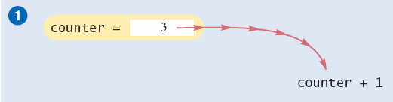
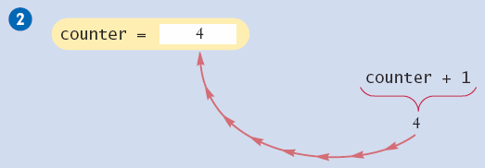
Incrementing a Variable
Step by Step:
counter = counter + 1;
Do the right hand side of the assignment first:
Find the value stored in counter, and add 1 to it
Store the result in the variable named on the left side of the assignment operator (counter in this case)

Slide 4
Shorthand for Incrementing
Incrementing (+1) and decrementing (-1) integer types is so common that there are shorthand version for each
Long Way | Shortcut
counter = counter + 1; | counter++ ;
counter = counter - 1; | counter-- ;

Slide 5
Integer Division and Remainder
When both parts of division are integers, the result is an integer.
All fractional information is lost (no rounding)
int result = 7 / 4;
The value of result will be 1
If you are interested in the remainder of dividing two integers, use the % operator (called modulus):
int remainder = 7 % 4;
The value of remainder will be 3
Sometimes called modulo divide
Integer division loses all fractional parts of the result and does not round

Slide 6
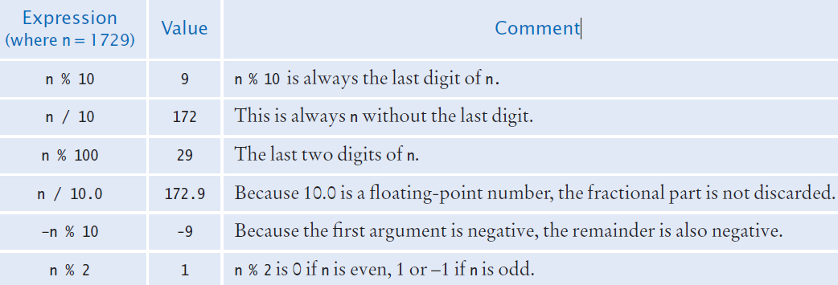
Integer Division and Remainder Examples
Handy to use for making change:
int pennies = 1729;
int dollars = pennies / 100; // 17
int cents = pennies % 100; // 29

Slide 7
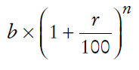
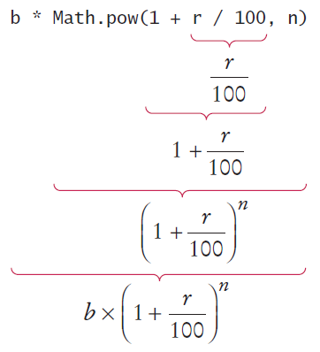
Powers and Roots
In Java, there are no symbols for power and roots
Becomes:
b * Math.pow(1 + r / 100, n)
Analyzing the expression:
The Java library declares many
Mathematical functions, such as
Math.sqrt (square root) and Math.pow (raising to a power).

Slide 8
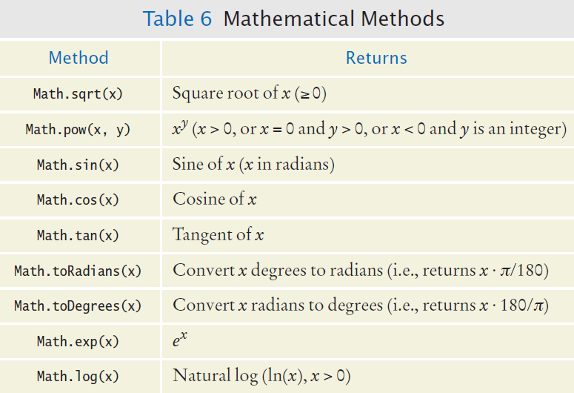
Mathematical Methods

Slide 9
Floating-Point to Integer Conversion
The Java compiler does not allow direct assignment of a floating-point value to an integer variable
double balance = total + tax;
int dollars = balance; // Error
You can use the ‘cast’ operator: (int) to force the conversion:
double balance = total + tax;
int dollars = (int) balance; // no Error
You lose the fractional part of the floating-point value (no rounding occurs)

Slide 10
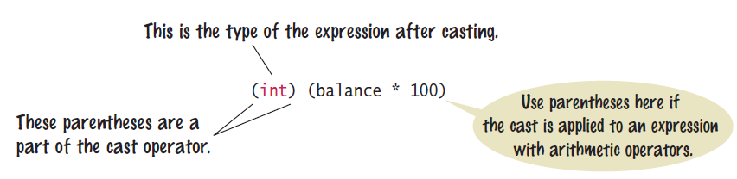
Cast Syntax
Casting is a very powerful tool and should be used carefully
To round a floating-point number to the nearest whole number, use the Math.round method
This method returns a long integer, because large floating-point numbers cannot be stored in an int
long rounded = Math.round(balance);

Slide 11
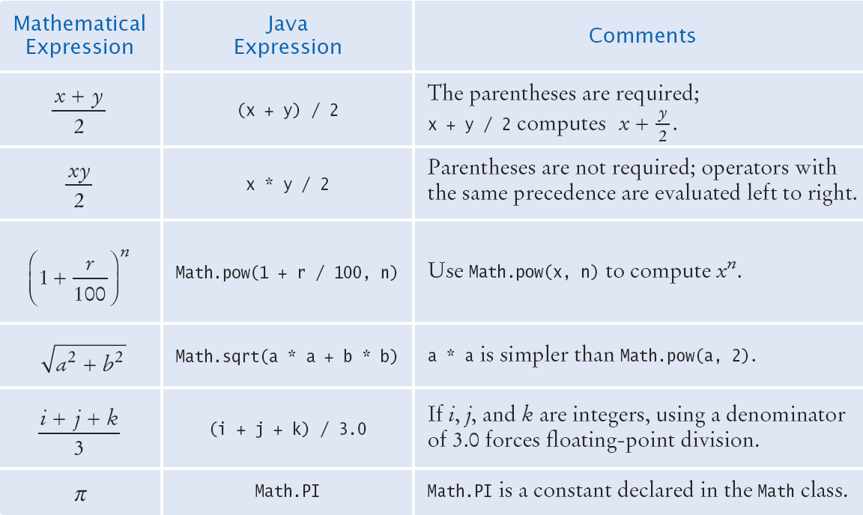
Arithmetic Expressions

Slide 12

Common Error
Unintended Integer Division
System.out.print("Please enter your last three test scores: ");
int s1 = in.nextInt();
int s2 = in.nextInt()
int s3 = in.nextInt();
double average = (s1 + s2 + s3) / 3; // Error
Why?
All of the calculation on the right happens first
Since all are ints, the compiler uses integer division
Then the result (an int) is assigned to the double
There is no fractional part of the int result, so zero (.0) is assigned to the fractional part of the double

Slide 13

Common Error
Unbalanced Parenthesis
Which is correct?
(-(b * b - 4 * a * c) / (2 * a) // 3 (, 2 )
-(b * b - (4 * a * c))) / 2 * a) // 2 (, 2 )
The count of ( and ) must match
Unfortunately, it is hard for humans to keep track
Here’s a handy trick
Count ( as +1, and ) as -1: Goal: 0
-(b * b - (4 * a * c) ) ) / 2 * a)
1 2 1 0 -1 -2

Slide 14
Formatted Output
Outputting floating point values can look strange:
Price per liter: 1.21997
To control the output appearance of numeric variables, use formatted output tools such as:
System.out.printf(“%.2f”, price);
Price per liter: 1.22
System.out.printf(“%10.2f”, price);
Price per liter: 1.22
The %10.2f is called a format specifier
10 spaces
2 spaces

Slide 15
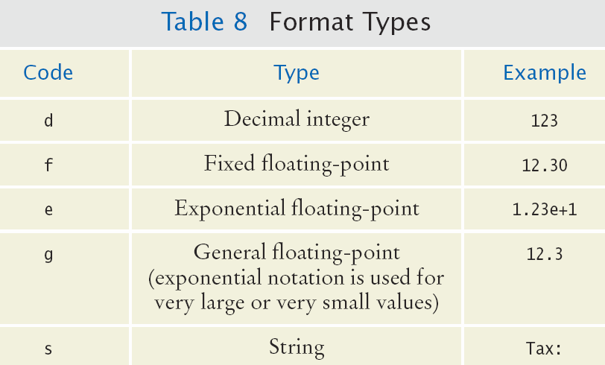
Format Types
Formatting is handy to align columns of output
You can also include text inside the quotes:
System.out.printf(“Price per liter: %10.2f”, price);

Slide 16
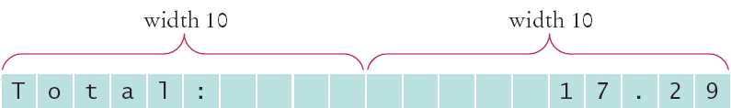


Format Flag Examples
Left Justify a String:
System.out.printf(“%-10s”, “Total:”);
Right justify a number with two decimal places
System.out.printf(“%10.2f”, price);
And you can print multiple values:
System.out.printf(“%-10s%10.2f”, “Total:”, price);

