Slide 1

ARRAYS

Slide 2
Chapter Goals
To collect elements using arrays and array lists
To use the enhanced for loop for traversing arrays and array lists
To learn common algorithms for processing arrays and array lists
To work with two-dimensional arrays
In this chapter, you will learn about arrays, array lists, and common algorithms for processing them.

Slide 3

Contents
Arrays
The Enhanced for Loop
Common Array Algorithms
Using Arrays with Methods
Problem Solving:
Adapting Algorithms
Discovering Algorithms by Manipulating Physical Objects
Two-Dimensional Arrays
Array Lists

Slide 4

6.1 Arrays
A Computer Program often needs to store a list of values and then process them
For example, if you had this list of values, how many variables would you need?
double input1, input2, input3….
Arrays to the rescue!
An array collects sequences of values of the same type.

Slide 5
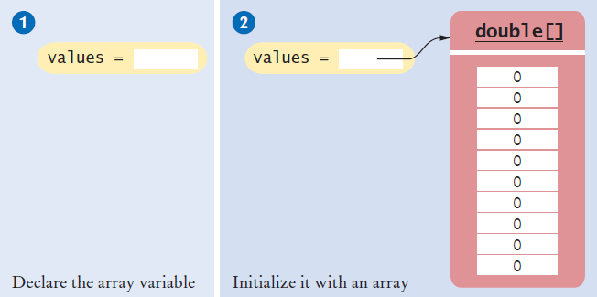
Declaring an Array
Declaring an array is a two step process
double[] values; // declare array variable
values = new double[10]; // initialize array
You cannot use the array until you tell the compiler the size of the array in step 2.

Slide 6
Declaring an Array (Step 1)
Make a named ‘list’ with the following parts:
Type Square Braces Array name semicolon
double [ ] values ;
You are declaring that
There is an array named values
The elements inside are of type double
You have not (YET) declared how many elements are in inside
Other Rules:
Arrays can be declared anywhere you can declare a variable
Do not use ‘reserved’ words or already used names

Slide 7
Declaring an Array (Step 2)
Reserve memory for all of the elements:
Array name Keyword Type Size semicolon
values = new double [10] ;
You are reserving memory for:
The array named values
needs storage for [10]
elements the size of type double
You are also setting up the array variable
Now the compiler knows how many elements there are
You cannot change the size after you declare it!
values
[0] [1] [2] [3] [4] … [9]
double
double
double
double
double
double

Slide 8
One Line Array Declaration
Declare and Create on the same line:
Type Braces Array name Keyword Type Size semi
double [] values = new double[10] ;
You are declaring that
There is an array named values
The elements inside are of type double
You are reserving memory for the array
Needs storage for [10]
elements the size of type double
You are also setting up the array variable

Slide 9
Declaring and Initializing an Array
You can declare and set the initial contents of all elements by:
Type Braces Array name contents list semi
int [ ] primes = { 2, 3, 5, 7} ;
You are declaring that
There is an array named primes
The elements inside are of type int
Reserve space for four elements
The compiler counts them for you!
Set initial values to 2, 3, 5, and 7
Note the curly braces around the contents list

Slide 10
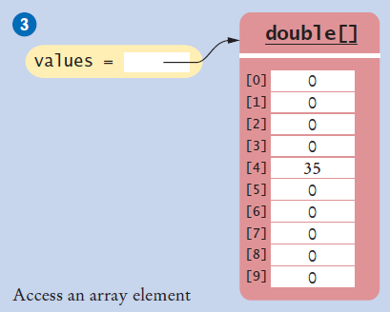
Accessing Array Elements
Each element is numbered
We call this the index
Access an element by:
Name of the array
Index number
values[i]
Elements in the array values are accessed by an integer index i, using the notation values[i].
public static void main(String[] args)
{
double values[];
values = new double[10];
values[4] = 35;
}

Slide 11
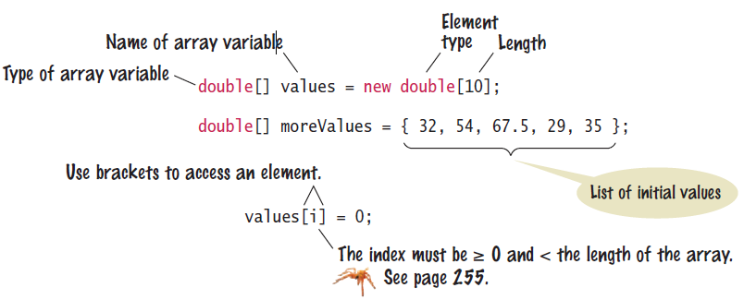
Syntax 6.1: Array
To declare an array, specify the:
Array variable name
Element Type
Length (number of elements)

Slide 12
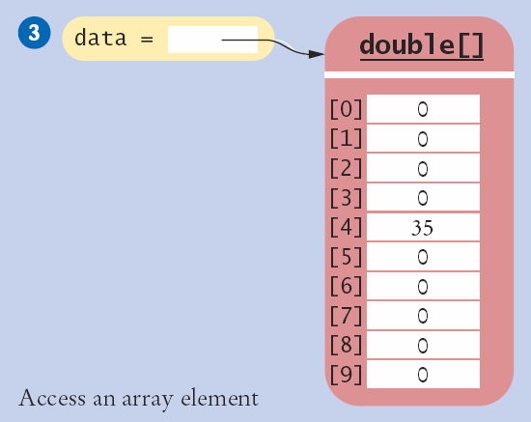
Array Index Numbers
Array index numbers start at 0
The rest are positive integers
An 10 element array has indexes 0 through 9
There is NO element 10!
The first element is at index 0:
public static void main(String[] args)
{
double values[];
values = new double[10];
}
The last element is at index 9:

Slide 13
Array Bounds Checking
An array knows how many elements it can hold
values.length is the size of the array named values
It is an integer value (index of the last element + 1)
Use this to range check and prevent bounds errors
public static void main(String[] args)
{
int i = 10, value = 34;
double values[];
values = new double[10];
if (0 <= i && i < values.length) // length is 10
{
value[i] = value;
}
}
Strings and arrays use different syntax to find their length:
Strings: name.length()
Arrays: values.length

Slide 14
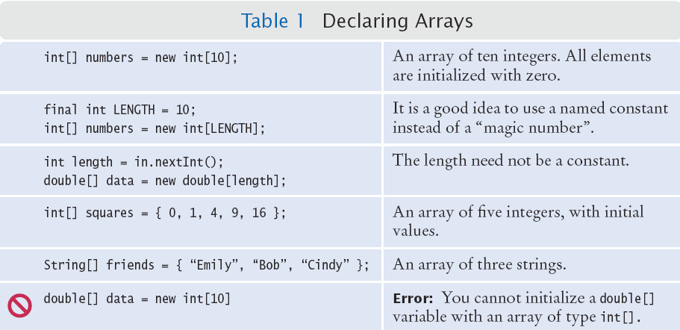
Summary: Declaring Arrays

Slide 15
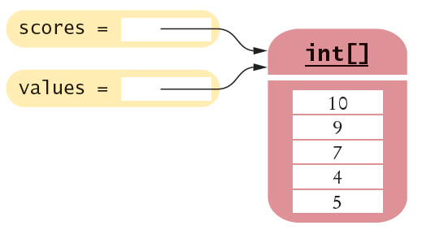
Array References
Make sure you see the difference between the:
Array variable: The named ‘handle’ to the array
Array contents: Memory where the values are stored
int[] scores = { 10, 9, 7, 4, 5 };
Array variable
Array contents
Reference
An array variable contains a reference to the array contents. The reference is the location of the array contents (in memory).
Values

Slide 16
Array Aliases
You can make one array reference refer to the same contents of another array reference:
int[] scores = { 10, 9, 7, 4, 5 };
Int[] values = scores; // Copying the array reference
Array contents
References
An array variable specifies the location of an array. Copying the reference yields a second reference to the same array.

Slide 17
Partially-Filled Arrays
An array cannot change size at run time
The programmer may need to guess at the maximum number of elements required
It is a good idea to use a constant for the size chosen
Use a variable to track how many elements are filled
final int LENGTH = 100;
double[] values = new double[LENGTH];
int currentSize = 0;
Scanner in = new Scanner(System.in);
while (in.hasNextDouble())
{
if (currentSize < values.length)
{
values[currentSize] = in.nextDouble();
currentSize++;
}
}
Maintain the number of elements filled using a variable (currentSize in this example)

Slide 18
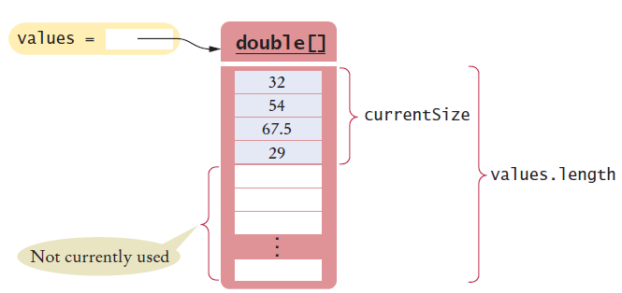
Walking a Partially Filled Array
Use currentSize, not values.length for the last element
for (int i = 0; i < currentSize; i++)
{
System.out.println(values[i]);
}
A for loop is a natural choice to walk through an array

Slide 19

Common Error 6.1
Array Bounds Errors
Accessing a nonexistent element is very common error
Array indexing starts at 0
Your program will stop at run time
public class OutOfBounds
{
public static void main(String[] args)
{
double values[];
values = new double[10];
values[10] = 100;
}
}
The is no element 10:
java.lang.ArrayIndexOutOfBoundsException: 10
at OutOfBounds.main(OutOfBounds.java:7)

Slide 20
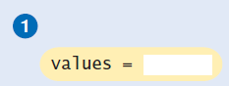

Common Error 6.2
Uninitialized Arrays
Don’t forget to initialize the array variable!
The compiler will catch this error
double[] values;
...
values[0] = 29.95; // Error—values not initialized
Error: D:\Java\Unitialized.java:7:
variable values might not have been initialized
double[] values;
values = new double[10];
values[0] = 29.95; // No error

Slide 21
6.2 The Enhanced for Loop
Using for loops to ‘walk’ arrays is very common
The enhanced for loop simplifies the process
Also called the “for each” loop
Read this code as:
“For each element in the array”
As the loop proceeds, it will:
Access each element in order (0 to length-1)
Copy it to the element variable
Execute loop body
Not possible to:
Change elements
Get bounds error
double[] values = . . .;
double total = 0;
for (double element : values)
{
total = total + element;
}

Slide 22
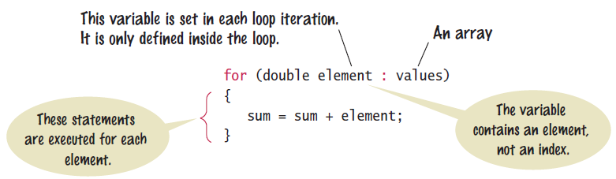
Syntax 6.2: The Enhanced for loop
Use the enhanced “for” loop when:
You need to access every element in the array
You do not need to change any elements of the array

Slide 23
6.3 Common Array Algorithms
Filling an Array
Sum and Average Values
Find the Maximum or Minimum
Output Elements with Separators
Linear Search
Removing an Element
Inserting an Element
Swapping Elements
Copying Arrays
Reading Input

Slide 24
Common Algorithms 1 and 2:
1) Filling an Array
Initialize an array to a set of calculated values
Example: Fill an array with squares of 0 through 10
2) Sum and Average
Use enhanced for loop, and make sure not to divide by zero
int[] values = new int[11];
for (int i = 0; i < values.length; i++)
{
values[i] = i * i;
}
double total = 0, average = 0;
for (double element : values)
{
total = total + element;
}
if (values.length > 0) { average = total / values.length; }

Slide 25
Common Algorithms 3:
double largest = values[0];
for (int i = 1; i < values.length; i++)
{
if (values[i] > largest)
{
largest = values[i];
}
}
Typical for loop to find maximum
Maximum and Minimum
Set largest to first element
Use for or enhanced for loop
Use the same logic for minimum
double largest = values[0];
for (double element : values)
{
if element > largest)
largest = element;
}
double smallest = values[0];
for (double element : values)
{
if element < smallest)
smallest = element;
}
Enhanced for to find maximum
Enhanced for to find minimum

Slide 26



Common Algorithms 4:
Element Separators
Output all elements with separators between them
No separator before the first or after the last element
Handy Array method: Arrays.toString()
Useful for debugging!
for (int i = 0; i < values.length; i++)
{
if (i > 0)
{
System.out.print(" | ");
}
System.out.print(values[i]);
}
import java.util.*;
System.out.println(Arrays.toString(values));

Slide 27
Common Algorithms 5:
Linear Search
Search for a specific value in an array
Start from the beginning (left), stop if/when it is found
Uses a boolean found flag to stop loop if found
int searchedValue = 100; int pos = 0;
boolean found = false;
while (pos < values.length && !found)
{
if (values[pos] == searchedValue)
{
found = true;
}
else
{
pos++;
}
Compound condition to prevent bounds error if value not found.
if (found)
{
System.out.println(“Found at position: ” + pos);
}
else { System.out.println(“Not found”);
}

Slide 28
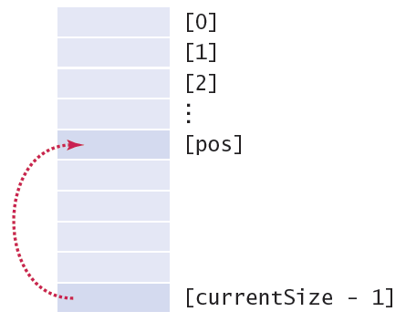
Common Algorithms 6a:
Removing an element (at a given position)
Requires tracking the ‘current size’ (# of valid elements)
But don’t leave a ‘hole’ in the array!
Solution depends on if you have to maintain ‘order’
If not, find the last valid element, copy over position, update size
values[pos] = values[currentSize – 1];
currentSize--;

Slide 29
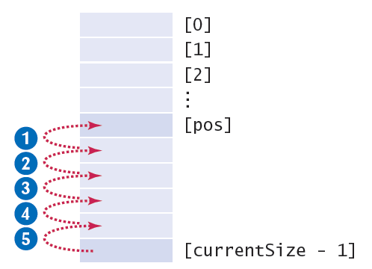
Common Algorithms 6b:
Removing an element and maintaining order
Requires tracking the ‘current size’ (# of valid elements)
But don’t leave a ‘hole’ in the array!
Solution depends on if you have to maintain ‘order’
If so, move all of the valid elements after ‘pos’ up one spot, update size
for (int i = pos; i < currentSize - 1; i++)
{
values[i] = values[i + 1];
}
currentSize--;

Slide 30
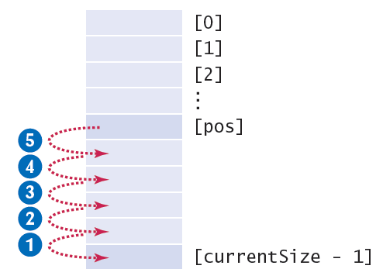
Common Algorithms 7:
Inserting an Element
Solution depends on if you have to maintain ‘order’
If not, just add it to the end and update the size
If so, find the right spot for the new element, move all of the valid elements after ‘pos’ down one spot, insert the new element, and update size
if (currentSize < values.length)
{
currentSize++;
for (int i = currentSize - 1; i > pos; i--)
{
values[i] = values[i - 1]; // move down
}
values[pos] = newElement; // fill hole
}

Slide 31
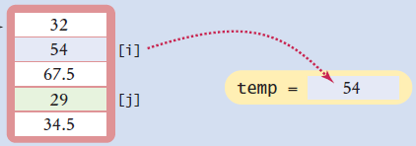
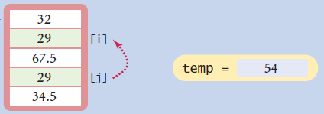
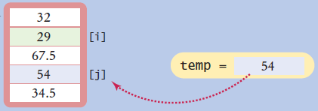
Common Algorithms 8:
Swapping Elements
Three steps using a temporary variable
double temp = values[i];
values[i] = values[j];
Values[j] = temp;

Slide 32
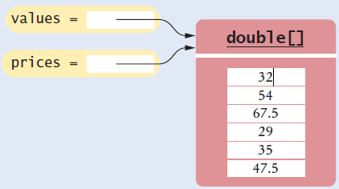
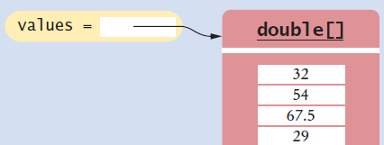
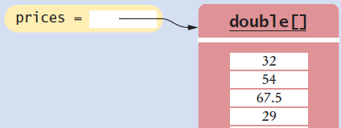
Common Algorithms 9a:
Copying Arrays
Not the same as copying only the reference
Copying creates two set of contents!
Use the new (Java 6) Arrays.copyOf method
double[] values = new double[6];
. . . // Fill array
double[] prices = values; // Only a reference so far
double[] prices = Arrays.copyOf(values, values.length);
// copyOf creates the new copy, returns a reference

Slide 33
Common Algorithms 9b:
Growing an array
Copy the contents of one array to a larger one
Change the reference of the original to the larger one
Example: Double the size of an existing array
Use the Arrays.copyOf method
Use ‘2 *’ in the second parameter
double[] values = new double[6];
. . . // Fill array
double[] newValues = Arrays.copyOf(values, 2 * values.length);
values = newValues;
Arrays.copyOf second parameter is the length of the new array

Slide 34
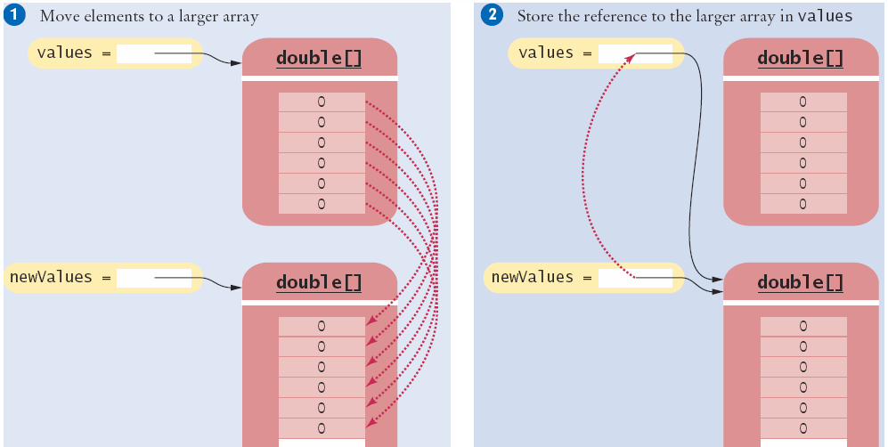
Increasing the Size of an Array
Copy all elements of values to newValues
Then copy newValues reference over values reference

Slide 35
Common Algorithms 10:
Reading Input
A: Known number of values to expect
Make an array that size and fill it one-by-one
B: Unknown number of values
Make maximum sized array, maintain as partially filled array
double[] inputs = new double[NUMBER_OF_INPUTS];
for (i = 0; i < values.length; i++)
{
inputs[i] = in.nextDouble();
}
double[] inputs = new double[MAX_INPUTS];
int currentSize = 0;
while (in.hasNextDouble() && currentSize < inputs.length)
{
inputs[currentSize] = in.nextDouble();
currentSize++;
}

Slide 36
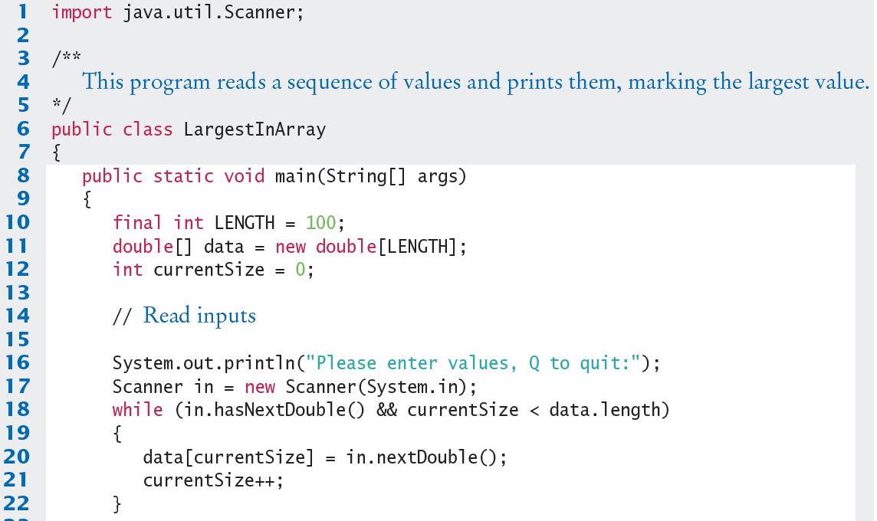
LargestInArray.java (1)
Input values and store in next available index of the array

Slide 37
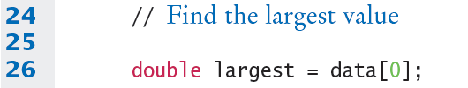
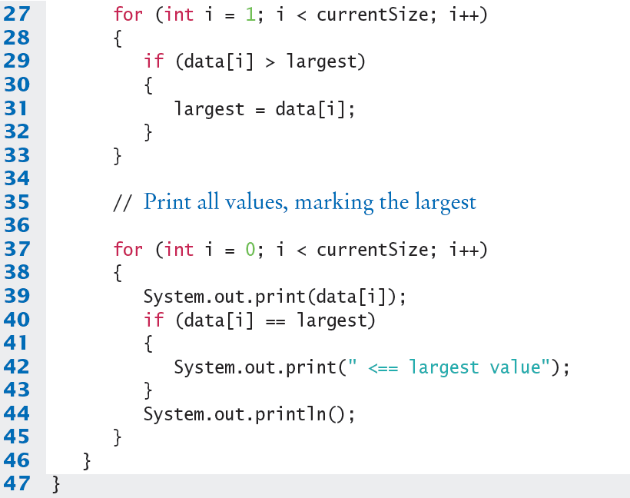
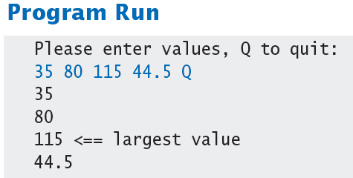
LargestInArray.java (2)
Use a for loop and the ‘Find the largest’ algorithm

Slide 38
Common Error 6.3
Underestimating the Size of the Data Set
The programmer cannot know how someone might want to use a program!
Make sure that you write code that will politely reject excess input if you used fixed size limits
Sorry, the number of lines of text is higher than expected, and some could not be processed. Please break your input into smaller size segments (1000 lines maximum) and run the program again.

Slide 39
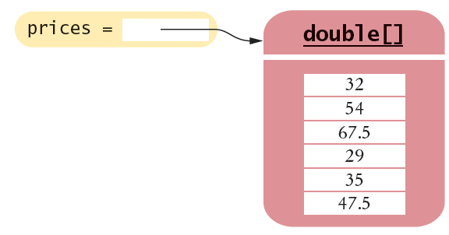
6.4 Using Arrays with Methods
Methods can be declared to receive references as parameter variables
What if we wanted to write a method to sum all of the elements in an array?
Pass the array reference as an argument!
priceTotal = sum(prices);
reference
public static double sum(double[] values)
{
double total = 0;
for (double element : values)
total = total + element;
return total;
}
Arrays can be used as method arguments and method return values.

Slide 40
Passing References
Passing a reference give the called method access to all of the data elements
It CAN change the values!
Example: Multiply each element in the passed array by the value passed in the second parameter
multiply(values, 10);
reference
value
public static void multiply(double[] data, double factor)
{
for (int i = 0; i < data.length; i++)
data[i] = data[i] * factor;
}

Slide 41
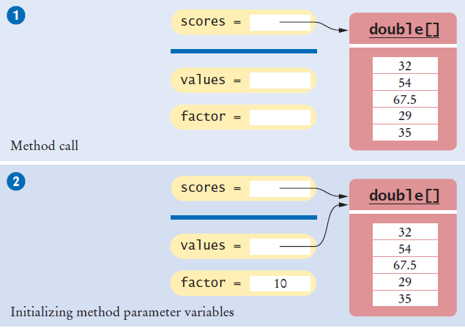

Passing References (Step 2)

Slide 42
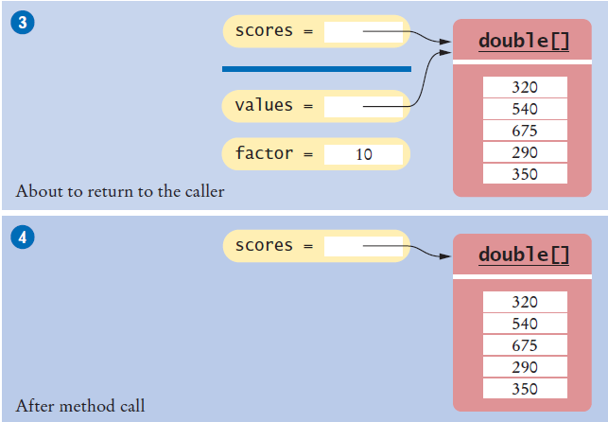
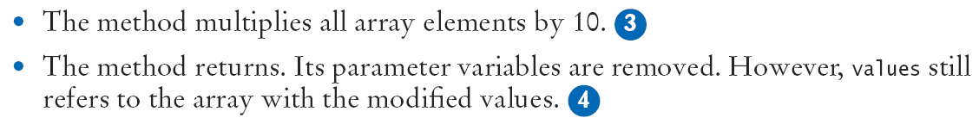
Passing References (Steps 3 & 4)

Slide 43
Method Returning an Array
Methods can be declared to return an array
To Call: Create a compatible array reference:
Call the method
public static int[] squares(int n)
int[] numbers = squares(10);
value
public static int[] squares(int n)
{
int[] result = new int[n];
for (int i = 0; i < n; i++)
{
result[i] = i * i;
}
return result;
}
reference

Slide 44
6.5 Problem Solving
Adapting Algorithms
Consider this example problem: You are given the quiz scores of a student. You are to compute the final quiz score, which is the sum of all scores after dropping the lowest one.
For example, if the scores are
8 7 8.5 9.5 7 5 10
then the final score is 50.

Slide 45

Adapting a Solution
What steps will we need?
Find the minimum.
Remove it from the array.
Calculate the sum.
What tools do we know?
Finding the minimum value (Section 6.3.3)
Removing an element (Section 6.3.6)
Calculating the sum (Section 6.3.2)
But wait… We need to find the POSITION of the minimum value, not the value itself..
Hmmm. Time to adapt

Slide 46


Planning a Solution
Refined Steps:
Find the minimum value.
Find it’s position.
Remove it from the array.
Calculate the sum.
Let’s try it
Find the position of the minimum:
At position 5
Remove it from the array
Calculate the sum

Slide 47
Adapting the code
Adapt smallest value to smallest position:
double smallest = values[0];
for (int i = 1; i < values.length; i++)
{
if (values[i] < smallest)
{
smallest = values[i];
}
}
int smallestPosition = 0;
for (int i = 1; i < values.length; i++)
{
if (values[i] < values[smallestPosition] )
{
smallestPosition = i;
}
}

Slide 48
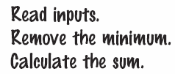
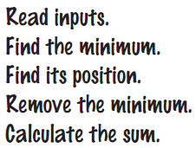

Using Arrays with Methods
1) Decompose the task into steps
2) Determine the algorithms to use
3) Use methods to structure the program
4) Assemble and Test the program
double[] scores = readInputs();
double total = sum(scores) - minimum(scores);
System.out.println("Final score: " + total);

Slide 49
6.7 Two-Dimensional Arrays
Arrays can be used to store data in two dimensions (2D) like a spreadsheet
Rows and Columns
Also known as a ‘matrix’

Slide 50
Declaring Two-Dimensional Arrays
Use two ‘pairs’ of square braces
You can also initialize the array
const int COUNTRIES = 7;
const int MEDALS = 3;
int[][] counts = new int[COUNTRIES][MEDALS];
const int COUNTRIES = 7;
const int MEDALS = 3;
int[][] counts =
{
{ 1, 0, 1 },
{ 1, 1, 0 },
{ 0, 0, 1 },
{ 1, 0, 0 },
{ 0, 1, 1 },
{ 0, 1, 1 },
{ 1, 1, 0 }
};
Note the use of two ‘levels’ of curly braces. Each row has braces with commas separating them.

Slide 51
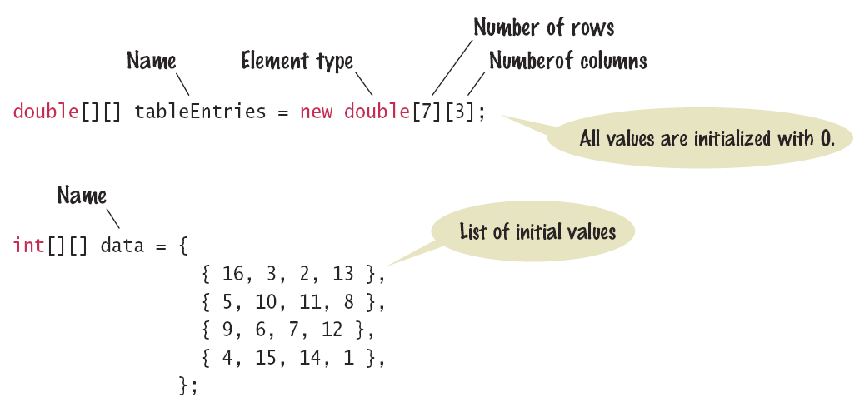
Syntax 6.3: 2D Array Declaration
The name of the array continues to be a reference to the contents of the array
Use new or fully initialize the array

Slide 52
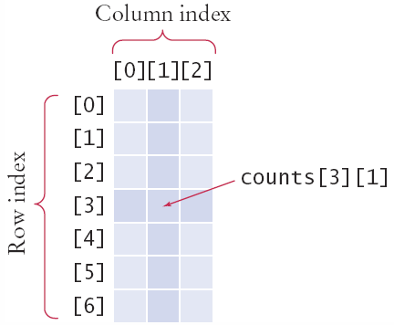
Accessing Elements
Use two index values:
Row then Column
To print
Use nested for loops
Outer row(i) , inner column(j) :
int value = counts[3][1];
for (int i = 0; i < COUNTRIES; i++)
{
// Process the ith row
for (int j = 0; j < MEDALS; j++)
{
// Process the jth column in the ith row
System.out.printf("%8d", counts[i][j]);
}
System.out.println(); // Start a new line at the end of the row
}

Slide 53
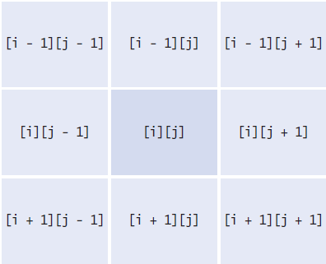
Locating Neighboring Elements
Some programs that work with two-dimensional arrays need to locate the elements that are adjacent to an element
This task is particularly common in games
You are at loc i, j
Watch out for edges!
No negative indexes!
Not off the ‘board’

Slide 54
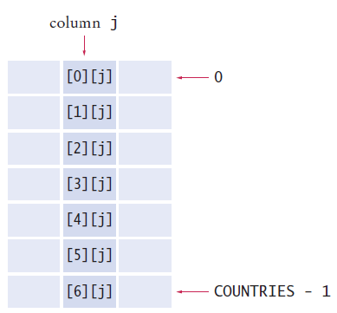
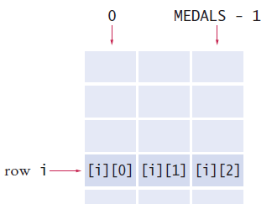
Adding Rows and Columns
Rows (x) Columns (y)
int total = 0;
for (int j = 0; j < MEDALS; j++)
{
total = total + counts[i][j];
}
int total = 0;
for (int i = 0; i < COUNTRIES; i++)
{
total = total + counts[i][j];
}

