Slide 1
Interface Types
An interface is a special type of declaration that lists a set of methods and their signatures
A class that ‘implements’ the interface must implement all of the methods of the interface
It is similar to a class, but there are differences:
All methods in an interface type are abstract:
They have a name, parameters, and a return type, but they don’t have an implementation
All methods in an interface type are automatically public
An interface type cannot have instance variables
An interface type cannot have static methods
public interface Measurable
{
double getMeasure();
}
A Java interface type declares a set of methods and their signatures.

Slide 2
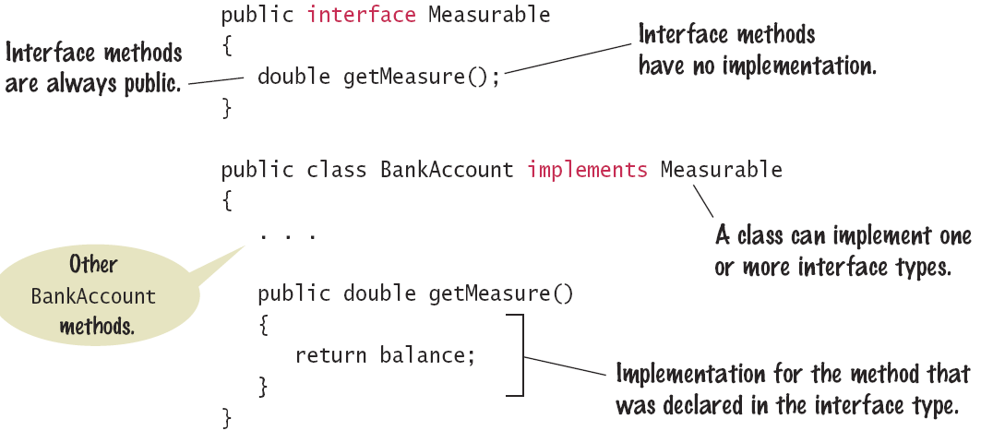
Interface Types
An interface declaration and a class that implements the interface.

Slide 3
Using Interface Types
We can use the interface type Measurable to implement a “universal” static method for computing averages:
public interface Measurable
{
double getMeasure();
}
public static double average(Measurable[] objs)
{
if (objs.length == 0) return 0;
double sum = 0;
for (Measurable obj : objs)
{
sum = sum + obj.getMeasure();
}
return sum / objs.length;
}

Slide 4
Implementing an Interface
A class can be declared to implement an interface
The class must implement all methods of the interface
public class BankAccount implements Measurable
{
public double getMeasure()
{
return balance;
}
. . .
}
Use the implements reserved word in the class declaration.
public class Country implements Measurable
{
public double getMeasure()
{
return area;
}
. . .
}
The methods of the interface must be declared as public

Slide 5
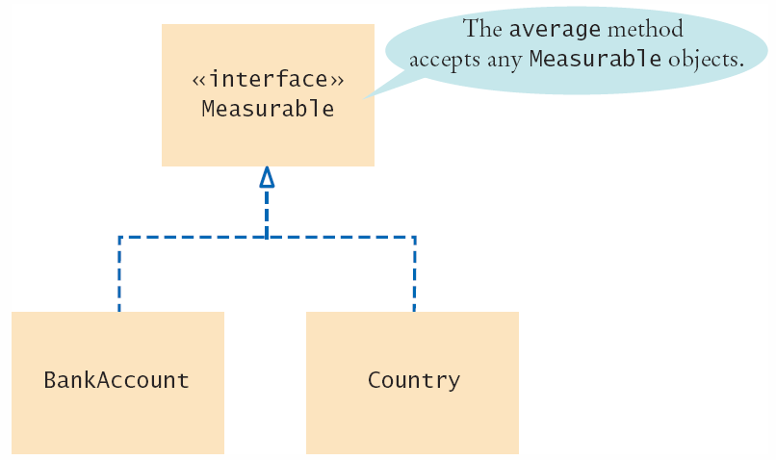

An Implementation Diagram
The dashed line with an arrow is used to denote implements relationships

Slide 6
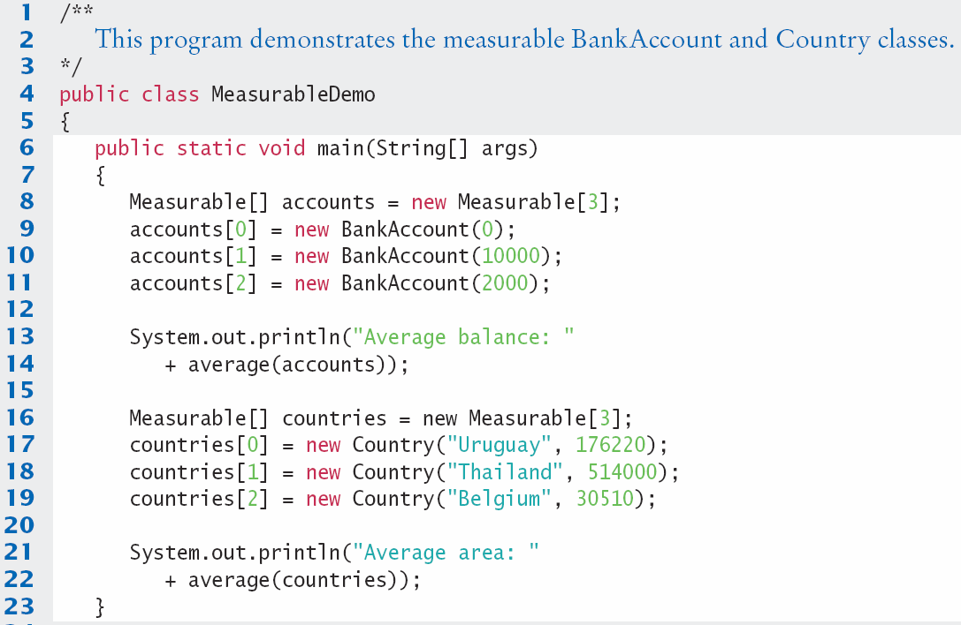
MeasureableDemo.java (1)

Slide 7
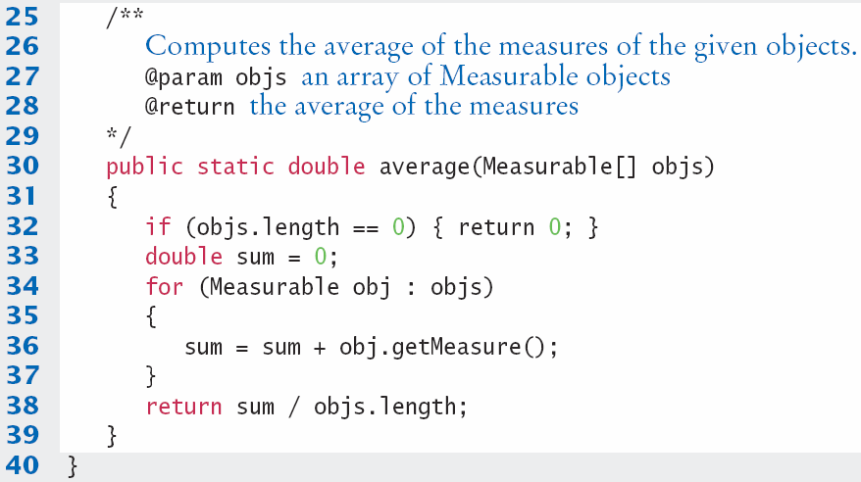
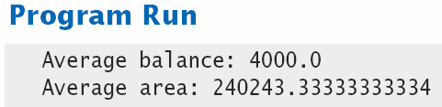
MeasureableDemo.java (2)

Slide 8
The Comparable Interface
The Java library includes a number of important interfaces including Comparable
It requires implementing one method: compareTo()
It is used to compare two objects
It is implemented by many objects in the Java API
If may want to implement it in your classes to use powerful Java API tools such as sorting
It is called on one object, and is passed another
Called on object a, return values include:
Negative: a comes before b
Positive: a comes after b
0: a is the same as b
a.compareTo(b);

Slide 9
The Comparable Type parameter
The Comparable interface uses a special type of parameter that allows it to work with any type:
The type <T> is a placeholder for an actual type of object
The class ArrayList class uses the same technique with the type surrounded by angle brackets < >
public interface Comparable<T>
{
int compareTo(T other);
}
ArrayList<String> names = new ArrayList<String>();
Using the type inside angle braces will be covered further in the next chapter.

Slide 10
A Comparable Example
The BankAccount compareTo method compares bank accounts by their balance.
It takes one parameter of it’s own class type (BankAccount)
public class BankAccount implements Comparable<BankAccount>
{
. . .
public int compareTo(BankAccount other)
{
if (balance < other.getBalance()) { return -1; }
if (balance > other.getBalance()) { return 1; }
return 0;
}
. . .
}
The methods of the interface must be declared as public

Slide 11
Using compareTo to Sort
The Arrays.sort method uses the compareTo method to sort the elements of the array
Once the BankAccount class implements the Comparable interface, you can sort an array of bank accounts with the Arrays.sort method:
The array is now sorted by increasing balance
BankAccount[] accounts = new BankAccount[3];
accounts[0] = new BankAccount(10000);
accounts[1] = new BankAccount(0);
accounts[2] = new BankAccount(2000);
Arrays.sort(accounts);
Implementing Java Library interfaces allows you to use the power of the Java Library with your classes.

Slide 12
Common Error
Forgetting to Declare Implementing Methods
as Public
The methods in an interface are not declared as public, because they are public by default.
However, the methods in a class are not public by default.
It is a common error to forget the public reserved word when declaring a method from an interface:
public class BankAccount implements Measurable
{
double getMeasure() // Oops—should be public
{
return balance;
}
. . .
}

Slide 13
Special Topic
Interface Constants
Interfaces cannot have instance variables, but it is legal to specify constants
When declaring a constant in an interface, you can (and should) omit the reserved words public static final, because all variables in an interface are automatically public static final.
public interface SwingConstants
{
int NORTH = 1;
int NORTHEAST = 2;
int EAST = 3;
. . .
}

Slide 14
Interface vs. Abstract Class
How does an Interface differ from an abstract class since both contain unimplemented and therefore abstract methods? The differences are significant:
An interface cannot implement any methods, whereas an abstract class can.
A class can implement many interfaces but can have only one superclass.
An interface is not part of the class hierarchy. Unrelated classes can implement the same interface.

Slide 15
Extending Interface
[public] interface InterfaceName [extends SuperInterfaces] {
// constants (optional)
// method declarations without implementations
}
Inheritance can also be applied to interfaces
Define one interface based on another by using the keyword extends to identify the base interface name.
A class can extend only one other class, an interface can extend any number of interfaces. The list of superi nterfaces is a comma-separated list of all the interfaces extended by the new interface.
Page 15

Slide 16
Extending Interface (cont)
public interface Transportation{
double travelTime();
}
public interface Vehicle extends Transportation{
int speedUp();
int slowDown();
}
Any class implementing Vehicle will have access to the Transportation interface
A class implementing the Vehicle interface should also implement Transportation interface
Page 16

Slide 17
Extending Interface
public interface Truck extends Vehicle, Container{
void load();
void unload();
}
Unlike a class, which can extend only one other class, an interface can extend any number of other interfaces. This is called “multiple inheritance”.
The Truck interface inherits all the methods and constants that are members of Container and Vehicle interfaces.
A class implementing Truck interface should also implement Container and Vehicle interfaces.
Page 17

