Slide 1
2.5 Strings
The String Type:
Type Variable Literal
String name = “Harry”
Once you have a String variable, you can use methods such as:
int n = name.length(); // n will be assigned 5
A String’s length is the number of characters inside:
An empty String (length 0) is shown as “”
The maximum length is quite large (an int)

Slide 2
String Concatenation (+)
You can ‘add’ one String onto the end of another
String fName = “Harry”
String lName = “Morgan“
String name = fname + lname; // HarryMorgan
You wanted a space in between?
String name = fname + “ “ + lname; // Harry Morgan
To concatenate a numeric variable to a String:
String a = “Agent“;
int n = 7;
String bond = a + n; // Agent7
Concatenate Strings and numerics inside println:
System.out.println("The total is " + total);

Slide 3
String Input
You can read a String from the console with:
System.out.print("Please enter your name: ");
String name = in.next();
The next method reads one word at a time
It looks for ‘white space’ delimiters
You can read an entire line from the console with:
System.out.print("Please enter your address: ");
String address = in.nextLine();
The nextLine method reads until the user hits ‘Enter’
Converting a String variable to a number
System.out.print("Please enter your age: ");
String input = in.nextLine();
int age = Integer.parseInt(input); // only digits!

Slide 4
String Escape Sequences
How would you print a double quote?
Preface the " with a \ inside the double quoted String
System.out.print("He said \"Hello\"");
OK, then how do you print a backslash?
Preface the \ with another \!
System.out.print("“C:\\Temp\\Secret.txt“);
Special characters inside Strings
Output a newline with a ‘\n’
System.out.print("*\n**\n***\n");
*
**
***

Slide 5

Strings and Characters
Strings are sequences of characters
Unicode characters to be exact
Characters have their own type: char
Characters have numeric values
See the ASCII code chart in Appendix B
For example, the letter ‘H’ has a value of 72 if it were a number
Use single quotes around a char
char initial = ‘B’;
Use double quotes around a String
String initials = “BRL”;

Slide 6
Copying a char from a String
Each char inside a String has an index number:
The first char is index zero (0)
The charAt method returns a char at a given index inside a String:
String greeting = "Harry";
char start = greeting.charAt(0);
char last = greeting.charAt(4);
0 | 1 | 2 | 3 | 4 | 5 | 6 | 7 | 8 | 9
c | h | a | r | s |  | h | e | r | e
0 | 1 | 2 | 3 | 4
H | a | r | r | y

Slide 7
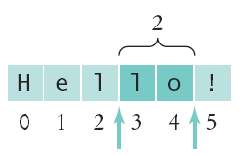
Copying portion of a String
A substring is a portion of a String
The substring method returns a portion of a String at a given index for a number of chars, starting at an index:
String greeting = "Hello!";
String sub = greeting.substring(0, 2);
String sub2 = greeting.substring(3, 5);
0 | 1 | 2 | 3 | 4 | 5
H | e | l | l | o | !
0 | 1
H | e

Slide 8
Table 9: String Operations (1)

Slide 9
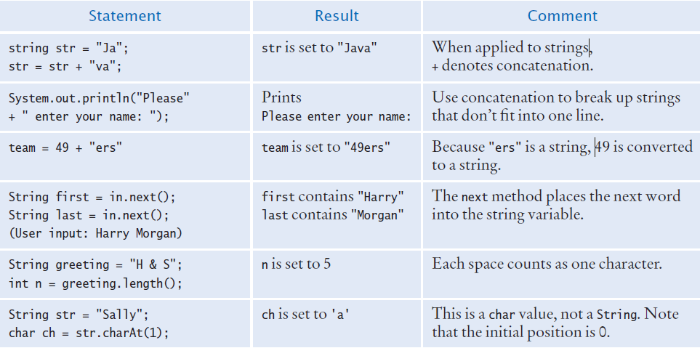
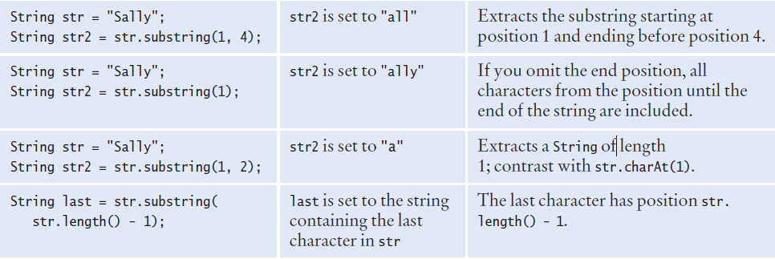
Table 9: String Operations (2)

