Slide 1
Polymorphism
Literal meaning of Polymorphism is “many forms”. The ability to assume several different forms or shapes.
Enables you to “program in the general” rather than “program in the specific.”
Polymorphism enables you to write programs that process objects that share the same superclass as if they’re all objects of the superclass; this can simplify programming.
Polymorphism is applied to two classes with inheritance relationship (i.e. Superclass and subclass relationship)
The ability to use a superclass object variable to call various subclasses’ methods seamlessly and the proper behavior is automatically invoked.
Page 1

Slide 2
Polymorphism Example (1)
Example: Suppose we create a program that simulates the movement of several types of animals for a biological study. Classes Fish, Frog and Bird represent the three types of animals under investigation.
Each class extends superclass Animal, which contains a method move and maintains an animal’s current location
A program maintains an Animal array containing references to objects of the various Animal subclasses. To simulate the animals’ movements
Page 2

Slide 3
Polymorphism Example (1)
Each specific type of Animal responds to a move message in a unique way:
a Fish might swim three feet
a Frog might jump five feet
a Bird might fly ten feet.
The program issues the same move method to each animal object, but each object knows how to modify its location appropriately for its specific type of movement.
Relying on each object to know how to “do the right thing” in response to the same method call is the key concept of polymorphism.
The same method to a variety of objects has “many forms” of results—hence the term polymorphism.
Page 3

Slide 4
Polymorphism Example (2)
Imagine an application where there are two different type of bank accounts: Personal Account and Business Account. The way the interest is calculated for each bank account is different. Personal accounts accrue fixed interest but Business accounts accrue variable interest based on the market value.
By overriding the “applyInterest” methods in the Personal Account and Business Account subclasses, the interest can be calculated properly based on the type of account
Page 4

Slide 5
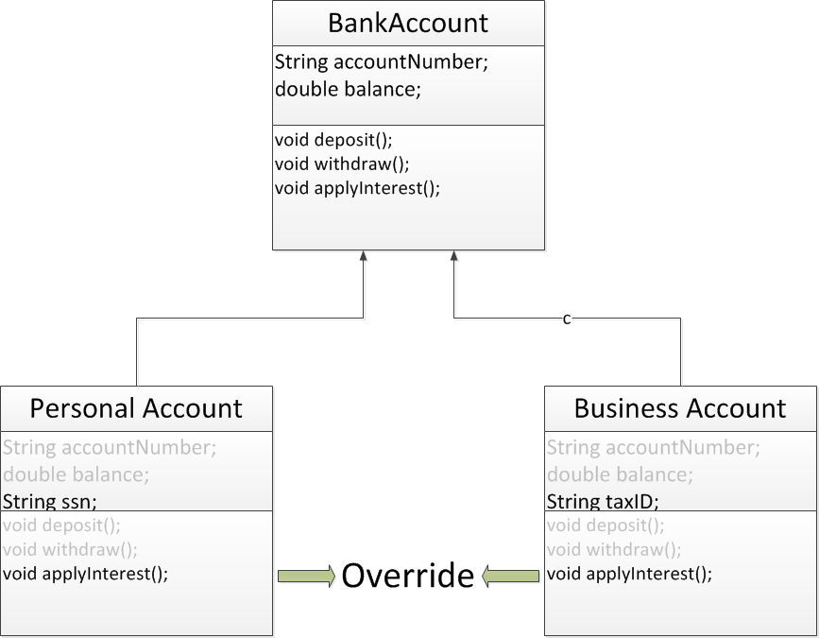
Polymorphism Example (2)
Page 5

Slide 6
Polymorphism Example (2)
Polymorphism allows us to define an array of Bank Account and create an object of any of the subclasses (Personal Account or Business Account) for each element in the array and call the applyInterest method and expect the interest is calculated correctly base on each type of account
BankAccount[] accounts = new BankAccount[2];
accounts[0] = new BusinessAccount();
accounts[1] = new PersonalAccount();
accounts[0].applyInterest();
accounts[1].applyInterest();
Page 6

Slide 7
Benefits of Polymorphism
With polymorphism, we can design and implement systems that are easily extensible
New classes can be added with little or no modification to the general portions of the program, as long as the new classes are part of the inheritance hierarchy that the program processes generically.
The only parts of a program that must be altered to accommodate new classes are those that require direct knowledge of the new classes that we add to the hierarchy.
Page 7

Slide 8
When Polymorphism Works
Polymorphism conditions that should be met:
The method call for a derived class object must be through a variable of a base class type
The method in the subclass must override the method in the superclass
Page 8

Slide 9
Demonstrating Polymorphic Behavior
In the next example, we aim a superclass reference at a subclass object.
Invoking a method on a subclass object via a superclass reference invokes the subclass functionality
The type of the referenced object, not the type of the variable, determines which method is called
This example demonstrates that an object of a subclass can be treated as an object of its superclass, enabling various interesting manipulations.
A program can create an array of superclass variables that refer to objects of many subclass types.
Allowed because each subclass object is an object of its superclass.
Page 9

Slide 10
Demonstrating Polymorphic Behavior
A superclass object cannot be treated as a subclass object, because a superclass object is not an object of any of its subclasses.
The is-a relationship applies only up the hierarchy from a subclass to its direct (and indirect) superclasses, and not down the hierarchy.
The Java compiler does allow the assignment of a superclass reference to a subclass variable if you explicitly cast the superclass reference to the subclass type
A technique known as downcasting that enables a program to invoke subclass methods that are not in the superclass.
Page 10

Slide 11
Demonstrating Polymorphic Behavior
When a superclass variable contains a reference to a subclass object, and that reference is used to call a method, the subclass version of the method is called.
When the compiler encounters a method call made through a variable, the compiler determines if the method can be called by checking the variable’s class type.
If that class contains the proper method declaration (or inherits one), the call is compiled.
At execution time, the type of the object to which the variable refers determines the actual method to use.
This process is called dynamic binding.
Page 11

Slide 12
Employee Example
Simple payroll example that calculate the weekly income of employees based on the number of hours worked per week.
There are two types of Employees: Contractor and Exempt.
Contractors get paid 1.5 times for overtime hours
Exempt Employee are not paid for the first 5 hours of overtime and the remainder is paid at normal hourly rate.
Page 12

Slide 13
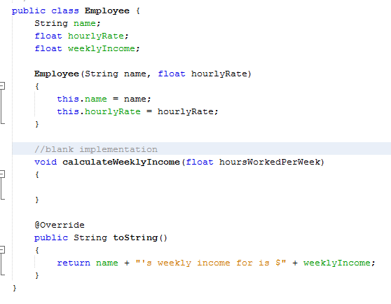
Employee Class
Page 13

Slide 14
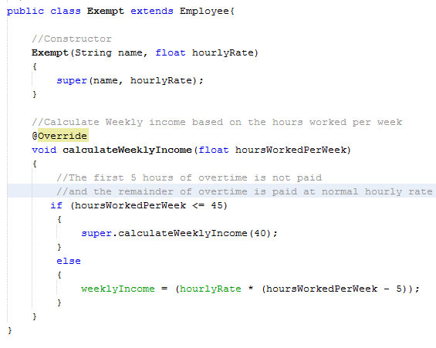
Exempt Class
Page 14

Slide 15
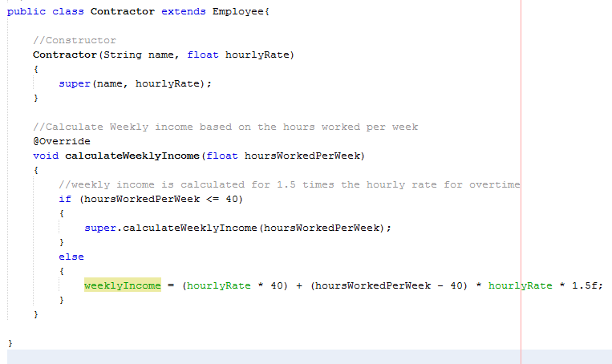
Contractor Class
Page 15

Slide 16
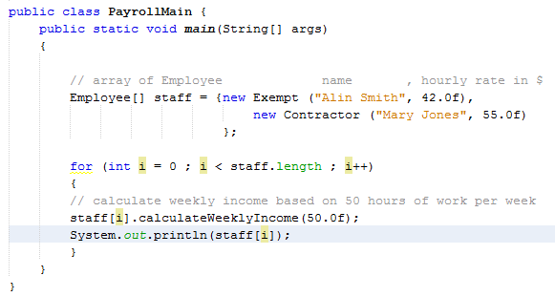
Payroll Main Class
Page 16

