Slide 1
Types of Errors
Compile-Time Errors
Detected by compiler
Detected prior to running/executing your program
Syntax Errors
Run-Time Errors
Not detected by the compiler
Occurs at run time (when executing your program)
Potentially could cause your program stop working or crash
Exceptions are run-time errors

Slide 2
Exception
Errors will happen in your program no matter how good of a programmer you are
User input errors, Device errors, Physical limitations, Coding errors
But what really matters is
What happens after the error?
How is the error handled?
Who handles the error?
Can the program recover or should it just die gracefully?
The Java language uses exceptions to provide error-handling capabilities for its programs

Slide 3
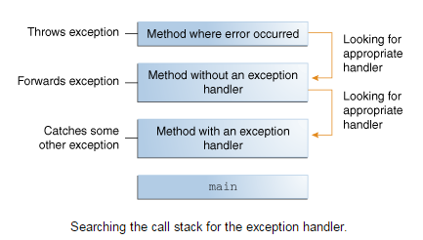
Throwing Exception
When an error occurs within a method, the method creates an object and hands it off to the runtime system. The object, called an exception object, contains information about the error, including its type and the state of the program when the error occurred. Creating an exception object and handing it to the runtime system is called throwing an exception.
After a method throws an exception, the runtime system attempts to find something to handle it. The set of possible "somethings" to handle the exception is the ordered list of methods that had been called to get to the method where the error occurred

Slide 4
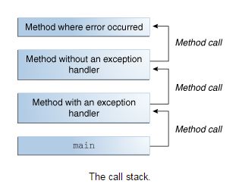
Call Stack
The list of methods is known as the call stack

Slide 5
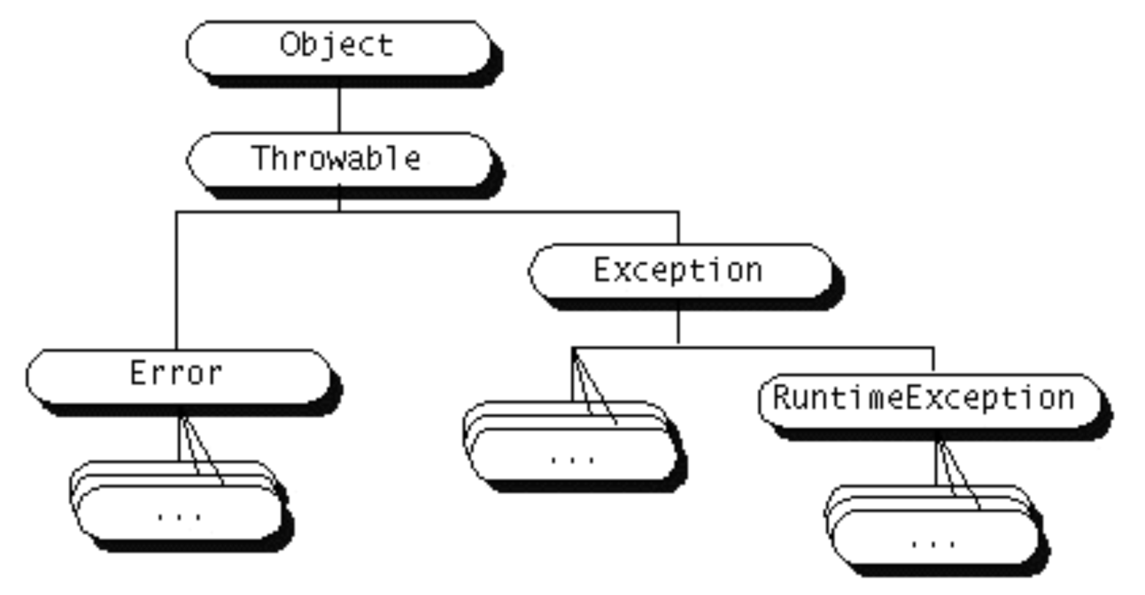
Throwable Objects
Anything that is a descendant of the class Throwable can be thrown

Slide 6
Throwable Objects
Errors
Typically a hard failure in the Java Virtual Machine
Java programs should not try and catch these errors
Exceptions
Most programs throw and catch objects that derive from the Exception class
Exceptions indicate that a problem occurred but that the problem is not a serious systemic problem
If specified, must be caught somewhere in the calling hierarchy (except for RuntimeExceptions)
Runtime Exceptions
Special subclass of Exception class
Exceptions that occur within the Java virtual machine (during runtime)
The compiler allows runtime exceptions to go uncaught and unspecified

Slide 7
Runtime Exception
A subclass of Exception that does not have to be caught
Subclasses of RuntimeException defined in the standard package java.lang:
Arithmetic Exception
IndexOutofBoundsException
NegativeArraySizeException
NullPointerException
etc

