Slide 1


Particle Swarm Optimization (PSO)
Presented by:
Bibek Gautam(078BCT030)
Bikash Niraula(078BCT031)
Janak Sapkota(078BCT043)
March 2025
Notes:
1

Slide 2

Introduction to Particle Swarm Optimization(PSO)
PSO is a population-based optimization algorithm inspired by the social behavior of birds and fish.
The algorithm iteratively improves solutions by updating particle positions based on their own experiences and the best-known global solution.
It balances exploration (searching for new solutions) and exploitation (refining the best-known solutions).
Notes:
The idea is that a group of candidate solutions, called particles, move through a solution space to find the optimal result

Slide 3




Project Objectives
Implement PSO and visualize it using the Rosenbrock function
Apply PSO to breast cancer feature selection
Compare PSO-based selection with other methods
Notes:
3

Slide 4

Literature Review
1
Introduction
PSO was introduced by Kennedy and Eberhart (1995).
2
Feature Selection
Xue et al. (2014): Surveyed PSO applications, highlighting advantages over traditional methods.
Cervante et al. (2012): Improved classification accuracy & efficiency using PSO.
3
Breast Cancer Classification
Shen et al. (2012): Applied PSO on the Wisconsin dataset, outperforming genetic algorithms.
Yao et al. (2015): Hybrid PSO approach for feature selection & parameter tuning.
Notes:
4

Slide 5
Literature Review
1
PSO Variants
Shi & Eberhart (1998): Introduced inertia weight for exploration-exploitation balance.
Clerc & Kennedy (2002): Proposed constriction factor for convergence.
Zhan et al. (2009): Adaptive PSO dynamically adjusting parameters.
2
Benchmarking
Tsoulos & Lagaris (2006): Analyzed PSO on the Rosenbrock function, showcasing its ability to escape local minima.
Notes:
4

Slide 6
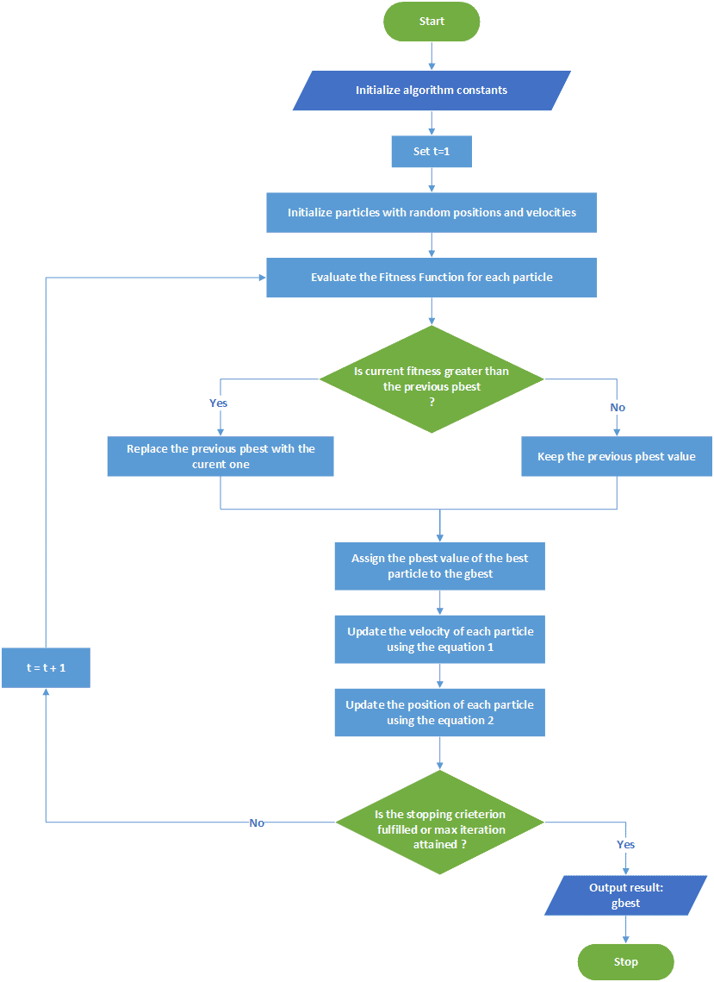
UNDERSTANDING THE
PSO ALGORITHM
PARTICLES IN THE PSO ALGORITHM
PSO consists of multiple particles that explore a defined search space
to find optimal solutions.
POSITION UPDATES
Each particle updates its position based on its own best known
position and the best known position of the swarm.
PERSONAL BEST POSITION
Each particle keeps track of its own personal best position,
which influences its movement.
GLOBAL BEST POSITION
The best position found by any particle in the swarm is
termed the global best, guiding other particles.
v(t+1)=w⋅v(t)+c1​⋅r1​⋅(pbest​−x(t))+c2​⋅r2​⋅(gbest​−x(t)) --------- eq(1)
x(t+1)=x(t)+v(t+1) --------- eq(2)
Notes:
5

Slide 7
UNDERSTANDING THE PSO ALGORITHM
POSITION UPDATE EQUATION
The position of a particle is updated using the formula:
x(t+1)=x(t)+v(t+1) --------- eq(2)
VELOCITY UPDATE
Velocity is updated using the following equation:−
v(t+1)=w⋅v(t)+c1​⋅r1​⋅(pbest​−x(t))+c2​⋅r2​⋅(gbest​−x(t)) --------- eq(1)
where:
w = inertia weight (controls exploration vs. exploitation)
c1​,c2​ = acceleration coefficients (cognitive and social factors)
r1​,r2​ = random values in [0,1]
pbest​ = personal best position
gbest​ = global best position

Slide 8
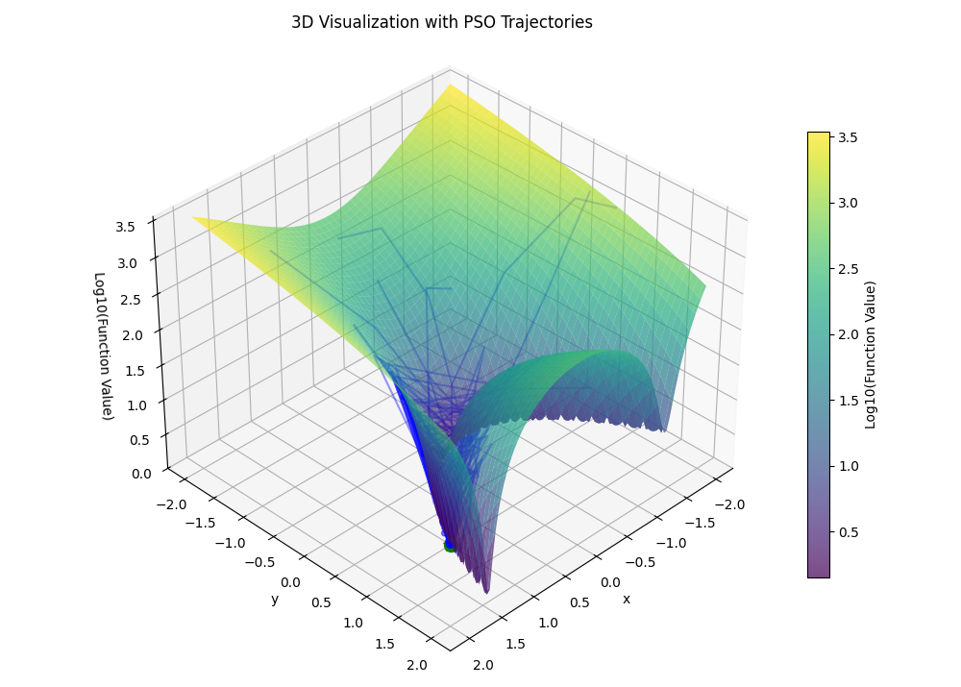
Experiment - Rosenbrock Function Minimization
The Rosenbrock function is defined as:
f(x, y) = (a−x)^2 +b(y−x^2 )^2
Where a and b are constants
(typically a = 1, b = 100). This function has a global minimum at (a,1) with a value of 0

Slide 9
Experiment - Rosenbrock Function Minization
PSO Parameters
Number of particles: 30
Maximum iterations: 100
Inertia weight (w): 0.7
Cognitive coefficient (c1): 1.5
Social coefficient (c2): 1.5
Search space: [-2, 2] for both dimensions
Fitness Function
f(x, y) = (a−x)^2 +b(y−x^2 )^2
Notes:
8

Slide 10
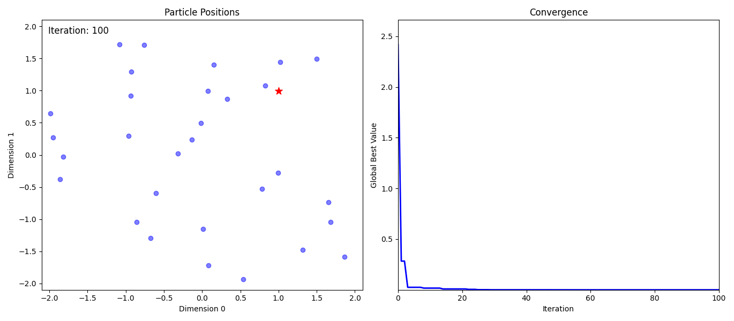
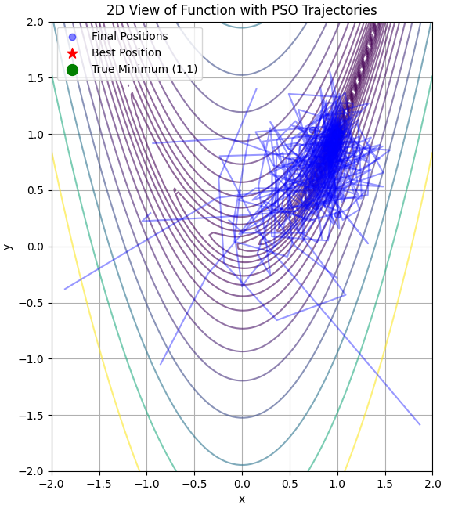
Results- Rosenbrock Function Optimization
Particles successfully converged to the global minimum
Visualization shows initial exploration followed by refinement

Slide 11
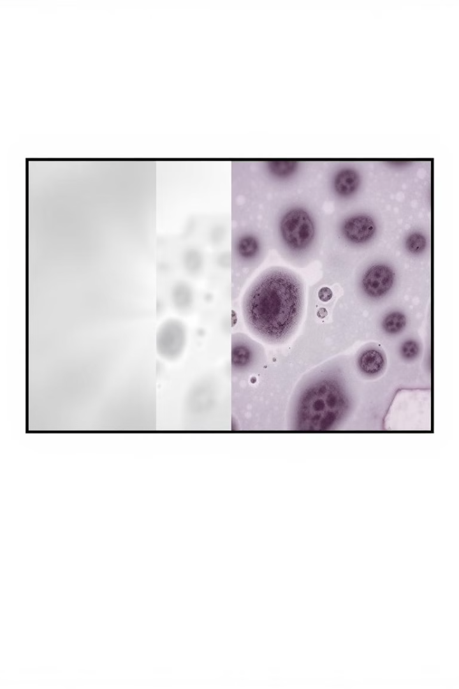
Methodology - Breast Cancer Feature Selection
Dataset
Wisconsin Breast Cancer Dataset (30 features, 569 samples).
Goal
Reduce features while maintaining classification accuracy.
Representation
Each particle represents a binary vector (1=selected, 0=not selected).
Fitness Function
Fitness function balances accuracy and feature reduction.
Notes:
7

Slide 12
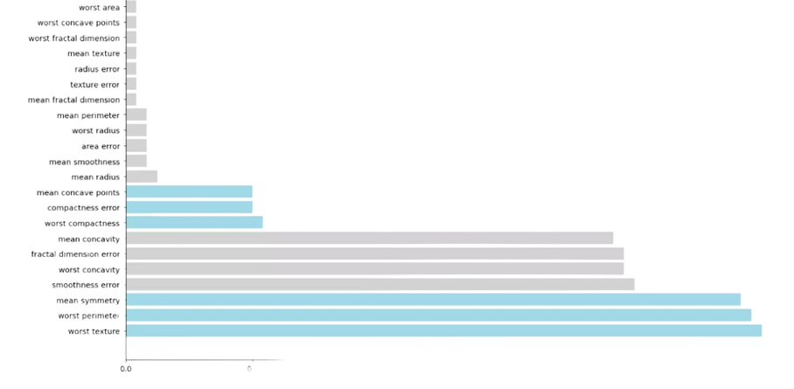
Experiments - Breast Cancer Feature Selection
Data Split
80% training, 20% testing
Feature Reduction
PSO reduced features from 30 to ~6 while maintaining accuracy
Key Features Selected
Texture, concavity, and symmetry attributes
Classification Method
SVM resulted in high accuracy
Notes:
9

Slide 13
Experiment : Feature Selection
Feature Selection for Breast Cancer Classification
Dataset: Wisconsin Breast Cancer (569 samples, 30 features)
Approach: PSO-based feature selection with binary encoding
Setup:
Training/Test split (80/20) with 5-fold cross-validation
PSO parameters: 20 particles, 50 iterations, w = 0.729, c₁ = c₂ = 1.5, α = 0.7
Outcome: Reduced average feature count from 30 to ~6.4 while maintaining/improving accuracy

Slide 14
HyperParameter Tuning
Parameters Tested:
Inertia weight (w): 0.4–0.9
Cognitive & Social coefficients (c₁, c₂): 1.0–2.0
Swarm sizes: 10, 20, 30, 40 particles
Iterations: 30, 50, 70, 100
Findings:
Best results with 30 particles, w ≈ 0.7–0.8, and c₁ = c₂ ≈ 1.5
Convergence typically reached in 40–50 iterations

Slide 15
Model Evaluation
Metrics Used: Accuracy, Precision, Recall, F1-score, AUC
Results:
Accuracy: 96.49%
Precision: 96.49%
Recall: 96.49%
F1-score: 96.49%
AUC: 99.67%
Visuals: PSO convergence curve, ROC curve, and confusion matrix

Slide 16
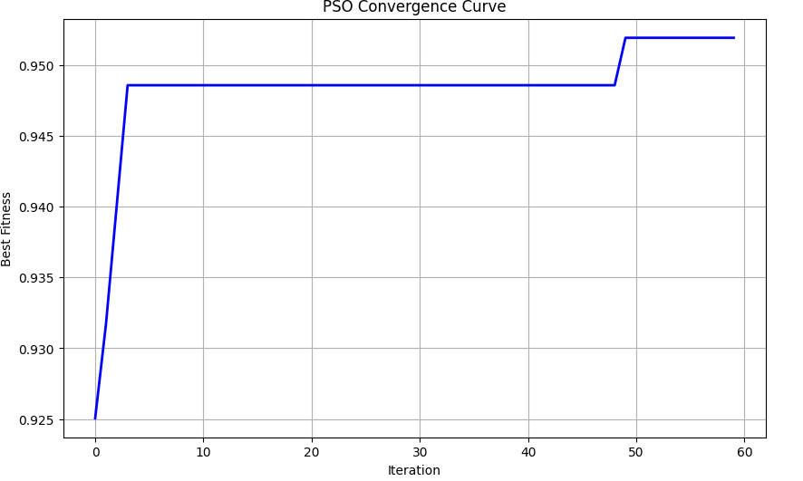
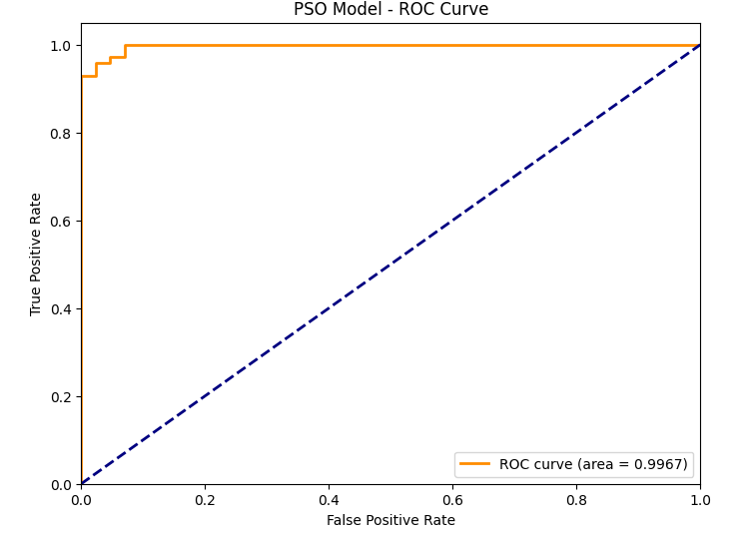
PSO Convergence Curve and PSO Model - ROC Curve

Slide 17
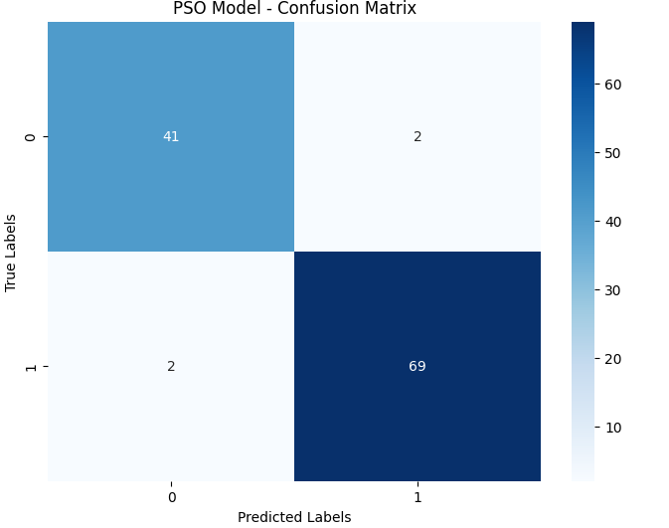
PSO Model : Confusion Matrix

Slide 18
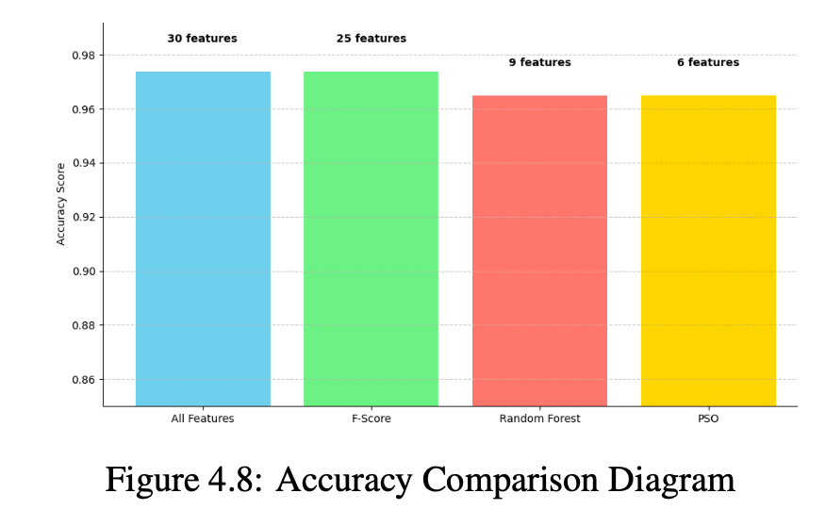
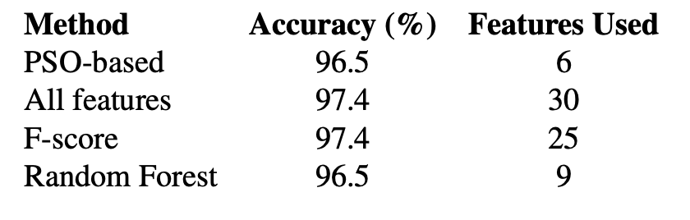
Comparision with other algorithms: Breast Cancer Feature Selection

Slide 19
Conclusion
Effective Optimization
PSO effectively optimized Rosenbrock function and reduced
Notes:
10

