Slide 1
Final Project Azure Batch
Keith, Joel
Deep Azure@McKesson
Dr. Zoran B. Djordjević

Slide 2
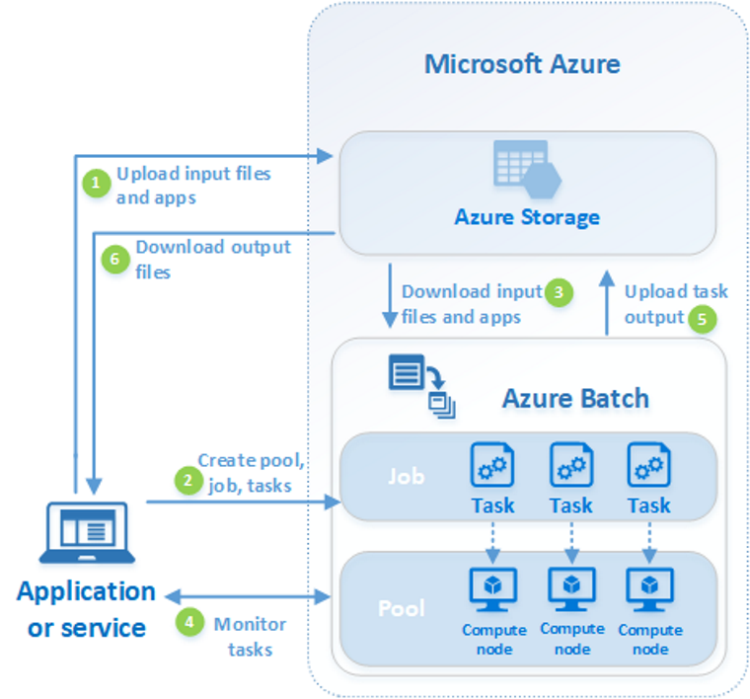
Introduction
Azure Batch overview
Used courtesy of Microsoft

Slide 3
Problem
Opioid crisis is a major nation-wide health issue
Tracking the ordering of Opioid drugs by pharmacies could help identify fraud and abuse but needs to be across all Suppliers for a customer
Azure Batch scalable computing environment can provide the platform for large-scale data extraction and recording, to provide a basis for analysis and reporting
Solution involves
Parsing EDI ordering documents to extract ordered drug information
Augmenting EDI data with demographic and detailed drug data
Storing historical record of opioid ordering activity
Demonstration of one aspect of visualization that can help identify “hot spots” for potential investigation
Data sets
“cleansed” EDI ordering documents from MPTS EnterpriseRx pharmacy system
USPS Zip code file
FDA Drug files (publicly available)

Slide 4
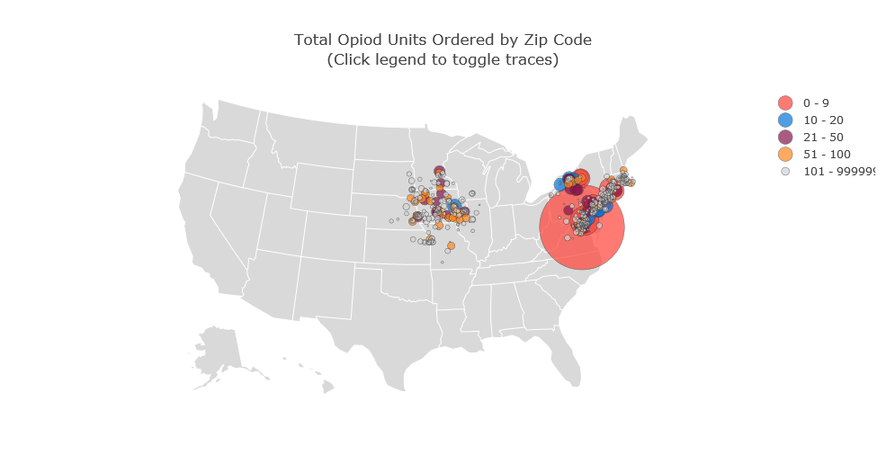
Example visualization
Python plotly library bubble chart viewed in Anaconda Jupyter notebook

