Slide 1
Final Project Azure Batch
Keith, Joel
Deep Azure@McKesson
Dr. Zoran B. Djordjević

Slide 2
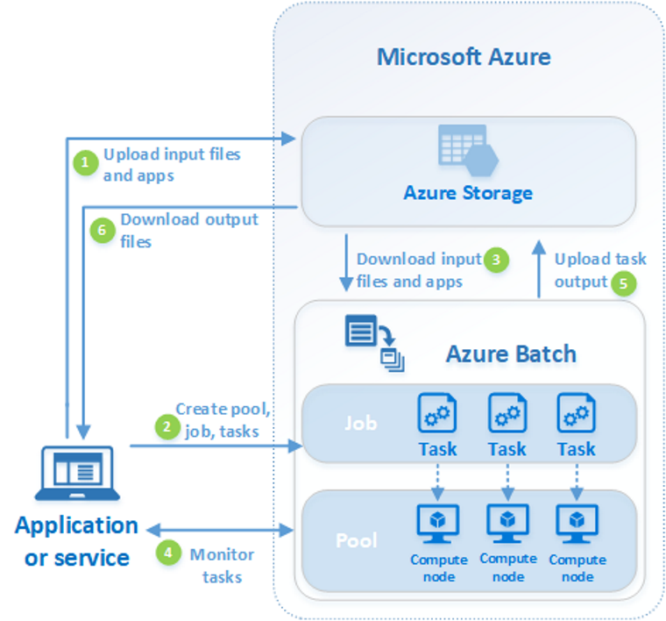
Overview
Used courtesy of Microsoft

Slide 3
Concepts
Batch Account
Pools
Jobs
Tasks
Application Packages
Tools

Slide 4
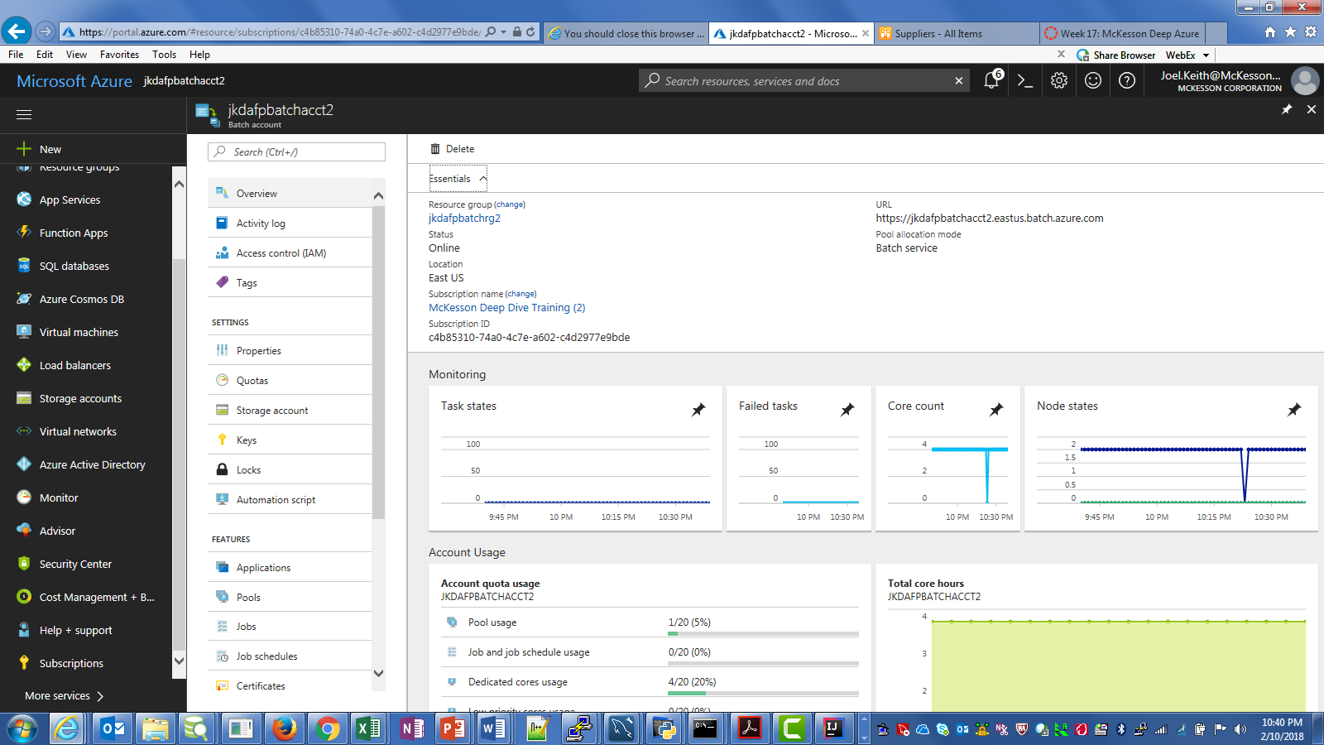
Concepts – Batch Account
Batch Account
All resources are held under this account
Includes an access Key and a URL
Linked to a Storage Account for Blob file storage

Slide 5
Concepts – Pools
Pools
Consist of 1 or more Nodes (VMs)
All VMs are homogeneous
Can use standard VM configurations or roll your own
Can be fixed in size or can grow dynamically
Can be created via API (as can the Nodes)
Can run Docker Containers within Nodes
See Batch Shipyard for more details!
Job Tasks are scheduled into Nodes
Can support massive scale (1000s of VMs)
Dedicated nodes vs low-priority nodes (can mix)
Application packages can be uploaded ahead of time

Slide 6
Concepts – Job
Jobs
Consists of 1 or more Tasks
Can be directly added to a Pool or scheduled to run in a Pool
Can be created via API
Can have constraints applied (e.g. max wall time)
Can have a priority assigned
Higher-priority get scheduled next but don’t preempt currently running jobs

Slide 7
Concepts – Tasks
Tasks
Perform the actual work
Can download files and applications and have resource files assigned
Command line to execute as well
Can upload files or write to other Azure resources
Can have inter-task dependencies
Start-finish, 1-M. M-M
Are typically scheduled into any Node in the VM
Special tasks
Start, Job Manager, Job prep and release, etc
Assigned directories within a node

Slide 8
Concepts – Tools
Application Packages
Used to pre-load applications to a node when a job or task starts
Can have multiple versions
Pool-level
Deployed to all nodes in a pool
Task-level
Only deployed to specific tasks just before execution

Slide 9
Concepts – Tools
Tools
Azure Portal
Azure CLI
Resource Manager
REST API
BatchLabs**
SDKs
.NET,Python,Java, C#, etc.
Batch Shipyard – Docker containers within Azure Batch

Slide 10
Business Problem
Opioid crisis – how can Azure Batch help?
Tracking dispenses is highly useful but doesn’t go far enough
Ordering habits can expose internal fraud and abuse
Individual Suppliers can only see their piece of the puzzle
EnterpriseRx PMS can see all orders across all Suppliers
1000s of Purchase Orders are processed daily, how to effectively track all of that activity?

Slide 11
Solution
Leverage Azure Batch for scalable processing environment
Run an Azure Batch job that can identify when opioids are ordered and track the ordering events
Parse EDI 855 Purchase Order Acknowledgments documents to identify opioid drugs
Store ordering data for reporting and analysis
Grow the processing capacity as more customers are brought in
Use Azure Batch Java SDK, MySQL

Slide 12
Architecture
Azure
Pool
Java app
Node
Node
EDI files
Job/Task
Job/Task
Visualization
MySQL VM
MySQL

Slide 13
Demonstration

Slide 14
Next Steps
Investigate Docker Containers in Azure Batch
Productionize the solution
Better drug data
Customer-specific (less aggregation)

Slide 15
YouTube URLs, GitHub URL, Last Page
Two minute (short): https://www.youtube.com/watch?v=4VFgUvS8UbU
15 minutes (part 1): https://www.youtube.com/watch?v=vdxz98lB1RY
(part 2): https://www.youtube.com/watch?v=bCZd43rZraE
GitHub Repository with all artifacts: https://github.com/jmkeith1303/DeepAzureFinalProject.git

