Slide 1
J.M.KAY · FOR DAVID WHITE · 9 SEPTEMBER 2026
Groundwork
Making the research method something a small team can run.
Two pages behind this. Three questions at the end. Everything else is decided.
Notes:
THE ONE SENTENCE — Making the research method something a small team can run.
Two pages behind this. Three questions at the end. Everything else is decided.

Slide 2
“We have to just replicate ourselves.”
David White, on the drive, 20 August
Notes:
THE ONE SENTENCE — Your sentence, on the drive.
I am not going to re-explain the idea back to you. I went and scored what we have against it.

Slide 3
The part that does not replicate yet
LARGELY PACKAGED
NOT WRITTEN DOWN ANYWHERE
Going to a market and getting the interviews
Turning verified evidence into a finding
Recording it, and filing it
Turning a finding into something a client reads
Closing a market out
Not partially — not at all
The instruments exist, they are blank, and they work
One test: could somebody we hire next month pick this up and use it, with nobody to call. It splits cleanly, and not where I expected.
Notes:
THE ONE SENTENCE — Getting the interviews is packaged. Turning evidence into something a client reads is not written down anywhere.
One test: could somebody we hire next month pick this up with nobody to call. It splits cleanly, and not where I expected.

Slide 4
The proof is the thing you already named
“The single best thing. Circulating through the booth, advertising for Juno, and the reason the Adria calls stopped being contentious.”
His words, not mine.
It already ran.
It already changed somebody's temperature.
It is now packaged so a second person can run it.
Notes:
THE ONE SENTENCE — The recaps already ran, already changed somebody's temperature, and are now packaged so a second person can run them.
Your words, not mine — the single best thing, and the reason the Adria calls stopped being contentious.

Slide 5
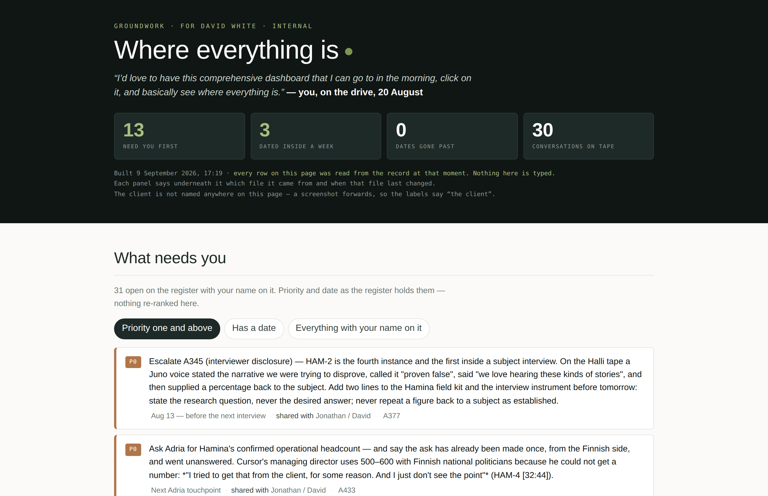
And the second one is on screen
The morning dashboard you asked for on the drive is built.
One place, every market, what moved.
Every row is read from the record when the page is built. Nothing on it is typed.
The client is not named anywhere on it — a screenshot forwards.
I am going to open the real one now.
Notes:
THE ONE SENTENCE — The morning dashboard you asked for on the drive is built.
You asked for this on the drive and I built it. Let me open the real one.

Slide 6
Your list, handed back
Ten things you committed to on the drives on 20 August. Five now exist.
Your morning dashboard
Speed as a priced deliverable
The AI line for the Oracle proposal
Site community managers, early
Ask for the bigger number up front
The stakeholder-category list
Who absorbs the surprises
Researcher names, and how we find more
Eight validated, two flagged — the claim audit
The educational repository
I went back through the tapes rather than my memory. The timecodes are in the plan.
Notes:
THE ONE SENTENCE — Ten things you committed to on the drives on 20 August.
I went back through the tapes rather than my memory. The timecodes are there if you want to check I have not put words in your mouth.

Slide 7
What a new researcher gets on day one
Most of it already existed — it needed extracting rather than inventing.
Five blank instruments
The interview guide, as a fill-in
The evidence discipline
The citation grammar
Consent and compensation rules
A reference set of finished work
TWO THINGS ARE GENUINELY NEW
A market scaffold
The synthesis instruction
One command stands up a new market's folders, its empty registers and the checks, and tells you whether it is ready.
It does not exist. I am writing it, and I would rather show you one worked example than describe it.
Notes:
THE ONE SENTENCE — Most of the kit already existed — it needed extracting rather than inventing.
Two things are genuinely new: a market scaffold, and the synthesis instruction, which does not exist and which I am writing.

Slide 8
The bench
Juno hires them. I certify them.
You stay the employer of record and the commercial relationship. I stay on the standard rather than on payroll.
Recruit tier one regionally.
Local fluency beats travel budget, and it is better for the work. A field journalist with diligence discipline — not an agency account person.
The first hard market stays the two of us.
With somebody in the periphery watching and learning. A bench debuting in the hardest room we have had is a bad first outing for something we want to sell.
Notes:
THE ONE SENTENCE — Juno hires them. I certify them.
That keeps you as the employer of record and it keeps me on the standard rather than on payroll. The first hard market stays the two of us.

Slide 9
What it costs, and where the margin is
A per-market model rather than a rate card. Six lines, the budget model's own.
PLATFORM FEE
RETAINER SHARE
CERTIFIED-RESEARCHER DAYS
The instruments, the registers and the standards function; a band from the rate card.
My standing time across the market; a band from the rate card.
Researcher days per phase, at a day cost you set; you employ the bench, so those days are yours.
FIELD DAYS
THIRD-PARTY LINES, BY KIND
CONTINGENCY
The discovery and production visits, at a flat day rate from the rate card.
Entered per market, never assumed.
A fixed share of the lines above.
The budget model prices one market at the level of its ten phases, in four moves, against what a sourced research pass runs at today. The point of it is that your margin per market goes up, not down.
No rate appears in this deck or in the plan. Those live in the private file.
Notes:
THE ONE SENTENCE — The point of the model is that your margin per market goes up, not down.
A per-market model rather than a rate card. If it does not grow your margin I have built the wrong thing, and I would rather find that out over this page than in October.

Slide 10
The sequence
1
2
3
4
Now to the end of the month
September is the field
Late September
Early October
Three trips, and I will shadow one candidate researcher under real conditions while I am already there. That is the certification pilot and it costs nothing extra.
The scaffold and one worked synthesis example get built.
One meeting. I will open with the dashboard on screen.
The kit gets blanked and dated. Nothing needs you.
Nothing here needs a reply from you to keep moving.
If you say nothing until October, all of it still happens.
Notes:
THE ONE SENTENCE — Nothing here needs a reply from you to keep moving.
If you say nothing until October, all of it still happens.

Slide 11
Three open questions
Each carries what I would do and what happens if we do nothing.
1
2
3
What is Juno's actual margin per market?
Which market does the bench debut in, and how far in?
The name.
What I'd do. Leave it open until October and decide it with the positioning rather than before it.
What I'd do. Give me a range rather than a number, and I will build the model against the bottom of it.
What I'd do. Debut them somewhere forgiving, apprenticing, and keep the hard market ours.
If we don't decide. It stays Groundwork by inertia, which is how names get decided badly.
If we don't decide. I price against my own estimate, and we find out in October whether it eats your margin — which is the version where you quietly stop using the apparatus and neither of us says so.
If we don't decide. We default to apprentice-only, which is the safe version and slower.
Notes:
THE ONE SENTENCE — Each one carries what I would do and what happens if we do nothing.
A silence on any of these is a decision, and I would rather it were a deliberate one.

Slide 12
WHERE I WANT YOUR REDRAFT
Section six — the economics.
You did this with the interview guide in July and it came back better. You know what you can carry into a room and I am guessing at it.
Notes:
THE ONE SENTENCE — Section six — the economics.
You did this with the interview guide in July and it came back better. You know what you can carry into a room and I am guessing at it.

