Slide 1
Restful apis
Jonathan Kobyluck
Presentation 2.2

Slide 2
Topics to discuss
What are RESTful APIs?
How are they used?
Website communications
The advantages of RESTful APIs
The disadvantages of RESTful APIs
The differences between a URI and URL

Slide 3
What are restful apis?
REST treats objects as resources that can be created or destroyed
API stands for Application Program Interface
APIs are basically the messenger between the client and server
With REST, HTTP requests are what the APIs carry between the client and server
They can be referred to as RESTful APIs or REST APIs
RESTful APIs just describes APIs that conform to REST constraints

Slide 4
How are restful apis used?
They are used by submitting requests
Most common requests are HTTP Methods
Most common methods are GET, POST, PUT, & DELETE
The HTTP Methods direct the action that the server should take
Endpoints are specified to access/update the data
Authentication can be used to ensure authorized requests

Slide 5
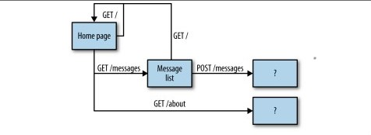
Website communications

Slide 6
Advantages of restful apis
Easy to integrate
Supports many languages
JSON supported, which is a common language
Uses HTTP requests
It is stateless
It is scalable

Slide 7
Disadvantages of restful apis
Susceptible to problems of architectural language
Not utilized to its advantage in “lo-rest” (just GET and POST)
Can lose ability to maintain state
Will be bound by constraints
High latency in request processing
Learning curve for new developers may be steep

Slide 8
The differences between a URI and URL
URI identifies a specific resource
This can include a page, book, or document
URL tells you how to access the resources
http, ftp, etc. is present as a URL
These are also URI’s
The URI encompasses the URL

Slide 9
Summary
RESTful APIs are a set of constraints for handling client/server communication
They are used for submitting requests that return responses
Its easy to integrate and uses common languages
Disadvantages include high latency and learning curve for new developers
The URI encompasses the URL

Slide 10
sources
RESTful Web APIs – Richardson and Amundsen
https://www.youtube.com/watch?v=Q-BpqyOT3a8&t=11s
https://dzone.com/articles/rest-%E2%80%93-good-bad-and-ugly
https://danielmiessler.com/study/difference-between-uri-url/

