Slide 1
Two-pizza team rule
Jonathan Kobyluck
Presentation 2.2

Slide 2
Topics to discuss
What is the “Two-Pizza Team?”
What communication is like without this concept
What are it’s advantages/disadvantages?
Why is it successful?

Slide 3
What is the “Two-Pizza Team?”
This concept was created by Jeff Bezos (Amazon’s Founder and CEO)
Not a fan of large team communications
“Two-Pizza Teams” are teams that are small enough to eat 2 regular-sized pizzas
Generally around 5-8 people
Keeps the communication avenues to a minimum
Keeps the team efficient

Slide 4
What communication is like without this concept
Creating too many avenues for communication requirements can hinder productivity
The efficiency drops drastically the more people added to the team
The lines of communication can be calculated with a simple equation
n(n-1)/2
This means a team of 5 would have 10 lines of communication
But then a team of 10 has 45 lines of communication

Slide 5
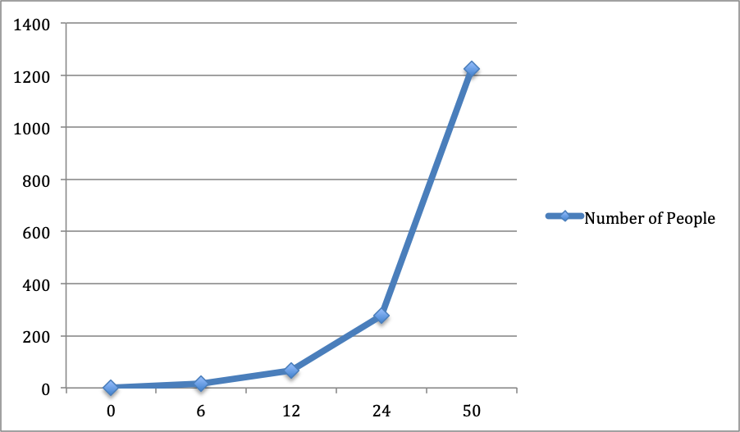
What communication looks like the more people you add to the team
Sourced from https://www.ntaskmanager.com/blog/how-jeff-bezos-2-pizza-rule-affects-productivity-in-todays-industry/

Slide 6
What are the Advantages/disadvantages?
As you can see, the advantages are pretty apparent
Communication requirements reduce
Efficiency increases
Productivity increases
One disadvantage would be a change in the team’s approach can take time to adapt to new concept
Efficiency might not improve right away once the team changes

Slide 7
Why is it successful?
It is successful because it increases productivity
Reduces the lines of communication
Small teams can focus more on what’s important
Proven concept
Amazon adopted this concept
Communication of relevant information can then be directed outside the small group

Slide 8
What social loafing?
In teams, people start to demonstrate social loafing
People will exert less effort when working in group
People are more conscious or their effort when working alone
Overall effort of a team masks individual effort
Greater the team, the less effort each person puts in
This will diminish the quality of the work put in and results will be lesser

Slide 9
Summary
The “Two-Pizza Team” concept was presented by Jeff Bezos
It reduces lines of communication to improve efficiency and productivity
Communication lines go up exponentially for every team member that is added
This can be represented by this equation:
n(n-1)/2
Social Loafing is greater when there are more people on a team

Slide 10
sources
The DevOps handbook (Gene Kim)
https://www.youtube.com/watch?v=vYpJAcAjPlI
http://blog.idonethis.com/two-pizza-team/

