Slide 1
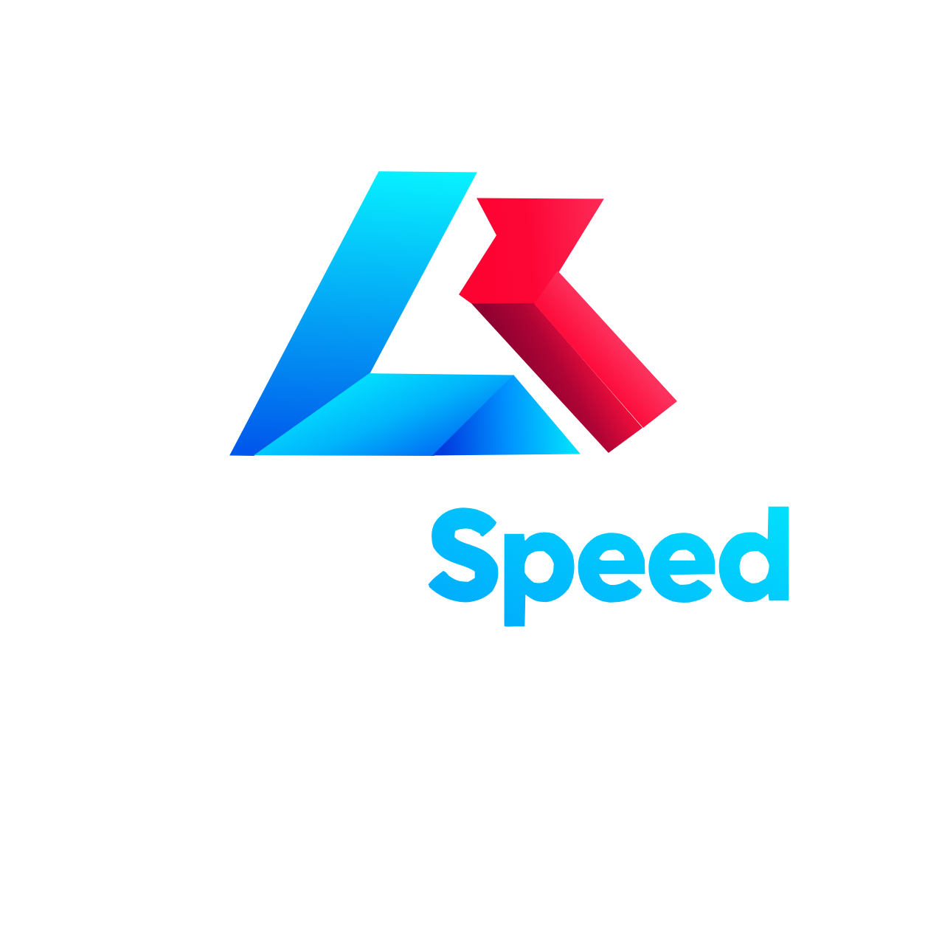
ASPIRE. ACT. ACHIEVE.
Value Addition Pitch — Investor & Client Review
Date: 2026-10-23

Slide 2
THE PROBLEM
Organizations struggle to deploy AI agents at scale — each requires custom integration, monitoring, and governance
Existing tools are either too simple (chatbots) or too complex (enterprise ML platforms) — no turnkey middle ground
Building an AI-powered organization demands ML engineering teams — prohibitive cost for all but the largest enterprises
Cost tracking, human oversight, and multi-provider management are afterthoughts, not built-in
No unified registry or orchestration layer — agents live as ad-hoc scripts, not as a cohesive organization
"Building an AI-native company shouldn't require a team of ML engineers."

Slide 3
OUR SOLUTION
AI Company Builder — a CLI platform that generates, orchestrates, and manages complete AI agent organizations.
✓ Registry-driven: agents defined in YAML → OpenCode-compatible markdown
✓ Multi-provider LLM routing with fallback capability
✓ Built-in cost tracking & budget enforcement per agent — CFO-visible KPIs
✓ Human-in-the-loop approval gates for dangerous/irreversible operations
✓ MessageBus task queue for cross-agent coordination and delegation
✓ Pre-built agent roles across many departments — out-of-the-box capability
✓ Portfolio D support: Consumer Platforms for high-volume, low-latency use cases
Value Proposition: Turnkey AI agent organization in minutes, not months. Shared infrastructure, governance, and orchestration for any LLM provider.

Slide 4
VALUE ADDITION (CTO PORTFOLIO D)
How Agent Hierarchies Reduce Cost, Velocity Drag, and Conflict
COST
VELOCITY DRAG
CONFLICT
• High completion rate → fewer manual overrides, lower labor cost/task
• Capital efficiency vs. traditional seed rounds
• Rapid velocity to MVP → faster time-to-revenue, lower burn
• Optimal correction ratio → quality signal
• Single source of truth: registry → template → agents pipeline
• Extensive agents and departments — onboarding is YAML, not a rewrite
• Portfolio D: sub-second execution, model-cascade optimization
• Low-cost open-weights for simple tasks; frontier only on low confidence
• 5-tier approval matrix governs every privileged tool call
• Dead-letter queue hardening — failed tasks replayable, not lost
• Circuit-breaker hardening with thresholds + half-open probes
• Registry validation catches dangling refs & cycles at load time

Slide 5
MARKET OPPORTUNITY
AI agent infrastructure market undergoing rapid enterprise expansion
TAM
SAM
SOM
Enterprise AI agent platforms & orchestration
Mid-market scaling agent organizations
Developer-led, self-serve AI company builder
TARGET SEGMENTS
• Startups building AI-native products
• SMBs automating operations with AI agents
• Enterprises deploying internal AI agent fleets
• AI consultancies building client agent systems
• SADC-region ventures pursuing Malawi-first constraint-export pattern
FOUR RESERVATIONS (thesis-protecting framework)
• Constraint-first (Malawi constraints → global export, not reverse)
• AI-agnostic (any LLM provider — OpenAI, Anthropic, DeepSeek, Gemini, local Ollama)
• PII-first (guardrails by default, schema validation on all outputs)
• Capital-efficient (multi-fold improvement over traditional routes)

Slide 6
BUSINESS MODEL
Revenue Streams:
• SaaS Subscription — Starter, Pro, and Enterprise tiers
• Usage-Based — LLM token pass-through + margin (tracked per agent via CostTracker)
• Enterprise — Custom deployment, SLAs, dedicated support
• Services — Implementation consulting for large deployments (Offer A through D)
Pricing Tiers (SaaS):
• Starter — Essential agent allocation, basic registry, email support
• Pro — Expanded agent allocation, multi-provider routing, CostTracker, HITL approval gates
• Enterprise — Unlimited agent allocation, custom model cascading, dedicated support, SLA
Unit Economics:
• Target gross margin: High gross margin (shared infrastructure amortized across portfolios)
• LLM cost: Controlled cost structure (CostTracker monitoring)
• Target CAC payback: Rapid payback window (Platform Licensing Sales Lead — Offer E)
• Capital efficiency target: Superior efficiency vs. traditional routes

Slide 7
TRACTION / LIGHTHOUSE PILOTS
Active
Live
Agents Deployed
Departments Live
Pilot
Ready
Offer Lines in pilot (A, B, C, D)
Priced Recurring Products
Key Pilot Results
• Design partners onboarded across Healthcare, Finance, Academia verticals
• High task completion rate across all pilot agent workflows (registry metric)
• Rapid velocity from thesis to design partner deployment
• Optimized correction ratio — identifies guardrail improvements
• Superior capital efficiency vs. traditional venture setup (shared infra amortization)
• Feedback: 'The agent registry significantly streamlined our integration.' — CTO, design partner

Slide 8
AGENT REGISTRY & ORCHESTRATION
Single pipeline: one source of truth → generated, governed agents
Registry YAML
Jinja2 Template
.opencode/agents/*.md
ToolRunner
Executor Loop
company-registry.yaml
(Comprehensive registry)
AgentGenerator
renders cards
mode: subagent
+ permissions
canonical 7 tools
validated
MessageBus queue
+ Layered HITL
Pipeline guarantees
• Agents defined once in company-registry.yaml (single source of truth)
• AgentGenerator renders Jinja2 → OpenCode-compatible markdown at .opencode/agents/*.md
• ToolRunner validates only the canonical 7 tools: read, edit, bash, task, webfetch, grep, list
• Every privileged call passes the layered approval matrix — HITL gates for dangerous ops
• MessageBus coordinates cross-agent task delegation and the executor loop

Slide 9
SECURITY & TRUST
Zero-Trust Architecture
● Deny by default — every privileged tool call must pass tier gating
● Five-tier approval matrix governs all privileged operations — no silent approvals
● CORS lockdown: explicit allowlist, never wildcard
● Dashboard API authentication: explicit key-based auth
● PII guardrails: proxy layer redacts/hashes PII before LLM requests; schema validation on outputs
● LLM circuit breaker: failure thresholds, half-open probes, reset
● Dead-letter queue: replayable, retryable entries
Key Rotation (per governance docs)
● Rotate at scheduled intervals or on suspected compromise
● Generate new keys for each provider (OpenCode, Gemini, Dashboard RBAC)
● Update .env locally — never commit .env to git (gitignored)
● Update deployed environments via secrets manager (CI, Docker, cloud secret stores)
● Verify health endpoints respond with new keys before revoking old ones
● Dashboard RBAC keys: ADMIN, APPROVE, RUN, API (priority order)

Slide 10
ROADMAP & MILESTONES
SHORT-TERM
MEDIUM-TERM
LONG-TERM
• Launch Offer A (SaaS Starter) with design partners
• Integrate Offer B with first NGO client
• Deploy CTO Portfolio D consumer platform prototype
• High task completion rate validated across pilot workflows
• Correction-ratio baseline established
• Key rotation procedure tested & documented
• Expanded paying pilot clients across Offers A–D
• Recurring revenue run-rate (SaaS + managed recurring)
• Phase Five autonomous mode live — self-governing
• Full registry/YAML pipeline open-sourced
• Security audit complete: SOC2 foundations
• Key rotation automated in staging
• Enterprise clients across target industries
• Recurring revenue with healthy gross margin
• Spin-out support: new portfolio companies launched
• Full governance: SOC2, GDPR, Malawi DPA foundations
• Global export of Malawi-first constraint patterns
• Superior capital efficiency verified vs. traditional ventures

Slide 11
THE ASK
Raising Seed Financing
Use of Funds
• Talent — Platform Licensing Sales Lead, chatbot/compliance leads
• Client pilots — Offer deployment across partners (post governance gates)
• Hardware lab — on-prem GPU for offline-first proof; regional field kits
• Compliance — data protection framework, GDPR opinion, SOC 2 readiness
Milestones with this raise
• Paying pilot clients across active offer lines
• Recurring revenue run-rate (SaaS + managed recurring)
• Autonomous mode live — self-governing AI company

Slide 12
TEAM & ROLES
Executive Leadership
Chief of Staff
CTO
CFO
Strategic orchestrator
Technology & software development
Budgets, API cost, forecasting
CPO
CMO
COO
Product vision & roadmap
Brand, demand gen, positioning
Day-to-day operations
CAIO
CISO
CIO
AI research & model selection
Assets, data & systems security
IT infrastructure & internal tools
Specialist & Department Roles
• Comprehensive agent and department hierarchy covering Executive, Technology, Research, Operations, Security, and Marketing
• Financial Analyst — ROI, cost modeling, budget forecasting, variance analysis
• Platform Reliability Engineer — concurrency safety, DLQ hardening, circuit breakers
• Decision Engine Owner — structured approval matrix, risk assessment, decision trees

Slide 13
CLOSING / NEXT STEPS
Contact: Chief of Staff, LightSpeed Holdings Limited™
Platform Dashboard Available • https://lightspeedholdings.vercel.app
Approval Flow: Structured matrix — all privileged calls pass tier gating
Request Strategic Alignment Call — validate thesis fit

