Slide 1
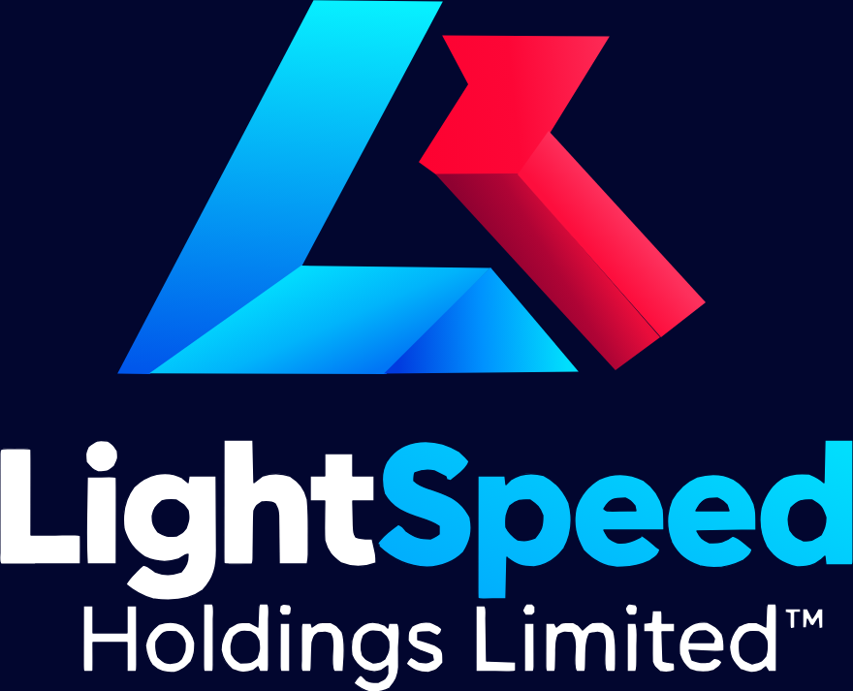
AI Venture Studio
Client Presentation
2026-10-12
Notes:
Cover. LightSpeed Holdings Limited(TM) lockup top-left, deck title, red accent rule. No tagline on this slide; the tagline appears once, on the closing slide.

Slide 2
Executive Summary
Part | Delivered | Core Deliverable
1 | Shipped | Website brand psychology
2 | Shipped | Sector landscape
3 | Shipped | AI-Company Builder engine
4 | Shipped | Technical architecture
5 | Shipped | Core metrics
Since shipping Parts 1–5 in September 2026, the studio has delivered a stage-gated, repeatable engine: shared infrastructure, agent stacks, data pipelines, and go-to-market engines that co-found, validate, build, and launch AI-native entities.
Why it matters
Each venture gets access to capital-efficient infrastructure, governance that scales without chaos, and a clear path from thesis to spin-out.
Parts 1–5 shipped September 2026. Several are internal build milestones, not client deliverables.
02
Notes:
Walk the five shipped parts, then land the point: this is one repeatable engine, not five separate projects. Note that some parts are internal milestones.

Slide 3
The Studio Operating Engine
Studio Operating Engine
Portfolio A
Enterprise Agent
Constraint-first
AI-agnostic
Strategic Validation
Portfolio B
Agent Orchestration
B2B AI Workflow
Portfolio C
PII-first
Capital-efficient
Shared Services
Sovereign Data
Portfolio A — Enterprise Agent
Portfolio B — B2B AI Workflow
Portfolio C — Sovereign Data
Deep workflow integration inside a single large organisation.
Vertical AI fine-tuned on a sector's recurring workflow.
On-prem / sovereign deployment where data cannot leave jurisdiction.
“Three” (Portfolios A–C) and “four” (reservations) are distinct frameworks, not a count error.
03
Notes:
One engine, three delivery portfolios. The left column is the engine; the right blocks are the constraint-first design principles that keep a portfolio buildable inside real limits.

Slide 4
Portfolio Archetypes A–D
Portfolio A
Portfolio B
Portfolio C
Portfolio D
Enterprise
B2B Workflow
Sovereign Data
Consumer Platforms
Deep workflow integration for large organisations; long sales cycles, high contract value.
Vertical AI fine-tuned on sector workflows, sold to operators who already own the process.
On-prem / sovereign deployment where regulated data cannot leave the jurisdiction.
High-volume, low-latency consumer surfaces where unit cost decides the business model.
Frontier tier
Fine-tuned tier
Sovereign tier
Cost-cascaded tier
Four reservations, applied to every archetype
Constraint-first
AI-agnostic
PII-first
Capital-efficient
Portfolio D added per CTO validation. The “three” and “four” refer to distinct frameworks.
04
Notes:
Four archetypes, one engine. Emphasise that D was added on technical validation, and that the four reservations apply to all four archetypes.

Slide 5
Stage-Gated Development Lifecycle
Phase | Duration | Key Deliverables | Gate Criteria
1. Discovery | Weeks 1–2 | Problem discovery & thesis definition | 3+ problem statements validated
2. Validation | Weeks 3–6 | POC + 15–20 buyer calls | 3+ positive commitments; feasibility confirmed
3. Build | Weeks 7–14 | MVA deployed to 2–3 design partners | MVA running; ATC ≥80% gate
4. Scale | Month 4+ | Spin-out, leadership recruitment | Entity formed; term sheet issued
Tracked across all phases
ATC Rate
Correction Ratio
Velocity to MVP
Capital Efficiency
Key metrics tracked across all phases. Velocity to MVP is measured from validation approval.
05
Notes:
Four gates, each with a hard criterion. The point for a client is that capital is only released after a gate is cleared, not on a calendar.

Slide 6
Technical Architecture (AI-Agnostic System)
L1 · Unified API Standard — one interface for every model provider
Guardrail Proxy (inbound)
Cost / Latency Router
Fallback Chains
Redacts or hashes PII; validates schema
The only fan-out point in the mesh
Deterministic retry and failover
Frontier models
Open-weights models
Local / Sovereign
Highest capability, highest unit cost
Fine-tuned, self-hosted, margin control
On-prem or in-jurisdiction deployment
Engineering directives
01
Universal Protocol Proxy
02
Model Cascade & Dynamic Router
Every provider speaks one contract; swapping a model is a config change.
Route by cost and latency budget, escalate only when quality demands it.
03
Deterministic Execution & State
04
Security & PII Guardrails
Every agent action is logged, replayable, and attributable.
Nothing reaches a model before redaction and schema validation.
The intermediary proxy layer redacts or hashes PII before every LLM request, and validates schema on all outputs.
06
Notes:
One interface, one guardrail, one routing point. The stack is AI-agnostic: it works with any LLM provider and with local models. Red is used only for the PII directive.

Slide 7
Core Performance Metrics
Metric | Goal | Why It Matters | CFO KPI Mapping
ATC Rate | ≥90% trailing 30 days | Autonomous agent efficacy | Cost per Agent; ROI per Dept
Velocity to MVP | <60 days | Speed-to-market | Budget Utilization
Manual Correction Ratio | Per 1,000 actions | Quality signal | Revenue per Task
Capital Efficiency | 3–5× (modeled) | Shared infrastructure | Cost per Agent; Budget Utilization
Studio vs. company KPIs
Velocity scope
3–5× basis
Studio metrics measure delivery. CFO registry KPIs: Budget Utilization, Cost per Agent, ROI per Dept, Total Revenue, Revenue Margin, Revenue per Task.
The <60-day goal measures Phase 2 validation approval to Phase 3 minimal MVP deployment, not idea to revenue.
Modeled estimate from traditional seed-round cost structures versus shared-infrastructure economics. Assumptions available on request.
07
Notes:
Four metrics, each mapped to a CFO KPI. Be explicit that 3-5x is a modeled estimate, and that velocity is measured from validation approval, not from idea.

Slide 8
Go-to-Market & Client Acquisition
Target industries
Competitive landscape
1
Healthcare
The “AI company builder” category has no direct local equivalent identified.
Key players: BCG, Deloitte Africa, Accenture, Qhala.
2
Finance
3
Government & Public Policy
4
Donor & Non-Profit Sector
Client acquisition model
5
Academia & Education
1
15–20 buyer discovery calls
2
Design partner program (2–3)
3
Spin-out with dedicated leadership
4
Ongoing studio support
Four reservations, applied to every client engagement
Constraint-first
Design inside real bandwidth, budget, and data limits.
AI-agnostic
Any provider, including local models.
PII-first
Redaction before inference, by default.
Capital-efficient
Shared infrastructure instead of duplicated builds.
08
Notes:
Lead with the empty category, not with a first-mover boast: no direct local equivalent was identified. The acquisition path is discovery calls, design partners, spin-out, support.

Slide 9
Governance & Compliance
Tier 1
Tier 2
Tier 3
Tier 4
Tier 5
5-tier approval matrix (GAP-003): every privileged tool call passes tier gating before execution.
Deny by default. Assume breach. Every finding gets a severity rating and a remediation timeline.
Dashboard CORS: explicit allowlist, never wildcard (GAP-010/011).
PII guardrails: the proxy redacts or hashes PII before LLM requests; schema validation on all outputs (GAP-002/011).
Compliance coverage: SOC 2 Type II controls mapped, certification pending; GDPR and industry-specific regulations mapped to agent actions.
Dashboard auth is fail-closed by default; open mode is loopback-only and must be explicitly opted in (ADR-013).
Security by default. Governance is enforced in code and CI, not in policy documents.
09
Notes:
Governance is concrete: five approval tiers, an explicit CORS allowlist, a PII proxy, and fail-closed auth. Two claims are worth spelling out: never a wildcard, and deny by default.

Slide 10
What You Get as a Studio Partner
Deliverable | Phase | Scope & Timing
Strategic validation | 1 (Discovery) | Weeks 1–2
Proof-of-concept | 2 (Validation) | Weeks 3–6
Minimum Viable Architecture | 3 (Build) | Weeks 7–14
Spin-out support | 4 (Scale) | Month 4+
Shared infrastructure | Ongoing | Model mesh, agent stacks, data pipelines, GTM engines
KPI dashboard | Ongoing | 7-department real-time monitoring (planned)
Governance compliance | Ongoing | 5-tier approval, PII guardrails, CORS lockdown
All Parts 1–5 shipped September 2026.
10
Notes:
This is the commercial summary: one table, phased, with the ongoing layer called out separately from the gated deliverables.

Slide 11
Next Steps
1
Strategic alignment call
60 min
Contact
Validate thesis fit and portfolio archetype.
Chief of Staff
2
Discovery phase
Lightspeed Holdings Limited™
2 weeks
Problem discovery and thesis definition.
3
Buyer discovery
AI Venture Studio Execution Plan Parts 1–5 (September 2026)
15–20 calls
Structured calls across target accounts.
4
Go / No-Go decision
After gate
Based on positive commitments and technical feasibility.
5
Spin-out execution
Month 4+
Dedicated leadership, capitalization, and studio transition.
This presentation is based on the AI Venture Studio execution plan documented in brand/ai_venture_studio_execution_plan.md and docs/venture-studio/. All Parts 1–5 shipped September 2026. AI-agnostic: works with any LLM provider (OpenAI, Anthropic, DeepSeek, local Ollama). Malawi-first constraint-export pattern applies.
11
Notes:
Close on the next five moves. The first is a decision, not a workshop: a 60-minute alignment call that picks the archetype.

Slide 12
Brand Compliance Checklist
Logo from official assets, never recreated
Logo clear space respected (1× "L" height on all sides)
Only palette colors used (navy #070A40, red #E63946, cyan #00BFFF, grey-light #F2F2F2, white #FFFFFF)
Vector format for print; transparent treatment on dark
™ on first mention of the company name
Type sizes from the brand scale in brand-tokens.json
Spacing multiples of 4px (base unit)
Tagline spelled exactly "ASPIRE. ACT. ACHIEVE."
Any deviation requires a documented brand decision approved by the Brand Strategist / CMO.
12
Notes:
Appendix: the checklist used to sign this deck off against brand guidelines section 9. Deviations are documented, not silent.

Slide 13
Thank You
ASPIRE. ACT. ACHIEVE.
Notes:
Closing. Full navy, official lockup, cyan tagline. No new content on this slide.

