Slide 1
The “Liquid Computer”: A Novel Strategy for Real-Time Computing on Time Series
Authors: T. Natschläger, W. Maass, H. Makram
Presented by Tingyu Thomas Lin
May 26, 2009

Slide 2
Goal
framework for analyzing computations on time series
Spike trains, in particular
Eliminate the need to explicitly store state
Liquid State Machine (LSM)
Concept of a “liquid”

Slide 3
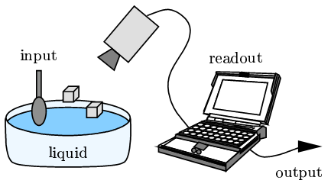
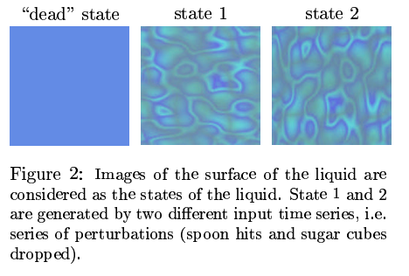
The Liquid
Liquid implicitly stores state
Input: perturbations of the liquid
Output: state of liquid

Slide 4
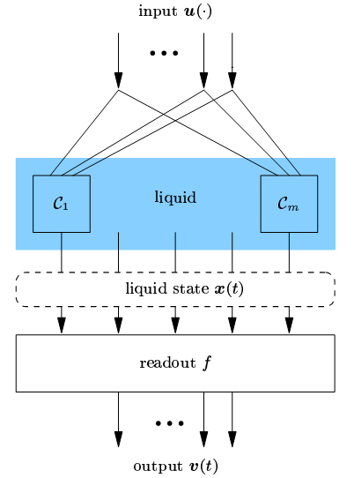
Liquid State Machine
Feed time-dependent input into liquid
Analyze input by interpreting liquid state
Depends only on liquid state
No need to consider time nor previous liquid states

Slide 5
Liquid State Machine and Neural Nets
Use neural net to “read” liquid state
Process
Choose a liquid
Feed time-dependent input sequence into liquid
Feed liquid state into neural network
Neural network does not have to depend on time nor have to remember past liquid state
Apply supervised learning algorithm to net

Slide 6
Caveats
Choices:
What is a suitable “liquid”?
Which neural net?
Restrictions on liquid
Liquid is a filter
Filter: a function that maps input functions of time to output functions of time
Conditions on filter:
Time invariant
Fading memory

Slide 7
Restrictions on Liquid
Time invariant
Any time shift in the input should produce the exact same time shift in the output
Fading memory
Output does not depend on really old input
Authors argue:
virtually all practical filters from a biological and engineering standpoint have these two properties
LSMs have universal computational power for computation on all time series

Slide 8
What Makes A Good Liquid
Desired properties
Inputs must “mix” into the liquid state
Leave past inputs available to be read
Can’t be too sensitive to inputs
Otherwise, the smallest change in input will put the liquid in a completely different state
Complexity of liquid depends on inputs/outputs
Tradeoff between complexity of liquid and complexity of readout
Example liquids
Realistically modeled neurons with random connections
Realistically modeled synapses
A recurrent neural network with locked weights

Slide 9
Applications of LSM
First model
Liquid: Randomly connected biologically realistic model neurons
Liquid State: The values at all the liquid-neurons
Reader: Another committee of model neurons (single layer of perceptrons)
Learning: adjusted synapse weights with a p-delta rule
Input data: Several spike trains
Output: Spike trains
Second model
Liquid: biologically realistic model synapses
Everything else the same

Slide 10
Paper Citation
T. Natschläger, W. Maass, and H. Markram. The "liquid computer": A novel strategy for real-time computing on time series. Special Issue on Foundations of Information Processing of TELEMATIK, 8(1):39-43, 2002.

