Slide 1
A PERCEPTRON-BASED APPROACH FOR IMAGE-WORD ASSOCIATION
Tingyu Thomas Lin
Juan M. Navarro
CS 263B – Natural Language Processing
Project Presentation
Tuesday, April 28th, 2009

Slide 2
Outline
Purpose
Image Learning Module
Relations Learning Module
Current Results
Conclusion & Future Work

Slide 3
Purpose
Associate an Image to a Concrete Noun
  Give as input a noun, such as tree, house, car, etc.
  Output image of input noun
Understand Relative Positioning of Objects
  Input consists of a phrase in the form of:
    <NOUN> <RELATIVE POSITION> <NOUN>
    Example: house right car, tree above box
  Output consists of image described by the input phrase

Slide 4
Image Learning Module
Associate an Image to a Concrete Noun
Input
  Noun encoded in 7-bit ASCII
  Ghost, blizzard, tree, house, car, window, box
Output
  10x10 grayscale image representing the input noun

Slide 5
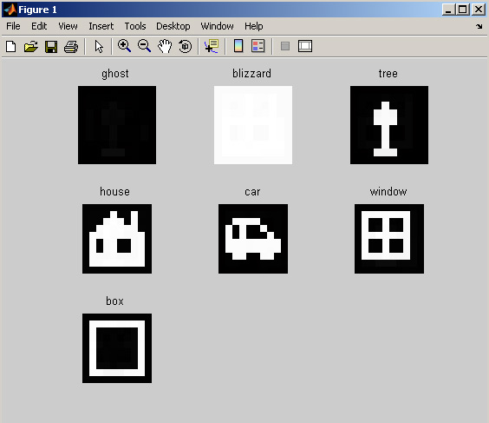
Image Learning Module (Input/Output)

Slide 6
Neural Network Architecture
Multi-layer Perceptron
  3 layers: input, hidden & output layers
  Logistic sigmoid function applied at outputs of hidden & output layers
Module 1
Input Layer
Hidden Layer
Output Layer
Concrete Noun
7-bit ASCII Encoded
Pixel Grayscale Intensity Values

Slide 7
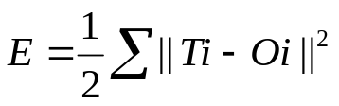
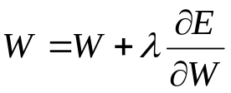
Learning
Feed-forward Backwards Propagating Neural Network
Update Weights Using Gradient Descent
  Error:
  Weight update:
Issue of Selecting Value for Learning Rate
Stochastic vs. Batch Gradient Descent

Slide 8
Refining Learning
First Attempt
  Stochastic gradient descent
  Learning rate = 0.8
  1737 epochs to converge for the 7 image set
Smarter Attempt
  Rprop (Resilient Backpropagation)
    Adaptive learning rate
    Batch gradient descent

Slide 9
Rprop
Problems with Fixed Learning Rate
  It’s Never the Right Number!
  Too Small: Takes Too Long to Converge
  Too Large: Diverges from Minimas
  Small partial derivatives slow down learning

Slide 10
Rprop, cont’d
Rprop general idea
  Adjust learning rate based on gradient direction
  If gradient is moving in the right direction, increase learning rate
  If gradient switches direction, decrease learning rate
Works by batch instead of stochastic learning
Results:
  Converges in 137 epochs instead of 1737 for the same 7 image set

Slide 11
Relation Learning
Understand Relative Positioning of Objects
Input consists of a phrase in the form of:
    <NOUN> <RELATIVE POSITION> <NOUN>
    Example: house right car, tree above box
    7-bit ASCII encoded
    Relations: right, left, above, below, (front, behind)
Output 20x20 images of what the input describes

Slide 12
Neural Network Architecture (Module 2)
Module 2
Inputs
Outputs
Module 1
Noun
3-Layer Perceptron
Relation
Pixel Grayscale Intensity Values
Noun
Module 1

Slide 13
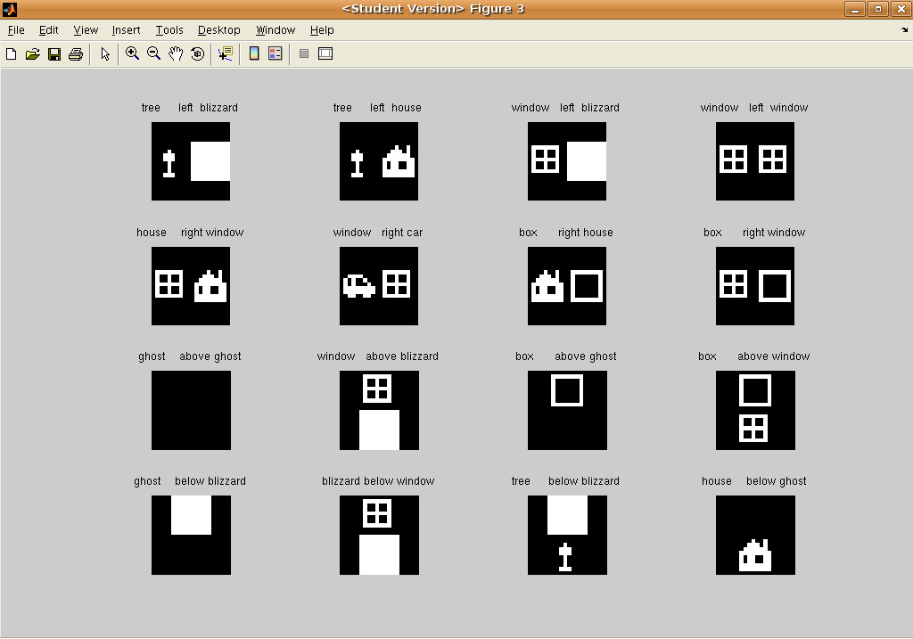
Relation Learning (Input/Output)

Slide 14
Learning
Trains the 3-layer perceptron in the same fashion as image learning
  Backprop with Rprop for adaptive learning rate
Results in next slide

Slide 15
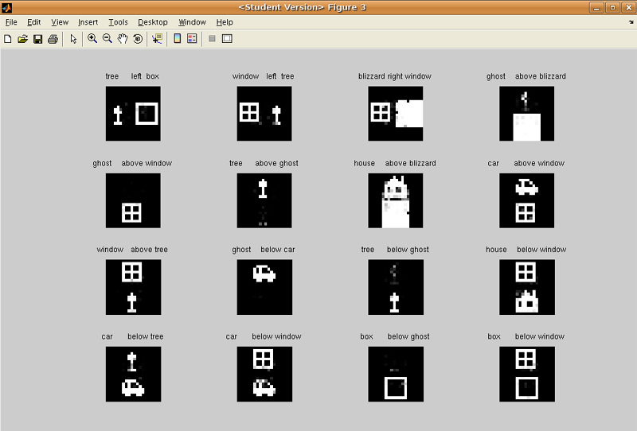
Test Set Results (156 Epochs)

Slide 16
Problems
Increasing training set size
  Adding more noun-image pairs
  Adding in relations front/behind
Rprop and batch learning
  Smoothly converges to a local minima that’s wrong
  But original stochastic gradient descent obscenely slow
Looking into other stochastic methods

Slide 17
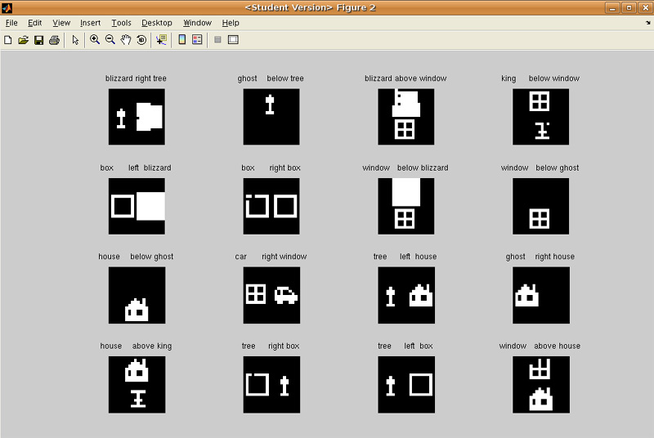
Results of Increasing Training Set Size
Training Set

Slide 18
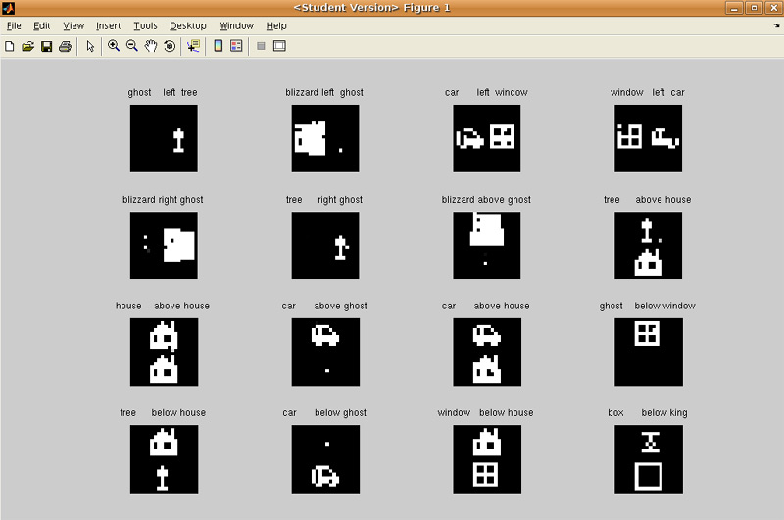
Results of Increasing Training Set Size
Test Set

Slide 19
Future Plans
Fix relationship learning to not break with largest test sets
Learn images without catastrophic forgetting
  Rehearsing previously learned patterns
  Generating and using pseudo-patterns
  Evolution-based approach
Suggestions?

