Slide 1
Rate Adaptation in IEEE 802.11 Networks
Juan M. Navarro
Lucas Wanner
Nathaniel Conos
Tutors: Kevin Lee, Uichin Lee

Slide 2
Outline
Introduction
Transmission rates in IEEE 802.11
Rate Adaptation Algorithms
  SampleRate, ONOE, Minstrel, AMRR, CARS, RRAA
Implementation
  MadWifi
Results
Conclusions & Future Work

Slide 3
Introduction
The IEEE 802.11g standard support a series of different transmission rates
  Whenever possible, we would like to use higher rates. However, when channel conditions are “bad”, higher data rates may imply higher loss ratios. Therefore, decreasing the rate may improve throughput.
  Many rate adaptation algorithms have been proposed, but many are limited to simulation, or specific test scenarios
  The mobile (V2V) scenario has not been (as) widely explored
The MadWiFi open-source driver provides an interesting test base
  Dynamically loadable modules for rate adaptation
The objective of this work is to implement and compare rate adaptation algorithms using MadWiFi

Slide 4
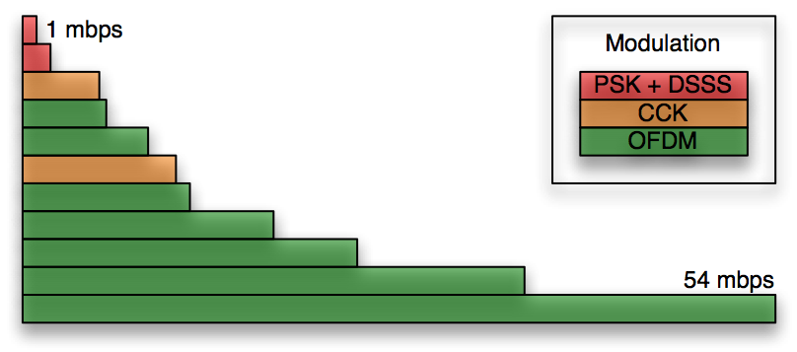
Transmission rates in IEEE 802.11
IEEE 802.11g rates
Why not always use the highest rate?
  Higher rates generally imply higher loss ratios

Slide 5
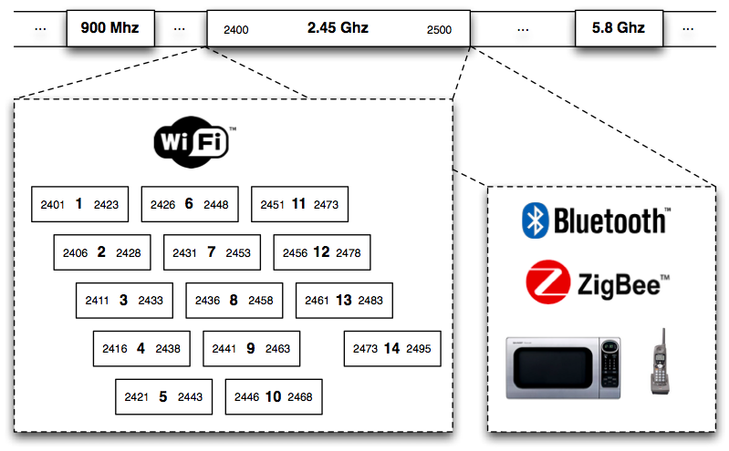
Transmission rates in IEEE 802.11
The ISM Band is very crowded!

Slide 6
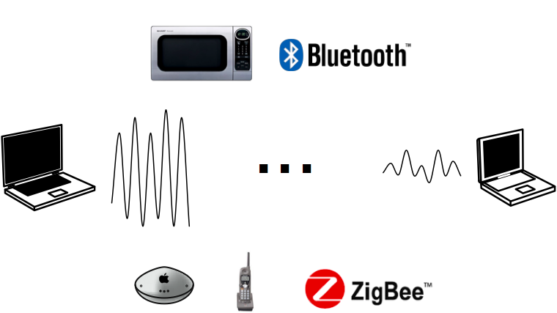
Transmission rates in IEEE 802.11
Interference and attenuation

Slide 7
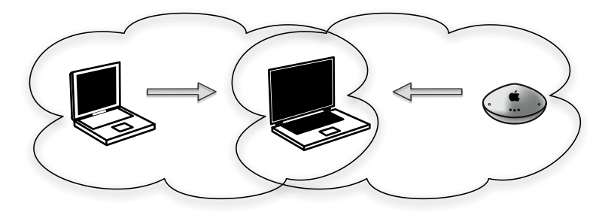
Transmission rates in IEEE 802.11
Doesn’t carrier sense solve (most of) that problem?
  Hidden terminal problem
In a mobile V2V scenario, channel conditions may change very quickly

Slide 8
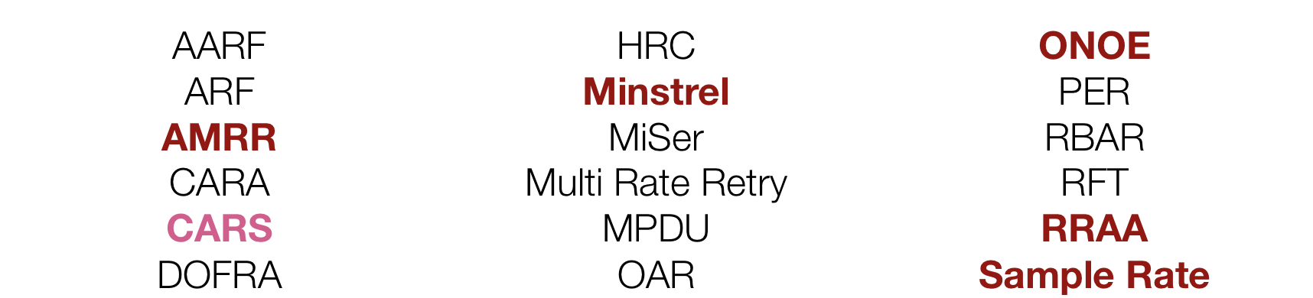
Rate Adaptation Algorithms
Doesn’t my router/WiFi card do that already?
  Rate adaptation algorithms
  Many works focus only on simulation only. There is room for contribution in implementation and comparison of different algorithms
  The fact that new algorithms keep coming up indicated that the problem has not been completely solved
    Especially in the mobile (V2V) case

Slide 9
Rate Adaptation Algorithms
Sample Rate [J. Bicket, 2005]
  Uses history and “probe” packets to estimate link quality
    Periodically send a packet at a higher rate to test the channel
    Transmits packets at the rate which has the lowest average transmission time.
ONOE [MadWiFi Project]
  "Credit-based" rate adaptation
    "Good" channels receive credit for low retransmission rates
    "Bad" channels (with high retransmission rates) lose credit
  When the credit reaches a threshold, the transmission rate is increased or decreased

Slide 10
Rate Adaptation Algorithms
Minstrel [Derek Smithies, MadWiFi Project]
  Determines the probability of successful transmission as the ratio between total data transmitted and elapsed time
  Matches the rate to the probability of successful transmission
AMRR (Adaptive Multi-Rate Retry) [Lacage, et al. 2004]
  History-based, Binary Exponential Backoff
  Probe packets to change the rate
  Takes advantage of hardware support for multi-rate transmission retries
CARS
  Designed specifically for vehicular applications.
  Uses context information (distance, speed) to estimate link quality and perform rate selection

Slide 11
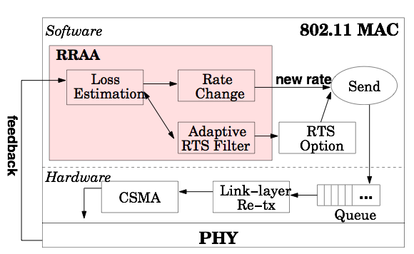
Rate Adaptation Algorithms
RRAA (Robust Rate Adaptation)
  [Wong, Yang, Lu, and Bhrarghavan, 2006]
  Responsive to drastic changes in channel quality
  Robust against random loss
  Three components:
    Loss estimation
    Rate change
    Adaptive RTS filter

Slide 12

Rate Adaptation Algorithms
RRAA (Robust Rate Adaptation)
  Does not use probe packets or long term statistics
  Instead, it relies on a dynamic estimation window, which may be different for each transmission rate
    Compute the loss over the window
    Use upper and lower loss threshold to decide when to switch rates

Slide 13
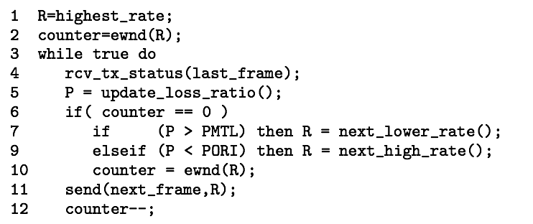
Rate Adaptation Algorithms
RRAA (Robust Rate Adaptation)
  Loss estimation and rate change
    PMTL = Maximum Tolerable Loss Threshold
    PORI = Opportunistic Rate Increase

Slide 14
Rate Adaptation Algorithms
RRAA (Robust Rate Adaptation)
  Critical loss is the loss ratio that determines when a higher rate has equivalent throughput as a lower rate
    For example 54Mbps will have “equivalent” throughput as 48Mbps if its loss ratio is 7.5%
  PMTL and PORI are obtained by multiplying the critical loss ratio by constants α and β
  Estimation window is fixed per rate
  PORI, PMTL, and ewnd determine the “aggressiveness” of rate RRAA

Slide 15
Implementation
MadWifi
  Multiband Atheros Driver for Wireless Fidelity
  Driver + set of tools for WiFi in Linux
  BSD/GPL License
  Supported by a proprietary binary HAL (Hardware Abstraction Layer) component
  Compatible with most Atheros WLAN chipsets
  Supports infrastructure, access point, adhoc, and monitor (sniffer) modes

Slide 16
Implementation
MadWiFi Rate Adaptation Modules
  Rate operation functions
  For each packet, MadWiFi requests a rate for transmission. When TX finishes, MadWiFi gives us the transmission results (# of retries, etc).
static struct ieee80211_rate_ops ath_rate_ops = { .ratectl_id = IEEE80211_RATE_AMRR, .node_init = ath_rate_node_init, .node_cleanup = ath_rate_node_cleanup, .findrate = ath_rate_findrate, .get_mrr = ath_rate_get_mrr, .tx_complete = ath_rate_tx_complete, .newassoc = ath_rate_newassoc, .newstate = ath_rate_newstate, .attach = ath_rate_attach, .detach = ath_rate_detach,};

Slide 17
Implementation
MadWiFi RRAA module implementation
  Implementation based on paper description
  Structure based on MadWiFi’s AMRR and SampleRate implementations
  RRAA Rate Selection Strategy
  Adaptive use of RTS not implemented
    We could not find a way to use per-packet RTS signals in MadWiFi
      No per-packet “RTS” descriptor
    We can enable/disable overall usage of RTS
  Implementation result: kernel module that implements RRAA rate selection
    Plus set of scripts to dynamically change MadWiFi configuration of rate adaptation

Slide 18
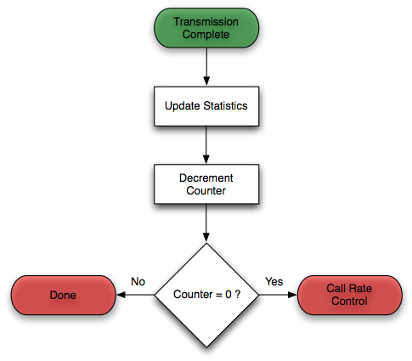
Implementation
MadWiFi RRAA module implementation
  tx_complete

Slide 19
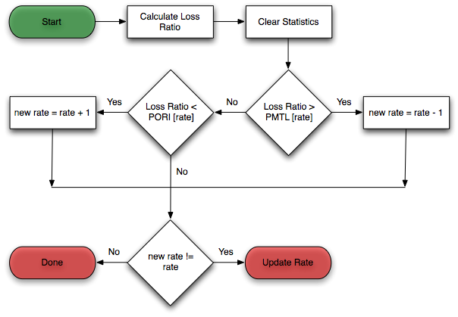
Implementation
MadWiFi RRAA module implementation
  rate_ctl

Slide 20
Implementation
MadWiFi RRAA module implementation
  rate_update
    Translates our “rate” into the corresponding IEEE 802.11 rate code
  node_init
    Initializes RRAA “node”, rate, PORI, PMTL, and EWND arrays
  rate_findrate
    Copies the current calculated rate into the MadWiFi rate descriptor
  get_mrr
    Multi-rate retry descriptors are set to zero
Module usage: At load time, MadWiFi initializes the selected rate adaptation
  sudo modprobe ath_pci ratectl=rraa;

Slide 21
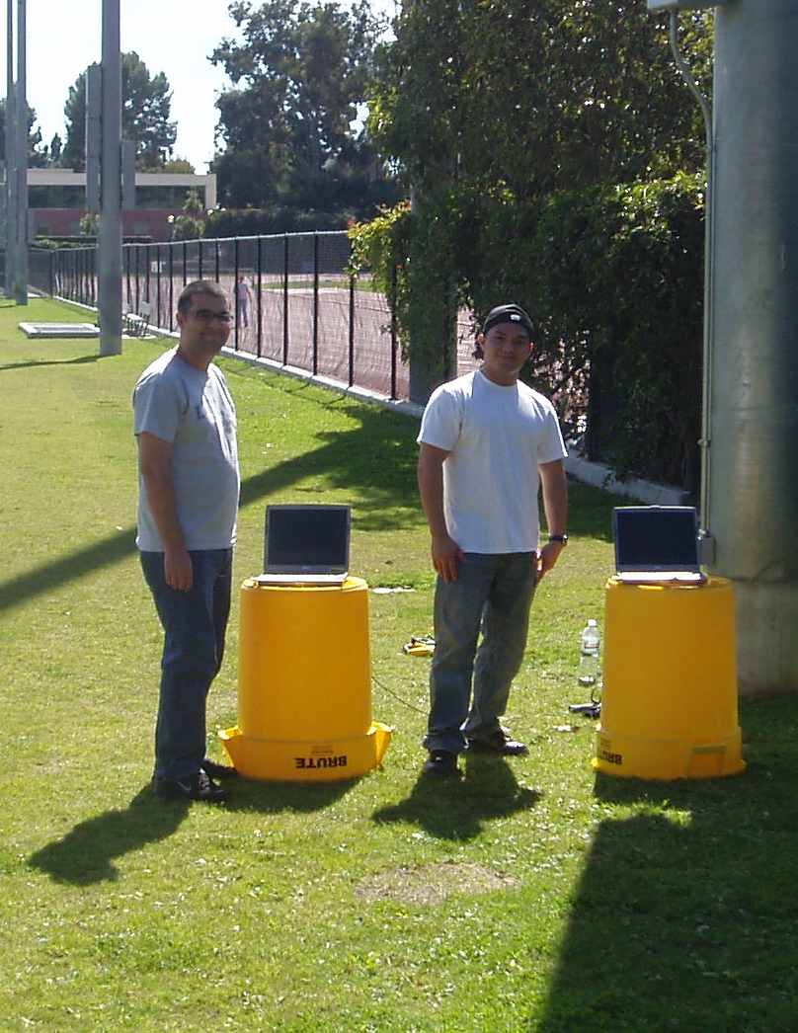
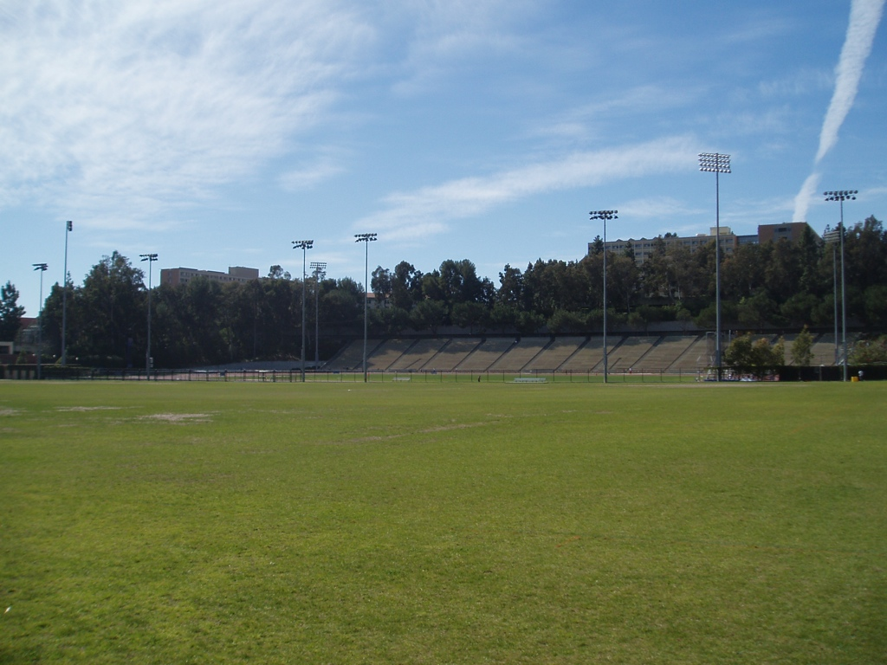
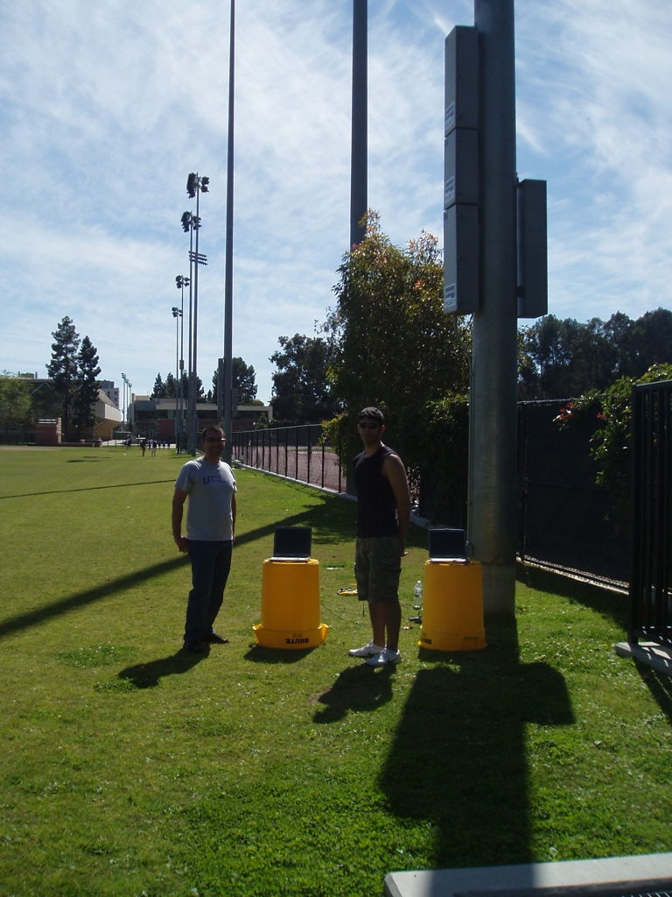
Results
Test scenarios
  Initial evaluation in the lab
  Field evaluation of performance at varying distances
    RRAA, SampleRate, ONOE, AMRR, Minstrel
    SampleRate and different versions of RRAA, changing PORI and PMTL

Slide 22
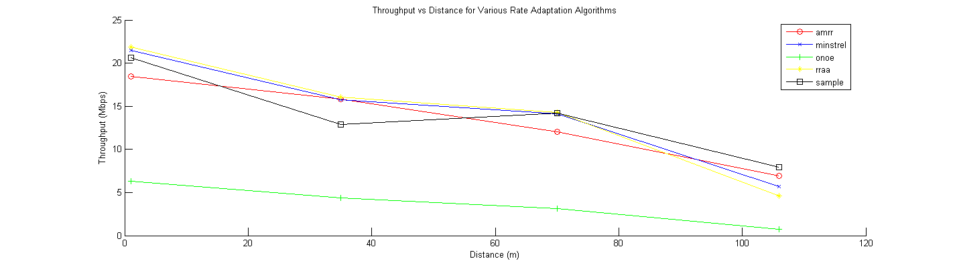
Results
Average throughput at varying distances (UDP)

Slide 23
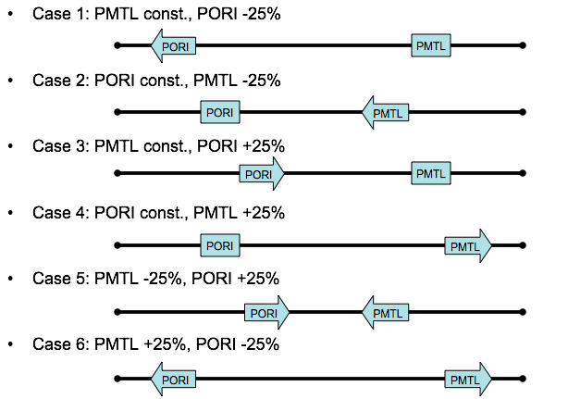
Results
Different versions of RRAA

Slide 24
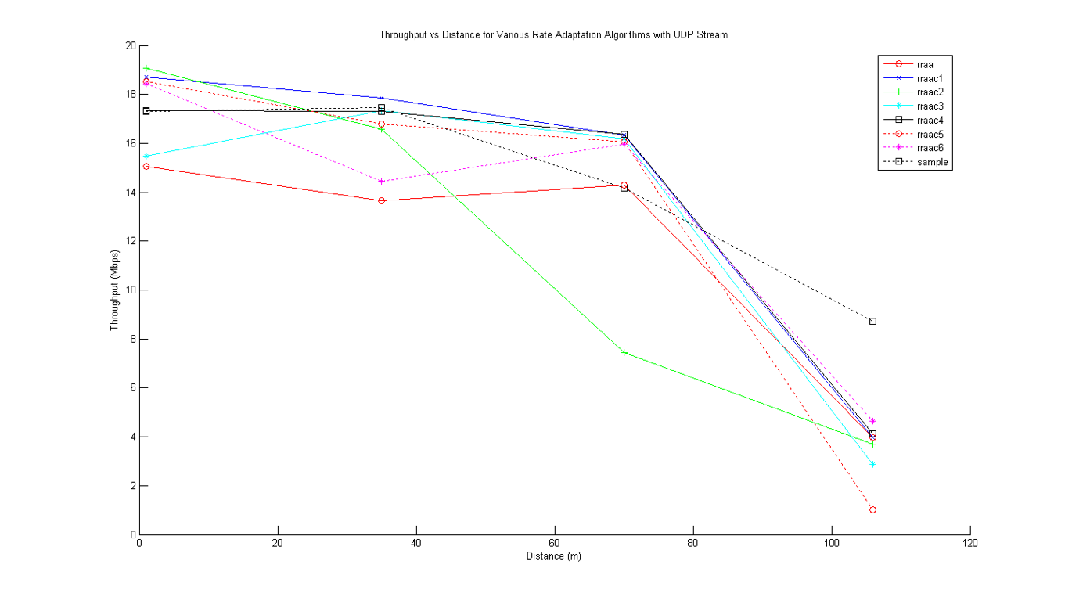
Results
Average throughput at varying distances (UDP)

Slide 25
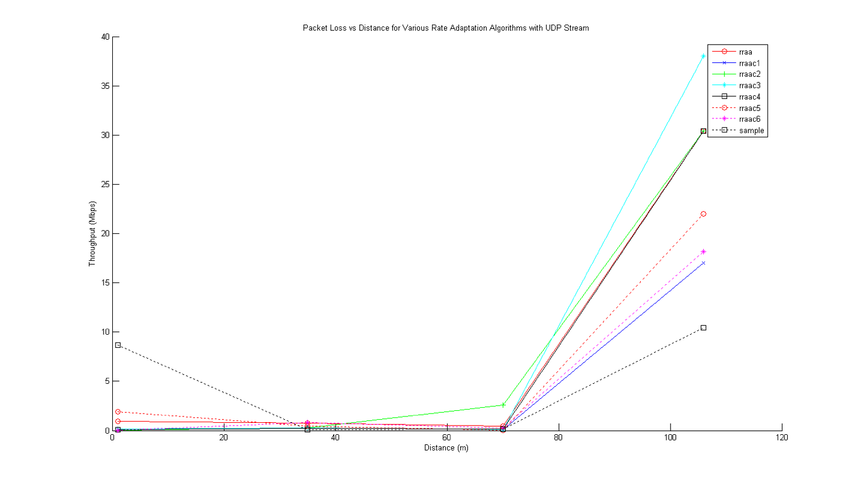
Results
Average packet loss at varying distances (UDP)

Slide 26
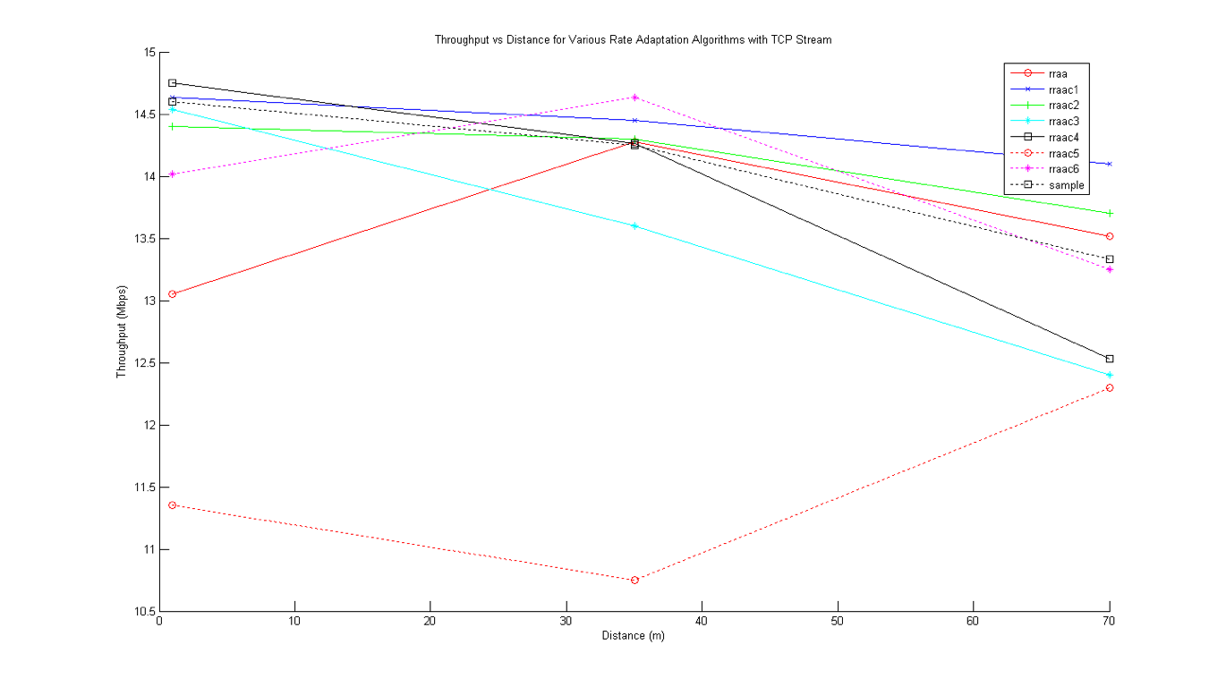
Results
Average throughput at varying distances (TCP)

Slide 27
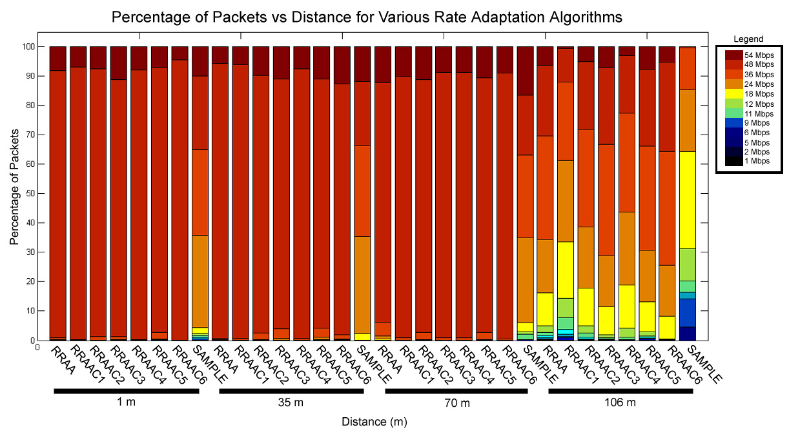
Results
Distribution of rates (UDP)

Slide 28
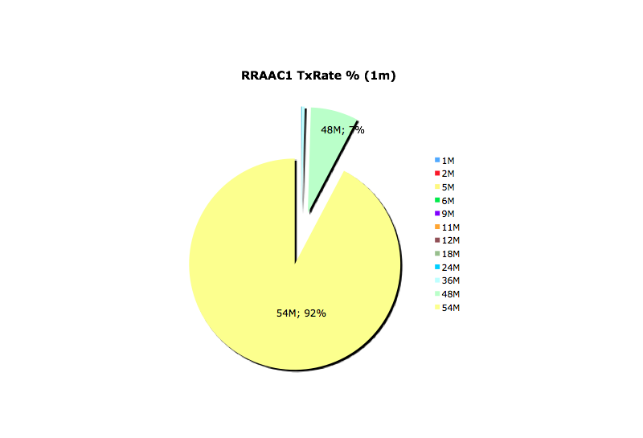
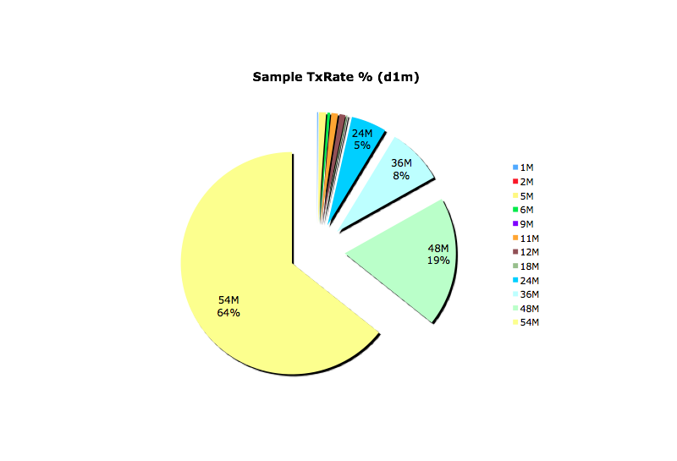
Results
RRAA vs. Sample, Distribution of Rates (1 meter)
  Sample is too conservative!

Slide 29
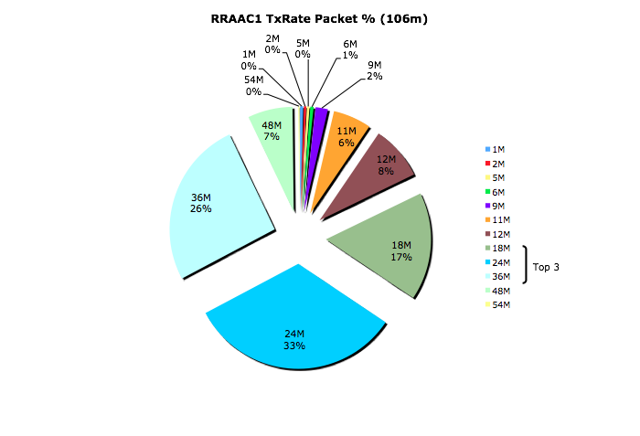
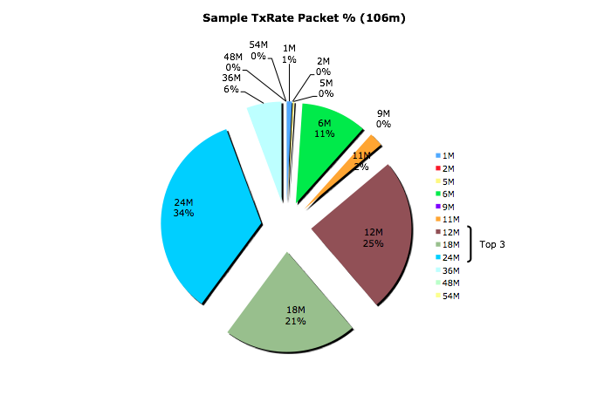
Results
RRAA vs. Sample, Distribution of Rates (100 meters)
  RRAA is too aggressive!

Slide 30
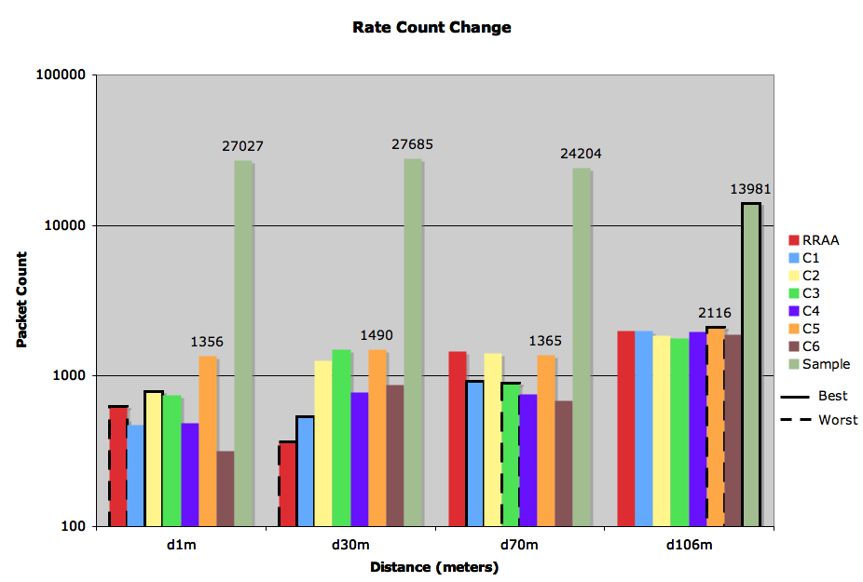
Results
RRAA vs. Sample, Rate Change Count
  PORI and PMTL values determine change rate for RRAA
Number of Changes

Slide 31
Conclusions & Future Work
Rate adaptation in IEEE 802.11
  RRAA outperforms the other rate adaptation algorithms in most cases
    Too “aggressive” for longer distances / lower signal strength
  Different PORI and PMTL values have direct impact in performance
Further measurements
  Outdoors test in a vehicular network
  Comparison with CARS
  RTS/CTS per-packet control in RRAA
  Dynamic Adaptation of PORI, PMTL according to distance

