Slide 1
Crossvalidation

Slide 2
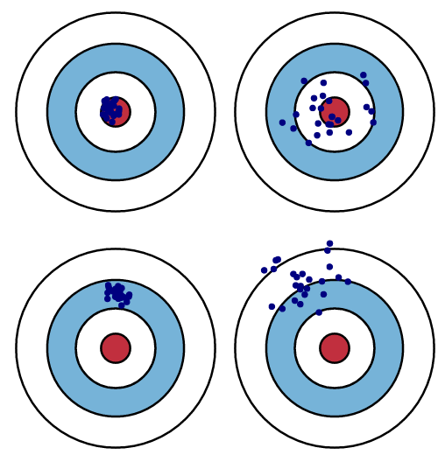
Bias and variance

Slide 3
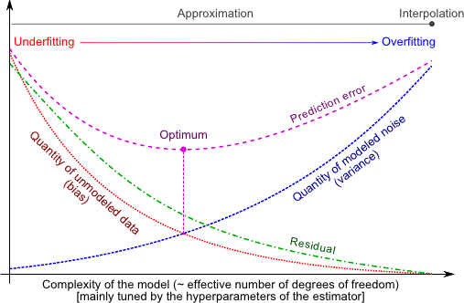
Bias-variance tradeoff

Slide 4
Testing and validating
Goal: to know how well a model will generalize to new cases
Split data into training and test set (e.g. 80%-20% ratio)
Original data
Training data
Test data
In-sample error
Out-of-sample error

Slide 5
Testing and validating
Ratio
(https://stackoverflow.com/questions/13610074/is-there-a-rule-of-thumb-for-how-to-divide-a-dataset-into-training-and-validatio)
Sometimes you will need to shuffle it first

Slide 7
Cross validation
Assessing how results will generalize to an independent data set
Mainly used for prediction models
To estimate how accurately a model will perform in practice
Holdout method, k-fold CV, and stratified k-fold CV

Slide 8
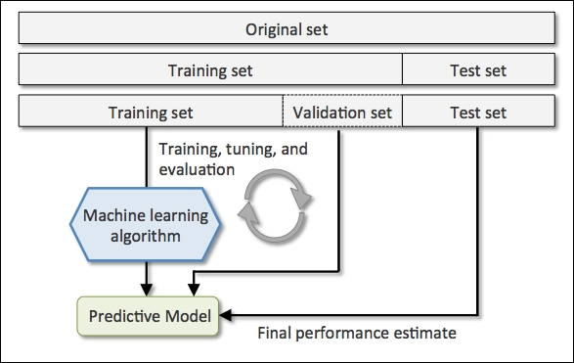
Cross validation – Holdout method
Sensitive to the partition!
Image source: S. Raschka, Python Machine Learning

Slide 9
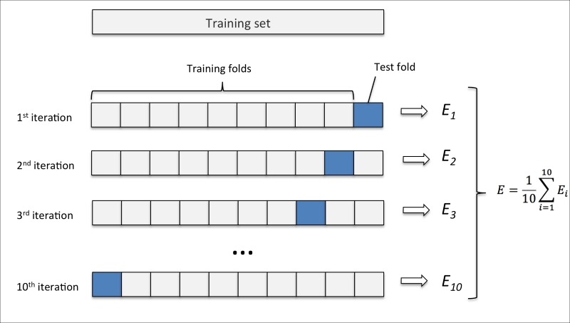
K-fold cross validation
More robust than simple holdout
The larger K, the bigger the computation cost
k=5 to 10 (typical values)
Source: S. Raschka, Python Machine Learning

Slide 10
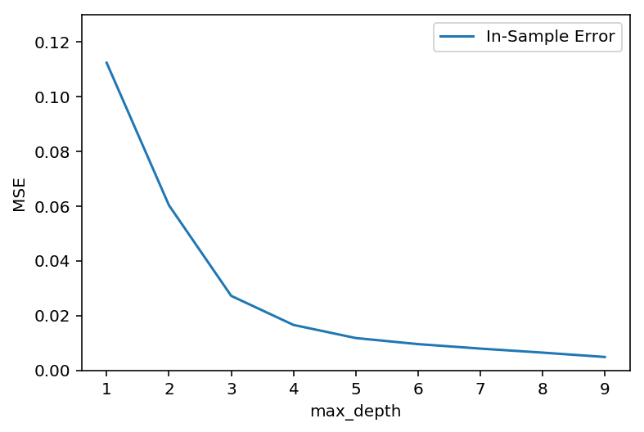
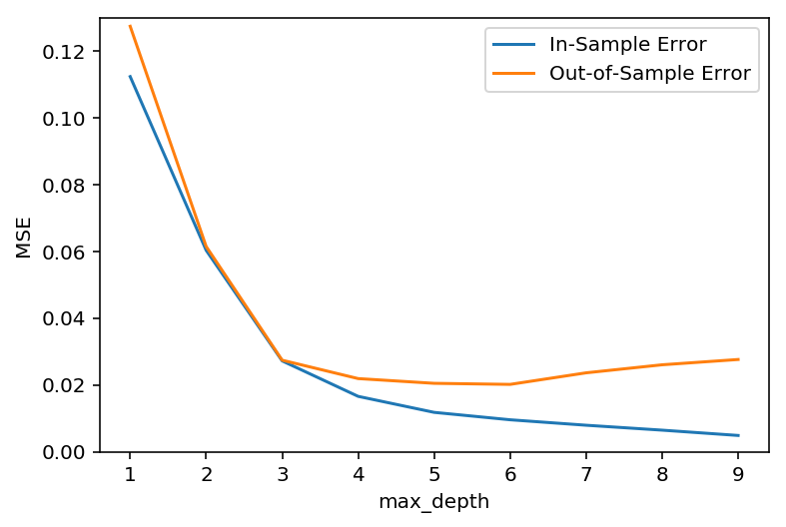
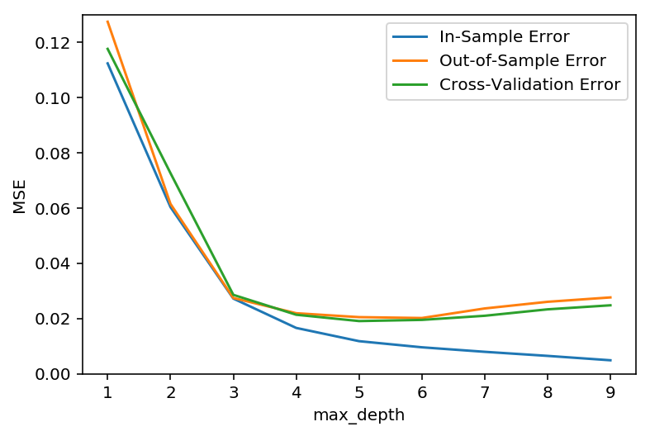
Cross validation – in and out of sample errors

Slide 11
K-fold cross validation
More robust than simple holdout
The larger K, the bigger the computation cost
k=5 to 10 (typical values)
Source: S. Raschka, Python Machine Learning

