Slide 1

XML et al
A Buzzword compliant introduction
Copyright, 1999 © Foliage Software Systems, Inc.

Slide 2
Introduction
History
Why
Defining XML
Other TLAs
Notes:
The goal here is to give a roadmap

Slide 3

Document Interchange in the beginning...
During 60-70s presentation markups
  nroff, scribe, inscript
  ASCII based
Document Interchange based on AWK
  Non-techies at the mercy of UNIX hackers
IBM was 2nd largest publisher of documents
IBM was paying every time
  Presentation style changed
  Legal boilerplate changed
  Indexing/Retrieval requirements changed
Notes:
IBM was really a pioneer at this point
They were doing the first information retrieval research system to try and cut down on the cost of a single litagation

Slide 4

Enter a Paranoid Lawyer
Charles Goldfarb wanted independence from hackers
Generalized Markup Language (GML)
  Separate structure definition
    Document Type Description (DTD)
    Document as a tree
  Markup for structure
  Style-sheet mapped structure to presentation
Still used for most of IBM’s documents

Slide 5
Why GML ?
The reasons carry down
Separate Definition of Structure
  Allows validation of document syntax and structure without additional information
Markup for structure
  Preserves information
  Structure -> Presentation is doable
  Presentation -> Structure is problematic
  Allows for multiple presentation targets
Notes:
Validation may seem trivial but think of the problems involved when a indexing run has to stop halfway through because a single doc was formatted incorrectly.
SP: We stripped all structure from a incoming file format (150+) and then only discovered a problem when a search went wrong.

Slide 6
Quick and Dirty History
Dates are not precise.
Adoption often occurred before a spec was declared official or finished.
I disclaim all accuracy.

Slide 7
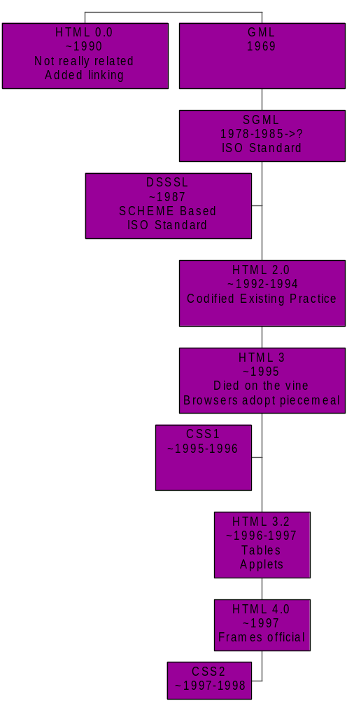
One spec led to another
Notes:
Goldfarb was instrumental in designing SGML (last minute additions like links)
Almost all of the HTML specs carry an SGML DTD declaration
Allows SGML tools to process HTML

Slide 8
Current TLAs
XML
DTD
DOM
DSSSL
XSL (XSLFO,XSLT)
CSS2

Slide 9
Defining XML
Simplified SGML
  SGML tools can (usually) process XML
  Already tested in large systems
Description of the Document Structure
  Document Type Description (DTD)
Very basic syntax for markup
  <TAG>,</TAG>
Notes:
SGML tools that support the latest version of the SGML Wevb Corrigdendum
XML is really a meta-language and for this reason
A DTD is often said to be a language description.
Describe Languages. CML = Chemical Markup Language.

Slide 10
XML Documents
Well-formed
  Has a correct syntax
Valid
  Is Well-formed and its structure conforms to the DTD
The DTD is the interface
The document body is the implementation.

Slide 11
XML Document
Example
1
<!-- A simple example document -->
<?xml version="1.0" encoding=“UTF-8”?>
<!DOCTYPE lectureseries SYSTEM “DistinguishedLectureSeries.dtd”>
<?xml-stylesheet type="text/xsl" href="DistinguishedLectureSeries.ie5.xsl" ?>
<lectureseries>
<title>Foliage Distinguished Lecturer Series &copyright</title>
<lecture author='Jim Murphy' id='1' part='1' total='3' date='7/14/99'>
<title>Intro to COM</title>
</lecture>
<lecture author='Jim Murphy' id='2' part='2' total='3' date='7/21/99'>
<title>COM Threading Models and Marshalling</title>
</lecture>
</lectureseries>

Slide 12
XML Document
In More Detail
Comments
  <!-- DTD generated by DDbE -->
Processing Instructions
  <?xml version="1.0" ?>
    Tells the processor the version of XML
  <?xml-stylesheet type="text/xsl" href="DistinguishedLectureSeries.ie5.xsl" ?>
    Tells the processor the location and type of the default style sheet
DOCTYPE Declaration
  <!DOCTYPE lectureseries SYSTEM “DistinguishedLectureSeries.dtd”>
    Specifies the DTD and the name of the root element
Notes:
There is a great deal more possible with the use of SYSTEM ids and
entity managers and catalogs.

Slide 13
XML Document
In More Detail…
Element
  <title>Foliage Distinguished Lecturer Series &copyright</title>
    Start tag and end tag, may contain other elements or data
Attributes
  author='Jim Murphy' id='1' part='1' total='3' date='7/14/99’
    May be required, optional, enumerated, or otherwise constrained
Entity Reference
  &copyright
    Defined in the DTD or in another external location
Notes:
Entities may also define external elements.

Slide 14
XML DTD
Example
2
<!-- DTD generated by DDbE -->
<!DOCTYPE DistinguishedLectureSeries [
<!ELEMENT lecture (title)>
<!ATTLIST lecture
id CDATA #IMPLIED
total CDATA #IMPLIED
part CDATA #IMPLIED
date CDATA #IMPLIED
author CDATA #IMPLIED>
<!ENTITY copyright “Copyright 1999 Foliage Software Systems”>
<!ELEMENT lectureseries (title,lecture+)>
<!ELEMENT title (#PCDATA)>
]>
Notes:
HINT: Don’t write the DTD up front. Write the document, play with it and then generate the DTD using one of several tools.

Slide 15
Example DTD
In more detail
Element Type Declaration
  <!ELEMENT lectureseries (title,lecture+)>
    Element lectureseries contains a title element followed by 1 or more lecture elements
  <!ELEMENT lecture (title)>
    Element lecture contains a title
  <!ELEMENT title (#PCDATA)>
    Element title contains “parsed character data”
Attribute List Declaration
  <!ATTLIST lecture id CDATA #IMPLIED total CDATA #IMPLIED>
    Lecture has attribute id of type “character data” with no default value
    Lecture has attribute total of type “character data” with no default value
Entity Declaration
  <!ENTITY copyright “Copyright 1999 Foliage Software Systems”>
    Expand &copyright to the supplied text.
Notes:
Element Type Declarations have a good number of the standard regular expression or BNF ordering information available
, Striict order
? Optional
+ one or more
* Zero or more
| this OR that
() grouping

Slide 16
Programming
A Standard Model of the Document Exists
Document Object Model (DOM)
  Java and IDL interfaces specified
  XML and HTML specific details described
Allows manipulation of entire document tree
Limited access to the DTD

Slide 17
Programming
Implementation
Many Java and C++ parsers that support the DOM
IE5 provides ActiveX DOM objects for XML and HTML documents

Slide 18
Presentation
Nothing but choices
Multiple Style Sheet languages
  None are truly human-friendly
  Designers assumed existence of authoring tools
  Few tools are out there for authoring
DSSSL
XSL
CSS2

Slide 19
DSSSL
Based on SCHEME
Maps elements and attributes to “Formatting Objects”
Powerful, but not very friendly unless you like parentheses
Not officially for XML

Slide 20
XSL
Is a XML DTD
  So an XSL style sheet is an XML document
XSL/FO or XSLFO
  FO = formatting objects
XSL/T or XSLT
  T = transformation
Not as powerful as DSSSL but an easier read
W3 specified for XML

Slide 21
CSS2
Basic Syntax
Mixture of transformation and formatting objects
W3 specified for XML
Actually has some inexpensive tools for authoring

Slide 22
Presentation
Current Implementations
No browser fully implements CSS2 or XSL
IE5 is closest
  CSS2 is incomplete
    No visible ongoing support
  XSL is based on an early draft
    VERY different from the current W3 recommendation

Slide 23
General News and Resources
W3
  http://www.w3.org/
    Definitive source for most standards
Café con Leche
  http://metalab.unc.edu/xml/
    Good XML news site
Oasis SGML/XML site
  http://www.oasis-open.org/cover/sgml-xml.html
    Good jump off point for tools.

Slide 24
Specs
XML Spec
  http://www.w3.org/TR/REC-xml
XLINK/XPOINTER
  http://www.w3.org/TR/WD-xlink
  http://www.w3.org/TR/WD-xptr
Annotated XML Spec
  http://www.xml.com/axml/axml.html
DOM
  http://www.w3.org/DOM/
XSL
  http://www.w3.org/TR/WD-xsl/

